Slide 1
Data Assimilation for NWP
3. The Met Office
Variational Assimilation
VAR
Andrew Lorenc

Slide 2
History of DA at the Met Office
1970s Orthogonal polynomials in the 10-level model.
1982 FGGE scheme in global model and fine-mesh.
1988 Analysis Correction scheme.
1993 Start of project
1999 3DVar in global & mesoscale models
2004 4DVar in global model; 2006 NAE; 2017 UKV.
2011 Hybrid-4Var in global; 2018? UKV.
2014 Hybrid-4DEnVar trialled in global. En-4DEnVar trialled for ensemble.
2020 Decision to go ahead with new system
2023 Trialling.
Dixon 1972
Nudging
Lyne et al.1982
Lorenc et al. 1991
Lorenc et al. 2000
VAR
Rawlins et al. 2007. Simonin et al. 2017
Clayton et al. 2013
Lorenc et al. 2015. Bowler et al. 2017a,b
Exascale

Slide 3
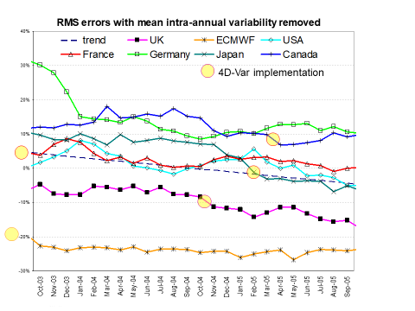
4DVar implementation at the leading global NWP centres.
Rawlins et al. 2007.
Notes:
Other centres are catching up ECMWF with introduction of 4D-Var, but 4D-Var benefits alone are quite small.
Based on RMS scores v own analyses, as exchanged via CBS.
Scores relative to the mean of 7 centres are averaged over all forecast times and fields in the Met Office’s global NWP index.
The mean relative linear trend over the 2 years shown is added back to each score.

Slide 4
The Met Office VAR system
Characteristics
Global and LAM configurations.
Copy file formats & IO and MPP methods from UM, but separate F90 code.
Incremental for fields, but full nonlinear observation operators.
Separate OPS, to interpolate full (outer-loop) model fields to observations;
and do obs. selection, preliminary 1DVar of radiances, quality control, etc.
From 3DVar to 4DVar using simplified PerturbationForecast model;
simplifications include using a single total moisture increment.
Hybrid-4DVar option uses hybrid static & ensemble covariances.
Hybrid-4DEnVar option uses 4D ensemble covariances instead of PF model.
Options for bias correction, quality control, impact assessment of obs.
(VarBC, VarQC, FSOI) discussed in lecture 4.

Slide 5
Incremental 4DVar with Outer Loop
Inner low-resolution incremental variational iteration
ADJOINT OF P.F. MODEL
U
T
An outer-loop reruns the
full forecast model
The guess
x^{g} is updated;
the background
x^{b} is not.
background
x^{b}
DESCENT
y
y
y
y
ALGORITHM
U
δx
PERTURBATION FORECAST MODEL
+δη
Incrementing operator
S
-g
x^{g}
+ η
FULL FORECAST MODEL
Outer, full-resolution iteration
Optional model error terms
© Crown copyright Met Office. Andrew Lorenc 5
Notes:
5

Slide 6
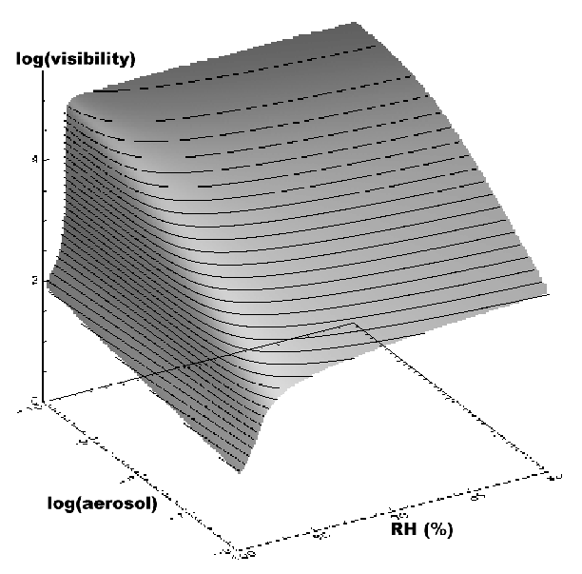
Incremental Approach
Essential for reducing relative cost 4DVar v Forecast (with best available model)
Suggested by John Derber and elaborated by Courtier et al. (1994).
Usual fully-incremental approach fits Hx' to d=yº-H(x^{b})
– the variational penalty uses linear H
We wanted to use highly nonlinear observations
such as visibility in MES 3DVar, so H is split into
horizontal- and time-interpolation (in the OPS) to columns c_{x}.
VAR interpolates and adds an increment, to give c_{x}⁺,
so it can fit a nonlinear y=H(c_{x}⁺) to yº
This makes the penalty function non-quadratic,
which rules out some minimisation algorithms.
Clark et al. 2008

Slide 7
Statistical, incremental 4DVar
Statistical 4DVar approximates entire PDF by a Gaussian.
(As in the Extended Kalman Filter.)
Lorenc & Payne 2007
Notes:
7

Slide 8
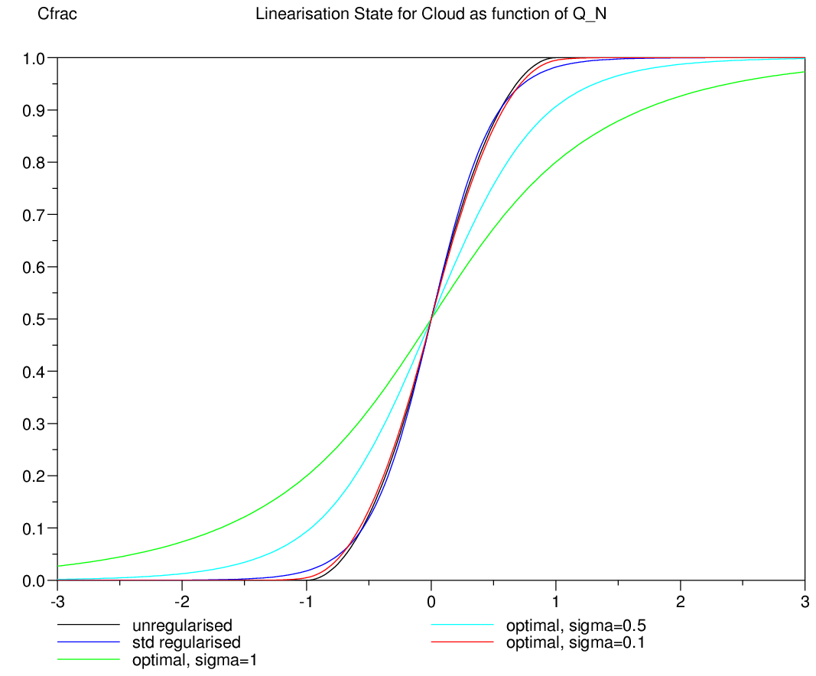
Designing a Perturbation Forecast model for 4DVar
Minimise:
Designed to give best fit for finite perturbations
Not Tangent-Linear
Filters unpredictable scales and rounds IF tests
Requires physical insight – not just automatic differentiation
cloud fraction
(RH^{total}-1)/(1-RH^{crit})
Payne 2009
© Crown copyright Met Office. Andrew Lorenc 8
Notes:
8

Slide 9
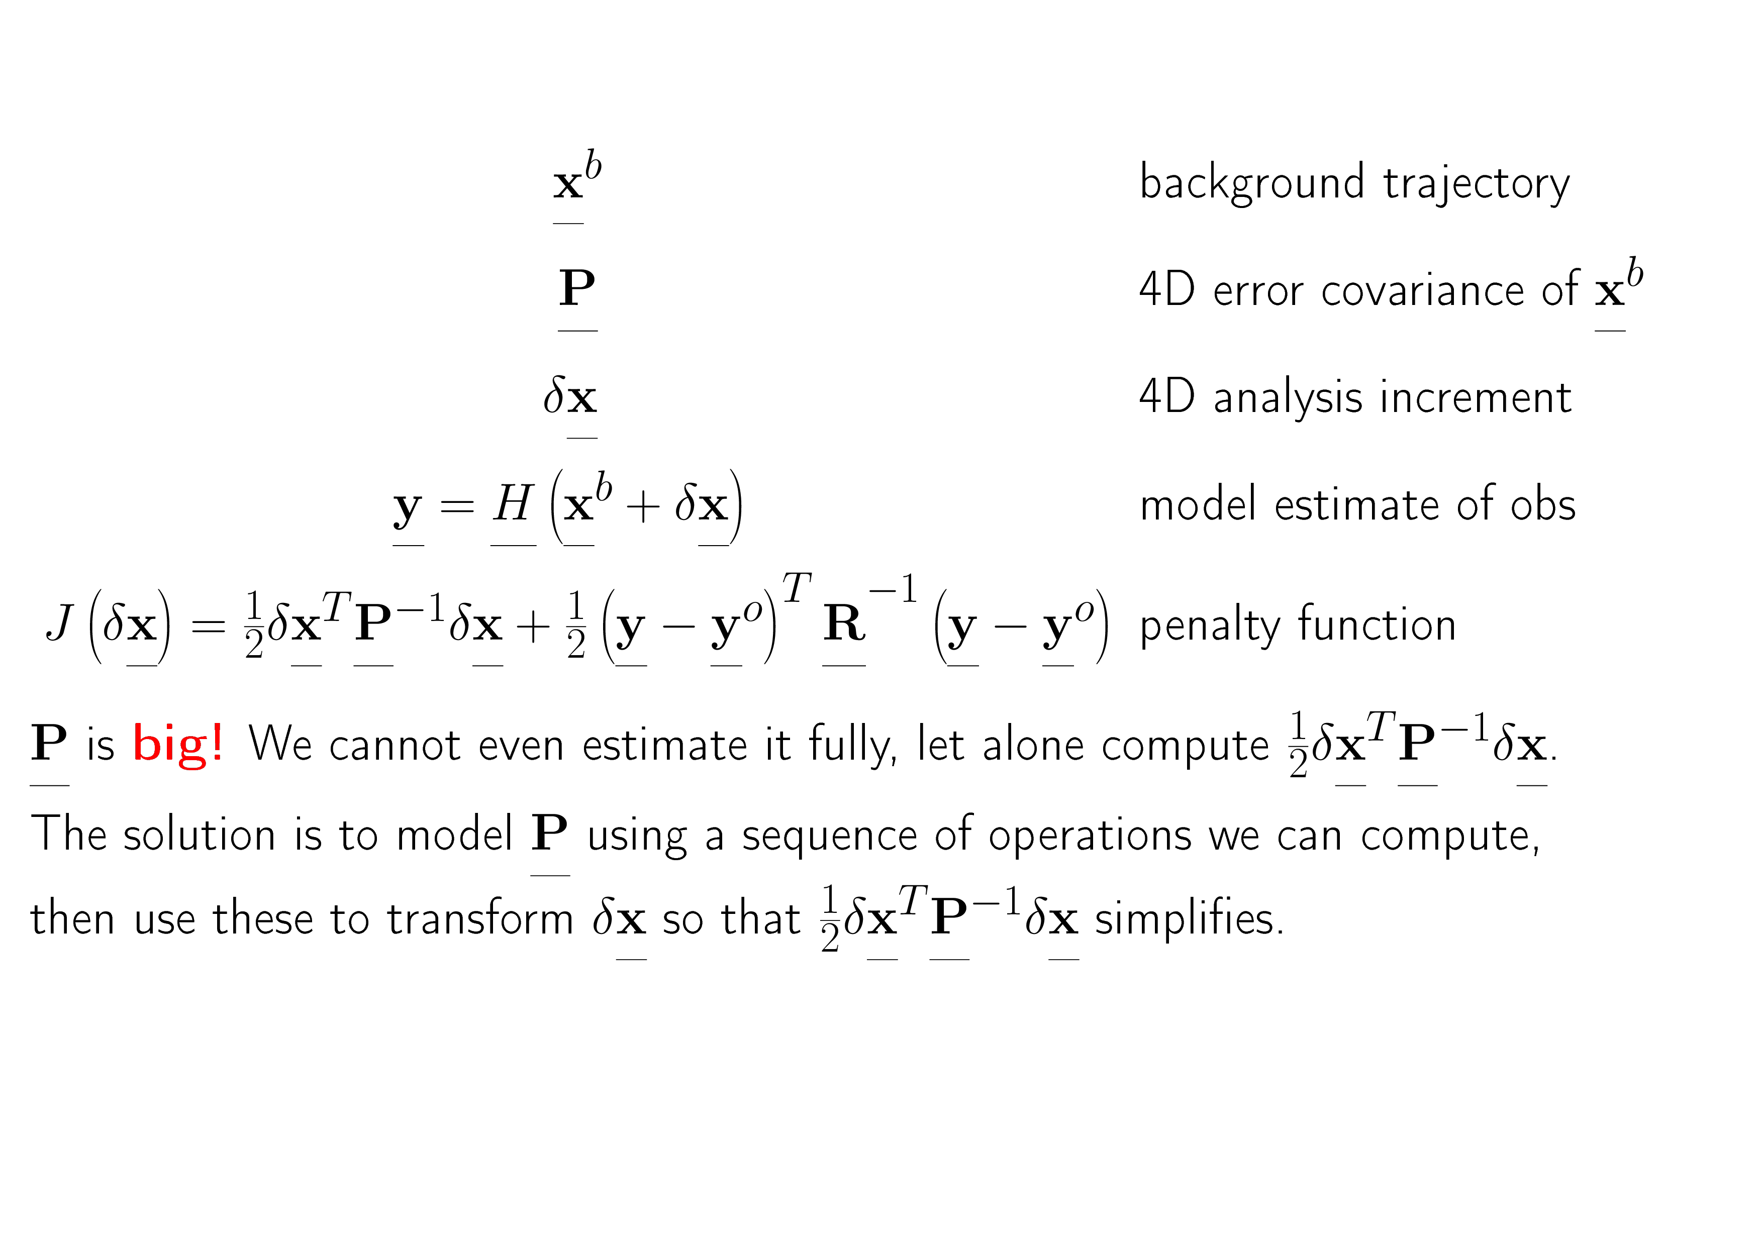
Idealised General Bayesian 4D DA

Slide 10
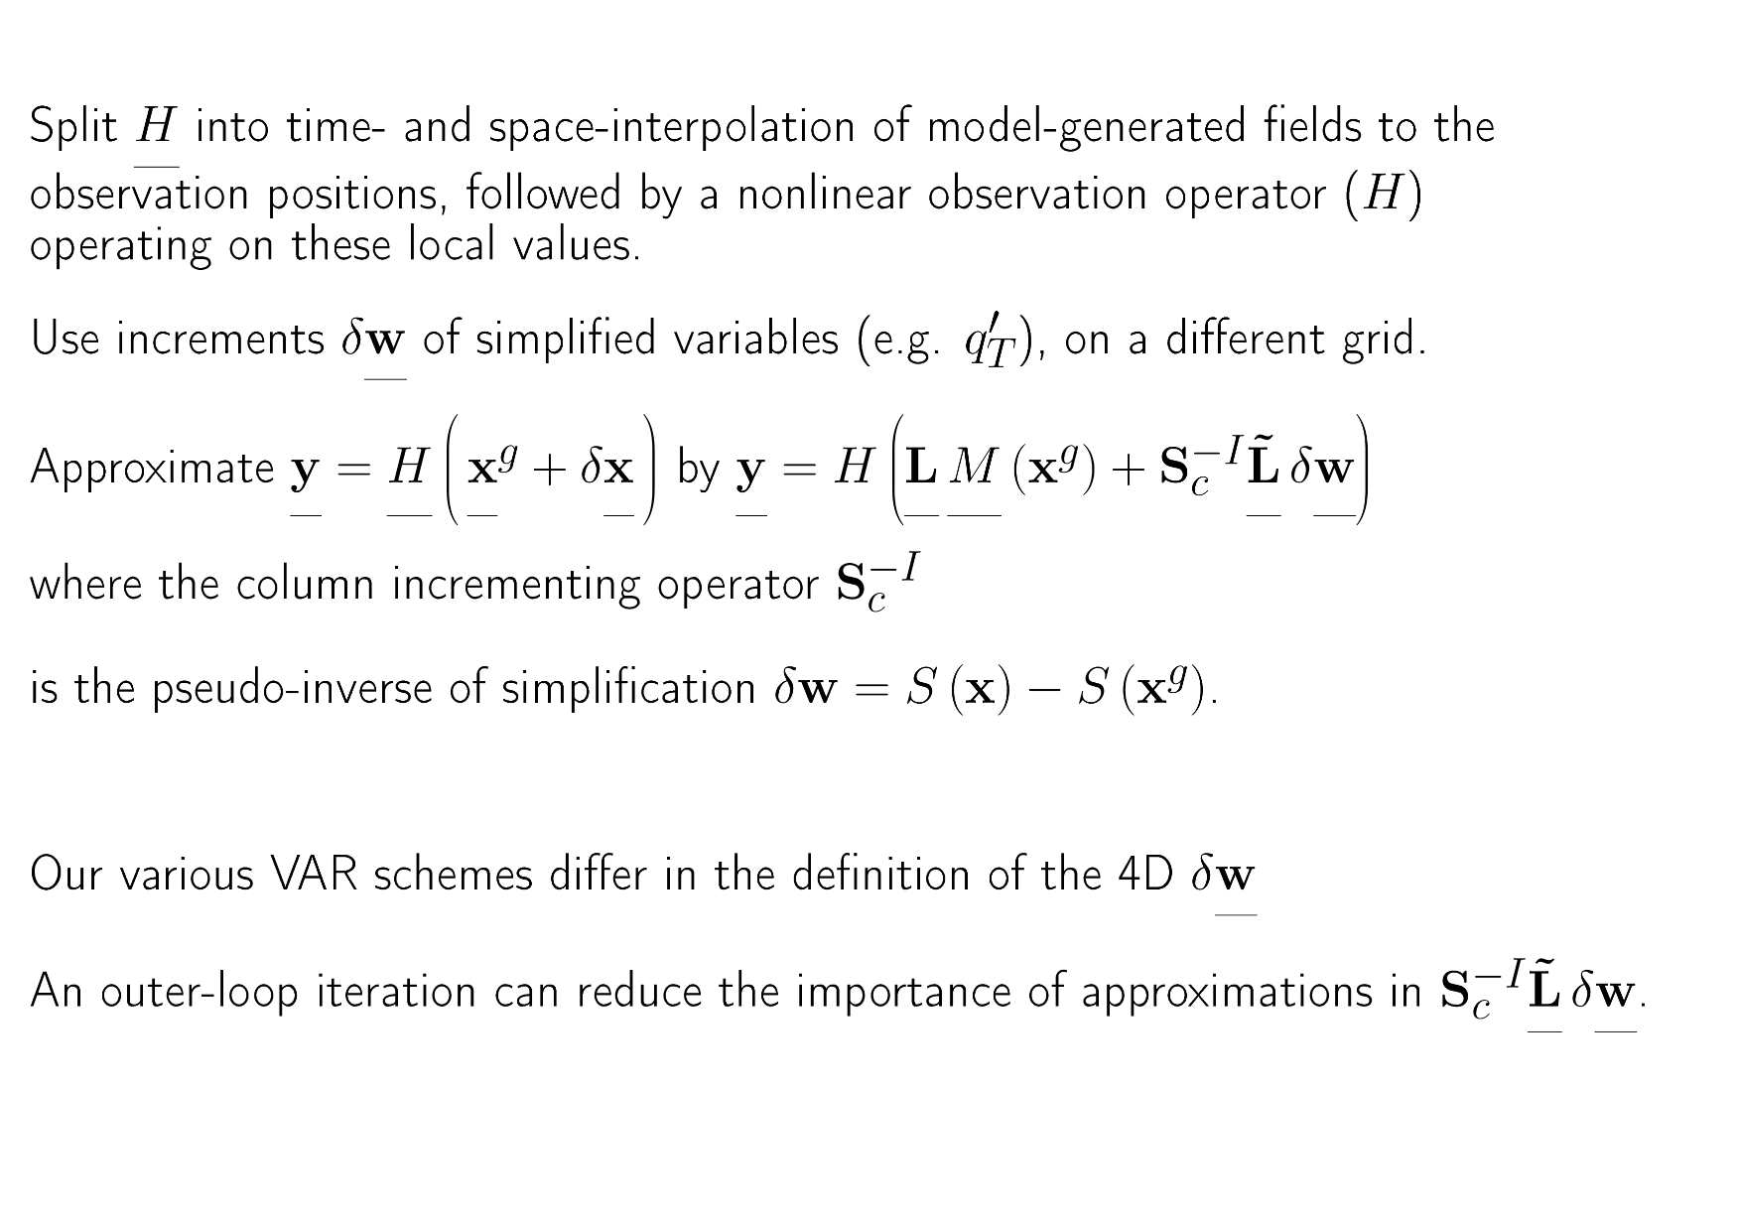
Met Office Incremental Approach

Slide 11
Simplification is more than resolution
The model has complicated moisture variables: vapour, cloud ice, cloud water.
The PF model has a single perturbation to total water.
The incrementing operator distributes this increment over all the model variables (depending on RH etc.)
This defines implicit covariances between all the model variables:
It would otherwise be difficult to define these sensibly.
Migliorini et al. 2017
© Crown copyright Met Office Andrew Lorenc 11

Slide 12
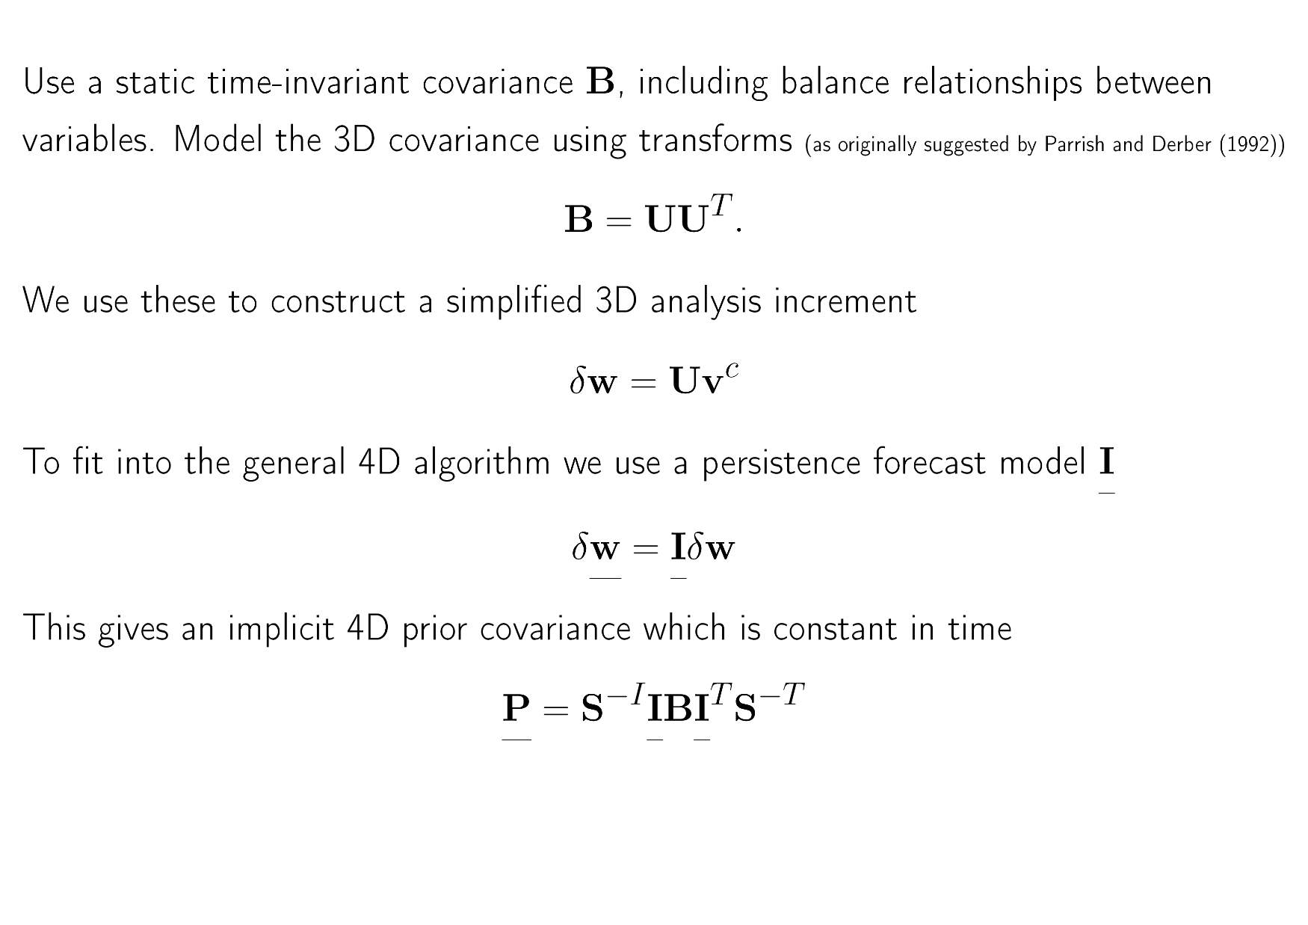
3DVar

Slide 13
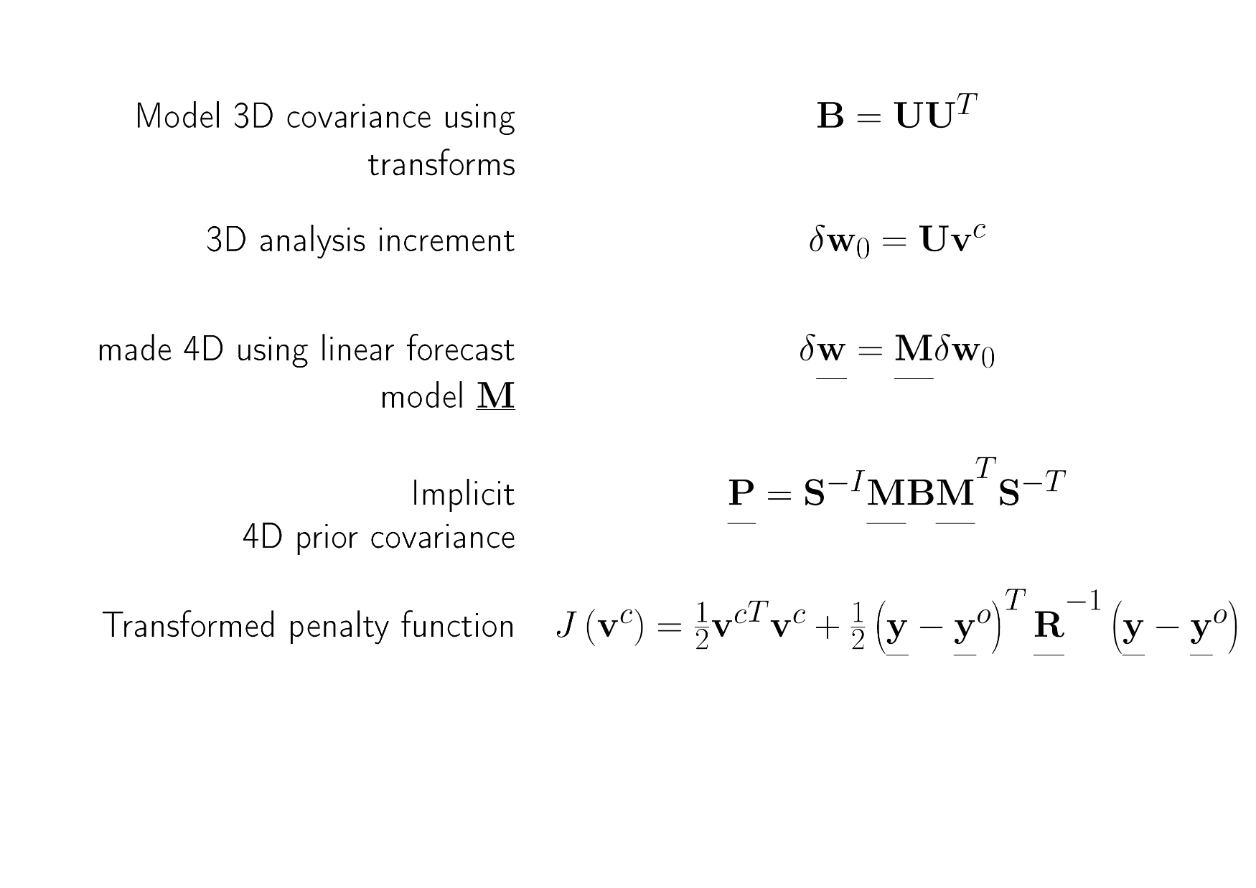
4DVar: using static covariance B

Slide 14
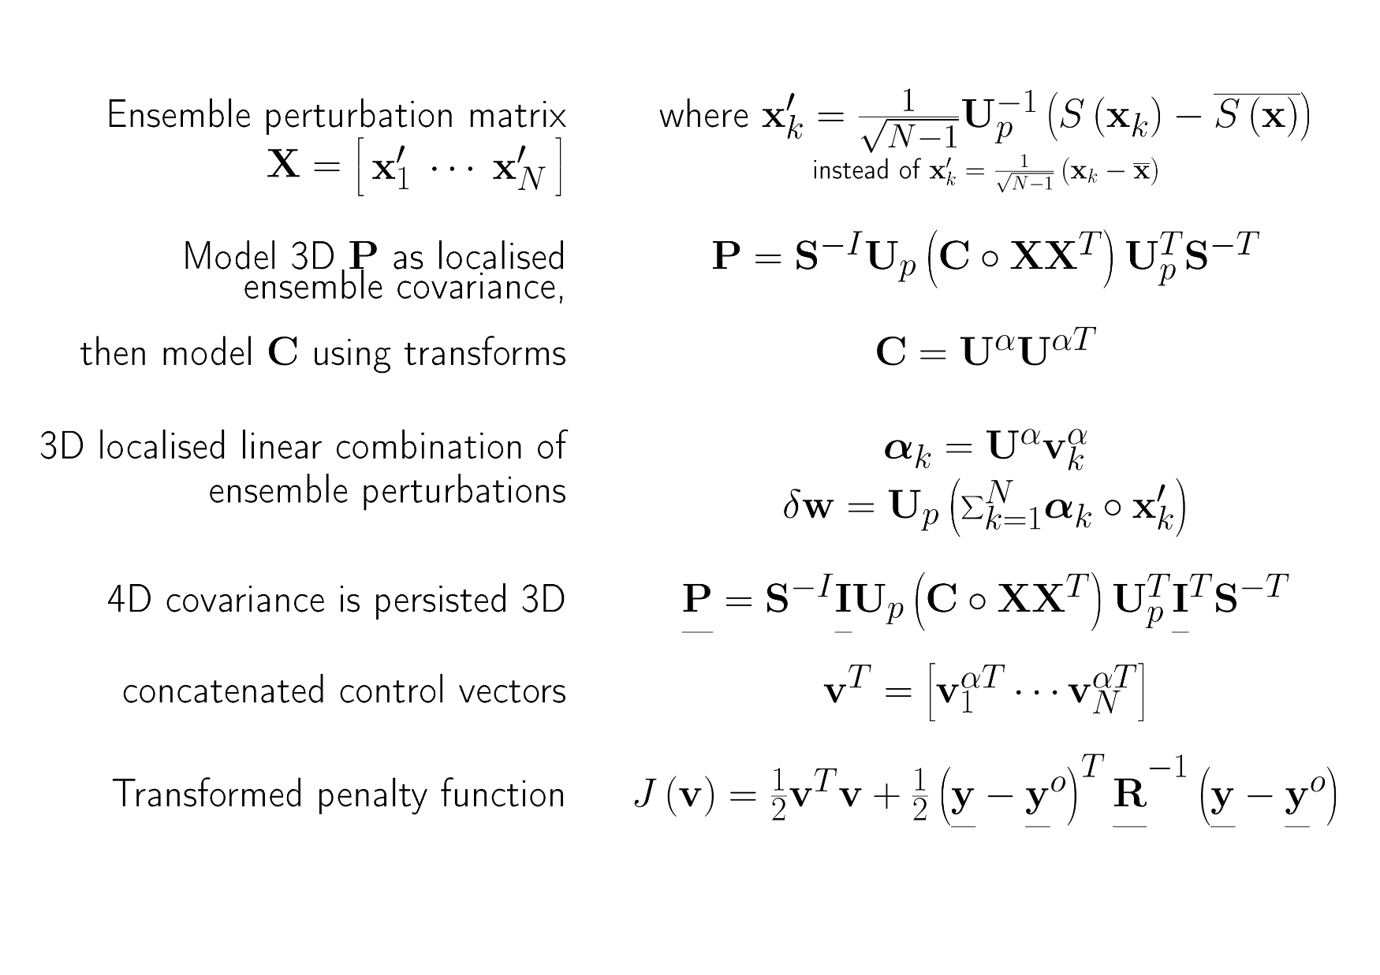
3DEnVar: using an ensemble of 3D states which samples background errors

Slide 15
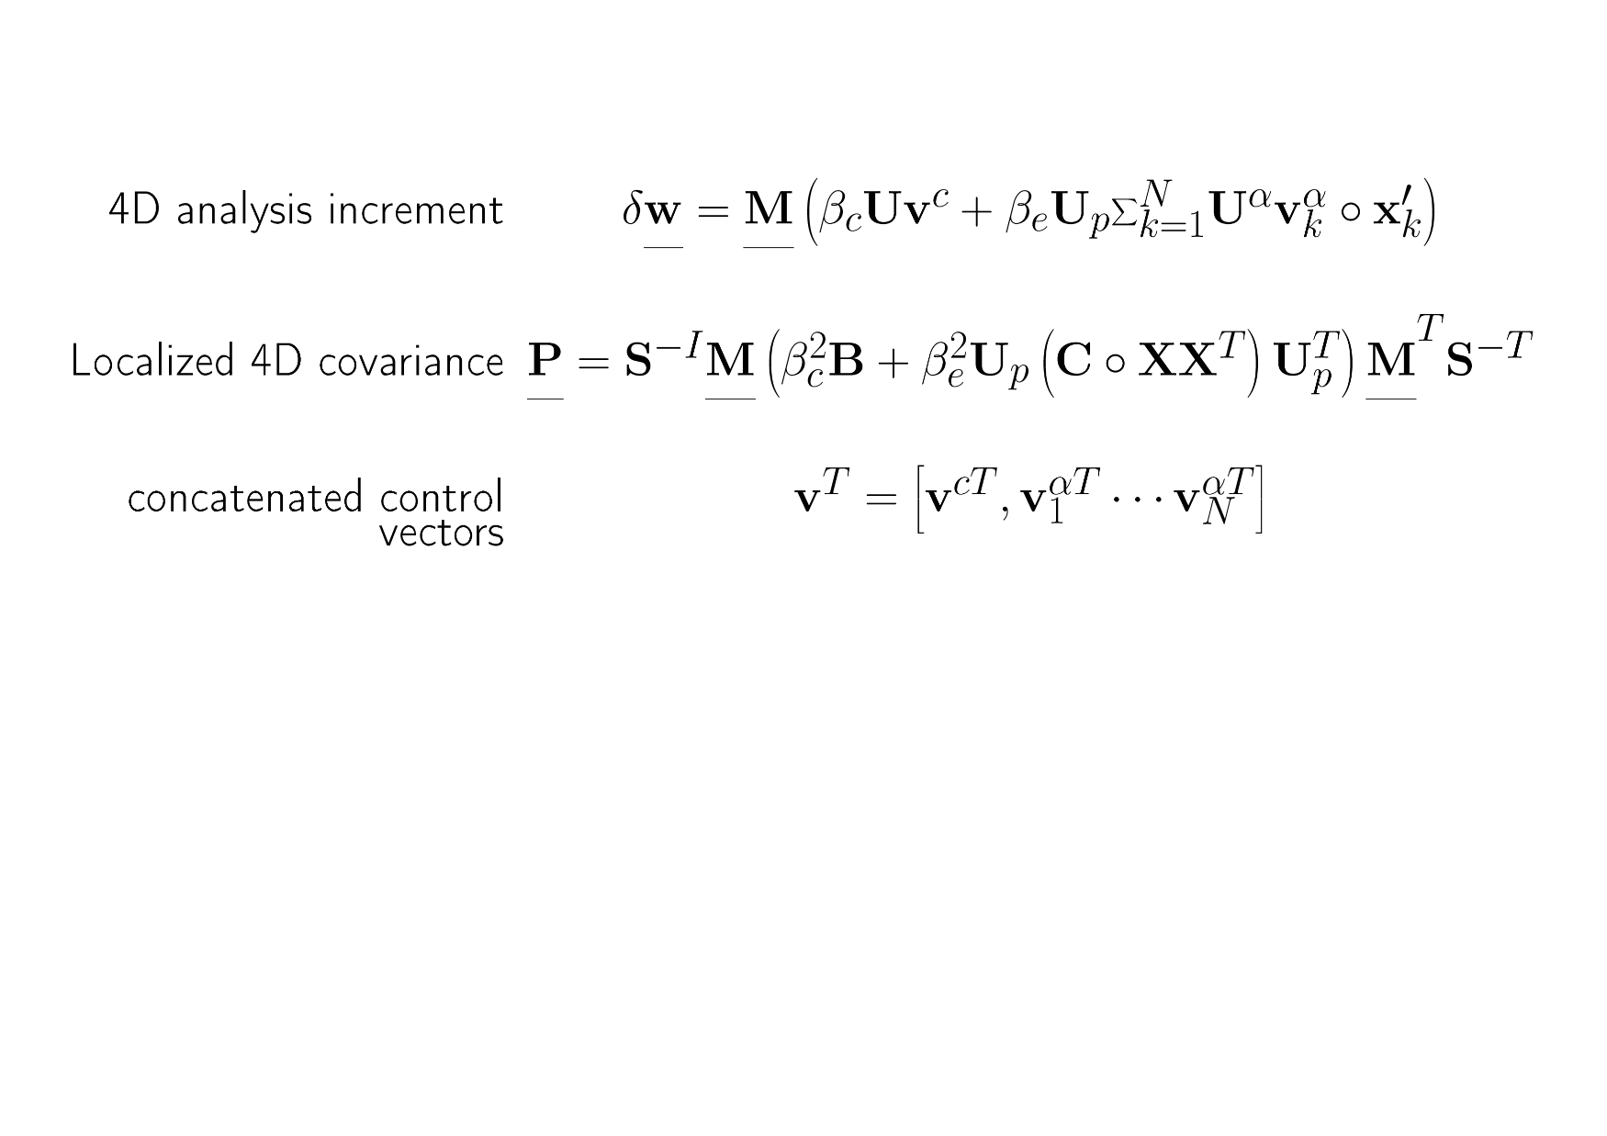
hybrid-4DVar
1% improvement in rms errors
when implemented at Met Office
(Clayton et al. 2013)

Slide 16
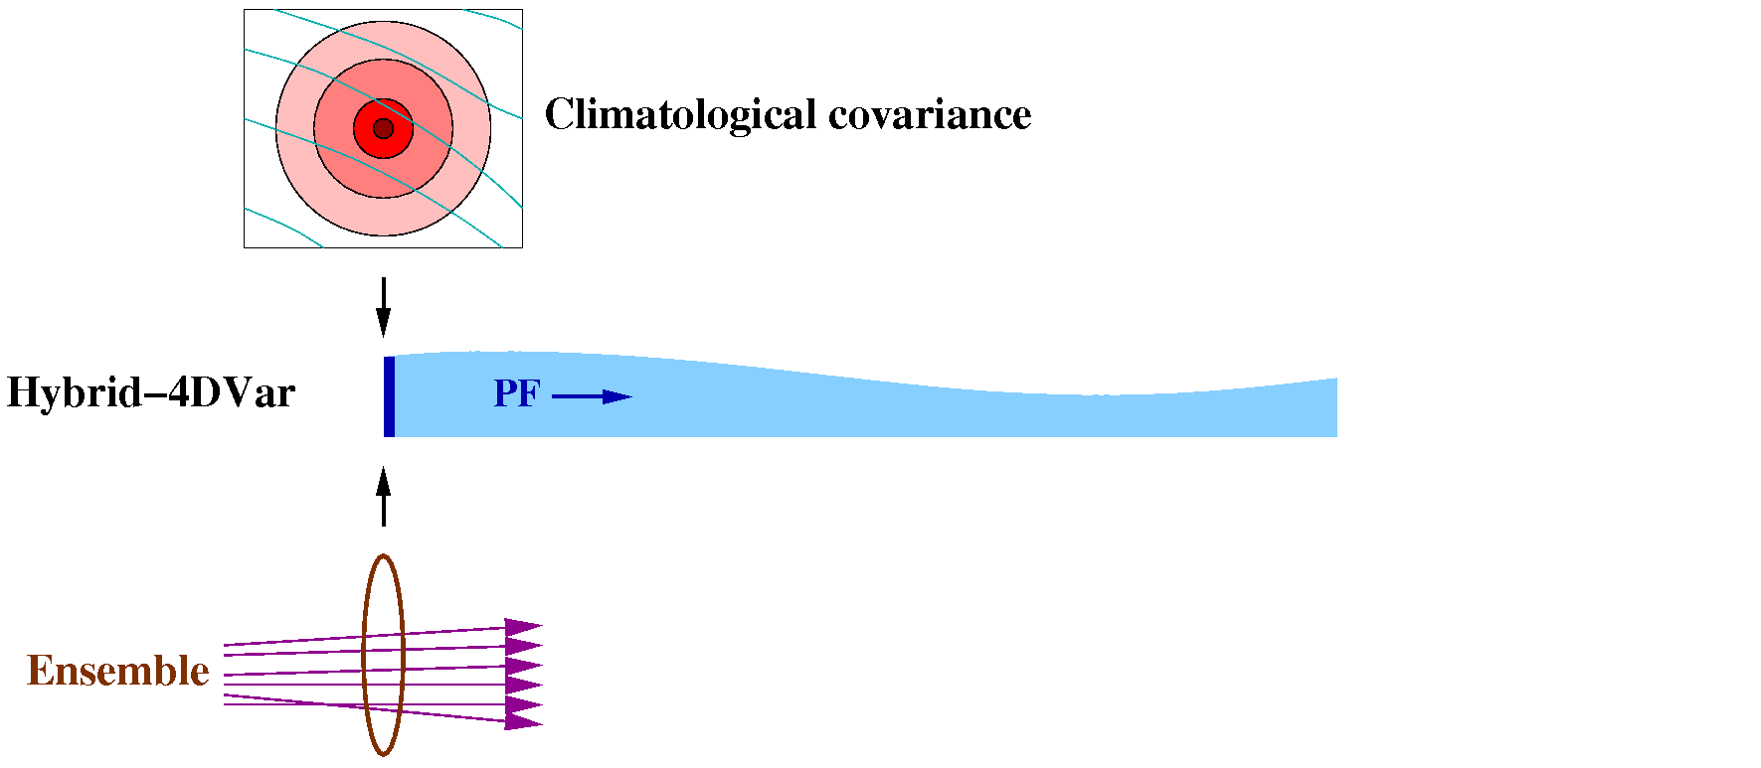
Hybrid-4DVar
(MOGREPS-G, based on localised ETKF. Currently 44 members.)
B implicitly propagated by a linear “Perturbation Forecast” (PF) model:
  ~100 PF + adjoint forecasts run serially.
  But PF model doesn’t scale well.
  And difficult to keep PF model in line with forecast model.
We need an alternative scheme for future supercomputers that excludes the PF model…

Slide 17
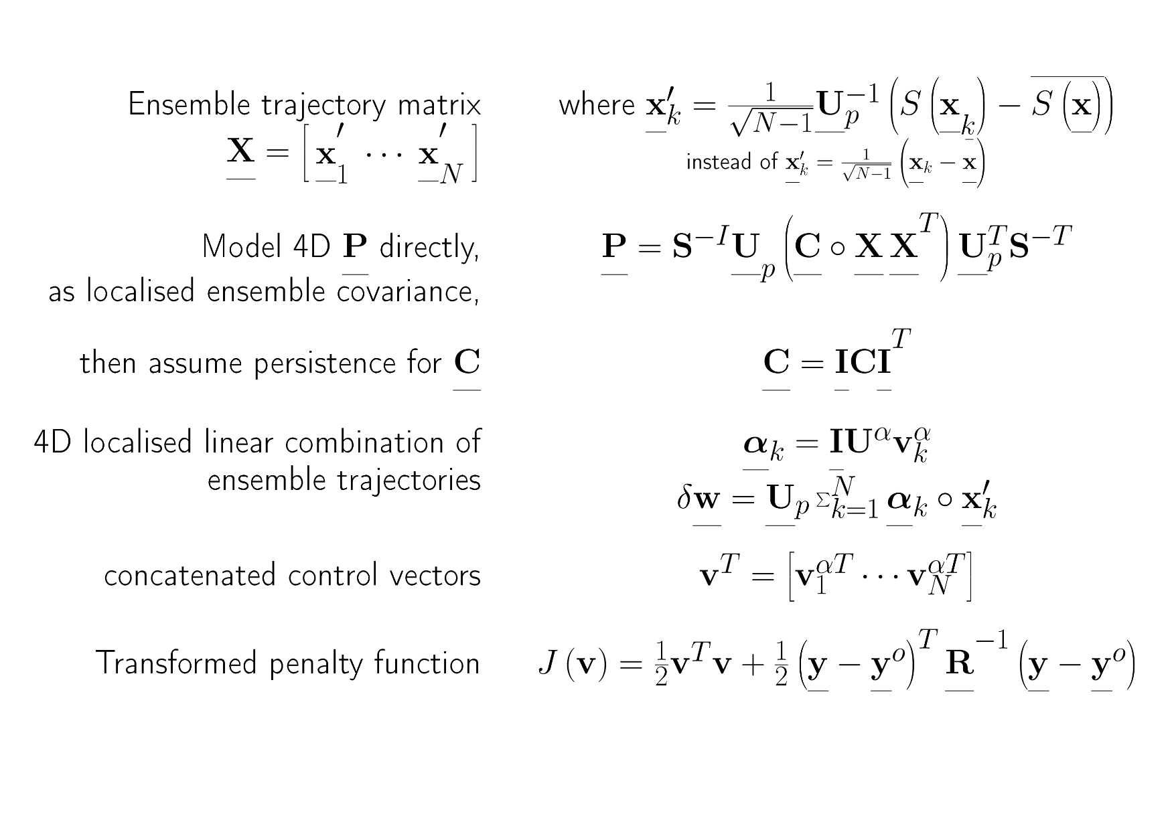
4DEnVar: using an ensemble of 4D trajectories which samples background errors

Slide 18
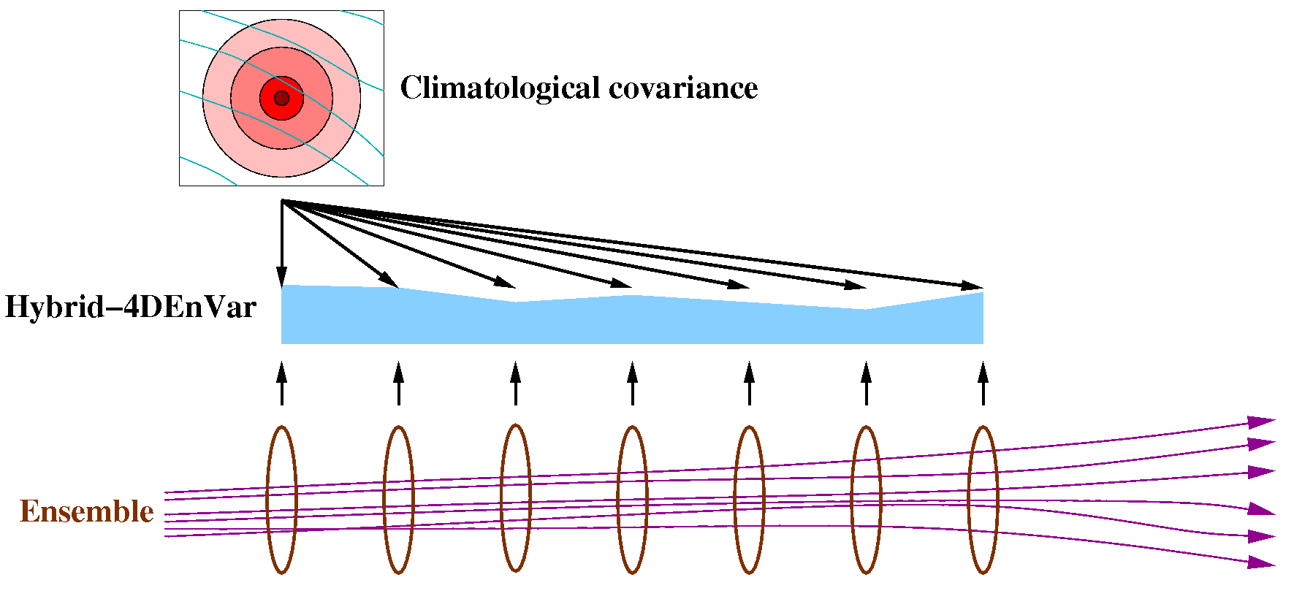
Hybrid-4DEnVar
No PF model, but much more IO required to read ensemble data:
  11 times faster with 22 N216 members and 384 PEs. (IO around 30% of cost)
Analysis consists of two parts:
  A 3DVar-like analysis based on the climatological covariance B_{c}
  A 4D analysis consisting of a linear combination of the ensemble perturbations.
Localisation is currently in space only: same linear combination of ensemble perturbations at all times.

Slide 19
Simple Idea for accounting for EOTD in VAR – weighted linear combination of ensemble members
Assume analysis increments are a linear combination of ensemble perturbations
and determine the weights α_{i} variationally
A priori independence of α_{i} implies that covariance of δx is that of the ensemble.
Allow each α_{i} to vary slowly in space,
so eventually we can have a different linear combination some distance away.
Four-dimension extension: apply the above to ensemble trajectories:
© Crown copyright Met Office Andrew Lorenc 19
Notes:
Kalnay, E., and Z. Toth, 1994: Removing growing errors in the analysis. Preprints, 10th Conf. on Numerical Weather Prediction, Portland, OR, Amer. Meteor. Soc., 212–215.

Slide 20
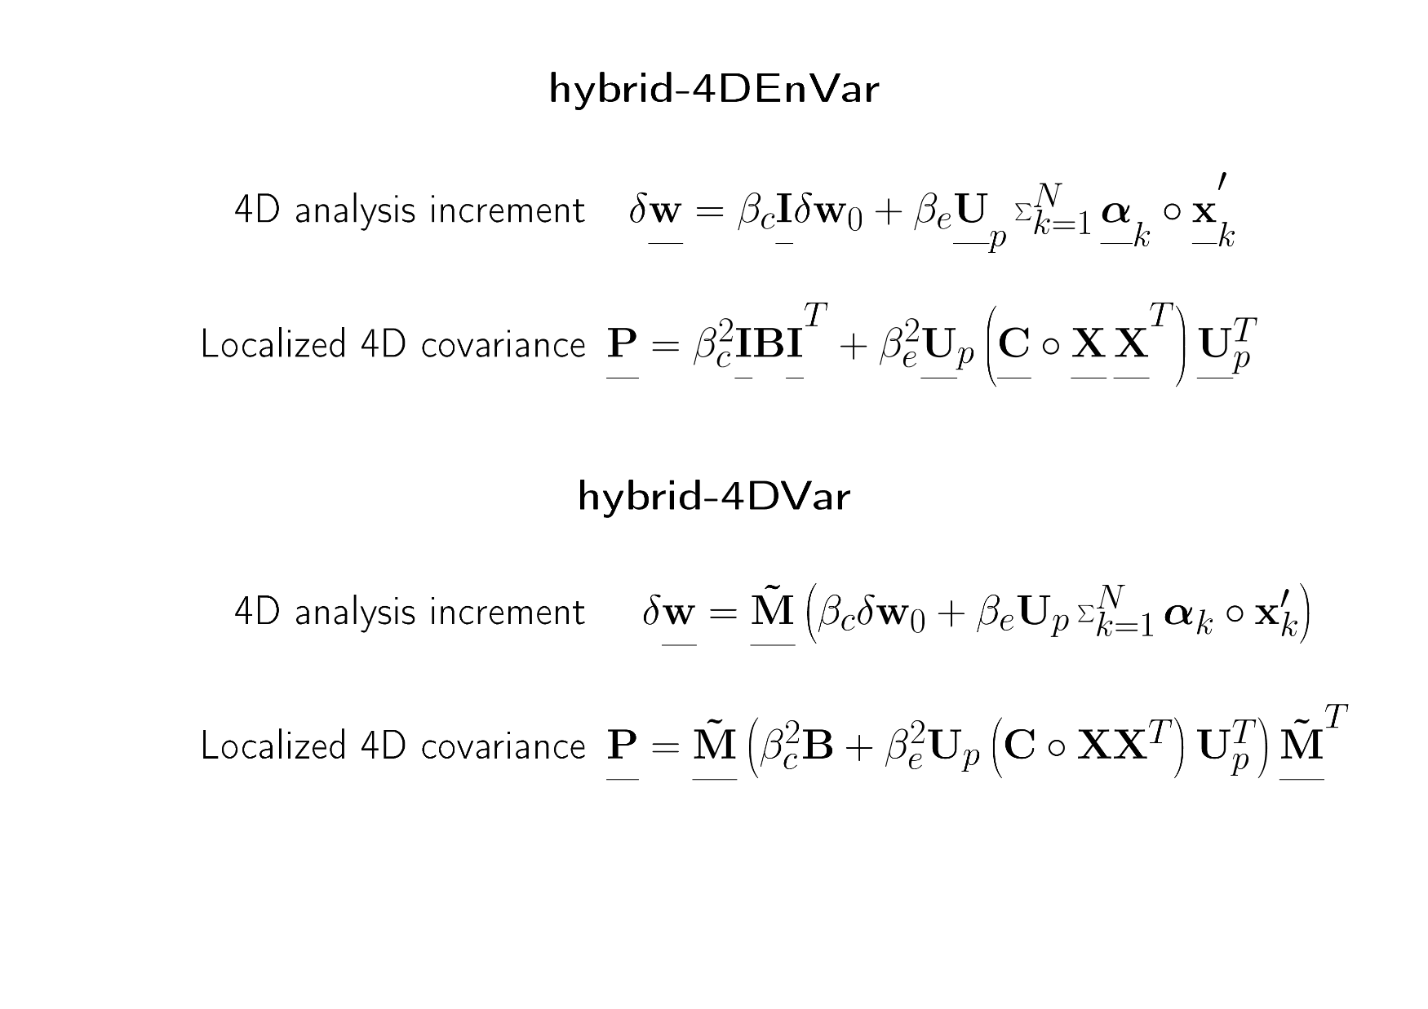
Summary comparison

Slide 21
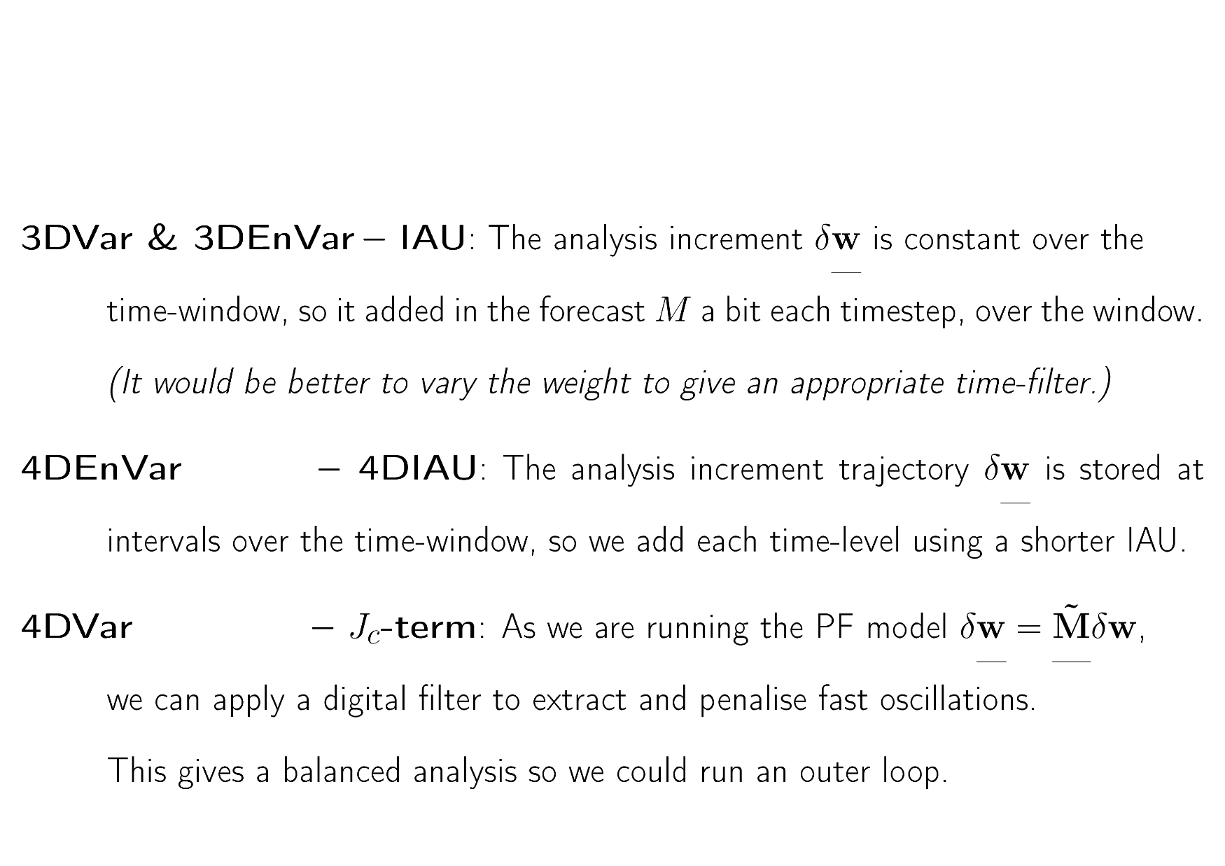
Initialisation methods

Slide 22
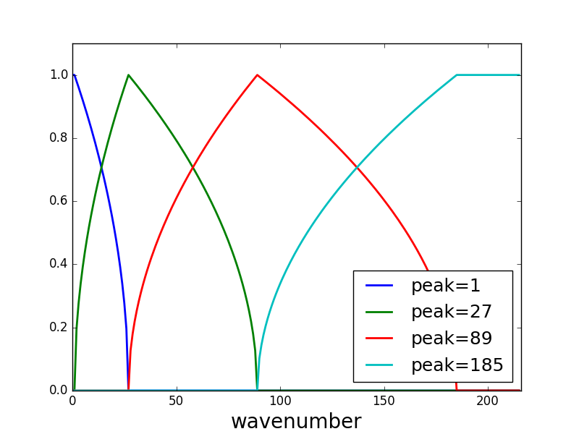
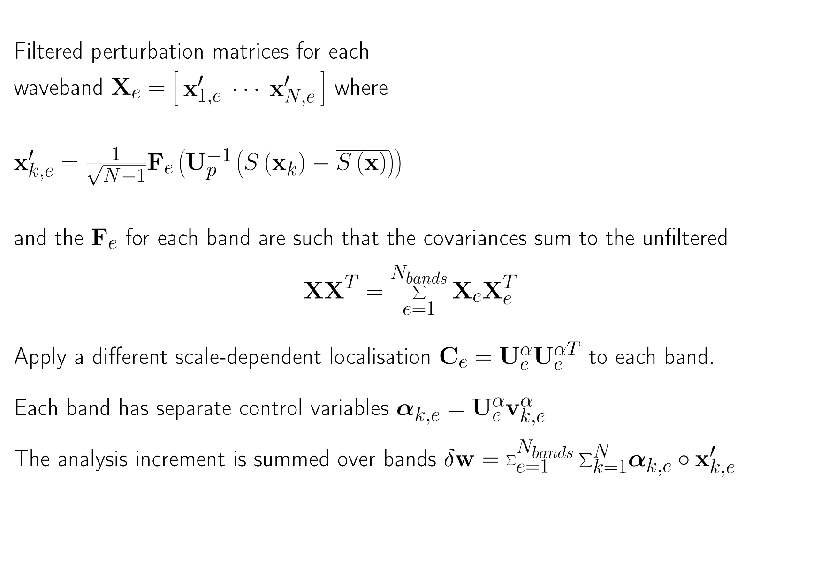
Scale-dependent localisation
& waveband filtering
6241, 919, 389, 256km

Slide 23
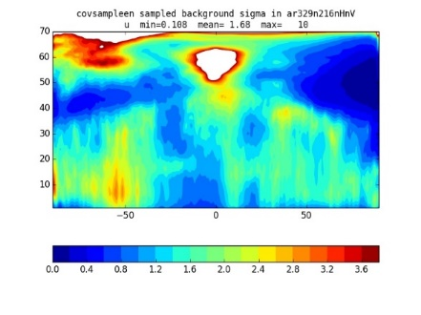

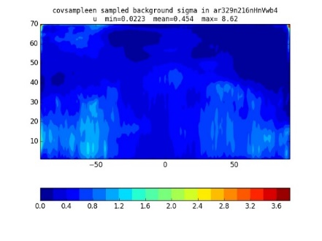
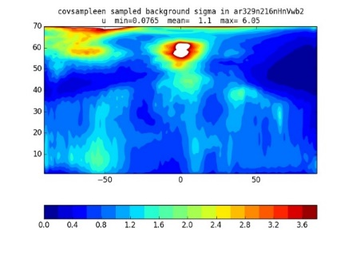
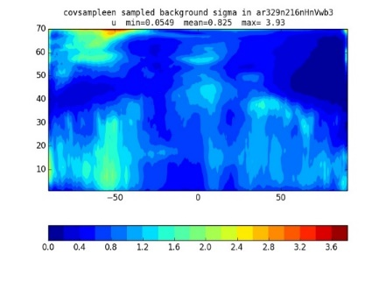
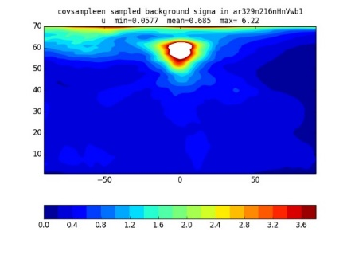
Wavebands copied from Lorenc (2017).
RMS zonal mean X-sections of u′
For a randomly chosen date in June
Raw ensemble
Sum of wavebands
waveband 1
waveband 2
waveband 3
waveband 4
Notes:
Wavebands were chosen to have width proportional to wavenumber.
Other variable have different distribution; e.g. Psi, chi have more in wb1 and humidity more in wb4. Overall, about an equal split.
We assume the bands are independent (i.e. Localise between them). The split preserves total covariance. There is some local smoothing (not visible in zonal means).

Slide 24
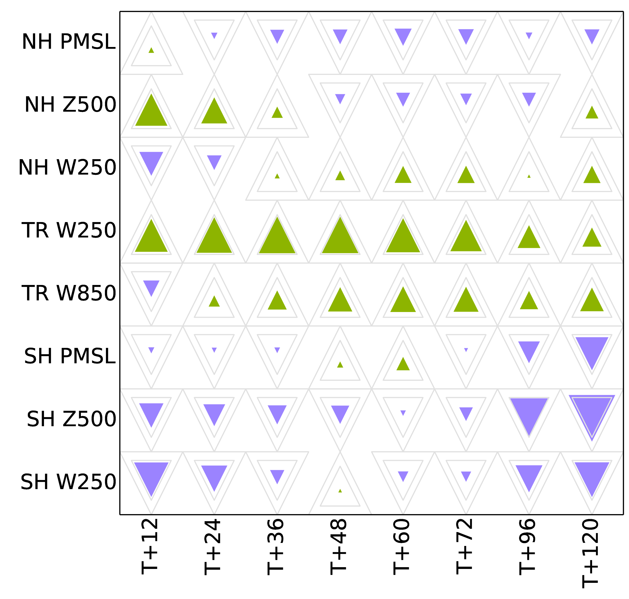
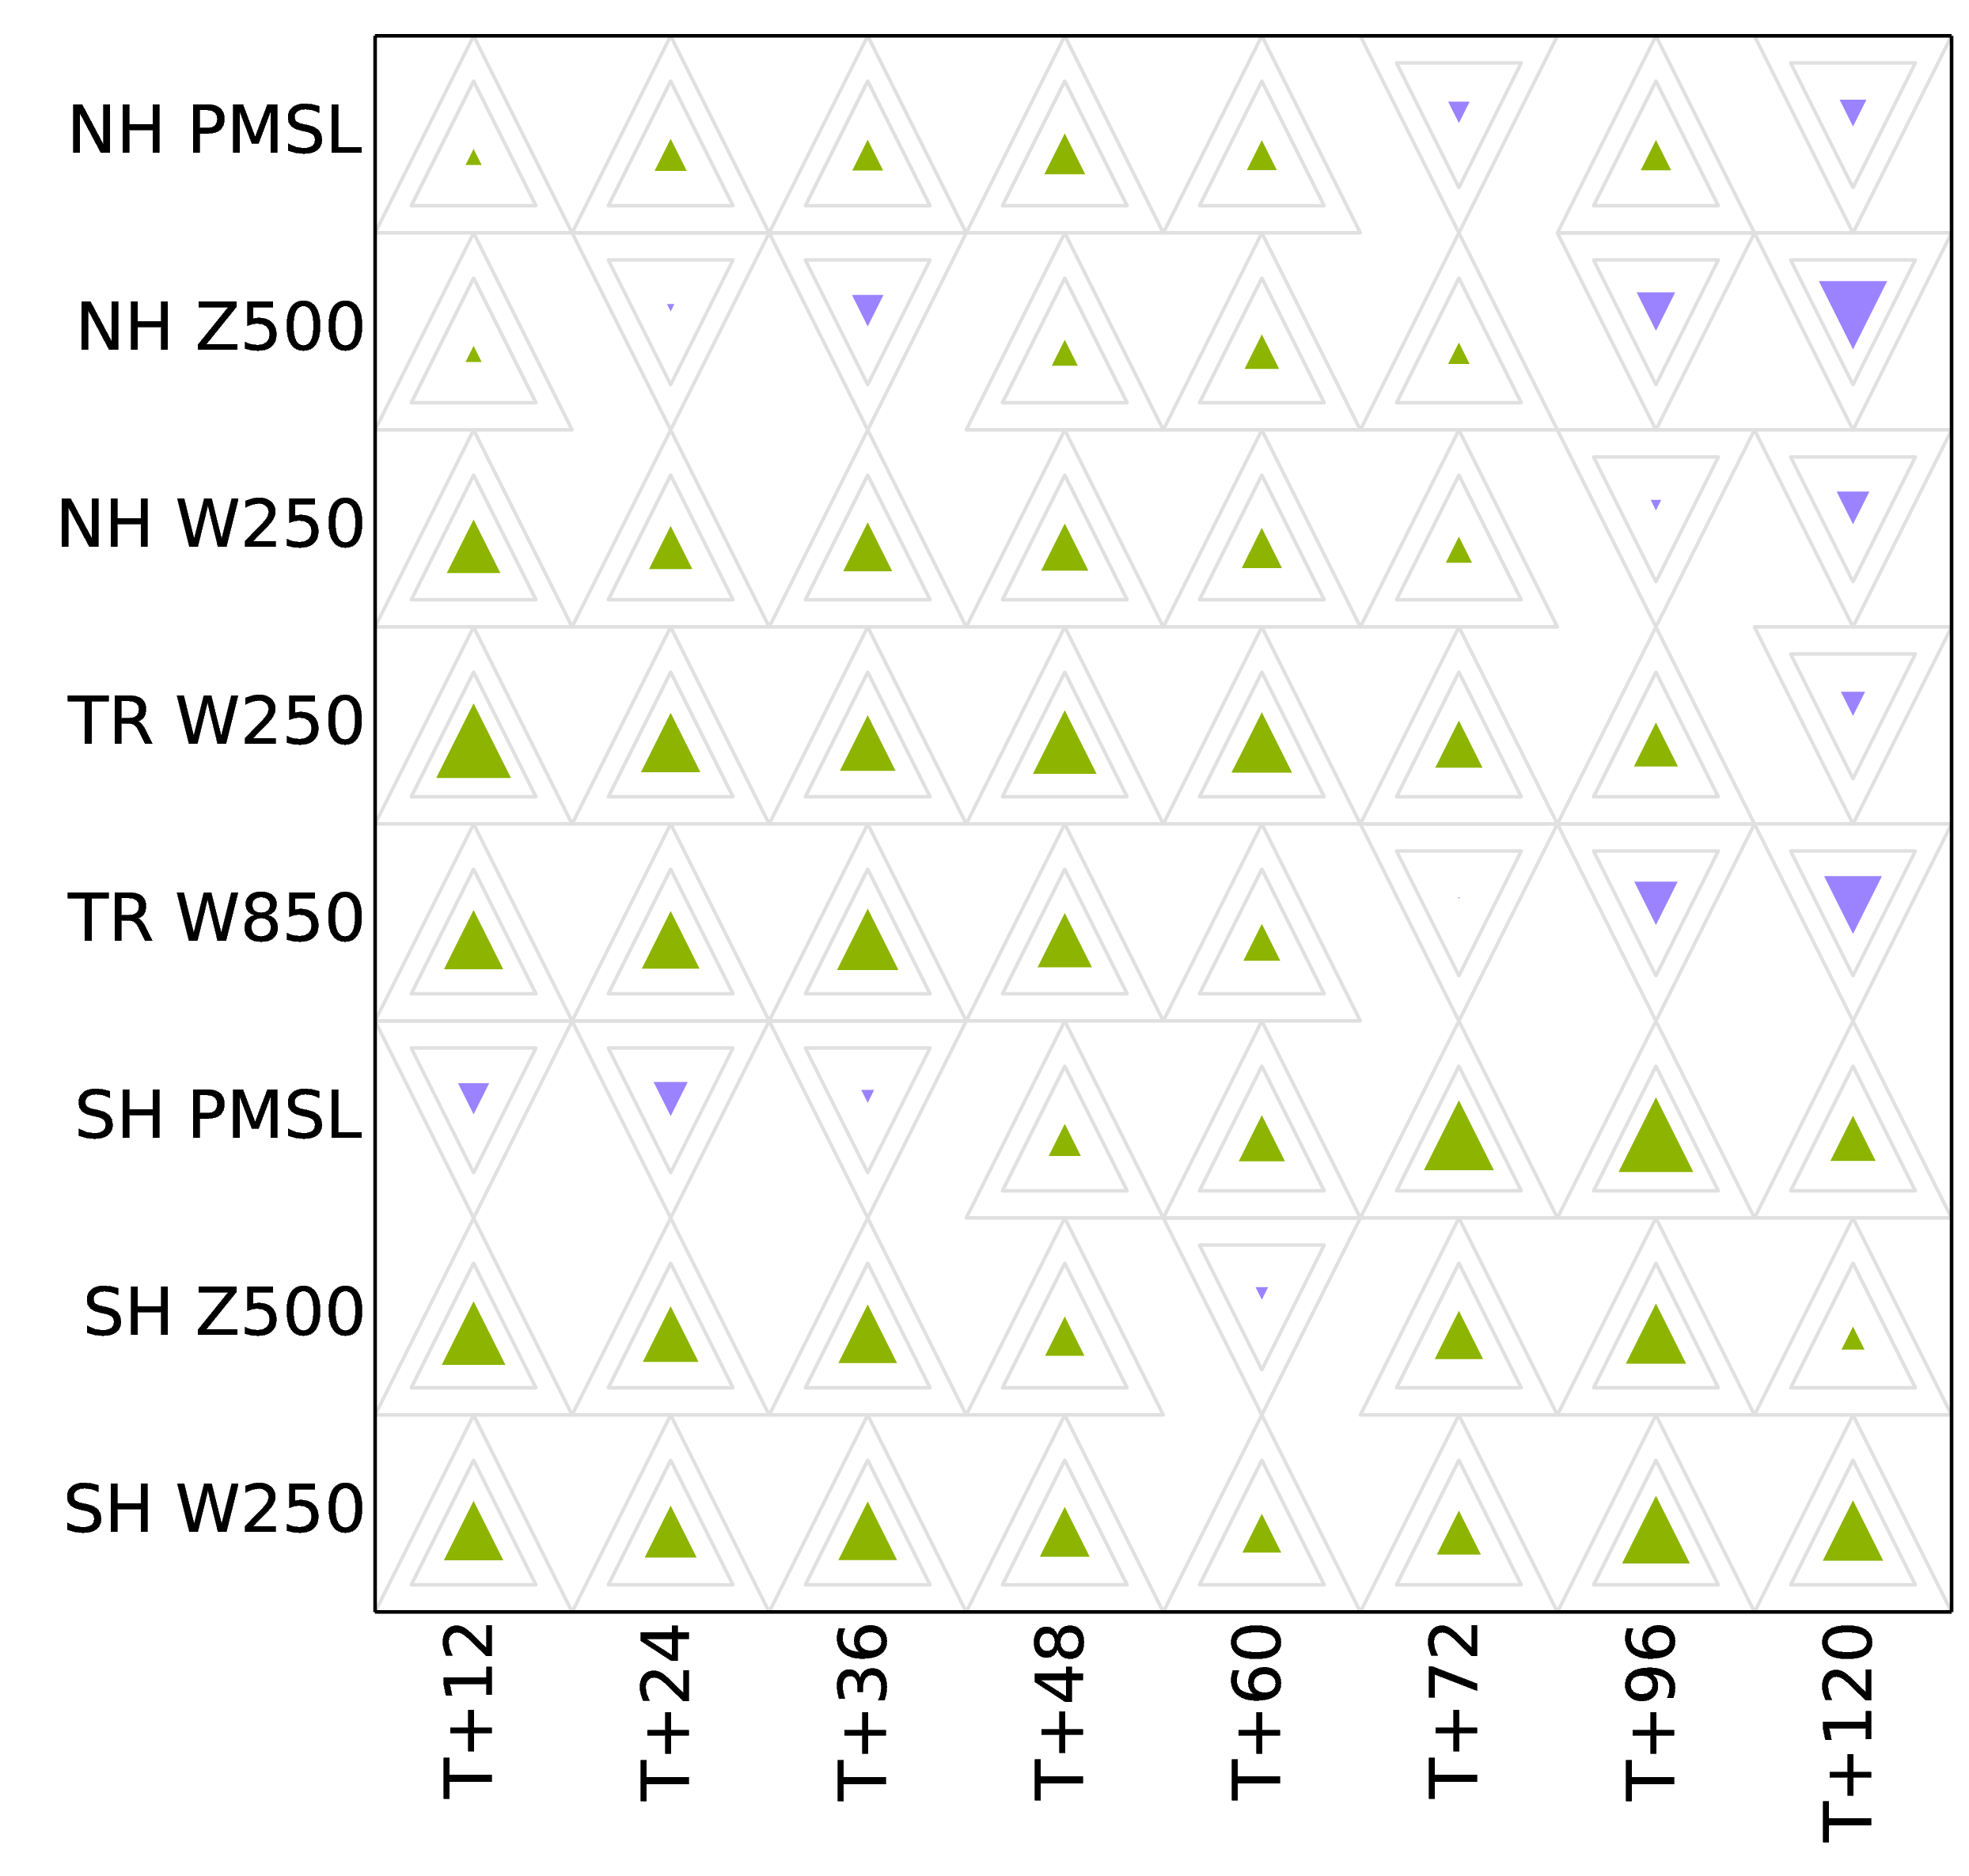
Wavebands & scale-dependent localisation help with some tuning!
Changing localisation scale (from 600km to 800km) has mixed benefit, depending on region,
when not using wavebands.
Changing all localisation scales (by factor 5/6) has consistent benefit when using wavebands with scale dependent localisation.
The regional variations in the split between wavebands
take care of many regional variations in optimal tuning. (Lorenc 2017)

Slide 25
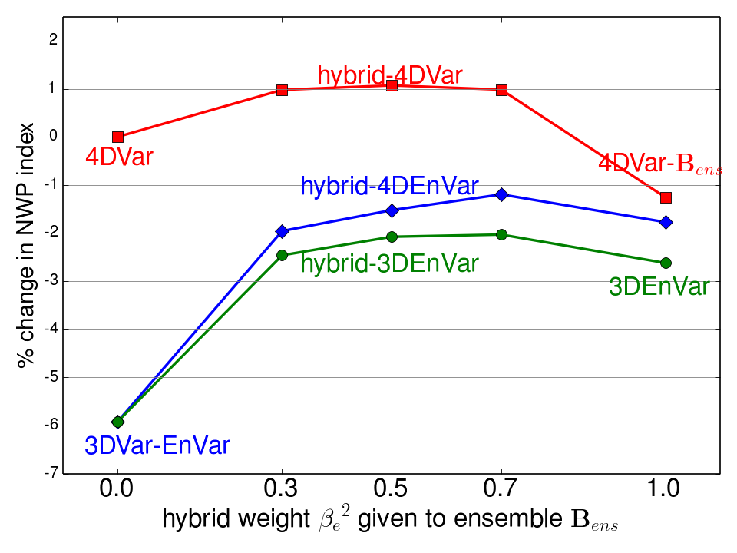
Comparison of hybrid-Var methods
All experiments used an Ne=44 ensemble from our current MOGREPS local ETKF system
4DVar improves static B_{c} by 6%
but doesn’t much improve B_{ens}
‒ with β_{e}²=1 4DEnVar is as good
Allowing for the obs-time in 4DEnVar gains 1% over 3DEnVar
Hybrid-4DVar is 1% better than 4DVar and 2% better than best hybrid-4DEnVar
Lorenc & Jardak 2018

Slide 26
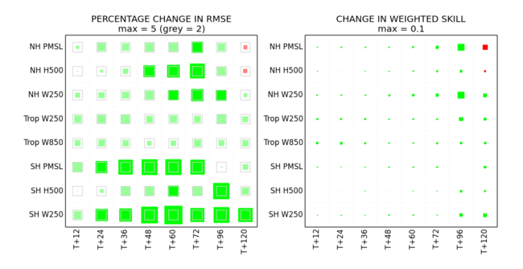
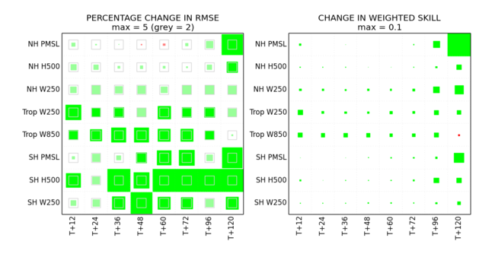
Scorecards for best method
Hybrid-4DVar with β_{e}²=0.5
beats 4DVar with β_{e}²=0.0
+1.1% on Index
Hybrid-4DVar with β_{e}²=0.5
beats hybrid-4DEnVar with β_{e}²=0.7
+2.2% on Index

Slide 27
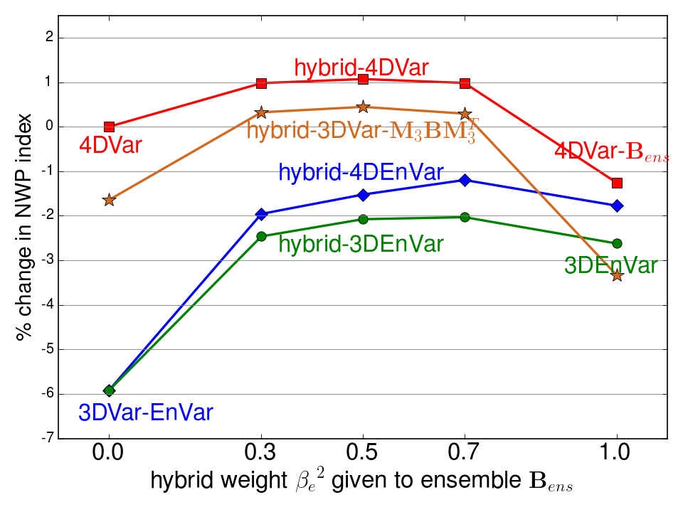
Comparison of hybrid-Var methods
Used 4DVar software to run 3DVar with covariances improved by 3hrs evolution (as in Lorenc & Rawlins 2005)
This improves static B_{c}, explaining most of the benefit of 4DVar
Allowing for the obs-time in 4DVar gains ~1% (like 4DEnVar over 3DEnVar)
Time-evolved M₃B_{ens}M₃^{T}
does not improve on B_{ens}
Lorenc & Jardak 2018

Slide 28
Explanation using ideas from nonlinear dynamics
For a perfect chaotic model, the errors from a Kalman filter based DA system
asymptote to the unstable–neutral subspace
Ensemble DA only works if N_{e} > dimensions of unstable-neutral sub-space
(Bocquet & Carrassi 2017). Our Ne=44 was too small, so needs augmenting by B.
4DVar methods work best when increments are in the unstable sub-space
(Trevisan et al. 2010)
Perturbations which grow typically slope ‒ our B model is isotropic.
So B has only a small projection on the unstable sub-space ‒ MBM^{T} does better.
The ideas above are only an idealised limiting case, based on small perfect models.
NWP models cannot be perfect because of the butterfly effect.
The dimension of the unstable sub-space is uncertain due to localisation.

Slide 29
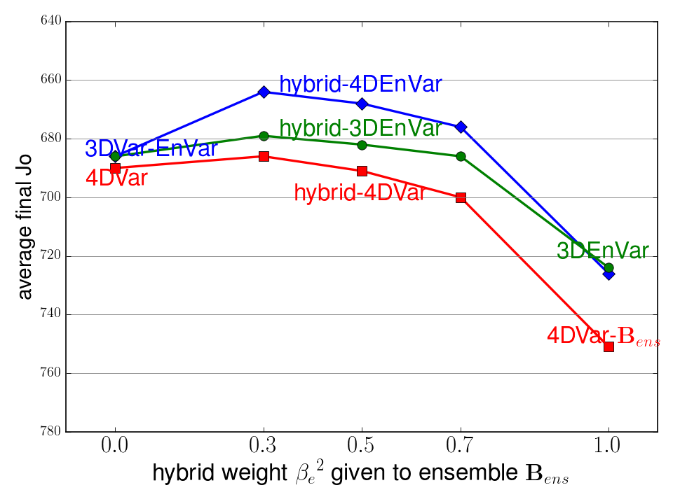
Analysis fit to observations
The ability to fit the observations
(to within their standard errors) is a necessary (but not sufficient) measure of a good analysis.
Even with waveband and scale‑dependent localisation, and augmentation by lagging & shifting, our 44 member ensemble covariance was not good at fitting the observations.

Slide 30
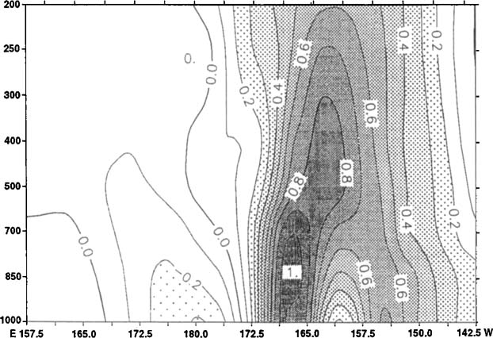
Dynamical structure functions in 4DVar
Thépaut et al. 1996
Time evolution (in this case for 24hrs) produces structures that are tilted and look like singular vectors.
Our isotropic B-model (in which scale is independent of direction) cannot give preference to such growing structures.

Slide 31
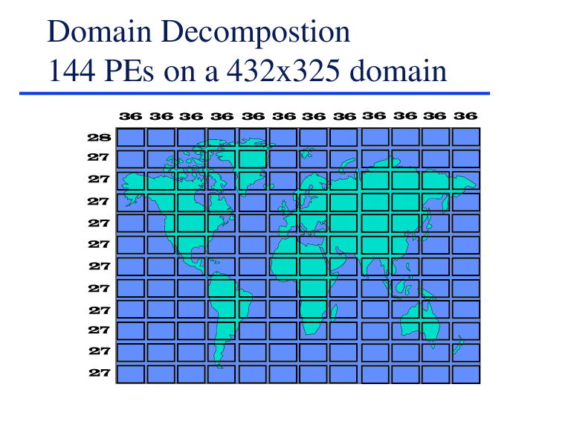
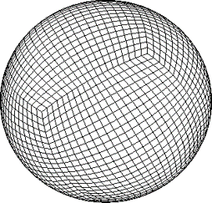
What next, after VAR?
VAR software is >20 years old. 4DVar took 42FTE over 10years.
Built around model grid and domain-decomposition of UM.
Not easy to develop further, but possible (e.g. added 4DEnVar).
Plan is to “go” with a new exascale DA software development
in 2020 for implementation on next computer ~2025.
Collaboration partners are being sought.
While at the start of such projects, flexibility is always a goal!
but we cannot work on everything! The aim of my recent work is to help decide which method(s) to develop and test first.
We have compared results from different methods.
How difficult are they to build in a new software system?

Slide 32
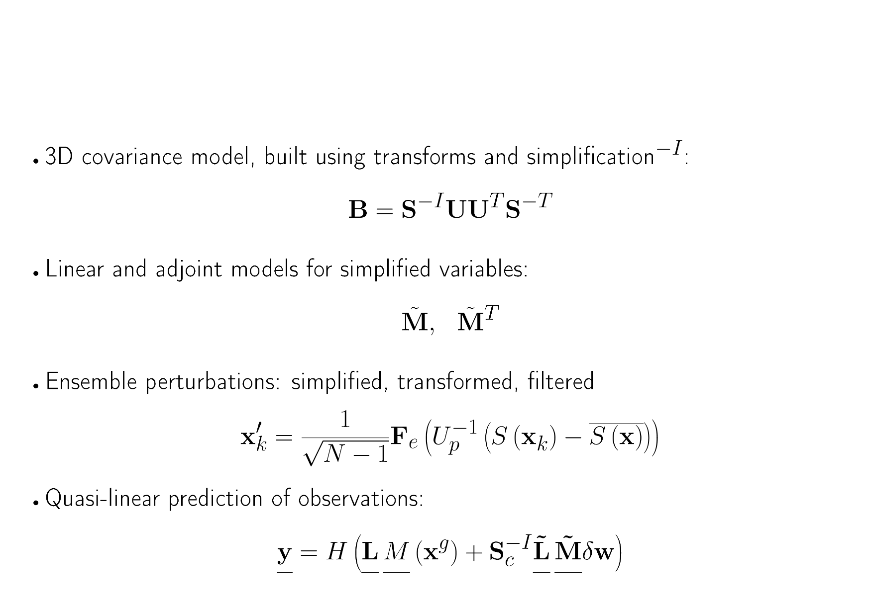
hybrid-4DVar Components

Slide 33
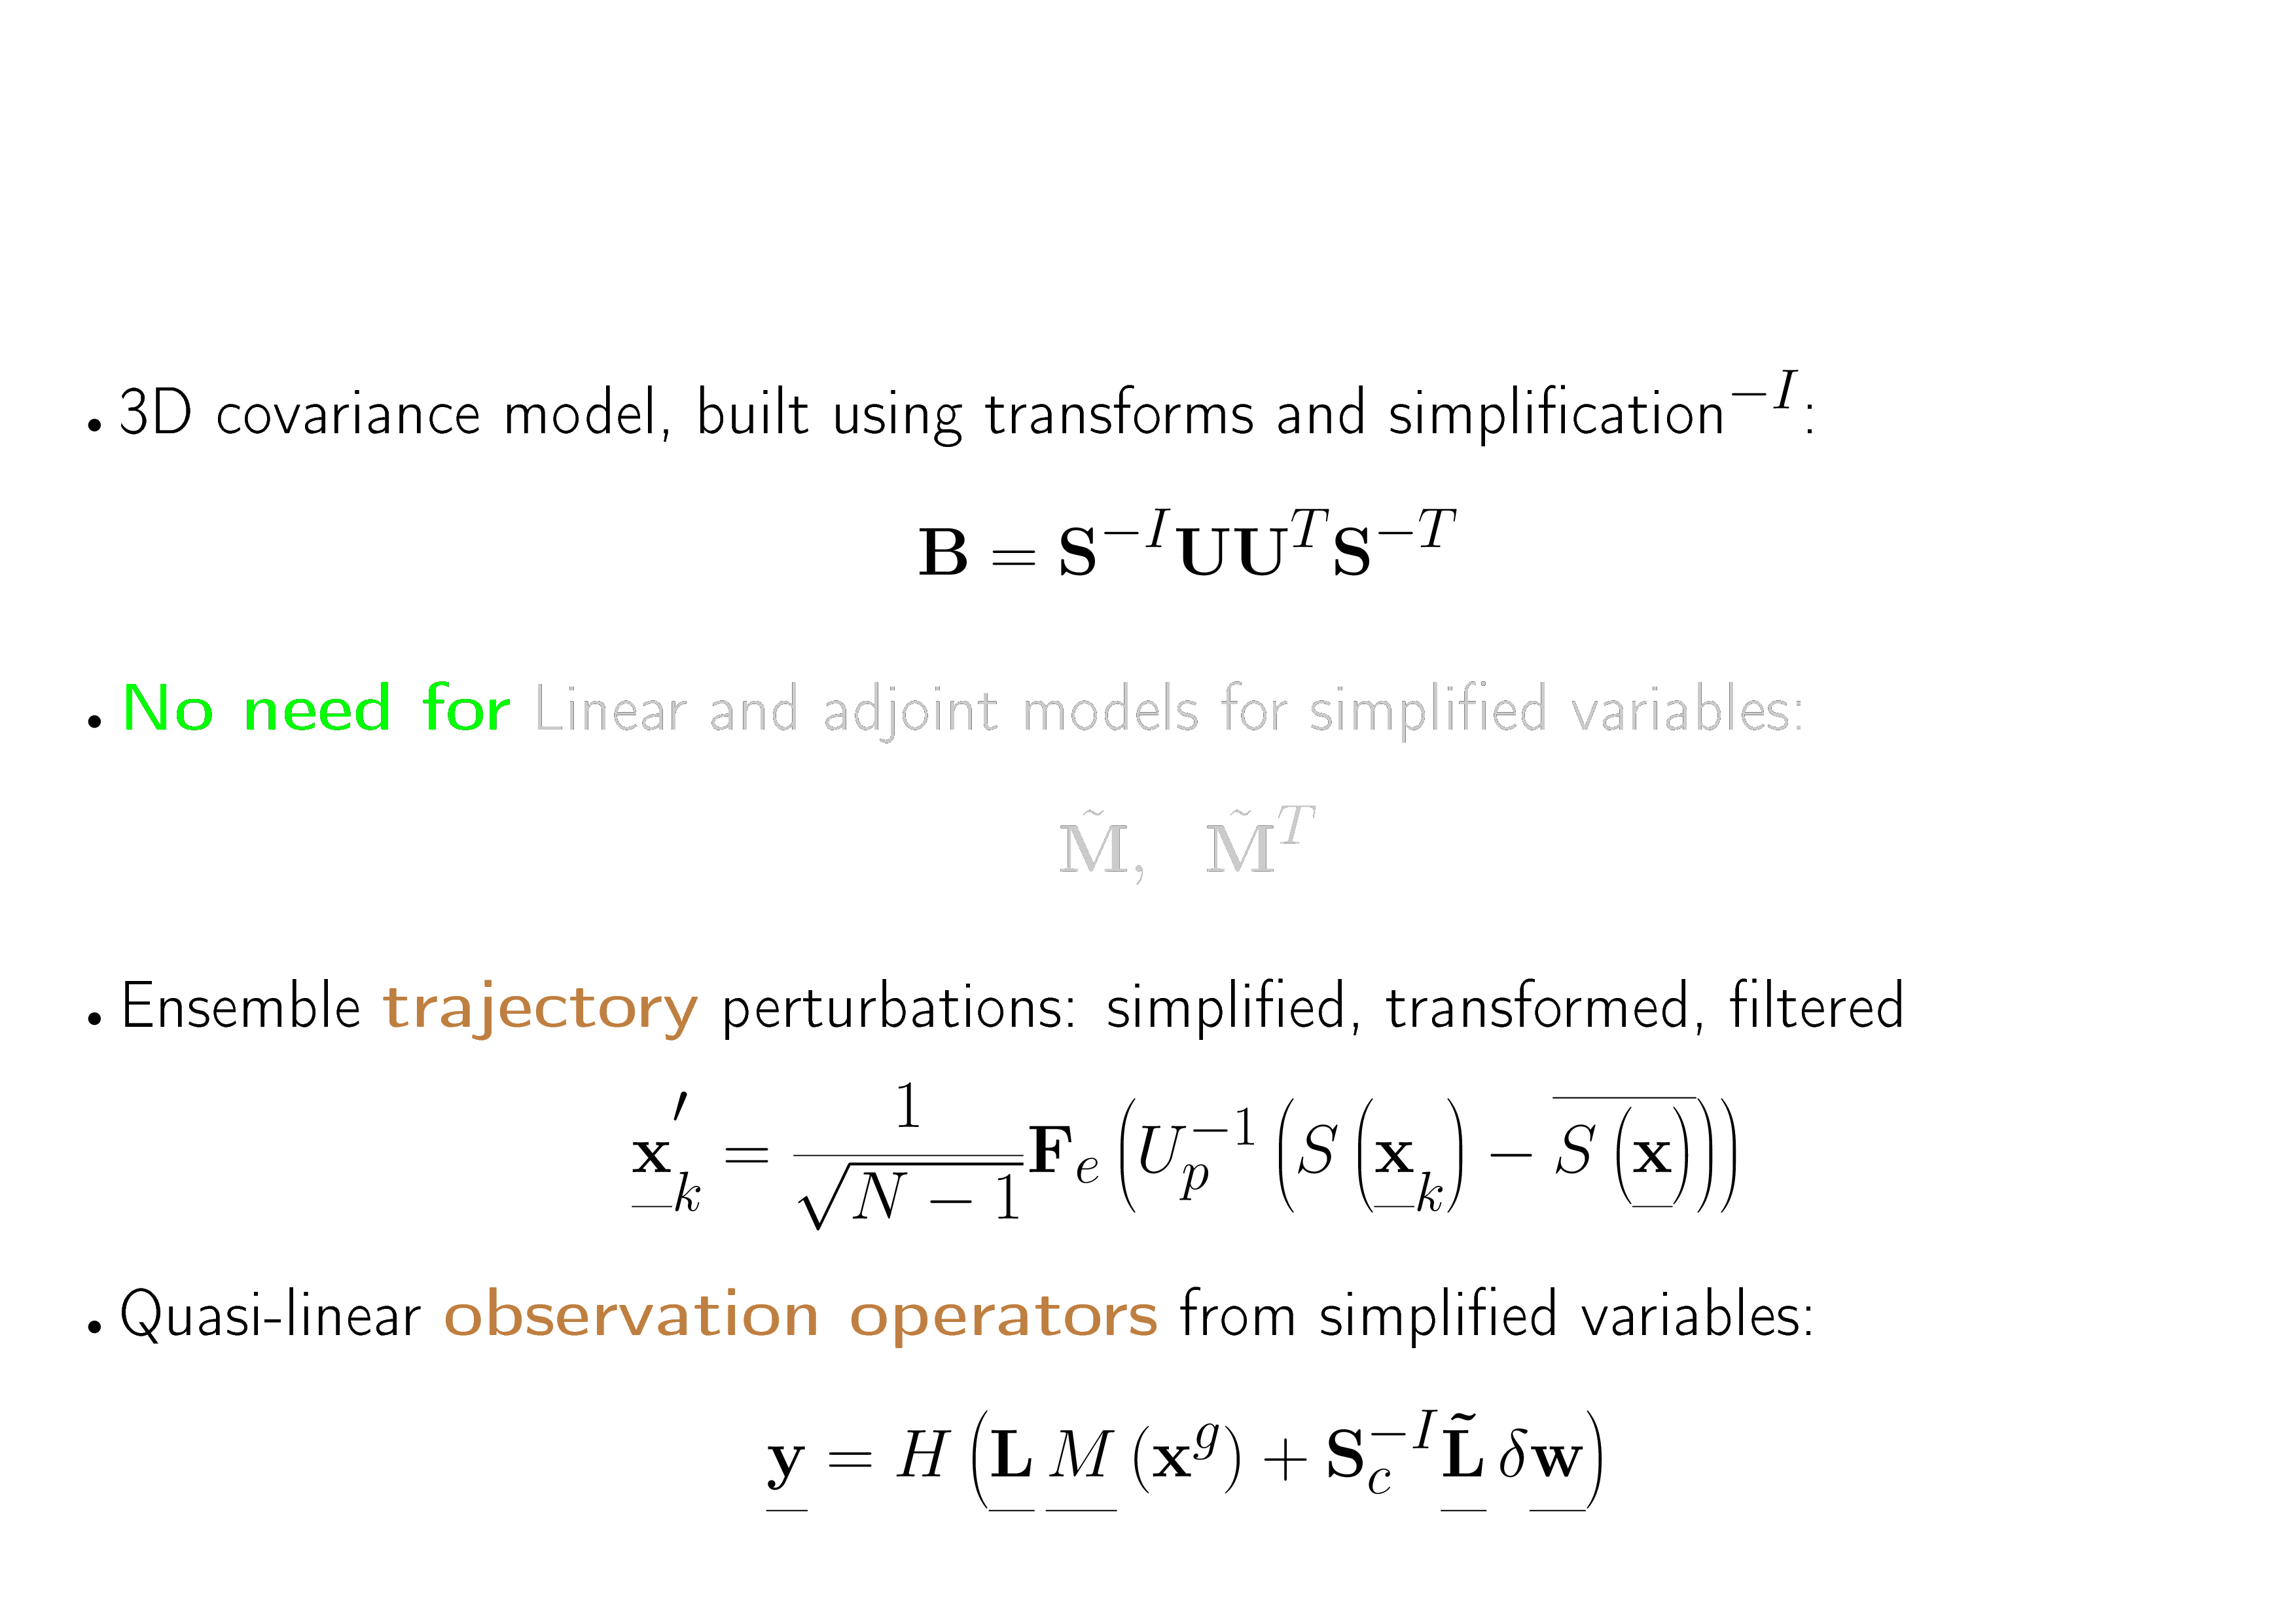
hybrid-4DEnVar Components

Slide 34
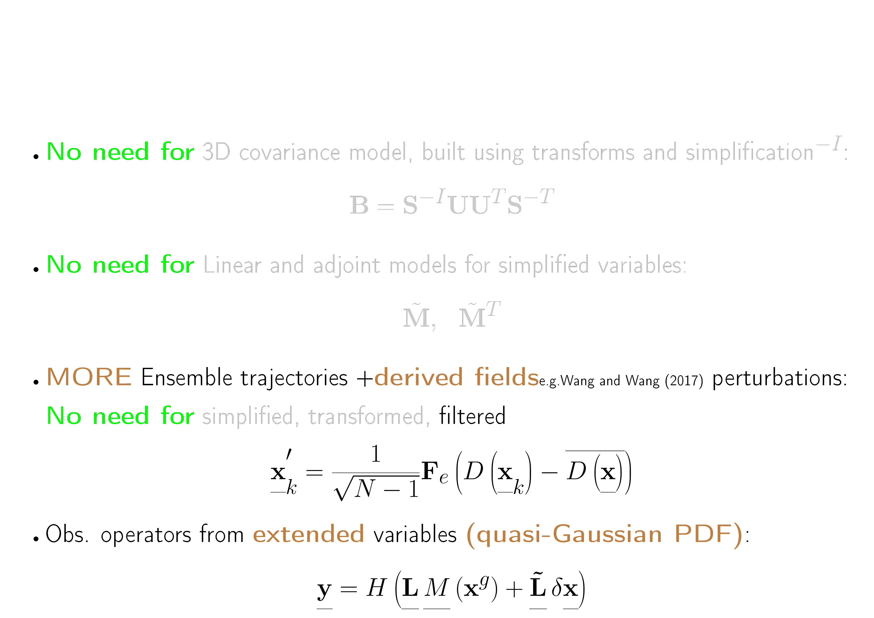
4DEnVar Components

Slide 35
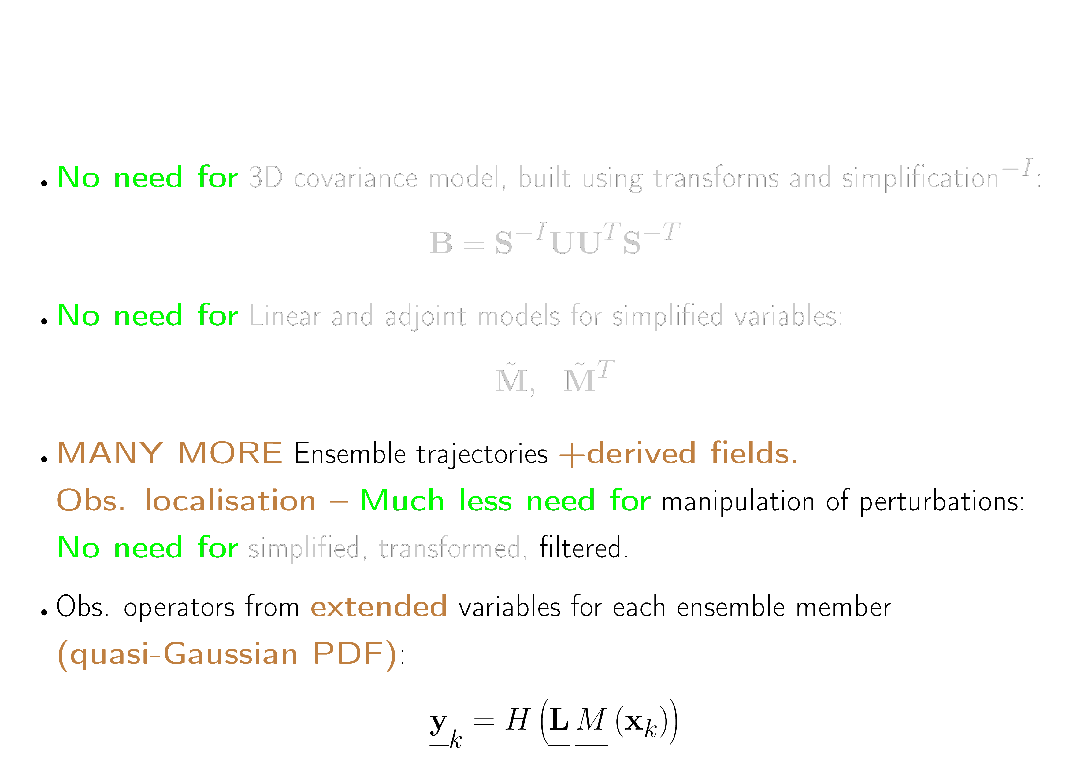
EnKF Components

Slide 36
My current views (It won’t be my decision!)
The UM provided utilities and methods (IO, swapbounds, …) we used in VAR.
LFRic currently provides little we need (e.g. manipulation of ensembles).
PSYCLONE might provide linear and adjoint versions of the dynamics, but not yet.
  Plan for model-independent software structure.
  Postpone working on 4DVar until model is more stable.
Lots of work, with new methods of programming!
  Seek collaboration.
Collaborators are almost certain to develop EnKF software (because its easiest).
  We should work first on 4DEnVar, perhaps moving later to 4DVar or EnKF.
  Global should try first to replicate hybrid-4DEnVar in old VAR system.
  UKV should try non-hybrid 4DEnVar using ensemble reflectivity
  (unless VAR assimilation of reflectivity obs is working OK by then)

Slide 37
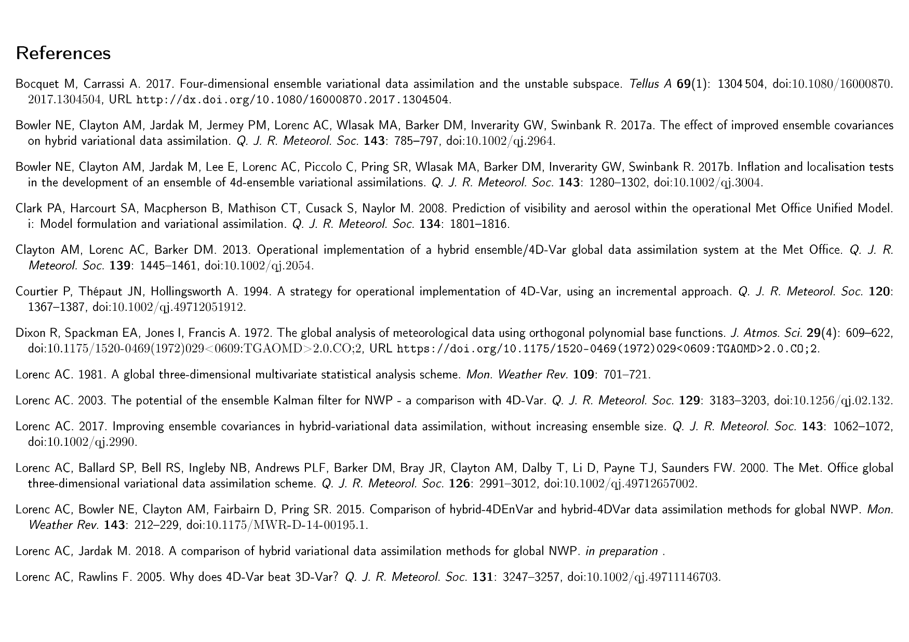

Slide 38
