Slide 1
Data Assimilation for NWP
1. Introduction,
Bayesian Derivation
& Overview
Andrew Lorenc
AW11 Aveiro 2018
Notes:
Concepts & Insights from >40 years’ experience, to explain “why make that choice?” in other lectures.

Slide 2
Data Assimilation is the process of absorbing and incorporating observed information into a prognostic model. OED "assimilate, v. t. … II: to absorb and incorporate."
This is normally done by integrating the model forward in time, adding observations.
  The model state summarises in an organised way the information from earlier observations.
  It is modified to incorporate new observations, by combining new & old information in a statistically optimal way.
OBSERVATIONS
ASSIMILATION MODEL
  At any time, the model state usually contains more information than the current observations.
  Only parameters well represented by the model can be assimilated in this way.

Slide 3
Motivation & Historical Background: DA for NWP
Much clever mathematics is available.
We have to simplify real-world problems before we can apply it in practice.
Which simplifications to make, and what it is important to get right,
depend on insight into the application.
  This, for me, is the most interesting bit of DA R&D,
  rather than the mathematics per se.
This lecture series is focusing on DA for NWP. I assume that:
  The best data assimilation scheme
  is that which leads to the best forecast.

Slide 4
Choices in Data Assimilation
Historical Background of DA for NWP
FGGE & how to use satellite data
How to combine imperfect information
Bayes Theorem
How to represent the errors in our prior (forecast)
Background Error Covariance modelling
How to calculate the evolution of errors,
to best use observations distributed in time
Kalman filter, ensembles, “Errors Of The Day”, 4DVar

Slide 5
Historical Background
Meteorology as a descriptive science (Hadley 1735).
Practical weather forecasts are possible (FitzRoy 1863).
Weather forecasting as a problem in mechanics and physics (Bjerknes 1904).
Weather prediction by numerical methods (Richardson 1922).
Met Office 10-level model representing frontal rain (Bushby 1967); operational 1972.
Use of incomplete historical data (Charney 1969); i.e. 4D-DA of satellite soundings.
First GARP Global Experiment (FGGE 1979); global NWP possible.
Operational Met Office global forecasts from 1983.
Met Office VAR system (1993-2020?)
THORPEX: 2003-2014. NWP can predict evolution & hence structure of errors.

Slide 6
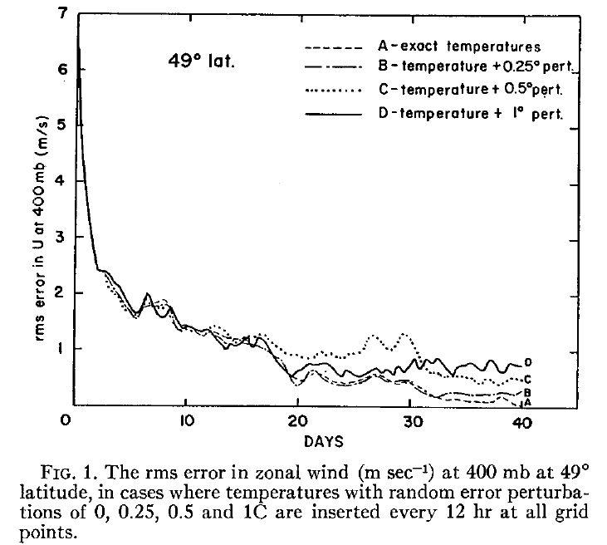
J. Charney, M. Halem, and R. Jastrow (1969)
J. Atmos. Sci. 26, 1160-1163.
Use of incomplete historical data to infer the present state of the atmosphere
OSSE using
Mintz-Arakawa model :
9° ^{x} 7° ^{x} 2 levels.
Data Assimilation could make satellite sounders a major part of the global OS.
Direct insertion of
satellite temperature retrievals
is a viable DA method.

Slide 7
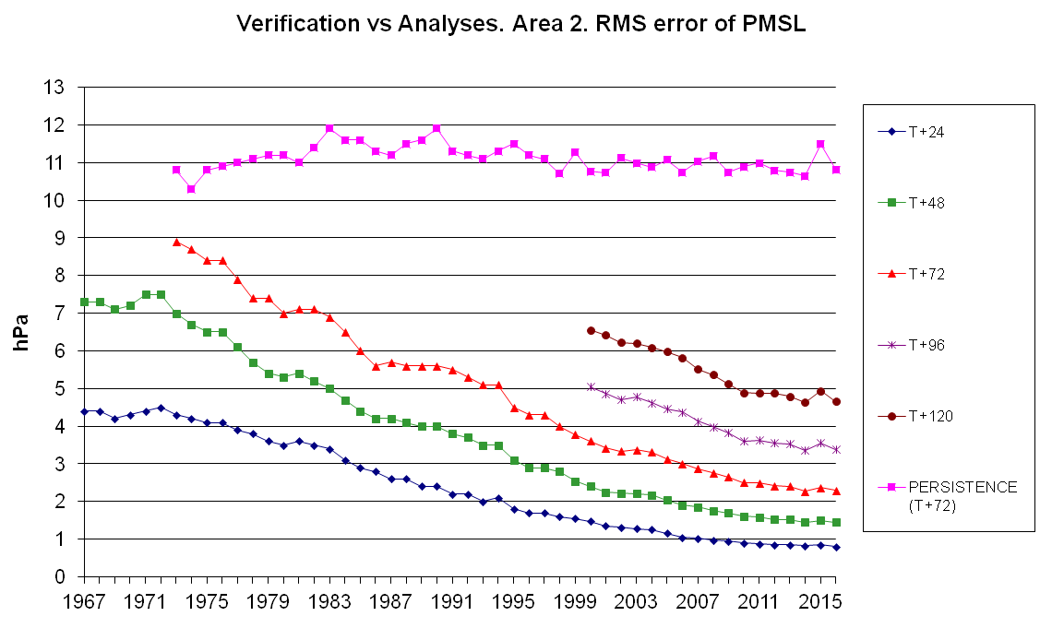
Performance Improvements
“Improved by about a day per decade”
Met Office RMS surface pressure error over the N. Atlantic & W. Europe
Notes:
http://www-nwp/~cfver/annrep/PMSL_VerifVsAnl.png
The longest continuous NWP verification time-series I know of. (Covers my career!)
Verificaction v analysis for “area 2” (covering the UK, Iceland and Western Europe), which is defined as a rectangle on a polar stereo-graphic projection.
Accuracy has improved to the extent that one day of forecast predictability has been gained approximately every 10 years.

Slide 8

Simmons & Hollingsworth, 2002
Notes:
From one of the few published studies of causes of improvements in NWP.
In 1990s we were afraid that scores were asymptoting.
The eventual resumption of decrease was due probably more to the realisation that the “background” from NWP was more accurate than the observations than to 4D-Var which was introduced at the same time (see following slides).

Slide 9
Causes of Improvement:
What has been important for getting the best NWP forecast?
NWP systems are improving by 1 day of predictive skill per decade. This has been due to:
  Model improvements, especially resolution.
  Careful use of forecast & observations,
  allowing for their information content and errors.
  Achieved by variational assimilation e.g. of satellite radiances.
  4DVar.
  Better observations.
Notes:
This ordered list is based on 40 years experience, including 13 as member of WMO&JSC’s WGNE where developments at the top NWP centres were discussed.
I realize it might be controversial – I present some evidence for each item.

Slide 10
Cray T3E
Cray C-90
ETA-10
Cray Y-MP
Cyber 205
IBM 360/195
Moore’s Law
KDF-9
Mercury
Leo

Slide 11
Importance of forecast model
A large part of the increase in assimilation accuracy comes from improvements to the model
A large part of the increase in model accuracy comes from improvements in resolution
The resolution has been limited by computer power, so the increase in skill is related to Moore’s Law.
NWP is an extreme example here.
Other applications of DA place less emphasis on the model and more on use of data.

Slide 12
How much of the improvement is due to better observations?
Whole observing systems used to give up to 6 hours improvement in skill
(Fourth WMO Workshop on the Impact of Various Observing Systems on NWP. 2008).
This is equivalent to 2~3 years improvement.
“No satellite” OSEs gave better forecasts than
“All Obs” OSEs did 6 years earlier (Richard Dumelow 2009).
However, recent improvements in satellite data should increase their importance.

Slide 13
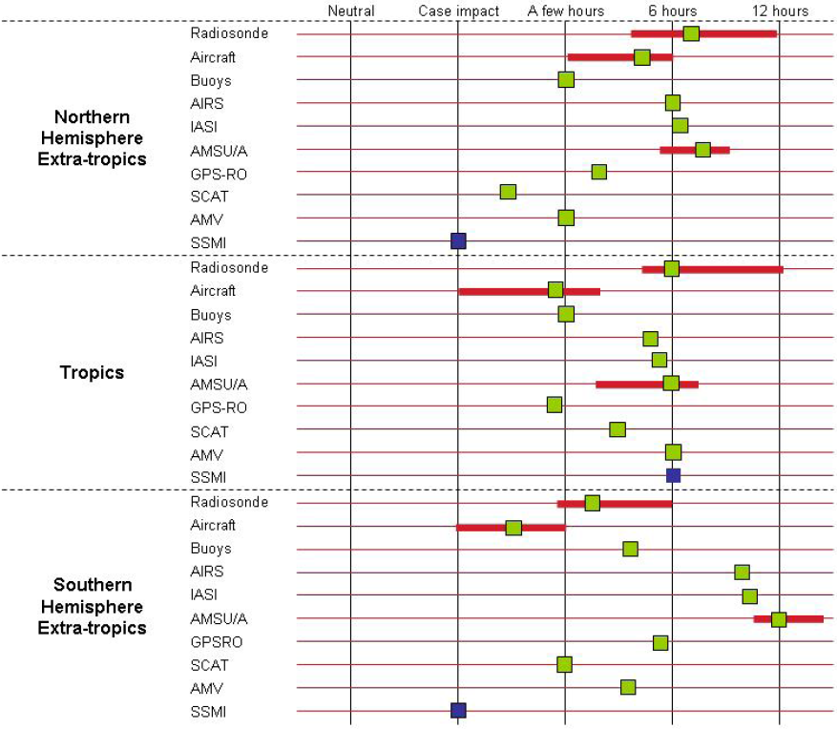
Impact of different observing systems.
Current contributions of parts of the existing observing system to the large-scale forecast skill at short and medium-range. The green colour means the impact is mainly on the mass and wind field. The blue colour means the impact is mainly on humidity field. The contribution is primarily measured on large-scale upper-air fields. The red horizontal bars give an indication of the spread of results among the different impact studies so far available.
Fourth WMO Workshop on the Impact of Various Observing Systems on NWP. Geneva, Switzerland, 19-21 May 2008
Notes:
-The table estimates the impact of the total ensemble system appearing on each line. For example the line “AMSU / A” corresponds to the 3 or 4 instruments available on current polar orbiting satellites. It is then compared to one single AIRS or one single IASI instrument, and scores more. One single AMSU/A has been quantified to a slightly smaller value than one AIRS;
-Compared to the situation in 2004, AMSU / A does not dominate any more; AMSU / B is used as well; the new infra-red sounders contribute to the impact with a magnitude similar to micro-wave sounders;
-Micro-wave instruments like SSM / I, SSM / IS and AMSU / B are also very important for large-scale humidity fields, especially in the tropics. Each of them can be rated similarly to SSM / I appearing in table 1;
-MODIS winds are very important for polar caps, and their impact spread quickly to mid-latitude: the impact is always found significant and positive in the southern hemisphere (and in the northern hemisphere, most of the time);
-Global wind profiles remain the more important information to observe, at least relatively to the current GOS where the temperature profiles can be indirectly observed by satellite sounders or GPS radio-occultation (no change with respect to the previous workshop, four years ago); and
-Surface pressure observations are important to anchor the model surface pressure; surface wind observations are less important, but are a very useful complement (provided mainly by scatterometers).

Slide 14
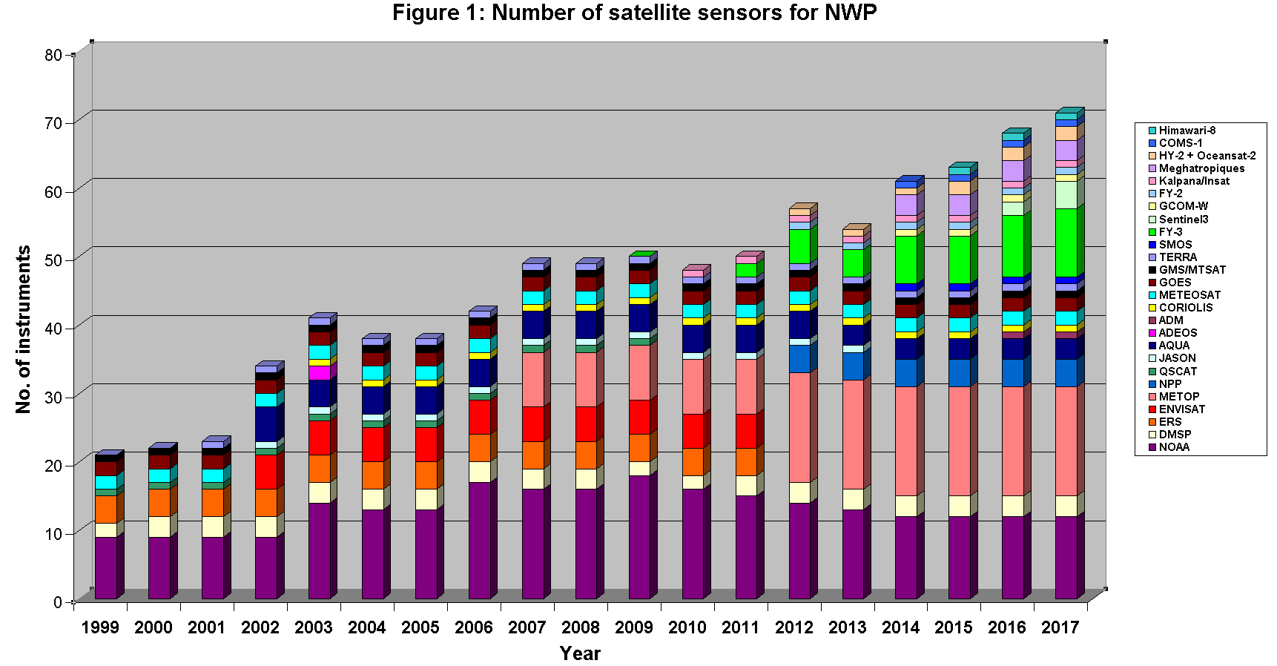
Number of satellite sensors for NWP
Roger Saunders, MOSAC 2016

Slide 15
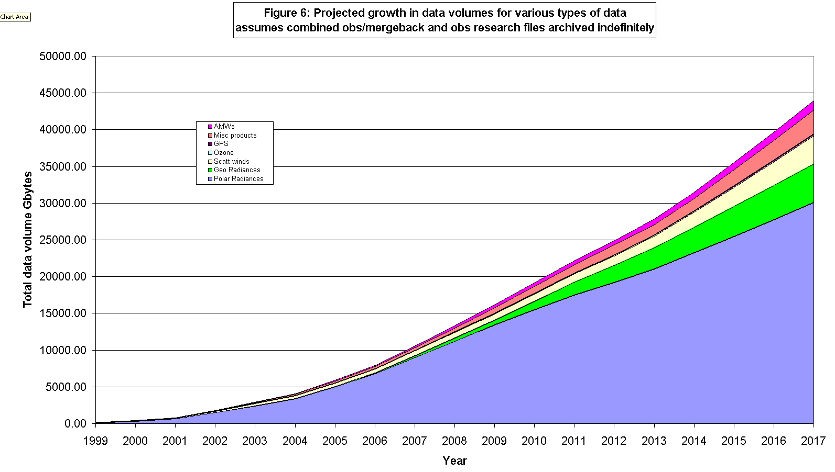
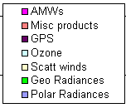
Satellite data volumes
Projected annual growth in data for different obs types
Polar radiances

Slide 16
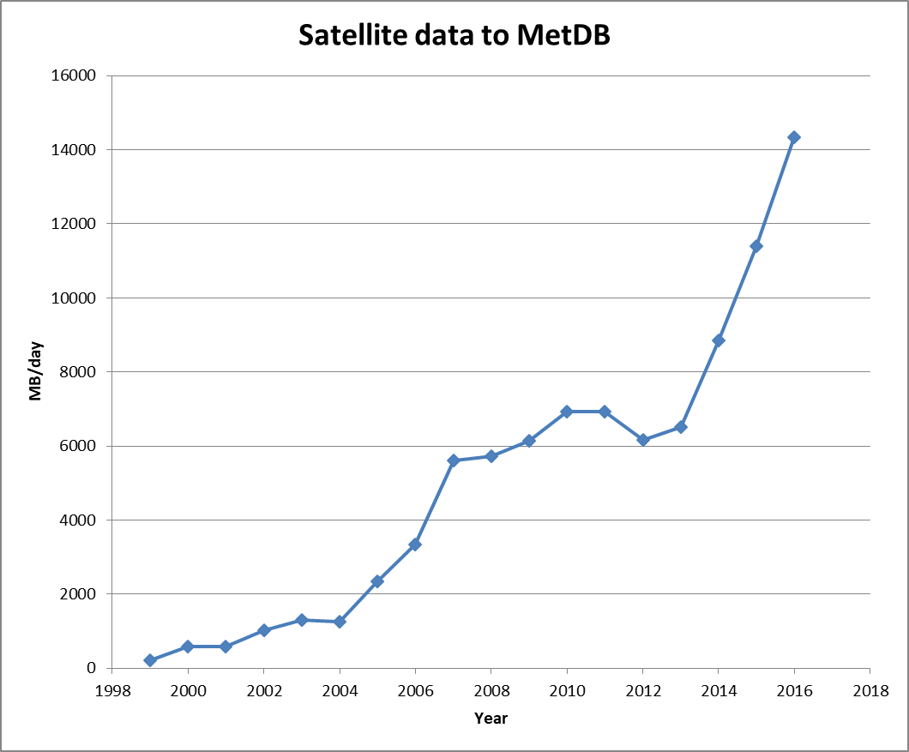
Met Office Satellite Data Analysis 2016

Slide 17
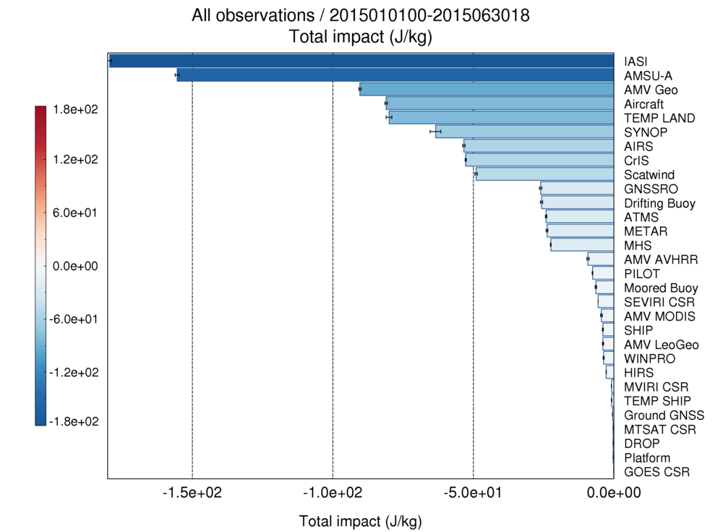
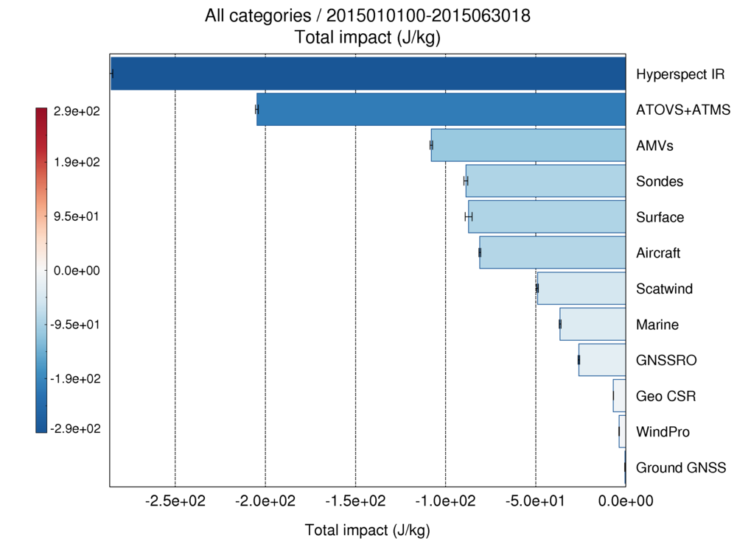
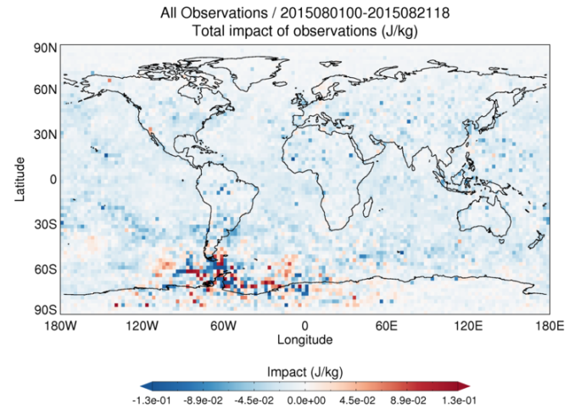
The Importance of satellite data
Latest FSOI results showing impact of observations for 24hr forecasts in global model
Notes:
This is the most recent set of FSO for 24 hr forecasts for Global results for 6 months

Slide 18
Bayes Theorem – adding information

Slide 19
How to combine imperfect information
If the astronomical observations and other quantities on which the computations of orbits is based, were absolutely correct, the elements also, whether deduced from three or four observations, would be strictly accurate (so far indeed as the motion is supposed to actually take place exactly according to the laws of Kepler), and therefore, if other observations were used, they might be confirmed, but not corrected. But since our measurements and observations are nothing more than approximations to truth, the same must be true of all calculations resting upon them, and the highest aim of all computation made concerning concrete phenomena must be to approximate, as nearly as practicable to the truth. But this can be accomplished in no other way than by a suitable combination of more observations than the number absolutely requisite for the determination of the unknown quantities. This problem can only be properly be undertaken when an approximate knowledge of the orbit has been already taken into account, which is afterwards to be corrected, so as to satisfy all the observations in the most accurate manner possible.
Gauss, 1809: Theoria
Motus Corporum Coelestium
- 1823:
Theoria combinationis observationum erroribus
minimis obnoxiae

Slide 20
Key Ideas from Gauss:
all models and observations are approximate
the resulting analysis will also be approximate
the observations must be combined in some optimal fashion
it is better to have enough observations to over-determine the problem
the model is used to provide a preliminary estimate
the final estimate should fit the observations within their (presumed) observational error

Slide 21
Bayes' Theorem for Discrete Events
A B events
P(A) probability of A occurring, or
knowledge about A's past occurrence
P(A∩B) probability that A and B both occur,
P(A⏐B) conditional probability of A given B
We have two ways of expressing P(A∩B):
⇒ Bayes' Theorem:
Can calculate P(B) from:

Slide 22
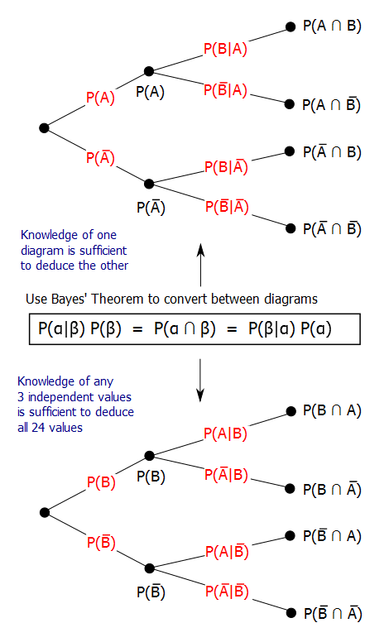
Bayes’ Theorem as explained on wikipedia (Gnathan87)

Slide 23
Bayes theorem in continuous form, to estimate a value x given an observation yº
p(x⏐yº) is the posterior distribution,
p(x) is the prior distribution,
p(yº⏐x) is the likelihood function for x
Can get p(yº) by integrating over all x:

Slide 24
Assume Gaussian pdfs
Prior is Gaussian with mean x^{b}, variance V_{b} :
Ob yº, Gaussian about true value x variance V_{o} :
Substituting gives a Gaussian posterior:

Slide 25
Advantages of Gaussian assumption
Best estimate is a found by solving linear equations:
  Taking logs gives quadratic equation; differentiating to find extremum gives linear equation.
Best estimate is a function of values & [co-]variances only.
  Often these are all we know.
Weights are independent of values.

Slide 26
Combination of Gaussian prior & observation
- Gaussian posterior,
- weights independent of values.
Non-Gaussian
Js

Slide 27
Variational Penalty Functions
Finding the most probable posterior value involves maximising a product [of Gaussians]
By taking –ln of the posterior PDF, we can instead minimise a sum [of quadratics]
This is often called the “Penalty Function” J
Additive constants can be ignored

Slide 28
Penalty functions: J(x) = -ln(p(x))+c p Gaussian ⇒ J quadratic
PDFs

Slide 29
Data Assimilation:
Use of a forecast as prior
Our prior knowledge about likely atmospheric states is far from Gaussian!
There are recurring coherent patterns (fronts, depressions, convective storms …), a chaotic “attractor”, and the butterfly effect, which are difficult to represent in a practical DA system.
The best we can do is build a computer model, and say that
likely atmospheric states are those which the model can generate.
We do not attempt to represent “butterflies” which are smaller than the model’s resolution.
We do not accept a “best” (minimum variance) estimate which is not a likely model state.
We then build a DA system using the model,
and use a forecast (based on earlier observations) as our current prior.
If the system is well observed, so that errors are small, then errors in the forecast are Gaussian. The forecast x^{b} provides much more accurate information than our earlier prior,
so we use it as the only prior: p(x) = N(x^{b},B)

Slide 30
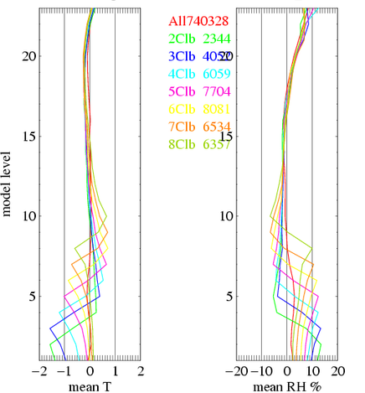
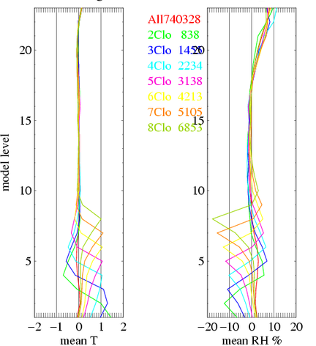
Example of non-Gaussian background PDF
Important weather situations have non-Gaussian background PDFs, with significant mean bias.
e.g. mean b-o profile for backgrounds containing a cloud layer composited by level of cloud in b (Lorenc 2007).
A good example of the principle of symmetry (lecture 2) since classified by o the patterns are nearly opposite.
Composited using cloud level in background
Composited using cloud level in sonde sounding

Slide 31
Simplest possible Bayesian NWP analysis

Slide 32
Simplest possible example – 2 grid-points, 1 observation. Standard notation:
Ide, K., Courtier, P., Ghil, M., and Lorenc, A.C. 1997: "Unified notation for data assimilation: Operational, Sequential and Variational" J. Met. Soc. Japan, Special issue "Data Assimilation in Meteorology and Oceanography: Theory and Practice." 75, No. 1B, 181—189
Model is two grid points:
1 observed value yº midway (but use notation for >1):
Can interpolate an estimate y of the observed value:
This example H is linear, so we can use matrix notation for fields as well as increments.

Slide 33
Bayes theorem in continuous form, to estimate a value x given an observation yº
p(x⏐yº) is the posterior distribution,
p(x) is the prior distribution,
p(yº⏐x) is the likelihood function for x
Can get p(yº) by integrating over all x:
© Crown copyright Met Office Andrew Lorenc 33

Slide 34
background pdf
We have prior estimate x^{b}₁ with error variance V_{b}:
But errors in x₁ and x₂ are usually correlated
⇒ must use a multi-dimensional Gaussian:
where B is the covariance matrix:

Slide 35
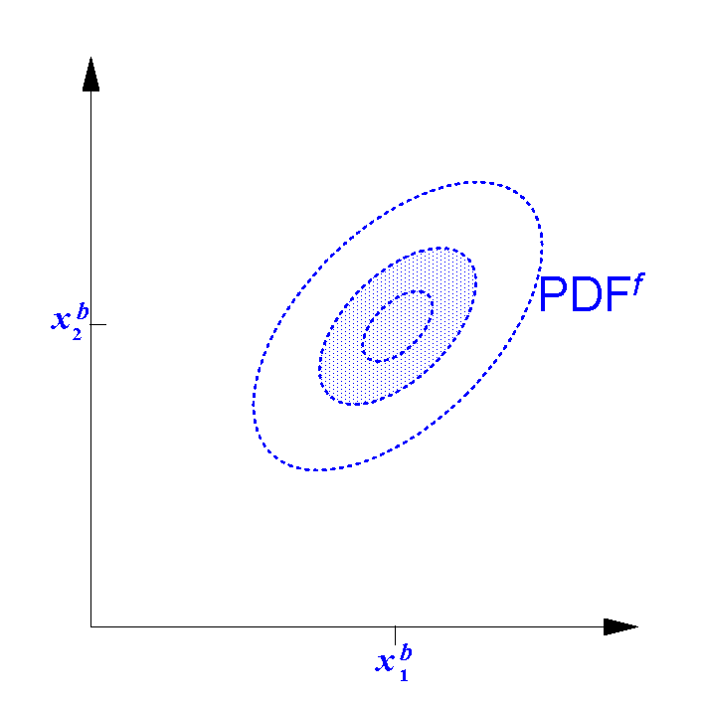
background pdf

Slide 36
Observational errors
Lorenc, A.C. 1986: "Analysis methods for numerical weather prediction." Quart. J. Roy. Met. Soc., 112, 1177-1194.
instrumental error
Difference between the actual instrument and a hypothetical perfect instrument.
For instance, for a wind observation from a radiosonde, the errors in tracking the balloon might lead to an instrumental error of about 1ms⁻¹.
error of representativeness
Errors from H and model resolution in predicting the value from a perfect instrument.
For instance, the error predicting a radiosonde wind from a model with grid-length 200km would be about 3ms⁻¹, and a grid-length of 20km would reduce the error of representativeness to about 1ms⁻¹.
© Crown copyright Met Office Andrew Lorenc 36

Slide 37
Observational errors
Lorenc, A.C. 1986: "Analysis methods for numerical weather prediction." Quart. J. Roy. Met. Soc., 112, 1177-1194.
Observational error combines these 2 :
Instrumental and representativeness errors are convolved to give a combined observational error: R=E+F.
Note that we have assumed observations and background are unbiased. Treatment of biases is discussed in another lecture.
We have also assumed that observational errors are uncorrelated with background errors.
© Crown copyright Met Office Andrew Lorenc 37

Slide 38
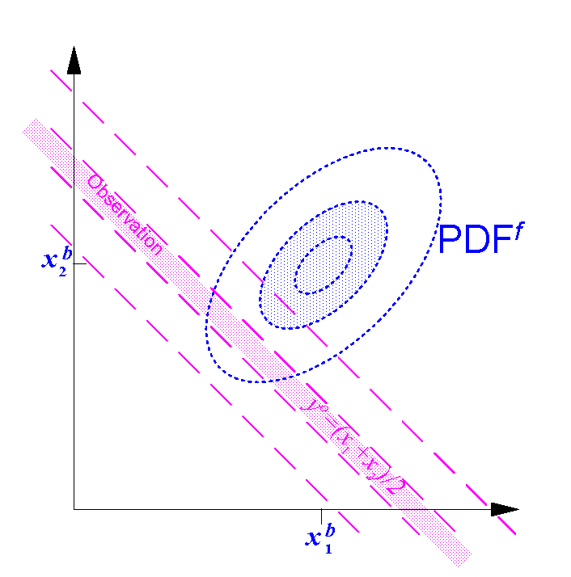
background pdf obs likelihood function

Slide 39
Bayesian analysis equation
Property of Gaussians that, if H is linearisable :
where xª and A are defined by:

Slide 40
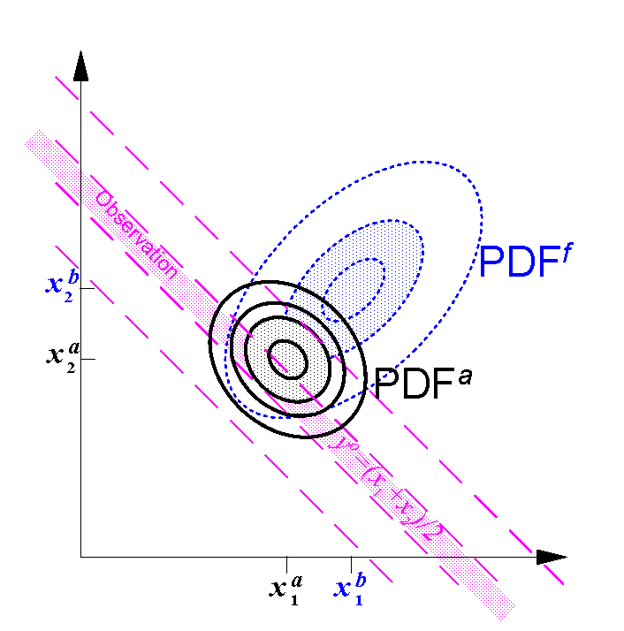
background pdf obs likelihood function posterior analysis PDF

Slide 41
Practical implementation of the Bayesian Analysis Equation
How do we apply it to assimilate millions of observations into an
NWP model with billions of variables?

Slide 42
Issues in practical implementation
“The devil is in the details”
There are significantly different choices possible for each of the following options. The combinations of these choices give a large number of very different analysis schemes, all implementing the same Bayesian equation!
  Modelling, representing & estimating prior background error covariances B.
  Expressing the equations in a form amenable to solution.
  Computing the solution.
Notes:
I have developed in my career 3 very different schemes, and can talk about many more.
But it is impossible to go into details in a lecture on “fundamentals”.

Slide 43
How to estimate the prior PDF?
Background error covariance model: B
Notation:
Traditionally we use
B to denote a modelled estimate of the covariance.
The Kalman filter traditionally uses
P^{f} to denote a forecast covariance.
© Crown copyright Met Office

Slide 44
Modelling and representing prior background error covariances B.
Explicit point-point [multivariate] covariance functions.
Transformed control variables to deal with inter-variable covariances.
Vertical – horizontal split
  EOF decomposition into modes.
  Spectral decomposition into waves.
  Wavelets.
Recursive filters or diffusion operators to give local variations.
Ensemble perturbations (from mean).

Slide 45
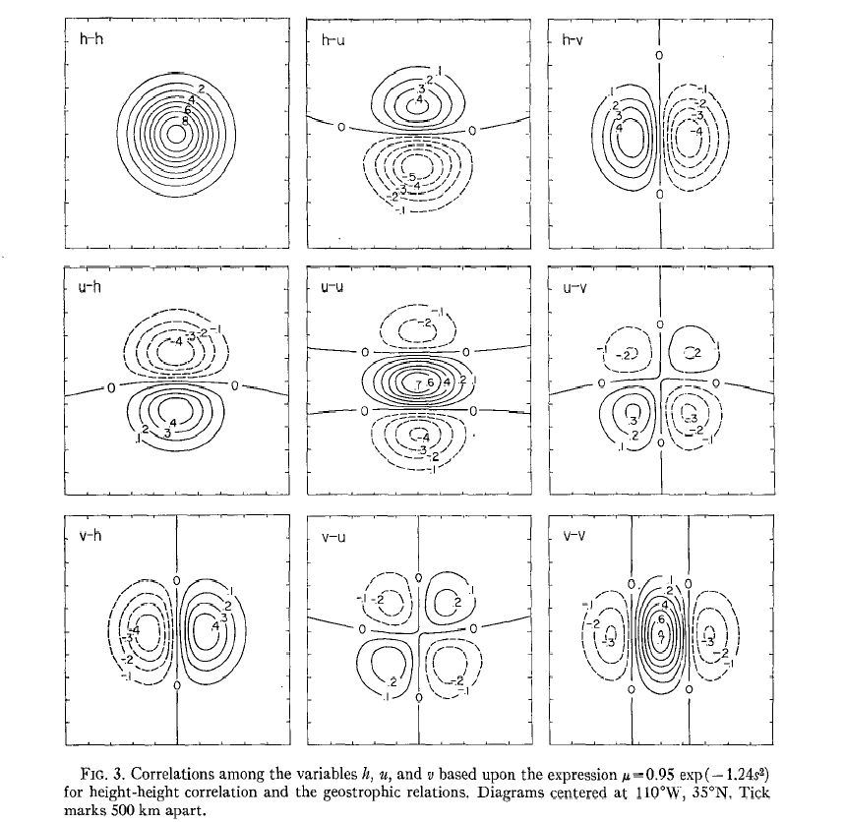
Schlatter’s (1975) multivariate covariances
Specified as multivariate 2-point functions.
Not easy to ensure that specified functions are actually valid covariances.
Used in OI and related observation-space methods.

Slide 46
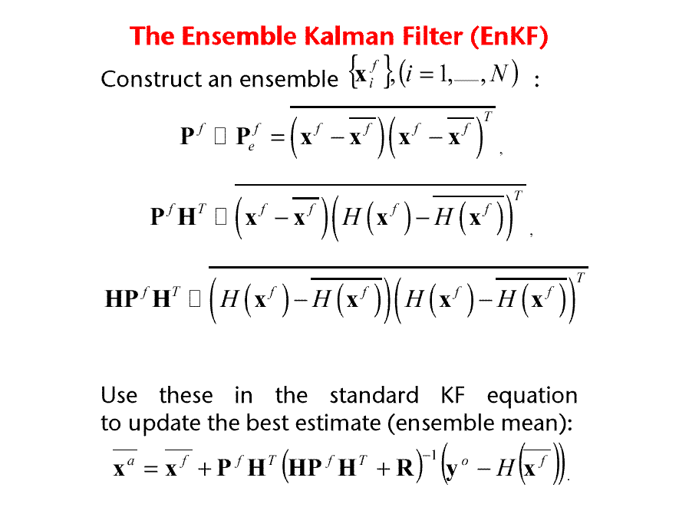
Covariances calculated directly from a sample:
=
=
=
© Crown copyright Met Office

Slide 47
Estimating PDFs or covariances
Even if we knew the “truth”, we could never run enough experiments in the lifetime of an NWP system to estimate its error PDF, or even its error covariance B.
Simplifying assumptions are essential (e.g. Gaussian, ...)
Even a simplified error model has so many parameters that we cannot afford enough NWP trials to determine which values give the best forecasts.
In practice we can only measure innovations and accumulate statistics on HBH^{T}+R. We cannot get separate estimates of B & R without assumptions (Talagrand).
We need to understand the physics!

Slide 48
Effect of the null space of B
B should be positive semi-definite. If it has any (near) zero eigenvalues, then no analysis increments are permitted in the direction of the corresponding eigenmodes.
Causes of a null space:
  Strong constraints used in the definition of B. E.g.
    Hydrostatic & geostrophic relationships
    Model equation in 4D-Var
  Too small a sample when estimating B
Effects of a null space:
  Synergistic use of complementary observations
  Spurious long-range correlations and over confidence in accuracy of analysis.
© Crown copyright Met Office Andrew Lorenc 48

Slide 49
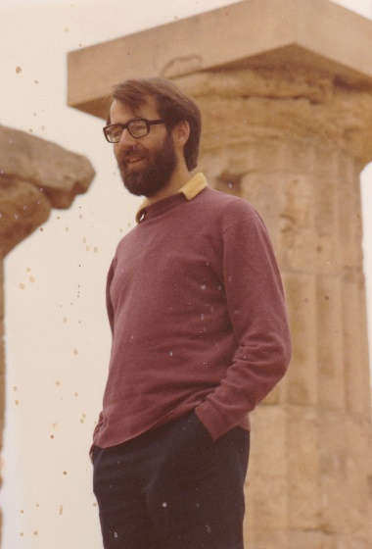
Analysis error in 500hPa height for different combinations of error-free observations.
Lorenc, A.C. 1981: "A global three-dimensional multivariate statistical analysis scheme." Mon. Wea. Rev., 109, 701-721.
© Crown copyright Met Office Andrew Lorenc 49

Slide 50
How to estimate the prior PDF?
How to calculate its time evolution?
Notation:
We add an underline to the variables in the standard notation, to denote their 4D equivalent over a finite DA time-window.
E.g. x^{b} is the 4D background forecast trajectory.

Slide 51
Flow dependence and time evolution in the background errors B
B is situation dependent: e.g. variances are larger in where there is error growth, correlations are less across a front.
B reflects the presence and accuracy of earlier observations.
Four-dimensional covariance B reflect the prognostic equations: observations measuring the time-tendency of one variable can be used to infer information about other variables which are coupled via the prognostic equation.

Slide 52
Fokker-Planck Equation

Slide 53
Kalman Filter – forecast step
Can allow for additive Gaussian forecast errors.
Exact for linear model & Gaussian errors.
Often “Extended” to nonlinear models –, using tangent-linear model – – to evolve the PDF.
Model error represented by adding covariance Q
© Crown copyright Met Office
Notes:
53

Slide 54
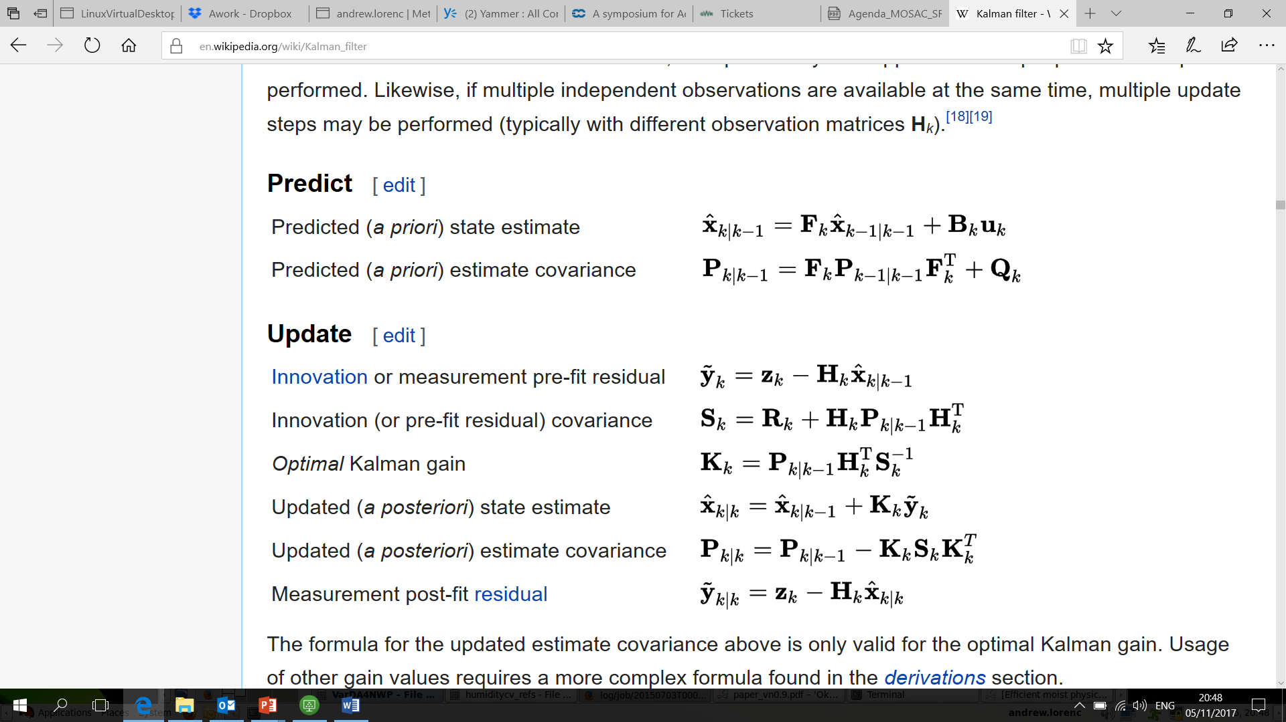
https://en.wikipedia.org/wiki/Kalman_filter

Slide 55
Ensemble Kalman Filter
Based on Kalman filter, which is optimal for linear model.
BIG approximation is that the full error covariance P (~10⁹) is well sampled by ~100 ensemble members:
By applying the same idea to forecast trajectories x^{f} over a time period, 4D covariances P^{f} can be estimated.
≈

Slide 56
Lecture 1 has covered:
Historical Background of DA for NWP
FGGE & how to use satellite data
How to combine imperfect information
Bayes Theorem
How to represent the errors in our prior (forecast)
Background Error Covariance modelling
How to calculate the evolution of errors,
to best use observations distributed in time
Kalman filter, ensembles, “Errors Of The Day”, 4DVar

Slide 57
What have we learnt is important for good DA for NWP?
Use the best affordable model to accumulate information & carry it information forward in time. 2017 global model represents its state using >10⁹ numbers.
It is better to analyse increments to the model, rather than estimating the full state.
Assimilate a large number of observations / day, taking account of their information & errors.
>10⁶/day. It is simplest to allow for errors if we use innovations of observations in original form (e.g. radiances) from model state.
Need an estimate of the error PDF of the current background state.
Our computers cannot handle matrices size 10⁹ × 10⁹ !
Correct synergistic use of observations close in space and time may increase their value.
Full KF equations are correct (for Gaussians), but cannot be done for a problem this big.
With approximate B only observations assimilated in the same batch can be correctly handled.

Slide 58
Other Lectures:
Data Assimilation Methods for NWP
  Nudging
  OI, 3DVar, 4DVar, EnVar, EnKF
  nonlinearities, Particle Filter, Synchonised chaos
The Met Office VAR system
  3DVar, 4DVar, hybrid-4DVar, 4DEnVar
  Comparison - What might come next, in exascale project?
Evaluation and improving use of observations
  OSSE, OSE, FSOI, OmF
  Bias correction: VarBC
  Quality Control: VarQC

Slide 59
Slides on QC copied from lecture 4
The need for QC of observations depends on the use being made of them.
All observations can be plotted for human analysis – an experienced forecaster will allow for errors while drawing up weather chart.
In contrast, “Objective” verification statistics are very sensitive to QC of verifying observations.
Gaussian-based (least-squares) analysis methods have fairly clear requirements to reject observations which do not fit the Gaussian hypothesis.
Non-Gaussian methods can allow directly for error properties, making a separate QC step unnecessary.

Slide 60
Models for Observation Error PDFs
Gaussian + “null” prior.
  Simple. Assumes that erroneous observations do not add to prior knowledge. Used in Lorenc & Hammon (1988) to build an Objective QC method.
  Problems normalising – does not integrate to 1. Gives multiple minima.
Gaussian + wider Gaussian.
  Similar in practice to above. Normalised. Erroneous obs make small change to prior. Gives multiple minima.
Back to back exponentials.
  Implied by use of L1 norm (Tarantola 1987). Finds median – “pull” of all observations is equal. Not differentiable at origin, so difficult to minimise. Robust.
Huber Norm.
  Huber (1973), Guitton and Symes (2003). Used at ECMWF. L2 for small deviations, L1 for large. Finds consensus average - “pull” of observations limited, rather than increasing indefinitely with misfit. Robust.

Slide 61
Gaussian prior combined with observation with gross errors - extreme obs are rejected.
Lorenc (2014)
Gaussian
Js

Slide 62
Penalty functions: J(x) = -ln(p(x))+c p non-Gaussian ⇒ J non-quadratic
Lorenc (2014)
PDFs

Slide 63
Coping with multiply minima – finding best combination of inter-related decisions.
Do a preliminary “pass” [with larger scale] before performing QC.
Start with inflated observational errors, decreasing to correct values during the iteration (Dharssi et al. 1992)
Only switch on variational QC after N (~20) iterations.
Rely mainly on QC v background forecast (which is assumed to have Gaussian errors).
Design iterative “buddy check” algorithm to start with easiest decisions.
Change to robust DA algorithm (e.g. Huber norm).

Slide 64
L1 norm is robust to outliers
Best fit straight lines to data including a gross error: solid line using a quadratic (L2) norm, dotted line using a mean absolute (L1) norm. (Based on Tarantola 1987).

Slide 65
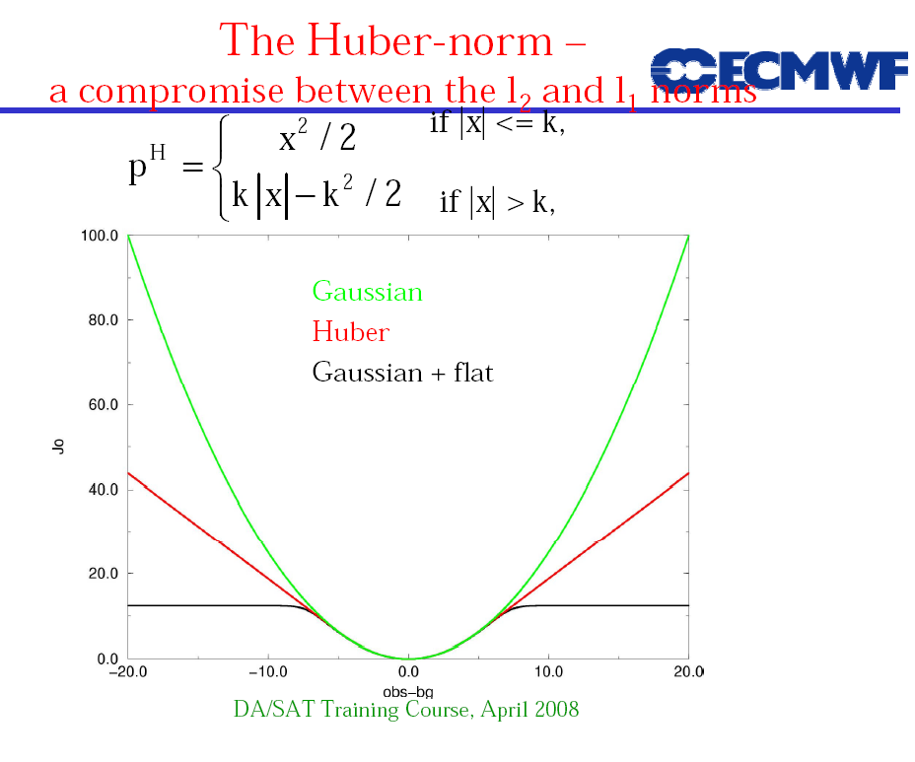
Huber Norm
Tavolato & Isaksen (2015)
Erik Andersson
© Crown copyright Met Office Andrew Lorenc 65

Slide 66
