Slide 1
Data Assimilation for NWP
4. Evaluation and improving use of observations
Andrew Lorenc

Slide 2
Estimating Covariances
R B Q

Slide 3
Focus on the Innovations
δx = K ( yº - H(x^{b}) )
It is important to get the most accurate, unbiased, estimates for innovations d = yº - H(x^{b})
– Bias correction, FGAT, accurate H
If biases are zero, and observations and background are uncorrelated, then <dd^{T}> = R + HBH^{T}
If DA system is optimal, then time correlation is zero <d_{t1}d_{t2}^{T}> = 0
All we can measure is d
– It is impossible from these to estimate unambiguously R or HBH^{T}
– It is similarly impossible to attribute bias <d> unambiguously to observation or forecast
unless we make additional assumptions.

Slide 4
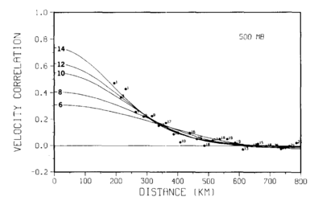
Hollingsworth & Lonnberg method (1986)
Assume stationarity, homogeneity and isotropy.
Assume observational error covariance R between different radiosondes is zero.
Working in a data-dense area, extrapolate off-diagonal <dd^{T}>
to zero separation;
assume this gives HBH^{T}.
Calculate R by subtraction.

Slide 5
Desroziers method (2005)
Presented at 4th WMO DA Symposium in Prague.
Assuming DA is optimal; gives expressions for R, HBH^{T} and HAH^{T}.
Widely used (e.g. Bormann et al. (2003, 2010), Waller et al. (2016a,b,c))
to give estimates of correlated observation errors.
Many related methods;
e.g. papers by Daley (1992), Ménard (2016), Talagrand (2014), Desroziers (2015), Todling (2015a,b), Bowler (2017) …
I will not cover estimation of Q in this talk – see Bowler (2017) and refs therein.

Slide 6
Statistical use of innovations
Innovation
Then
, where
and
are assumed to be un-correlated.
should be approximatively equal to
if
and
are well specified.

Slide 7
Separate check of background errors
Difference between analysis and background in obs. space:
Thus
if

Slide 8
Separate check of observation errors
Difference between analysis and observations:
Thus
if

Slide 9
Diagnostic of estimation error in observation space
Similarly
if
If
is optimal through a correct specification of
and
then
and thus

Slide 10
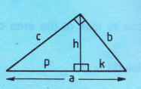
A geometrical interpretation
(Pythagoras)
(Euclid)
(Euclid)
c²=ap
h²=pk
b²=ak
(Euclid)
: statistical expectation
scalar product

Slide 11
Variational Bias Correction
VarBC

Slide 12
Variational Bias Correction at Met Office
Normally referred to as “observational” bias correction,
but in fact it is the innovations d = yº - H(x^{b}) which are corrected!
Previous off-line system was run (when judged necessary) on off-line data collected from OPS o-b innovations.
Replaced by VarBC version-1 designed to replicate [some of] off-line scheme
(DingMin Li: OPS & Predictors, Andrew Lorenc: VarBC code, James Cameron: testing & implementation)
VSDP32: based on Derber and Wu (1998), Auligné et al. (2007), Dee and Uppala(2009).
+ Easier to maintain.
+ Slightly better due to use of o-a biases – fully consistent with VAR usage.
+ Scope to extend to other observation types and predictors.
Gave unexpectedly large positive impact in Mar 2016 – still largely unexplained.

Slide 13
VarBC flow chart
MetDB
Raw observations
β_{i} etc.
VarBC.IN
OPS
yº = yº - ( β₁ + β₂*pred₂ + β₃*pred₃ + … + scan bias )
Bias corrected observations
VarBC.IN
VAR
VarBC.IN
Add increment to VarBC β_{i}

Slide 14

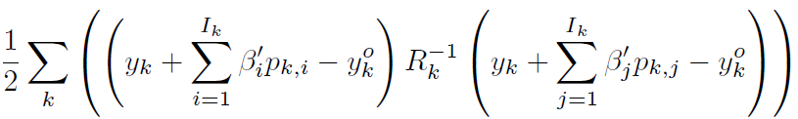

Outline of VarBC
Coefficients are scaled in control vector:
Observation penalty:
Limit how much the coefficients can change with a
background term:
Ipred_const = 1 ! 1 (constant)
Ipred_thick1 = 2 ! 850-300hPa thickness
Ipred_thick2 = 3 ! 200-50hPa thickness
Ipred_Tskin = 4 ! T_skin
Ipred_tcw = 5 ! total column water
Original predictors
Offset & scaled:
mean≈0, variance≈1

Slide 15
Quality Control
Station lists, Bayesian in OPS, VarQC

Slide 16
Simple model for PDF of observations with errors
Assume that a small fraction of the observations are corrupted, and hence worthless. The others have Gaussian errors.
For each observation we have:
G is the event "there is a gross error" and
means not G.

Slide 17
Applying this model
Can simply apply Bayes Theorem to the discrete event G
Lorenc and Hammon 1988:

Slide 18
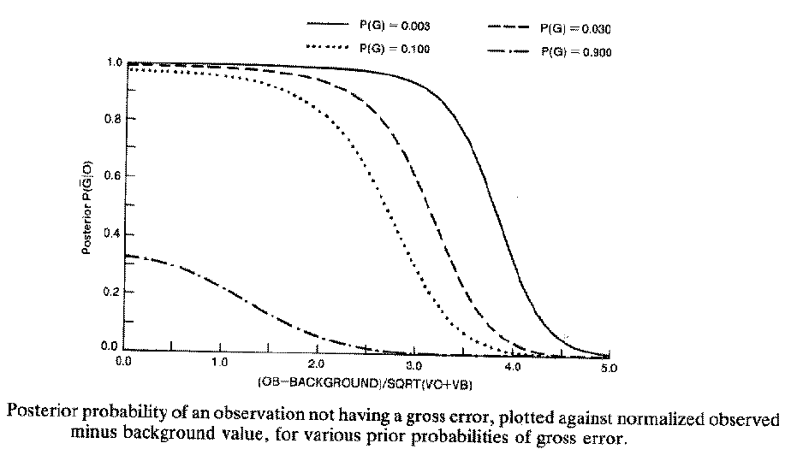
Posterior probability that an observation is “correct”, as a function of its deviation from the background forecast
Lorenc and Hammon, 1988

Slide 19


Met Office Bayesian QC
Prior experience sets P(G).
Background check (just described) modifies P(G).
Allows for independent gross error affecting whole report as well as in each reported element:
Sequential comparison of “buddies” modifies P(G):
Finally, reject if P(G)>0.5
Lorenc & Hammon, 1988

Slide 20
Bayes theorem in continuous form, to estimate a value x given an observation yº
p(x⏐yº) is the posterior distribution,
p(x) is the prior distribution,
p(yº⏐x) is the likelihood function for x
Can get p(yº) by integrating over all x:

Slide 21
Combination of Gaussian prior & observation
- Gaussian posterior,
- weights independent of values.
Lorenc (2014)
Js

Slide 22
Gaussian prior combined with observation with gross errors - extreme obs are rejected.
Lorenc (2014)
Js

Slide 23
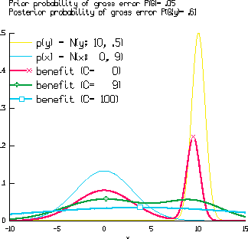
What answer do we want?
If we can afford to represent it (eg by an ensemble) then the full posterior PDF carries all the information.
Normally we can only cope with a single “best” estimate.
Can only find best w.r.t. a “loss function” specifying how much we lose for a wrong estimate.
Lorenc (2002) suggested using a Gaussian-shaped function:
  a very narrow “delta-function” finds the mode X, ;
  a very broad (quadratic) function finds the mean ◻;
  can argue for a width similar to the background PDF’s; this finds the mean of the largest peak +.
Lorenc, A. C., 2002: Atmospheric Data Assimilation and Quality Control. Ocean Forecasting, eds Pinardi & Woods. ISBN 3-540-67964-2. 73-96
Notes:
Expected benefit as a function of analysed value. Curves are plotted for three different benefit functions, with widths C=0 C=9 (maximum at +), C=100 (max at ◻).
Shown for reference are the background pdf (with x^{b}=0, B=9), and the observational pdf (with yº=10, R=0.5).

Slide 24
Variational Penalty Functions
Finding the most probable posterior value involves maximising a product [of Gaussians]
By taking –ln of the posterior PDF, we can instead minimise a sum [of quadratics]
This is often called the “Penalty Function” J
Additive constants can be ignored.
Only implemented in Met Office system for scatterometer (Candy 2001).

Slide 25
Penalty functions: J(x) = -ln(p(x))+c p Gaussian ⇒ J quadratic
Lorenc (2014)
PDFs

Slide 26
Penalty functions: J(x) = -ln(p(x))+c p non-Gaussian ⇒ J non-quadratic
Lorenc (2014)
PDFs

Slide 27
Non-Gaussian DA.
The need for QC of observations depends on the use being made of them.
All observations can be plotted for human analysis – an experienced forecaster will allow for errors while drawing up weather chart.
In contrast, “Objective” verification statistics are very sensitive to QC of verifying observations.
Gaussian-based (least-squares) analysis methods have fairly clear requirements to reject observations which do not fit the Gaussian hypothesis.
Non-Gaussian methods can allow directly for error properties, making a separate QC step unnecessary.

Slide 28
L1 norm is robust to outliers
Best fit straight lines to data including a gross error: solid line using a quadratic (L2) norm, dotted line using a mean absolute (L1) norm. (Based on Tarantola 1987).

Slide 29
Coping with multiply minima – finding best combination of inter-related decisions.
Do a preliminary “pass” [with larger scale] before performing QC.
Start with inflated observational errors, decreasing to correct values during the iteration (Dharssi et al. 1992)
Only switch on variational QC after N (~20) iterations.
Rely mainly on QC v background forecast (which is assumed to have Gaussian errors).
Design iterative “buddy check” algorithm to start with easiest decisions.
Change to robust DA algorithm (e.g. Huber norm).

Slide 30
Models for Observation Error PDFs
Gaussian + “null” prior.
  Simple. Assumes that erroneous observations do not add to prior knowledge. Used in most of my QC work. Problems normalising – does not integrate to 1. Gives multiple minima.
Gaussian + wider Gaussian.
  Similar in practice to above. Normalised. Erroneous obs make small change to prior. Gives multiple minima.
Back to back exponentials.
  Implied by use of L1 norm (Tarantola 1987). Finds median – “pull” of all observations is equal. Not differentiable at origin, so difficult to minimise. Robust.
Huber Norm.
  Huber (1973), Guitton and Symes (2003). Used at ECMWF. L2 for small deviations, L1 for large. Finds consensus average - “pull” of observations limited, rather than increasing indefinitely with misfit. Robust.

Slide 31
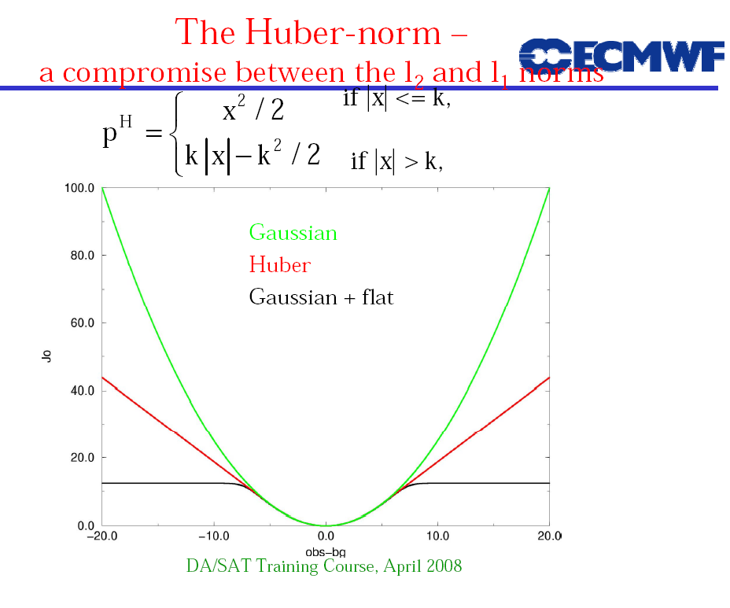
Huber Norm
Tavolato & Isaksen (2015)
Erik Andersson
© Crown copyright Met Office Andrew Lorenc 31

Slide 32
Minimum of single observation penalty function for various observation norms
© Crown copyright Met Office Andrew Lorenc 32

Slide 33
Assessing the Value of Observations

Slide 34
Forecast Sensitivity to Observations
(sensitivity of forecast error to forecast)
(sensitivity of analysis to observations)
(sensitivity of forecast to analysis)
Forecast error difference
Observations
Analysis
Forecast
Data Assimilation
(K)
Error measure
(e)
Model
(M)
Baker and Daley (2000)

Slide 35
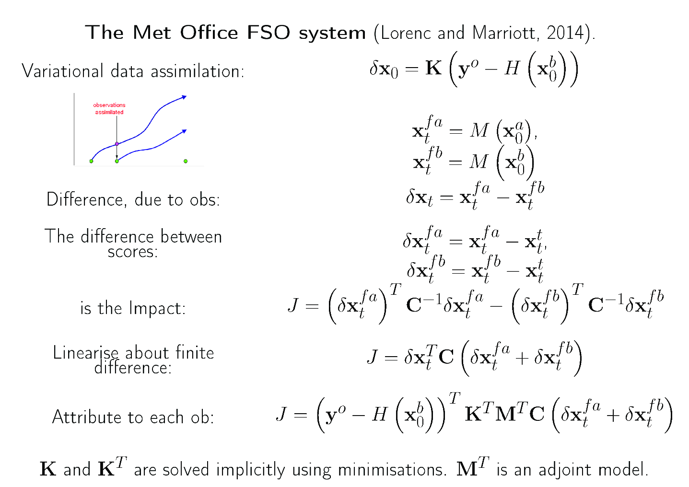
FSOI: Forecast Sensitivity to Observation Impacts

Slide 36
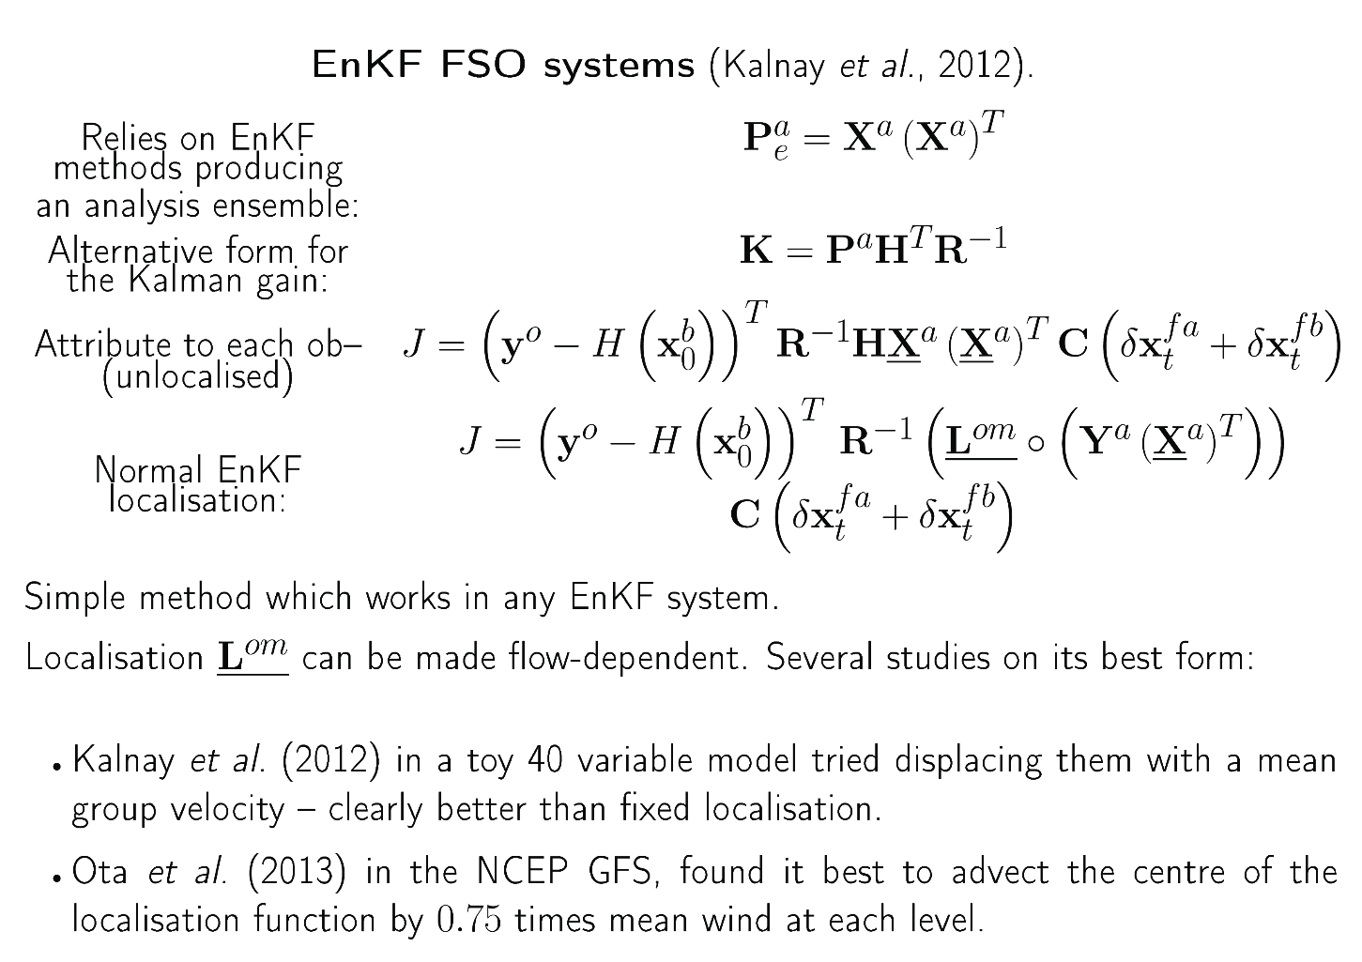
EFSOI: FSOI using an EnKF

Slide 37
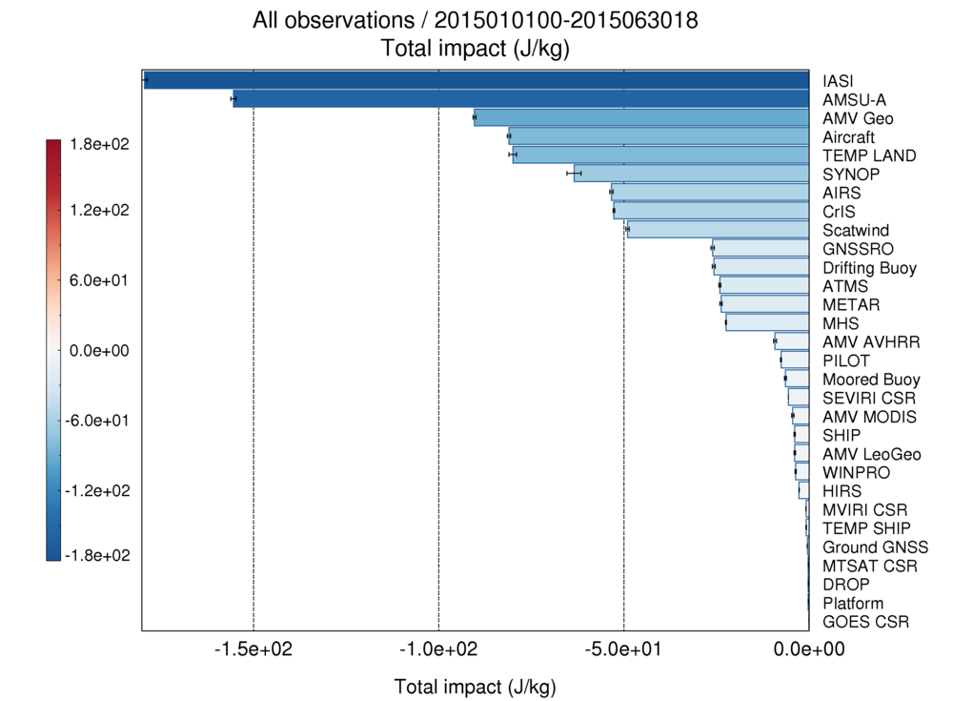
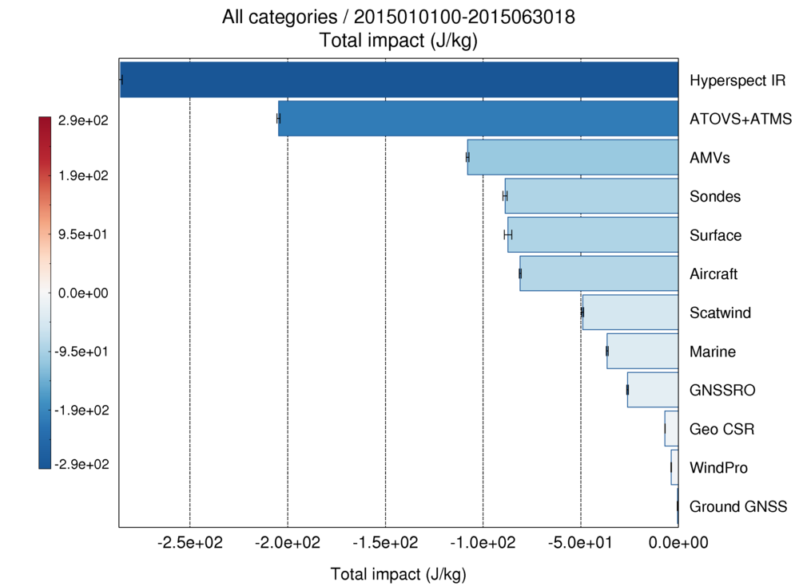
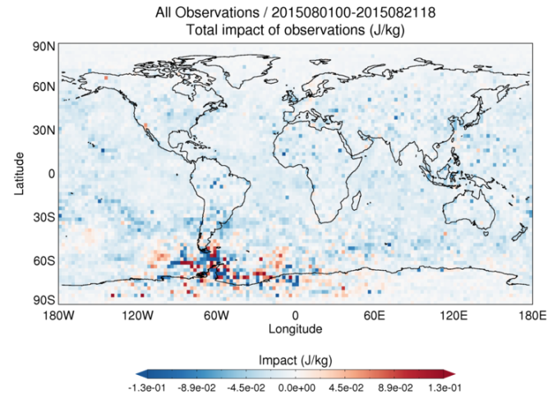
The Importance of satellite data
Latest FSOI results showing impact of observations for 24hr forecasts in global model
Notes:
This is the most recent set of FSO for 24 hr forecasts for Global results for 6 months

Slide 38
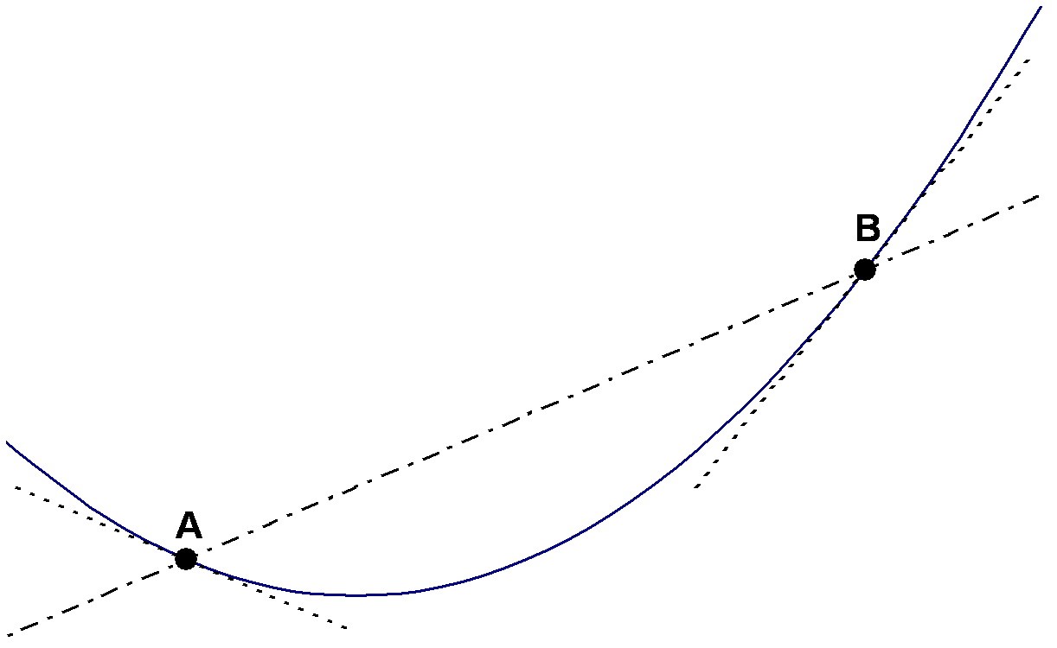
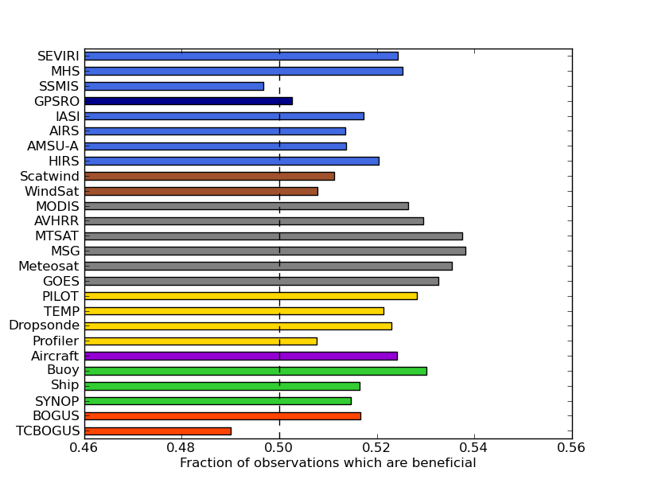
Understanding FSOI
It uses a linear equation for a nonlinear quantity
There is lots of sampling noise:
      x^{b} is a random draw from B
      some analysis errors grow, some decay
      εº is a random draw from R
      verifying analysis is imperfect
Some misleading attribution of impact
to observations used together:
      accurate observations
      used in extrapolation
      radiances with overlapping
      weighting functions and correlated R

Slide 39
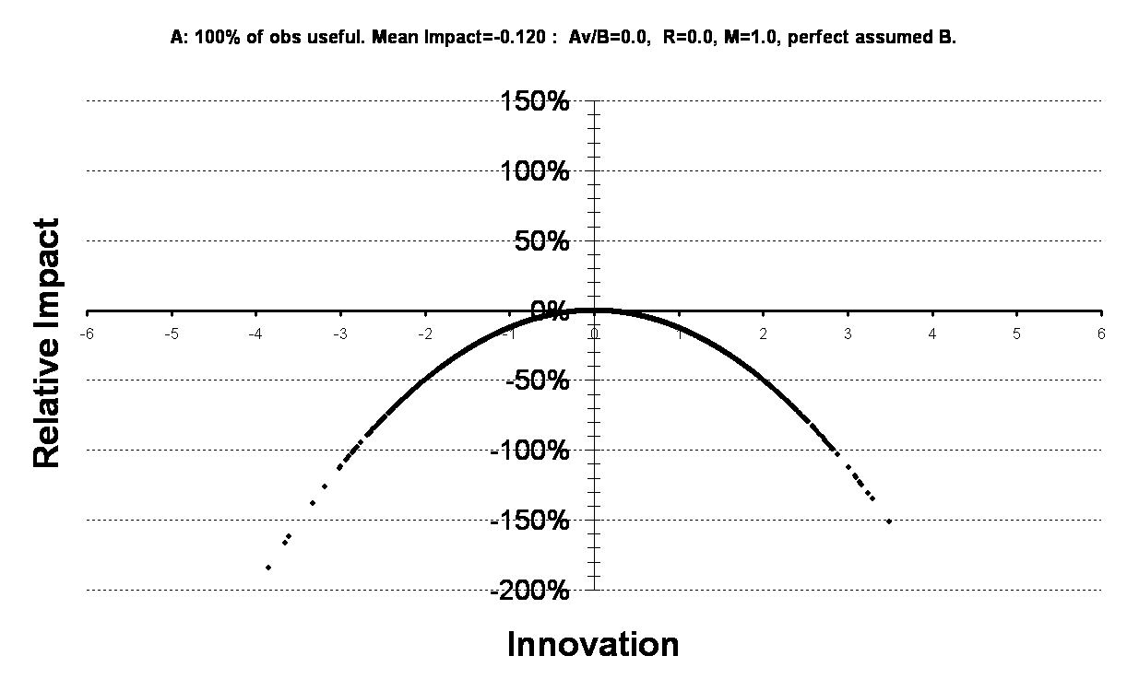
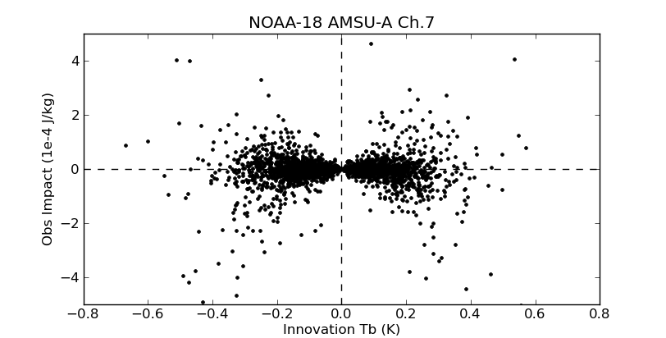
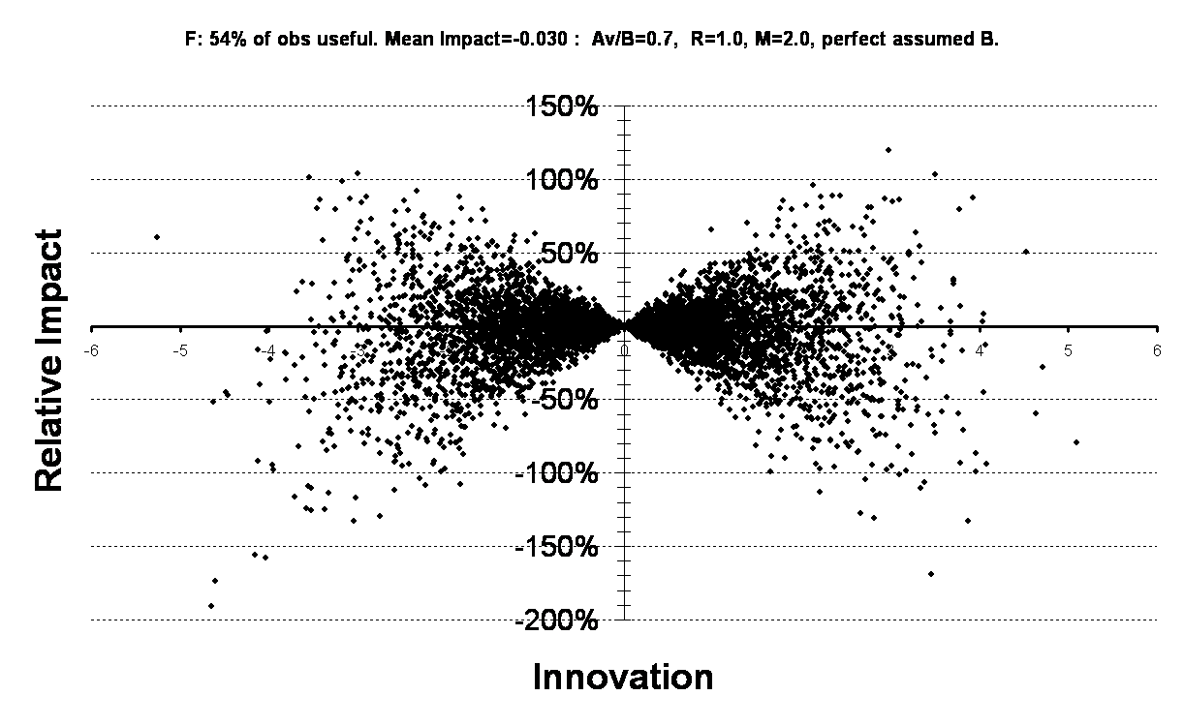
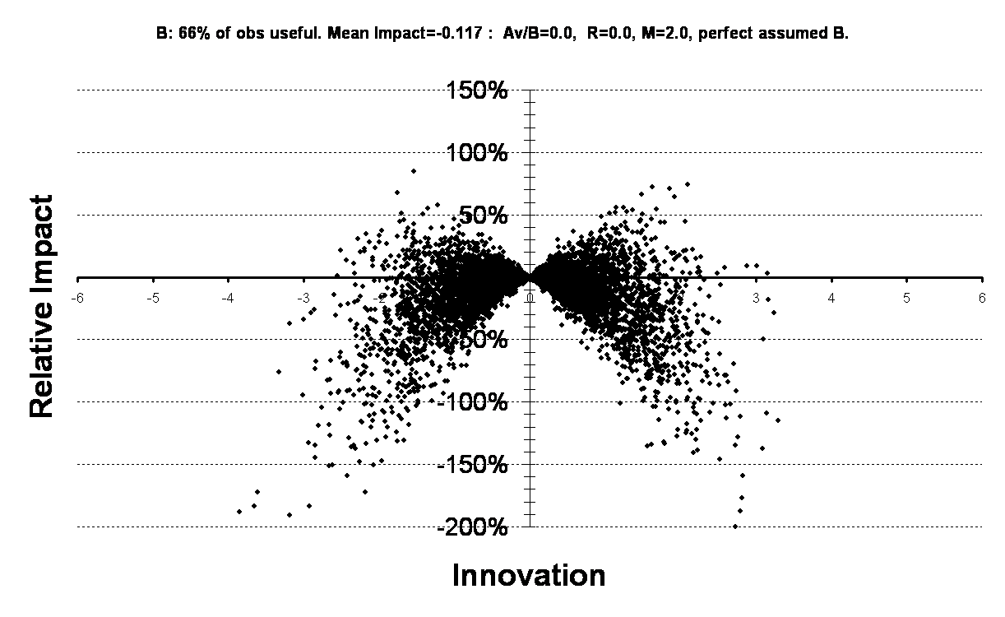
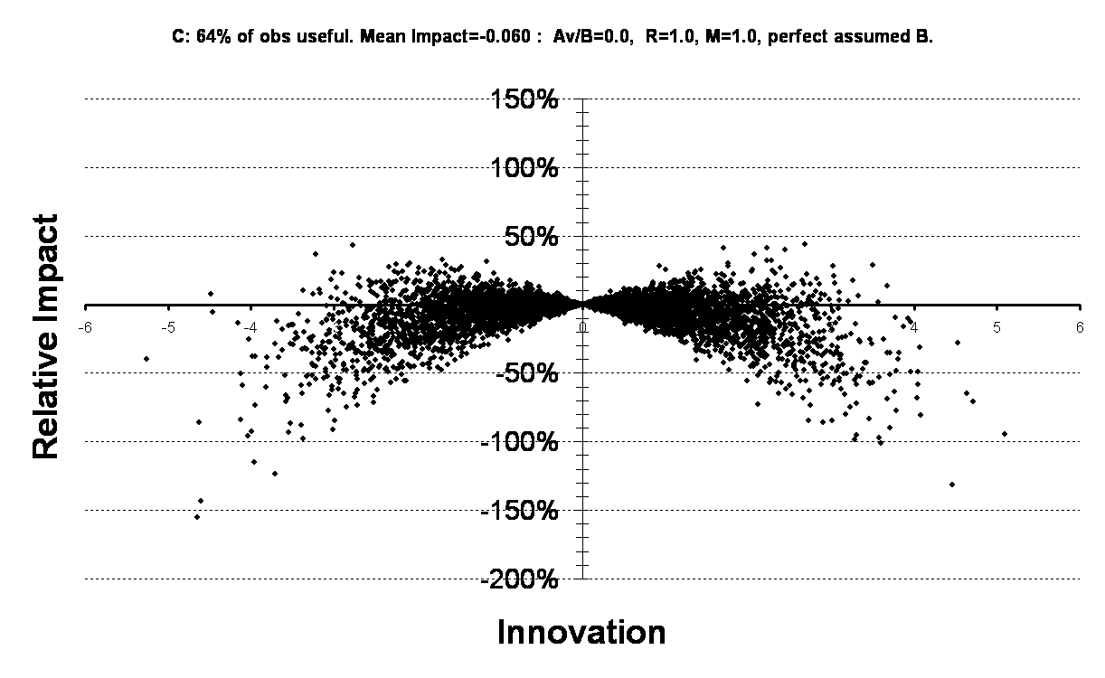
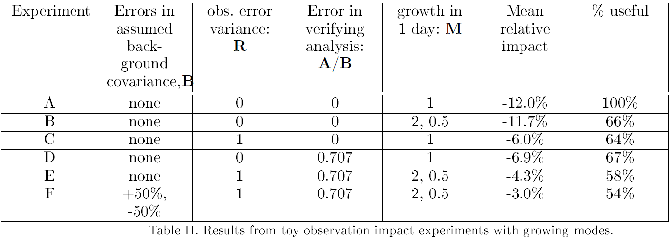
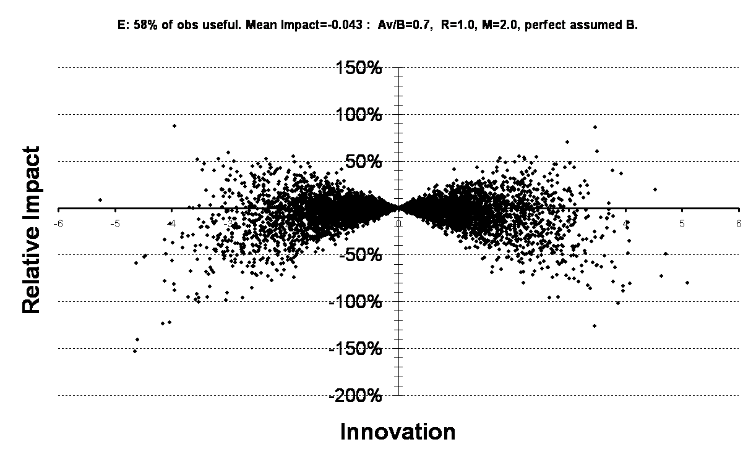
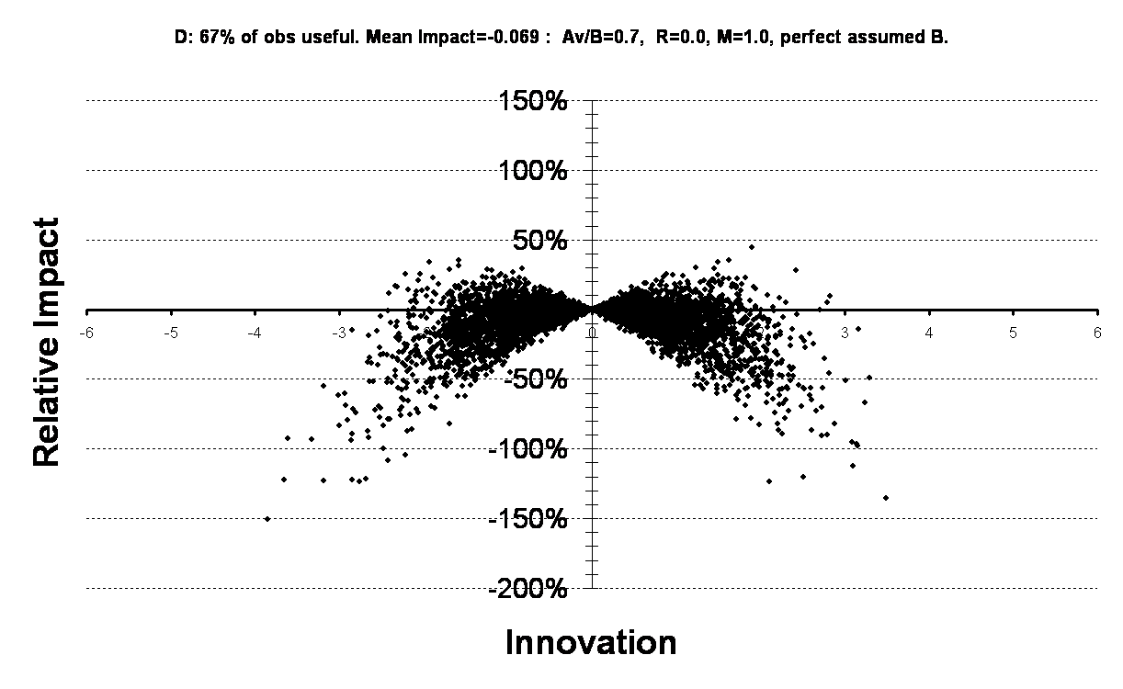
Sampling noise in FSOI
A: none
F: E + imperfect covariances
B: some analysis errors grow
C: observation errors
E: A + B + C + D
D: analysis errors
Lorenc &
Marriott 2014

Slide 40
Retrospective attribution of important forecasts difference
Care is needed – apparent results may be due to the various “sampling” errors
Hollingsworth, Lorenc, Tracton, Arpe, Cats, Uppala & Kallberg 1985
"The response of Numerical Weather Prediction Systems to FGGE IIb Data, Part I : Analyses"
Lorenc, Bell, Davies and Shutts 1988:
"Numerical forecast studies of the October 1987 storm over southern England".
Semple, Thurlow and Milton, 2012:
Experimental Determination of Forecast Sensitivity and the Degradation of Forecasts through the Assimilation of Good Quality Data.
Hotta, Chen, Kalnay, Ota, and Miyoshi 2017:
Proactive QC: a fully flow-dependent quality control scheme based on EFSO.

Slide 41
Other methods for assessing observation impact
OSE: Observing System Experiments. “What is the impact of omitted/adding OS
on current NWP system?” Measures impact of one OS on many scores.
Expensive in computing. Usual by-product of trials of a new OS.
OSSE: Observing System Simulation Experiments. Often used to answer
“What would the impact be of a new OS on NWP skill in ~20 years time?”
Expensive in labour and computing. Needs expert interpretation/validation.
DA Ensemble Spread (Tan et al. 2007): Uses real observations + simulated new system.
Assesses impact via the reduction in analysis ensemble spread.
OmF statistics (Todling 2013): Avoids problems of FSOI, but only estimates potential impact, rather than actual impact. Compares innovation variances
for different forecast lengths, and assumes that
“Decrease in OmF=<d²> for an OS, due to a better Forecast”
⇒ “Assimilating this OS would give a better Forecast”.

Slide 42
Targeted of Observations

Slide 43
Adaptive observations – “Targeting” in FASTEX.
The Fronts and Atlantic Storm-Track Experiment (FASTEX) addressed the life cycle of cyclones evolving over the North Atlantic Ocean in January and February 1997. (Joly et al. 1997)
FASTEX was adopted as the first substantial field test of various methods for observation targeting:
  Ensemble Transform.
  Singular vectors.
  Sensitivity gradient.
  Quasi-inverse.
  Subjective.
~1/3 publications from FASTEX were about targeting.
The success of targeting in FASTEX led directly to the instigation of THORPEX.
Notes:
THORpex Workshop 26 April 2000 in Nice, France ... to discuss the opportunity for international collaborations on hemispheric predictability and observing system design. We view this as a continuation of FASTEX type research. The program is currently referred to as The Hemispheric Observing-system Research and Predictability Experiment (THORpex).

Slide 44
Some other targeting experiments
North Pacific Experiment (NORPEX) 1997.
Winter Storms Reconnaissance Program. 1999-2011(?).
  Operational ETKF-targeted dropsondes over the Pacific.
  Improved 70-90% of cases; 10-20% average RMS error reduction.
Atlantic-THORPEX Regional Campaign (ATReC). 2003.
  EUCOS targeting of operational AMDAR, ASAP, sondes & AMVs as well as dropsondes. Few big impacts. Typically 24% cases better, 10% worse.
ECMWF OSE studies of the value of observations. 2007.
  Removal of ALL observations in targeted & random regions over Atlantic & Pacific for 2 seasons. Targeted ~2 times better than random.
EURORISK PREVIEW 2008.
T-PARC.

Slide 45
My Conclusions on Targeting
Targeting is possible and successful – mid-latitude targeted observations are 2~3 times as effective as random observations.
Improvements to DA methods should improve the assimilation of all observations in sensitive regions, including targeted obs, but the statistical basis still means that only just over 50% will have a positive impact.
Improvements to targeting methods are possible (e.g. longer leads for large areas) but the statistical basis means that impacts on scores will vary.
Thanks to the general improvement of operational NWP, the average impact of individual observing systems is decreasing.
Targeting alone is unlikely to significantly accelerate improvements in the accuracy of 1 to 14-day weather forecasts compared to other improvements over the THORPEX period in NWP and satellites.

Slide 46
Observing System Experiments

Slide 47
OSEs
Measure the impact of observations on existing NWP systems, by comparing a wide range of scores with & without them.
To get a statistically significant signal, have to do it on whole observing systems over many cases.
Best done with operational NWP system.
  Data denial: Control has all observations, Experiment removes those to be tested. Necessary as test that operational system is behaving as expected.
  Data addition: Control does not use observations; Experiment adds those to be tested. Necessary before operational use of new observation type.

Slide 48
OSE designs
Run parallel data assimilation cycles for a month or more,
with regular forecasts.
          Cleanest measure of impact on operational NWP.
          Noisy signal (since independent DA cycles will differ) so long runs necessary. Interesting cases may be few in any month.
Run alternative data assimilation and forecast for specific cases,
without cycling.
          Does not measure the cumulative benefit of an observing system.
          Less noise.
          Can select interesting cases, to get result with less effort.
          But less relevant to average performance.

Slide 49
Global data denial experiments: the scenarios
All data
All data – all satellite
All data – all radiosonde
All data – all aircraft
All data – all surface
All data – all conventional (satellite only)
All data – European wind profilers
Dumelow (2009)

Slide 50
Global denial experiments: the runs
Met Office operational system as at December 2001 and October 2007.
One month summer period: 1/7/01 -> 1/8/01
24/5/07 -> 24/6/07.
Forecasts from 12UTC out to 6 days.
Verification of standard fields against observations and ‘All data’ analysis.

Slide 51
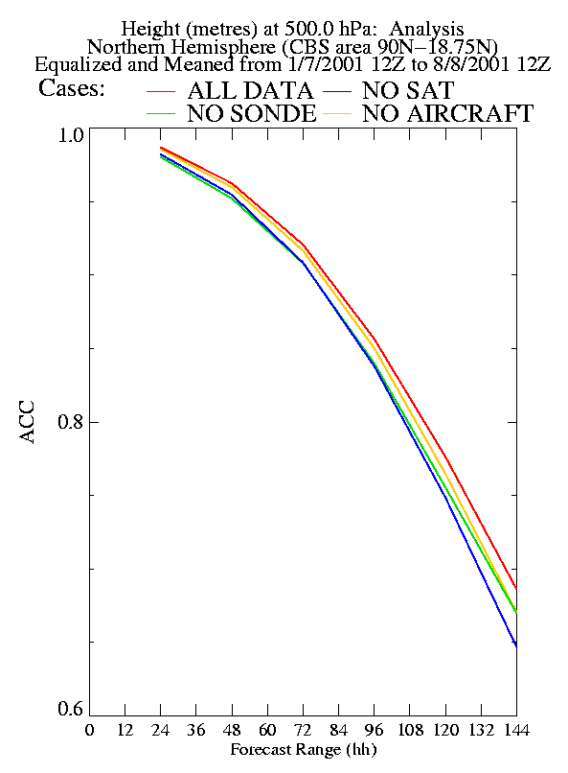
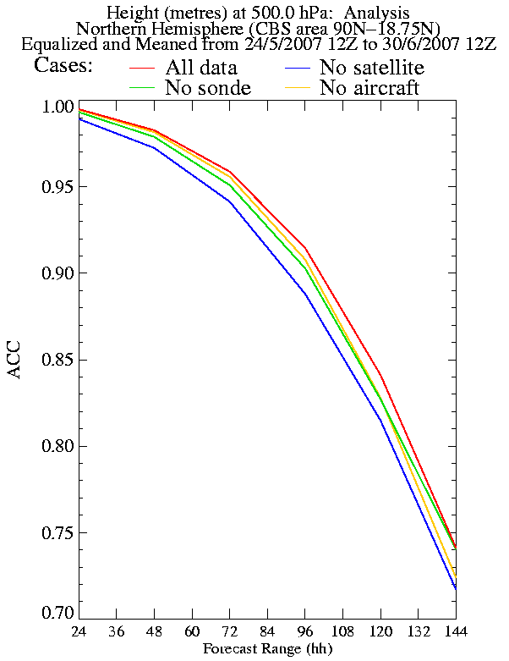
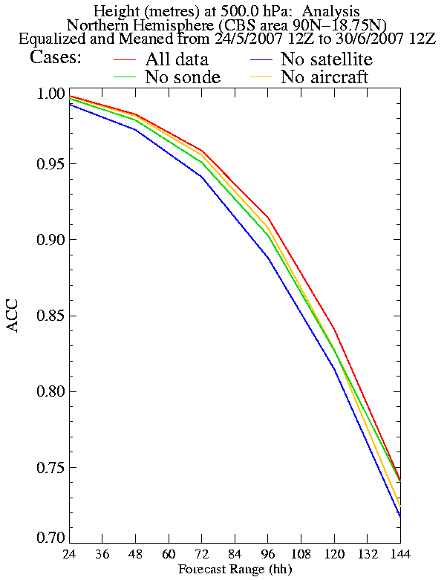
Change in OSE results 2001-2007.
N-hem 500hPa height ACC.
Not the same period,
so only make qualitative comparisons!
Notes:
Attached are 2 figures showing the impact on 500 hPa ACC height over the northern hemisphere of the main observing systems. The periods over which the statistics have been averaged is about the same at just over a month and both are 'summer' periods. Using these plots then it can clearly be seen the worse run (with 4D-Var) from last year (No sat) is better than the best run from 5 years ago (using 3D-Var). In the recent 'No sat' run I removed a lot of data, namely:
(a) radiance from three NOAA polar orbiting satellites: from the AMSU-A and AMSU-B instruments on NOAA-16; AMSU-B instrument on NOAA-17; AMSU-A, and MHS instruments on NOAA-1
(b) radiance from the AIRS, AMSU-A & HSB instruments on the Aqua polar orbiting satellite
(c) radiance from the AMSU-A1, AMSU-A2, HIRS/4 instruments on MetOp-A polar orbiting satellite (d) radiance from the SSMIS instrument on the DMSP-F16 polar orbiting satellite
(e) atmospheric motion vectors (AMVs) from instruments on geostationary satellites Meteosat 7,9; GOES 11,12; and MTSAT-1
(f) polar winds from polar orbiting satellites: the MODIS instrument on the Aqua and Terra satellites; the AVHRR instrument on the NOAA 15, 16,17, 18 satellite
(g) surface wind speed over the sea from the SSM/I instrument on theDMSP-F13 and DMSP-F15 polar orbiting satellite
(h) surface vector wind over the sea from the scatterometer instruments on the QuikSCAT and ERS-2 polar orbiting satellite
(i) refractivity from the GPS on the COSMIC 2, 3, 5 & 6 low earth orbiting satellite
So the result shows that good data assimilation can partly overcome data loss and targeting in the northern hemisphere is unlikely to affect mean scores. However, my latest runs also showed that all of the main observing systems are having a statistically significant positive impact on forecasts, so losing data would hurt us. Richard

Slide 52
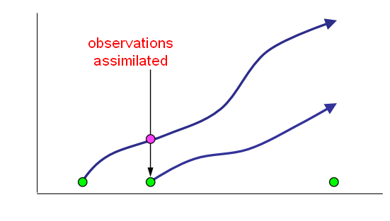
Objective case selection
Decide on important features, and criteria for a significant difference in forecast quality.
Monitor an operational NWP system for successive forecasts with important differences meeting these criteria.
These differences are probably due to the last batch of observations, used by the later forecast but not by the earlier.
Perform a series of OSE to find which of these observations had the impact.

Slide 53
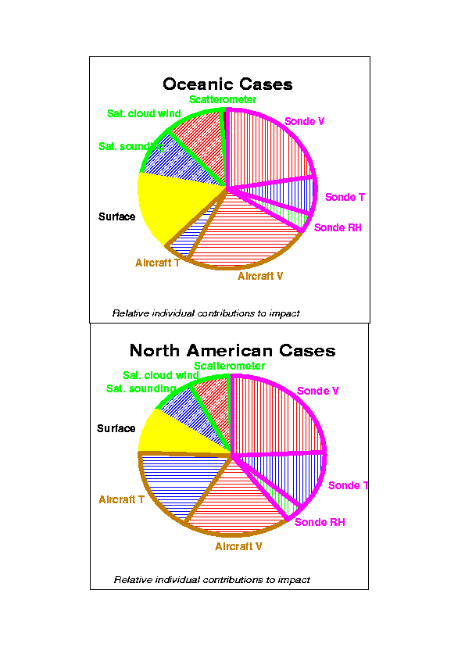
Graham Anderson and Bader (2000)
The relative utility of current observation systems to global-scale NWP forecasts

Slide 54
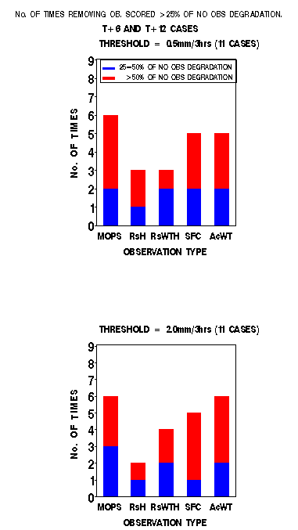
S Anderson (2000, 2002)
The Impact of Observations on Mesoscale Model Forecasts of 3-hourly Rainfall Accumulations
Each observation type is shown to provide benefit in 3 or more cases
MOPS, Surface and Aircraft data in particular show strong benefits
The benefit of aircraft data is far greater than in the mid-90's (probably due to the increase in AMDAR reports)
Sonde data show a more supporting role
No significant impacts were found from model boundary data up to T+12.

Slide 55
Observing System Simulation Experiments
OSSEs

Slide 56
OSSEs
Allow us to estimate the impact of observing systems which do not yet exist.
Simple idealised experiments. What might be the impact of next generation satellite data on next generation NWP systems?
Full calibrated OSSEs. What is the impact of next generation satellite data on current NWP systems?

Slide 57
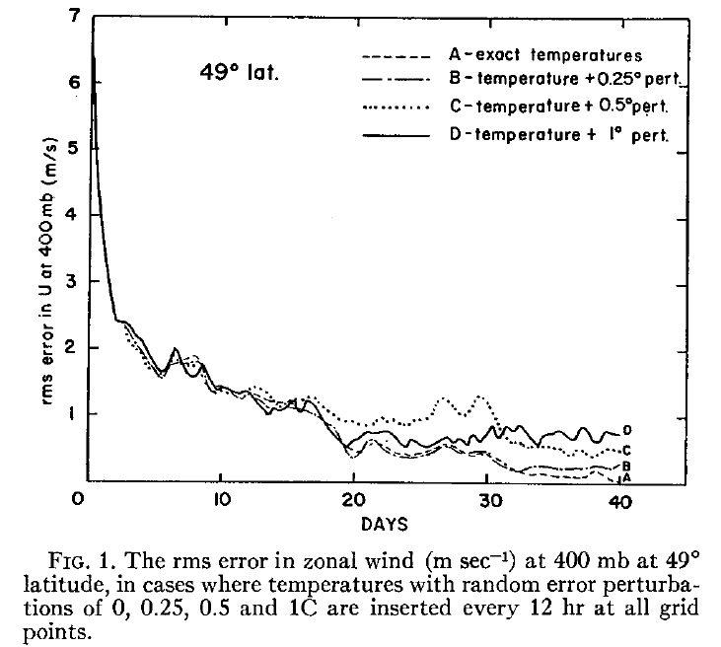
J. Charney, M. Halem, and R. Jastrow (1969)
J. Atmos. Sci. 26, 1160-1163.
Use of incomplete historical data to infer the present state of the atmosphere
OSSE using
Mintz-Arakawa model :
9° ^{x} 7° ^{x} 2 levels.
Satellite sounders could become a major part of the global OS.
Direct insertion of satellite temperature retrievals is a viable DA method.

Slide 58
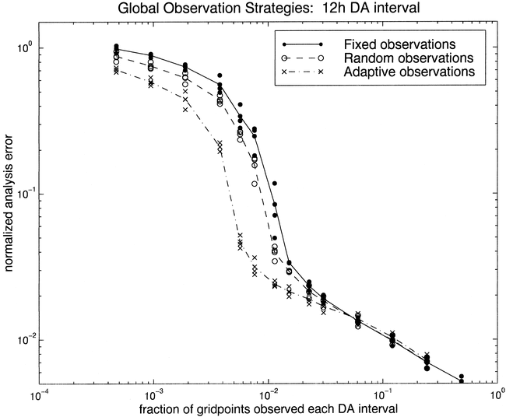
Morss and Emanuel (2001)
Idealized Adaptive Observation Strategies for Improving Numerical Weather Prediction
QG channel model: 250^{x}250km ^{x} 5levels
Targeted observations are twice as effective as random ones.

Slide 59
International Collaborative Joint OSSE
- Toward reliable and timely assessment of future observing systems -
http://www.emc.ncep.noaa.gov/research/JointOSSEs
Participating Institutes
National Centers for Environmental Prediction (NCEP)
NASA/Goddard Space Flight Center (GSFC)
NOAA/ NESDIS/STAR,
ECMWF,
Joint Center for Satellite and Data Assimilation (JCSDA)
NOAA/Earth System Research Laboratory (ESRL)
Simpson Weather Associates(SWA),
Royal Dutch Meteorological Institute (KNMI)
Mississippi State University/GRI (MSU)
University of Utah
Other institutes expressing interest
Northrop Grumman Space Technology, NCAR,
NOAA/OAR/AOML, Environment of Canada,
National Space Organization (NSPO,Taiwan),
Central Weather Bureau(Taiwan),
JMA(Japan), University of Tokyo, JAMSTEC,
Norsk Institutt for Luftforskning (NILU,Norway), CMA(China), and more

Slide 60
Planned OSSEs (as of Sep. 2009)
Future GPSRO constellation configuration and impact
Lidia Cucurull (JCSDA,NOAA/NESDIS), NCAR, CWB, NPSO
GOES-R preparation experiments (NOAA/NESDIS)
Tong Zhu,, Fuzhong Weng, T.J. Kleespies, Yong Han, Q. Liu, Sid Boukabara (NOAA/NESDIS),
Jack Woollen, Michiko Masutani (NOAA/EMC),
L. P Riishojgaard (JCSDA)),
Wind Lidar (GWOS) impact and configuration experiments for NASA
M.Masutani(NCEP), L. P Riishojgaard (JCSDA)
Simulation of DWL planned from NASA and selected DWL from ESA
G. David Emmitt, Steve Greco, Sid A. Wood,(SWA)
Simulation of ADM-Aeolus and follow up mission
G.J. Marseille and Ad Stoffelen (KNMI)
Evaluation of Unmanned Aircraft System
Yuanfu Xie, Nikki Prive, Tom Schlatter, Steve Koch (NOAA/ESRL)
Michiko Matsutani, Jack Woollen (NOAA/EMC)
NPP (CrIS and ATMS) regional impact studies (NASA)
C. M. Hill, P. J. Fitzpatrick, X. Fan, V. Anantharaj, and Y. Li (MSU)

Slide 61
Need for OSSEs
Benefit of OSSEs
OSSEs help in understanding and formulating observational errors
DAS (Data Assimilation System) will be prepared for the new data
Enable data formatting and handling in advance of “live” instrument
OSSE results also showed that theoretical explanations will not be satisfactory when designing future observing systems.
♦Quantitatively–based decisions on the design and implementation of future observing systems
♦ Evaluate possible future instruments without the costs of developing, maintaining & using observing systems.
Simulating observational data requires a significant amount of work. However, if we cannot simulate observations, how could we assimilate observations? (Jack Woollen)

Slide 62
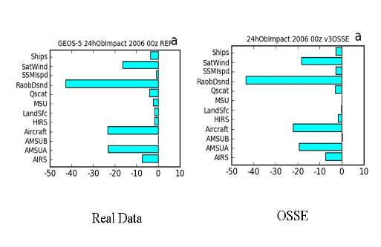
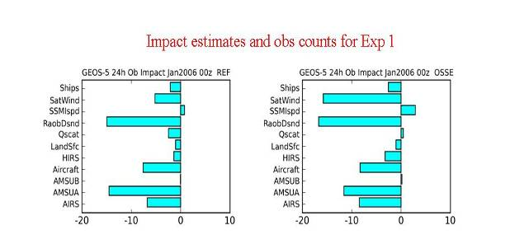
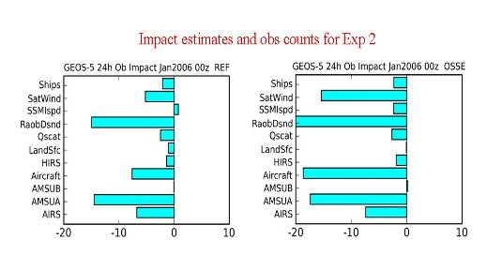
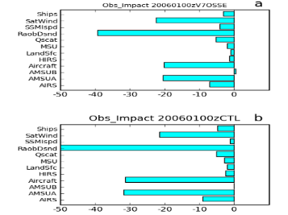
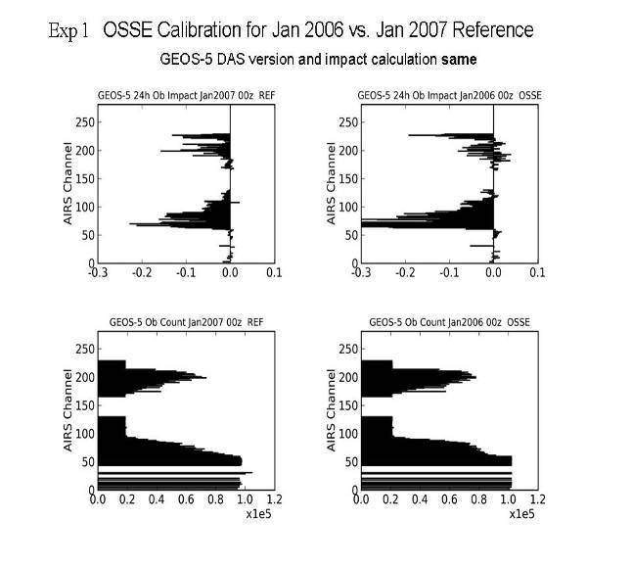
Calibration for Joint OSSEs at NASA/GMAO
Version 4
Version 1
REAL OSSE
REAL OSSE
Real
Version 2
Most recent
REAL OSSE
OSSE
Calibration using adjoint technique
This figure shows the mean change in E-norm of the 24-hour forecast error due to assimilating the indicated observation types at 00 UTC for OSSE (top) and real assimilation, or CTL (bottom) for the period of January 2006.
Version 1
Overall impact of simulated data seems realistic
Tuning parameter for cloud clearing
(courtesy of Ron Errico and R. Yang)

Slide 63
International Collaboration
Running OSEs is expensive. Not all are published.
Results may be dependent on NWP system used.
Many judgements have to be made, and advice given, without being able to run specific experiments.
  WMO has sponsored a series of Workshops on the Impact of Various Observing System on NWP:
      Geneva, Switzerland (1997)
      Toulouse, France (2000)
      Alpbach, Austria (2004)
      Geneva, Switzerland (2008)
      Sedona, Arizona, USA (2012)
      Shanghai, China (2016)
  The purpose is to
      Review latest OSE, ADJ, OSSE results
      Inform the evolution of the Global Observing System (WMO)
      Provide guidance for satellite agencies and other providers
  Each workshop outcome is documented in a comprehensive WMO report

Slide 64
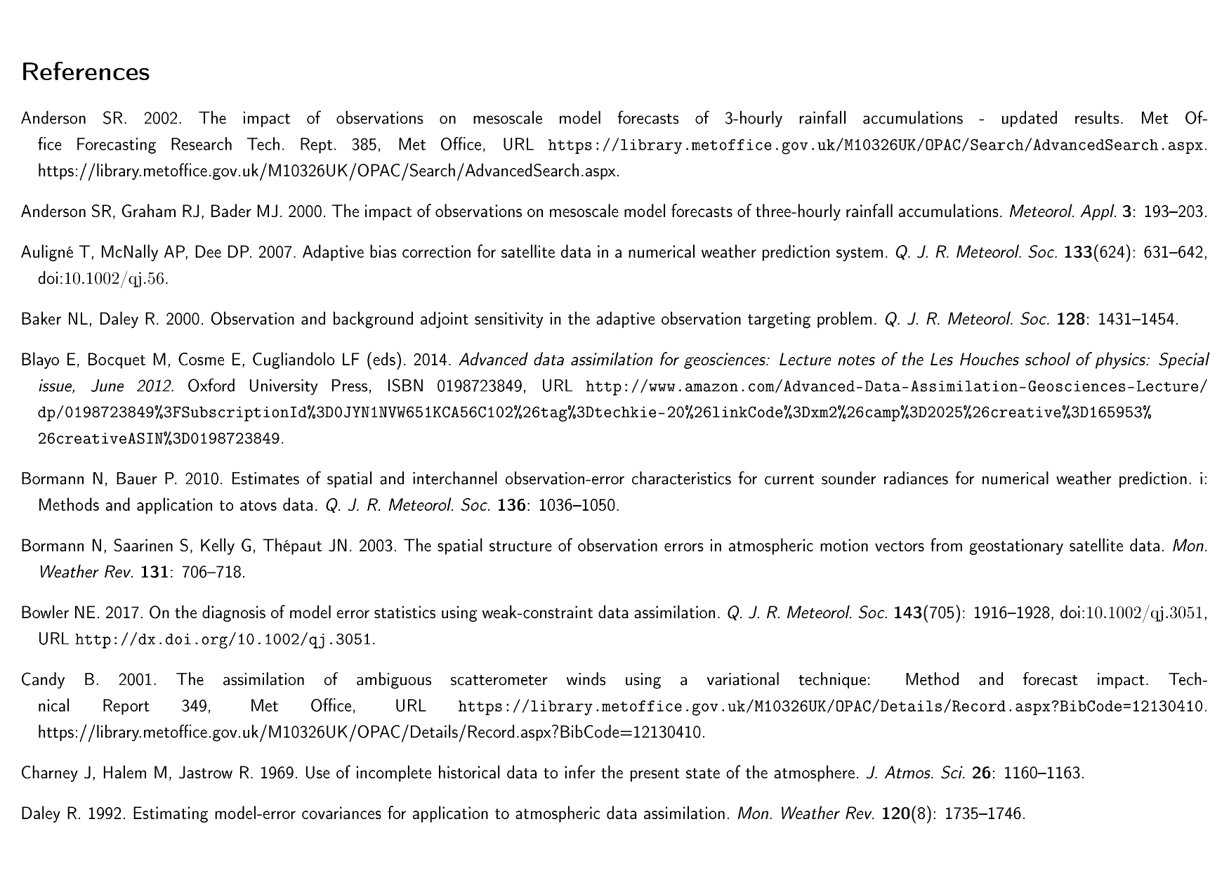

Slide 65
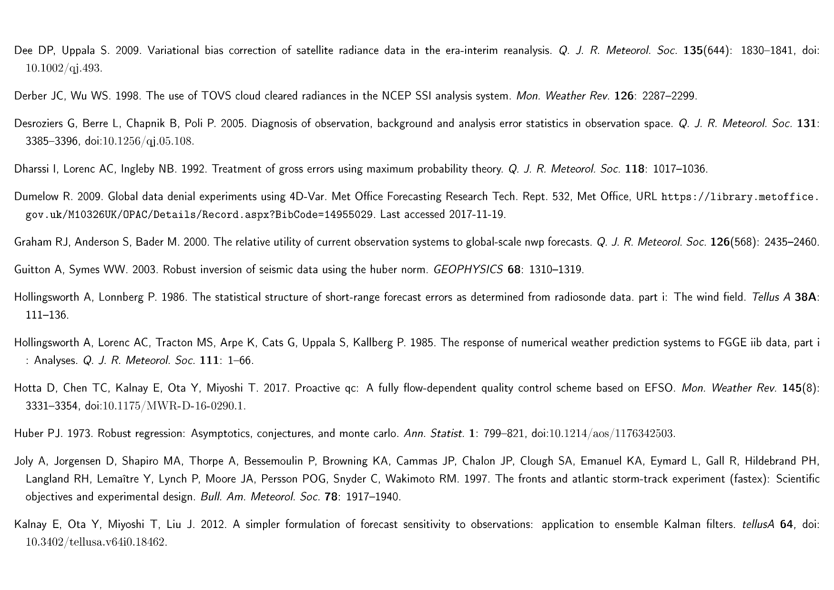

Slide 66
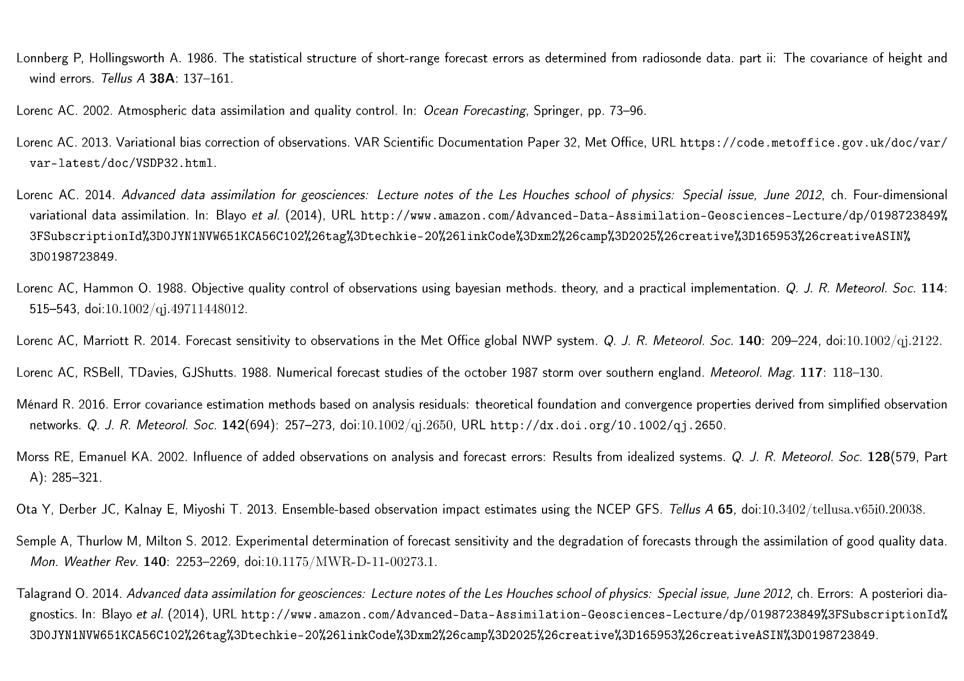

Slide 67
