Slide 1
Data Assimilation for NWP 2. Methods
Andrew Lorenc
AW11 Aveiro 2018

Slide 2
What have we learnt is important for good DA for NWP?
Use the best affordable model to accumulate information & carry it information forward in time. 2017 global model represents its state using >10⁹ numbers. It is better to analyse increments to the model, rather than estimating the full state.
Assimilate a large number of observations / day, taking account of their information & errors. >10⁶/day. It is simplest to allow for errors if we use innovations of observations in original form (e.g. radiances) from model state.
Need an estimate of the error PDF of the current background state. Our computers cannot handle matrices size 10⁹ × 10⁹ !
Correct synergistic use of observations close in space and time may increase their value. Full KF equations are correct (for Gaussians), but cannot be done for a problem this big. With approximate B only observations assimilated in the same batch can be correctly handled.

Slide 3
Overview of Methods
Direct insertion, Nudging, Analysis Correction Scheme, etc.
Kalman update based schemes (optimal if errors are Gaussian):
OI, 3DVar, 4DVar, EnKF, localisation, EnVar
Allowing for non-Gaussianity
Var: outer-loop, nonlinear H in inner loop, principle of symmetry
Global convective scale DA
Particle Filter - curse of dimensionality
Synchronised chaos

Slide 4
Gaussian Probability Distribution Functions Methods based on the Kalman Filter
Easier to fit Gaussian to sampled errors.
Quadratic optimisation problems, with linear solution methods – much more efficient.
The Kalman filter is optimal for linear models, but
it is not affordable for expensive models (despite the “easy” quadratic problem)
it is not optimal for nonlinear models.
Advanced methods based on the Kalman filter can be made affordable:
Ensemble Kalman filter (EnKF, ETKF, ...)
Four-dimensional variational assimilation (4DVar)
They allow some nonlinearity, but this loses strict optimality.
The Particle Filter is an optimal Bayesian method which allows for non‑Gaussian errors, but the curse of dimensionality may make it impractical for NWP.

Slide 5
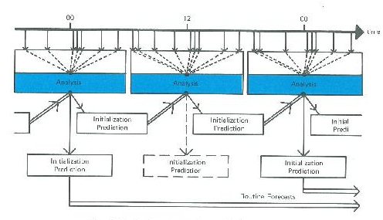
At the top level, DA is a filter
OBSERVATIONS
ASSIMILATION MODEL
But there are advantages in batching the observations, so the assimilation is intermittent.
From the First GARP Global Experiment: Objectives and Plans (1973)

Slide 6
Issues in designing a DA cycle
Although the KF equations are valid for sequential assimilation, in practice we must make approximations to the covariance (B instead of P^{f}), losing optimality. Batching together potentially synergistic observations, in space and/or time, will be beneficial if the analysis algorithm’s implicit covariance improves on the modelled B. Having a “long” window is important in 4DVar because it implicitly uses MBM^{T}, which is better.
The analysis is only needed to start forecasts intermittently. But the interval is decreasing for nowcasting applications.
The overheads of starting software for forecast and analysis are reduced by longer cycles. But these overhead may be avoided by direct coupling in next-generation computer systems.
We need a method to use observations which arrive a bit late. Currently we use an “update” run in the DA cycle, but other approaches are possible.
Complexity. Robustness. Ease of maintenance. Flexibility.

Slide 7
Various forms of the Kalman update equation
© Crown copyright Met Office

Slide 8
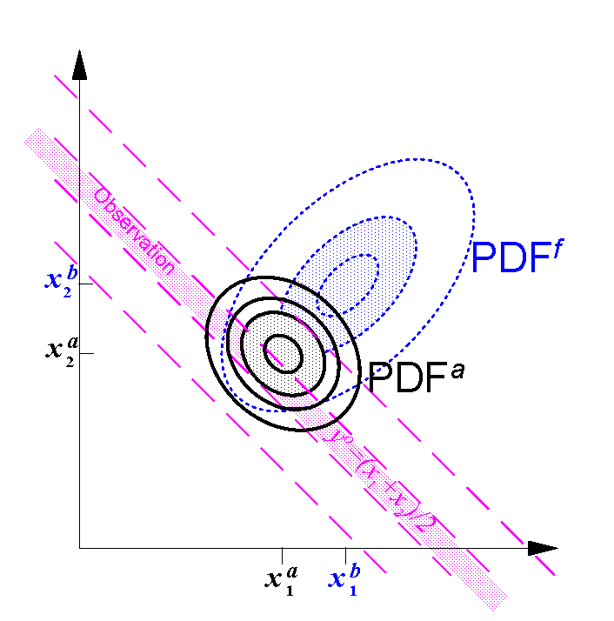
background pdf obs likelihood function posterior analysis PDF
© Crown copyright Met Office Andrew Lorenc 8

Slide 9
Bayesian analysis equation
Property of Gaussians that, if H is linearisable :
where xª and A are defined by:

Slide 10
Issues in practical implementation “The devil is in the details”
There are significantly different choices possible for each of the following options. The combinations of these choices give a large number of very different analysis schemes, all implementing the same Bayesian equation!
Modelling, representing & estimating prior background error covariances B.
Expressing the equations in a form amenable to solution.
Computing the solution.

Slide 11
Options in solution methods
Global or local or sequential
Local allows observation selection, localising correlations
Global avoids seams and does all scales, simplifies logic, allows use of model operators & hence extends to 4DVar.
Sequential (one observation at a time) processing is possible in an EnKF
Explicit or iterative
Iterative is cheaper (allowing bigger problems to be solved) and can be extended to weakly nonlinear analysis.
Explicit matrix inversion give analysis error covariance. Useful in QC and in some ensemble methods.
© Crown copyright Met Office Andrew Lorenc 11

Slide 12
OI (Optimal Interpolation), Statistical Interpolation
Gandin 1965.
Lorenc 1981.
Use a point-point model of a “static” B
Split the analysis into separate points, or regions, and select a small sub-set of observations for each.
Use the observation-space form of the analysis equation
Solve using an efficient numerical method to calculate δx = xª - x^{b}
Don’t bother to calculate A since that is more expensive.

Slide 13
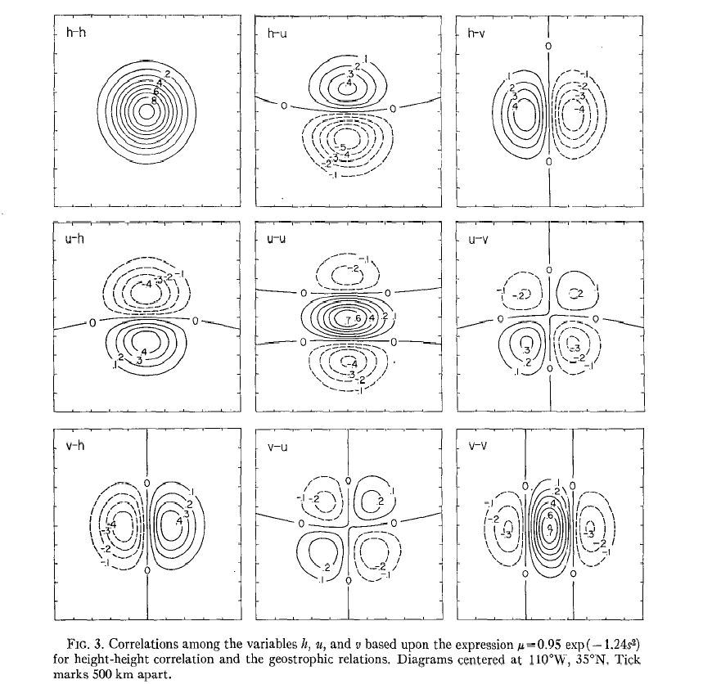
Schlatter’s (1975) multivariate covariances
Specified as multivariate 2-point functions.
Not easy to ensure that specified functions are actually valid covariances.
Used in OI and related observation-space methods.

Slide 14
Variational methods
We cannot hope to store matrices as big as B on our computers;
instead we represent them as operators.
Similarly we cannot hope to consider the whole PDF,
instead we just seek the mode, i.e. the minimum of the penalty function:
We seek the minimum xª using a descent algorithm, using the gradient:
At the minimum the gradient is zero.

Slide 15
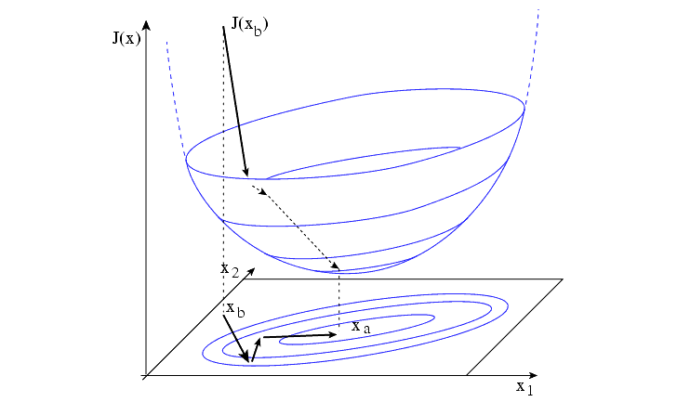
Descent Algorithm & Preconditioning
We are seeking the minimum of a MULTI-dimensional quadratic; visualise this schematically in 2 dimensions.
Normally, some directions are MUCH less likely than others, leading to long thin ellipses and slow convergence.
The Newton method shows that Hessian preconditioning is ideal:
In practice we use the variable transform such that
UU^{T}=B to precondition:
Figure from ECMWF DA lecture notes

Slide 16
Transformed control variable.
Choose a “balanced” variable from which we can calculate balanced flow in all variables: e.g. streamfunction Ψ.
Define transforms from (U) or to (T) this variable and residual variables; by construction/hypothesis inter‑variable correlations are then zero.
Continue with each unbalanced residual variable in turn (velocity potential χ, pressure p, moisture μ) making B block diagonal. (Compare EOFs)
Transformed variables still need a spatial covariance model, but not multivariate. (Further transforms are used to represent these.)
Lorenc et al. 2000

Slide 17
Incremental approach
This follows logically from the use of a forecast prior (background).
Rather than determine xª directly, we can determine δx where xª =x^{b}+δx.
This allows us to make simplifying, cost-saving assumptions about δx (e.g. that it is larger-scale) while maintaining full detail in x^{b}. E.g.
First-Guess at Appropriate Time (FGAT) in 3DVar.
Incremental 4DVar.

Slide 18
Basic 3D-Var

Slide 19
3D-Var with FGAT
Lorenc & Rawlins 2005

Slide 20
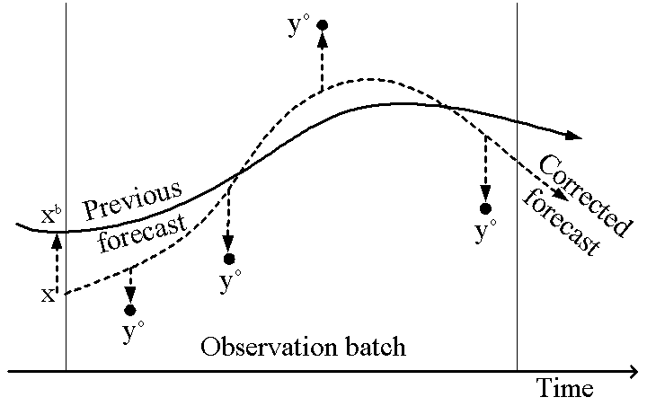
Simple 4D-Var, as a least-squares best fit of a deterministic model trajectory to observations
© Crown copyright Met Office Andrew Lorenc 20

Slide 21
Deterministic 4DVar
Include a nonlinear forecast model as part of the variational prediction of the observations
Measure the misfit to background and observations over a time-window
The gradient used in the descent algorithm will contain the adjoint model M*
Precondition as for 3DVar

Slide 22
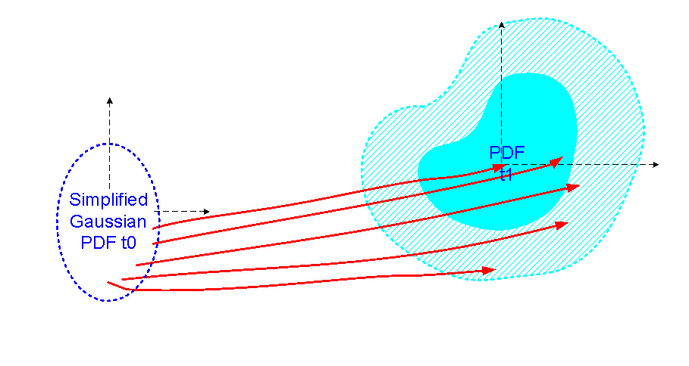
Deterministic 4D-Var
Initial PDF is approximated by a Gaussian.
Descent algorithm only explores a small part of the PDF, on the way to a local mode at a local minimum of J.
Notes:
22

Slide 23
But nobody does 4D-Var this way for real NWP!
Does not work – the adjoint of a real NWP model occasionally gives very large gradients which prevent the descent algorithm converging.
It would be too expensive.
In practice, most NWP centres use the incremental approach (Courtier et al. 1994) and a simplified, regularised Tangent-Linear model and its adjoint.
It is still common to present this as an approximate solution method for the deterministic 4D-Var equation.
I prefer to derive & solve a statistical 4D-Var equation (Lorenc 2003a)

Slide 24
When does 4DVar using “automatic” adjoint methods not work?
Thermostats: - Fast processes which are modulated to maintain a longer-time-scale “balance” (e.g. boundary layer fluxes).
Limits to growth: - Fast processes which in a nonlinear model are limited by some available resource (e.g. evaporation of raindrops).
Butterflies: - Fast processes which are not predictable over a long 4DVar time-window. (e.g. eddies with short space- & time-scales).
Observations of intermittent processes: - If something (e.g. a cloud or rain) is missing from a state, then the gradient does not say what to do to make it appear.
These are fundamental atmospheric processes – it is impossible to write a good NWP model without representing them.
© Crown copyright Met Office Andrew Lorenc 24

Slide 25
Kalman Filter – forecast step
Can allow for additive Gaussian forecast errors.
Exact for linear model & Gaussian errors.
Often “Extended” to nonlinear models –, using tangent-linear model – – to evolve the PDF.
Model error represented by adding covariance Q
© Crown copyright Met Office
Notes:
25

Slide 26
Statistical, incremental 4D-Var
Statistical 4D-Var approximates entire PDF by a Gaussian.
Lorenc & Payne 2007
Notes:
26

Slide 27
Statistical 4D-Var - equations
Independent, Gaussian background and model errors ⇒ non-Gaussian pdf for general y:
Incremental linear approximations in forecasting model predictions of observed values converts this to an approximate Gaussian pdf:
The mean of this approximate pdf is identical to the mode, so it can be found by minimising:
Lorenc 2003a
Notes:
27

Slide 28
Nonlinearities in 4DVar
Nonlinear processes, leading to non-Gaussian PDFs and a non-quadratic penalty function, can be:
The forecast model M,
The observation operators H,
Interactive quality assessments, leading to changes in R,
Nonlinear transforms U designed to model non-Gaussian background errors.
Usually these are allowed to vary in the outer-loop, but held constant linear in the variational loop.
Variational methods may gain accuracy (over the EnKF) by linearising M H R U about the best estimate, rather than the background. This usually requires an outer loop.
The Met Office is unusual in allowing a non-quadratic penalty function in its variation problem, using accurate nonlinear H R U without the cost of rerunning the model M.
Notes:
28

Slide 29
Incremental 4D-Var
Inner low-resolution incremental variational iteration
ADJOINT OF P.F. MODEL
U
T
An outer-loop reruns the full forecast model The guess x^{g} is updated; the background x^{b} is not.
background
x^{b}
DESCENT
y
y
y
y
ALGORITHM
U
δx
PERTURBATION FORECAST MODEL
+δη
x^{g}
+ η
FULL FORECAST MODEL
Outer, full-resolution iteration
Optional model error terms
Notes:
29

Slide 30
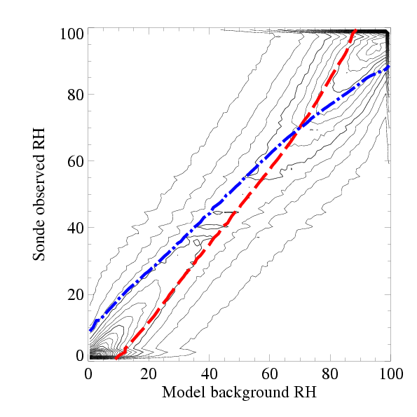
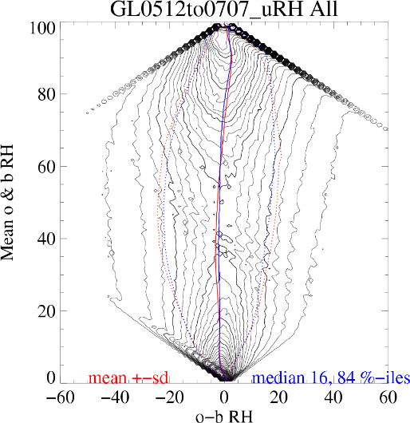
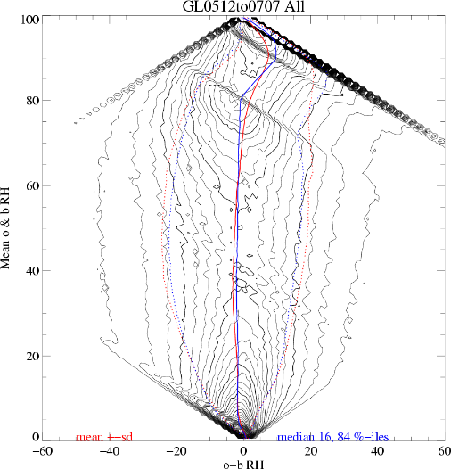
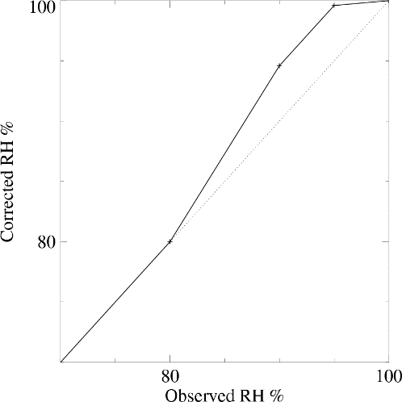
The Principle of Symmetry
Methods for coping with non-Gaussian PDFs & nonlinear H R U must be careful not to introduce bias – this can be a bigger problem than the local nonlinearity or non-Gaussianity.
e.g.
Joint PDF rh^{b} v rhº
Rotated joint PDF
rhº-rh^{b} v ½(rh^{b}+rhº)
Sonde bias correction
Rotated joint PDF with bias correction
Due partly to the apparent bias when classified using rh^{b}, sonde humidity bias correction was introduced (Lorenc et al. 1996). This was later seem to be spurious when classified using ½(rh^{b}+rhº) (Lorenc 2007). This symmetric classification is the basis of our nonlinear humidity transform U (Ingleby et al. 2013).
The same principle was expounded and used by Geer & Bauer (2011) for assimilating all-sky radiances.
Notes:
30

Slide 31
Background error covariance B modelling assumptions
We construct B using x-x^{b}=Uv such that B=UU^{T}
Early methods made the following assumptions about B, all of which are wrong!
Stationary – time & flow invariant
Balanced – predefined multivariate relationships exist
Homogeneous – same everywhere
Isotropic – same in all directions
3D separable – horizontal correlation independent of vertical levels or structure & vice versa.
Since then many clever schemes have been developed to address them individually, but they can be complicated to combine and so have limited success because of the errors remaining in the others.
© Crown copyright Met Office Andrew Lorenc 31
Notes:
31

Slide 32
Variational DA Methods + & -
Use all observations together
Apply relationships between variables e.g. balance and (in 4DVar) relate structure of fields to their evolution
Exploit synergies between different observations Best use of obs from remote sensing, or for a wide range of scales, or distributed in time
Has given best results in NWP for recent decades.
Requires a covariance model describing all likely errors
All steps in prediction of observations from control variables must be near linear – cannot easily use precipitation and cloud observations
Software is built using [components of] a forecast model – technical skill needed.
Sequential algorithm – 4DVar running of linear and adjoint model not suitable for future MPP computers.

Slide 33
The Ensemble Kalman Filter
Developed by Evensen & others in 1990s; strongly advocated by Kalnay & others.
Many flavours – common features are:
Assume an ensemble of forecasts is a good sample of likely true prior states
Assume errors are Gaussian so Kalman Gain equations are valid
Use background error covariance estimated from the forecast ensemble
Update the ensemble members, such that the ensemble of analyses samples the posterior state
Forecast all the members, allowing for model errors, to get back to 1
Two main methods for 4 give respectively stochastic or square-root EnKF methods
Different ways of applying the Kalman equations to keep computational costs low
Evensen 1994, 2003, 2007, Kalnay et al. 2007

Slide 34
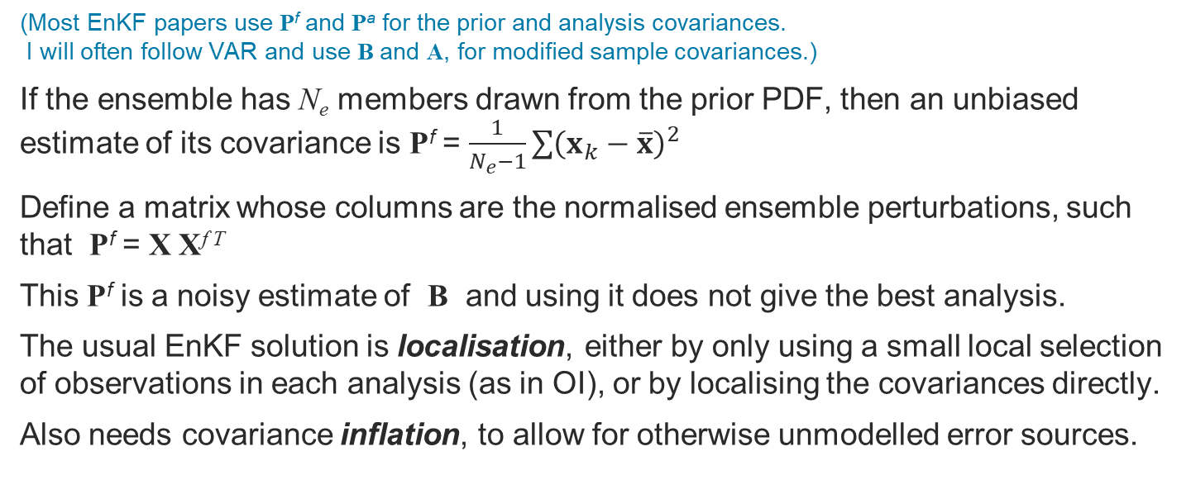
Estimating B from an ensemble
(Most EnKF papers use P^{f} and Pª for the prior and analysis covariances. I will often follow VAR and use B and A, for modified sample covariances.)
If the ensemble has N_{e} members drawn from the prior PDF, then an unbiased estimate of its covariance is P^{f} = $\frac{1}{N_{e}−1}\sum{{\left(x_{k}−\overline{x}\right)}^{2}}$
Define a matrix whose columns are the normalised ensemble perturbations, such that P^{f} = X X^{f T}
This P^{f} is a noisy estimate of B and using it does not give the best analysis.
The usual EnKF solution is localisation, either by only using a small local selection of observations in each analysis (as in OI), or by localising the covariances directly.
Also needs covariance inflation, to allow for otherwise unmodelled error sources.

Slide 35
Localisation by data selection
For each analysed grid point (or analysis volume), select only a few observations. Ideally, there should be enough d.o.f. in the ensemble to fit the useful information from the selected obs.
This was the approach since OI schemes: Lev Gandin advised me never to select more than 8 observations. (The Lorenc (1981) ECMWF scheme used 192 obs, for a 6⁰×6⁰ volume.)
It is still the approach in the popular LETKF method (which uses matrices in ensemble space, so cannot apply other methods).
Most other methods reduce sampling noise directly by modifying the ensemble covariances, using a Schur product.

Slide 36
Errors in sampled covariances
Lorenc 2003b

Slide 37
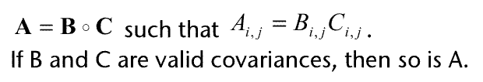
Localisation: The Schur Product
The best localisation can be deduced by brute force for a toy model (Lorenc 2003b, 2017).
It can be estimated, making several assumptions, using 4th order ensemble statistics (Ménétrier et al. 2015)

Slide 38
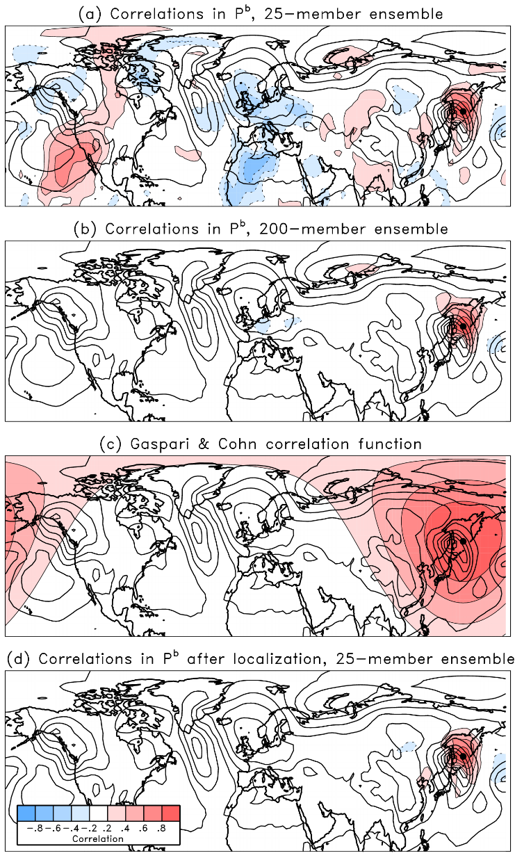
Example of covariance localization
obs
location
Background-error correlations estimated from 25 members of a 200-member ensemble exhibit a large amount of structure that does not appear to have any physical meaning. Without correction, an observation at the dotted location would produce increments across the globe.
Proposed solution is element-wise multiplication of the ensemble estimates (a) with a smooth correlation function (c) to produce (d), which now resembles the large-ensemble estimate (b). This has been dubbed “covariance localization.”
from Tom Hamill’s talk in Buenos Aires (2008),
Chapter 6 of “Predictability of Weather and Climate”

Slide 39
Stochastic EnKF v Ens Sqrt Filter
The original EnKF method applied the Kalman equations to each member.
This gives an under-spread analysis ensemble, which can be avoided in the stochastic perturbed observations method by sampling from R (Burgers et al. 1998 and Houtekamer & Mitchell 1998).
Alternatively, apply the Kalman equations to the ensemble mean, then applies a transform T for the perturbations from the mean (Tippett et al. 2003) such that the analysis covariance A is correct. Calculating T requires a SQRT: TT^{T} = ( I + (HX^{b})^{T}R⁻¹HX^{b} ) ; Xª = X^{b} T
The stochastic method is more robust for imperfect analysis methods and non‐Gaussian errors; it is more in tune with Monte Carlo methods (stochastic physics). It is only correct in the limit of large ensembles.
The SQRT method is more accurate for small ensembles.

Slide 40
Summary Equations - all equivalent
Variational
Kalman Filter. Kalman Gain = K.
Observation space
Model space
Ensemble Square-root Filters: - ETKF calculates SQRT in ensemble space; - Sequential filters calculate in ob-space for 1 ob at a time
Demonstrate equivalence using Sherman–Morrison–Woodbury formula
B = X^{f} (X^{f})^{T}
Calculate T (needs SQRT(matrix)) such that
Xª = X^{f} T
A = Xª (Xª)^{T}

Slide 41
Flavours of EnKF used for NWP
EnKF: closest to KF. Allows Schur product localisation. Uses perturbed observations to get correct spread. (e.g. Houtekamer & Mitchell Canada)
SQRT filters: Deterministic equation gives correct spread. Efficient with sequential processing of obs; this allows Schur product localisation. (e.g. Tippett, Anderson, Bishop, Hamill, Whitaker, Flowerdew)
LETKF: Localised by data selection. One form of SQRT filter; efficient because matrices have order = ensemble size. (e.g. Bowler Met Office, Kalnay, Ott, Hunt et al. Univ Maryland, Miyoshi Japan)
En-Var: An ensemble of separate variational assimilations; allows same DA system to be used for deterministic & ensemble. Only loosely related to EnKF. (e.g. ECMWF’s EnDA, Bowler et al. En-4DEnVar)

Slide 42
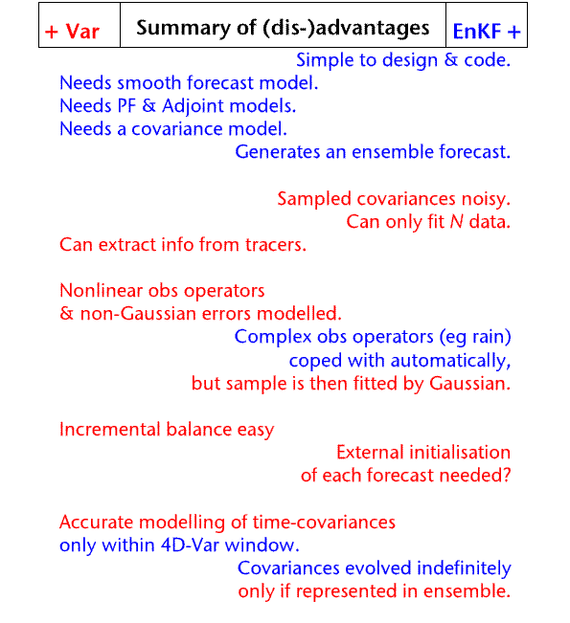
4DVar vs EnKF
Lorenc, A. C., 2003: The potential of the Ensemble Kalman filter for NWP - a comparison with 4D-Var. Quart. J. Roy. Met. Soc., 129, 3183-3203. did a review with the summary shown:
before suggesting a hybrid, combining the good features of both methods.

Slide 43
Using a localised ensemble covariance in VAR
Localisation is a simple idea used in the ensemble Kalman filter: B = P_{e} ◦ C (Hamill et al. 2001, Houtekamer & Mitchell 2001)
But a key characteristic of NWP variational DA schemes is that they never need to calculate covariance matrices – these are implicit in the algorithm’s control variable transforms
Similar transforms can be used to transform an “alpha control variable” which implicitly represents C
B = UU^{T}
B = MUU^{T}M^{T}
© Crown copyright Met Office Andrew Lorenc 43

Slide 44
Simple Idea for accounting for EOTD in VAR – weighted linear combination of ensemble members
Assume analysis increments are a linear combination of ensemble perturbations and determine the weights α_{i} variationally
A priori independence of α_{i} implies that covariance of δx is that of the ensemble.
Allow each α_{i} to vary slowly in space, so eventually we can have a different linear combination some distance away.
Four-dimension extension: apply the above to ensemble trajectories:
© Crown copyright Met Office Andrew Lorenc 44
Notes:
Kalnay, E., and Z. Toth, 1994: Removing growing errors in the analysis. Preprints, 10th Conf. on Numerical Weather Prediction, Portland, OR, Amer. Meteor. Soc., 212–215.

Slide 45
Localised ensemble perturbations – the extended control variable method
Met Office code written in late 90’s for 3D-Var or 4D−Var (Barker and Lorenc) then shelved pending an ensemble.
Proven to work in NCAR 3D-Var (Wang et al. 2008a,b)
Proven to be equivalent to EnKF localisation (Lorenc 2003, Wang et al. 2007).
Eventually implemented in Met Office operational global hybrid-4DVar (Clayton et al. 2013).
Also developed by Buehner et al. (2010a,b), Zhang and Zhang (2011, 2013), implemented at NCEP (Daryl Kleist), under development in France (Desroziers et al. 2014) …
© Crown copyright Met Office Andrew Lorenc 45

Slide 46
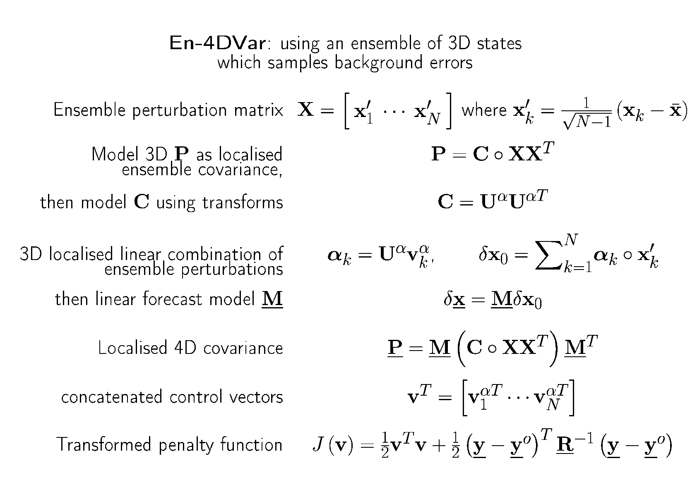

En-4DVar: using an ensemble of 3D states which samples background errors
4DVar-B_{ens} ------------
© Crown copyright Met Office Andrew Lorenc 46
Notes:
46

Slide 47
Nonlinearities
are necessary!
Both VAR & EnKF can be extended to handle weak nonlinearities:
4DVar can use an outer loop, or it can handle nonlinear observation operators in its inner loop.
EnKF uses the nonlinear model & observation operators, but then works with covariances, implicitly assuming Gaussian PDFs.
These seem like unattractive approximations to a nice Kalman filter theory. If only the atmosphere and NWP were linear, so that errors could be Gaussian!
NO! Chaos helps us.

Slide 48
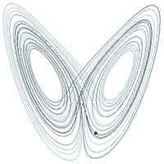
The atmosphere is nonlinear and chaotic
If the atmosphere were linear, some small perturbations would grow exponentially until we were all blown away!
Instead there is a chaotic attractor – the atmosphere, and good models of it, evolve towards a small subset of states. Others are very unlikely.
The attractor gives us the recurring recognisable weather patterns which made forecasting possible: fronts, cyclones, convective cells, …
These long-lived features result from balances between nonlinear processes. There is no general way of describing them mathematically.
DA relies on the assimilating model moving towards the attractor – spin-up.
We help this by aiming for balanced increments, and using initialisation methods which avoid large rapid variations.

Slide 49
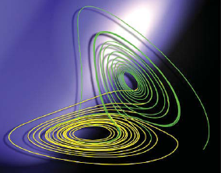
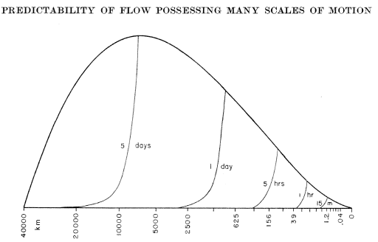
Meteorological butterfly effect:
- a description of the loss of predictability in terms of the upscale cascade, rather than low-order chaos. Compared with the volumes written about low-order chaos, relatively little has been written about the meteorological butterfly effect. (Palmer 2005)
Much research has been published about 4DVar and other DA methods in chaotic systems (e.g. using the Lorenz 1963 model).
More relevant to NWP are models which possess many scales of motion, and hence have a finite limit to predictability (Lorenz 1969).

Slide 50

Prospects for global convective‐scale NWP
We run 4DVar for global NWP and for convective-scale regional models.
Convective-scale LAMs are being developed to work in all regions of the globe.
We will soon have the ability and the computing power to run global convective‐scale NWP, if Moore’s Law continues.
?
Current DA methods like 4DVar only work for small near-Gaussian errors.
Convective-scale NWP needs lots of observations to keep errors small; these are only available in a few parts of the world.
Because of the butterfly effect, 4DVar will not converge to the correct answer as its resolution decreases (Lorenc & Payne 2007).

Slide 51
Particle Filters
For low order nonlinear models, the particle filter is ideal:
Run a large ensemble. Each member k is a free-running forecast, so on the attractor.
Use Bayes & fit to observations to estimate P_{k} that each is correct.
Resample using P_{k} to create new ensemble with members on the attractor and close to obs.
Does not work for NWP: The curse of dimensionality refers to various phenomena that arise when analyzing and organizing data in high-dimensional spaces that do not occur in low-dimensional settings. As the dimensionality increases, the volume of the space increases so fast that the available data become sparse (Wikipedia).
Suggested solutions involve:
Nudge each member towards the observations during the forecast. This moves it off the attractor
Localise the particle filter, as in the LETKF, then merge the solutions. Very difficult to ensure consistency across the seams – this loses optimality

Slide 52
Synchronised Chaos
The nonlinear dynamics and control theory community have some useful concepts:
The Lyapunov exponent characterizes the rate of separation of infinitesimally close trajectories. Positive values (in a compact space) indicate chaos.
For a perfect chaotic model, the errors from a Kalman filter based DA system asymptote to the unstable–neutral subspace (Bocquet & Carrussi 2017, papers by Anna Trevisan).
There is a spectrum of Lyapunov exponents — equal in number to the dimensionality of the phase space.
With enough observations, DA can control these, so the DA system is not chaotic, even though the free model is. This is called synchronised chaos.
However the “butterfly-affected” earth system is more complicated:
There are always model errors (due to unresolved scales).
Our NWP DA system is quite well observed and working satisfactorily, yet it is chaotic for some regions & scales.

Slide 53
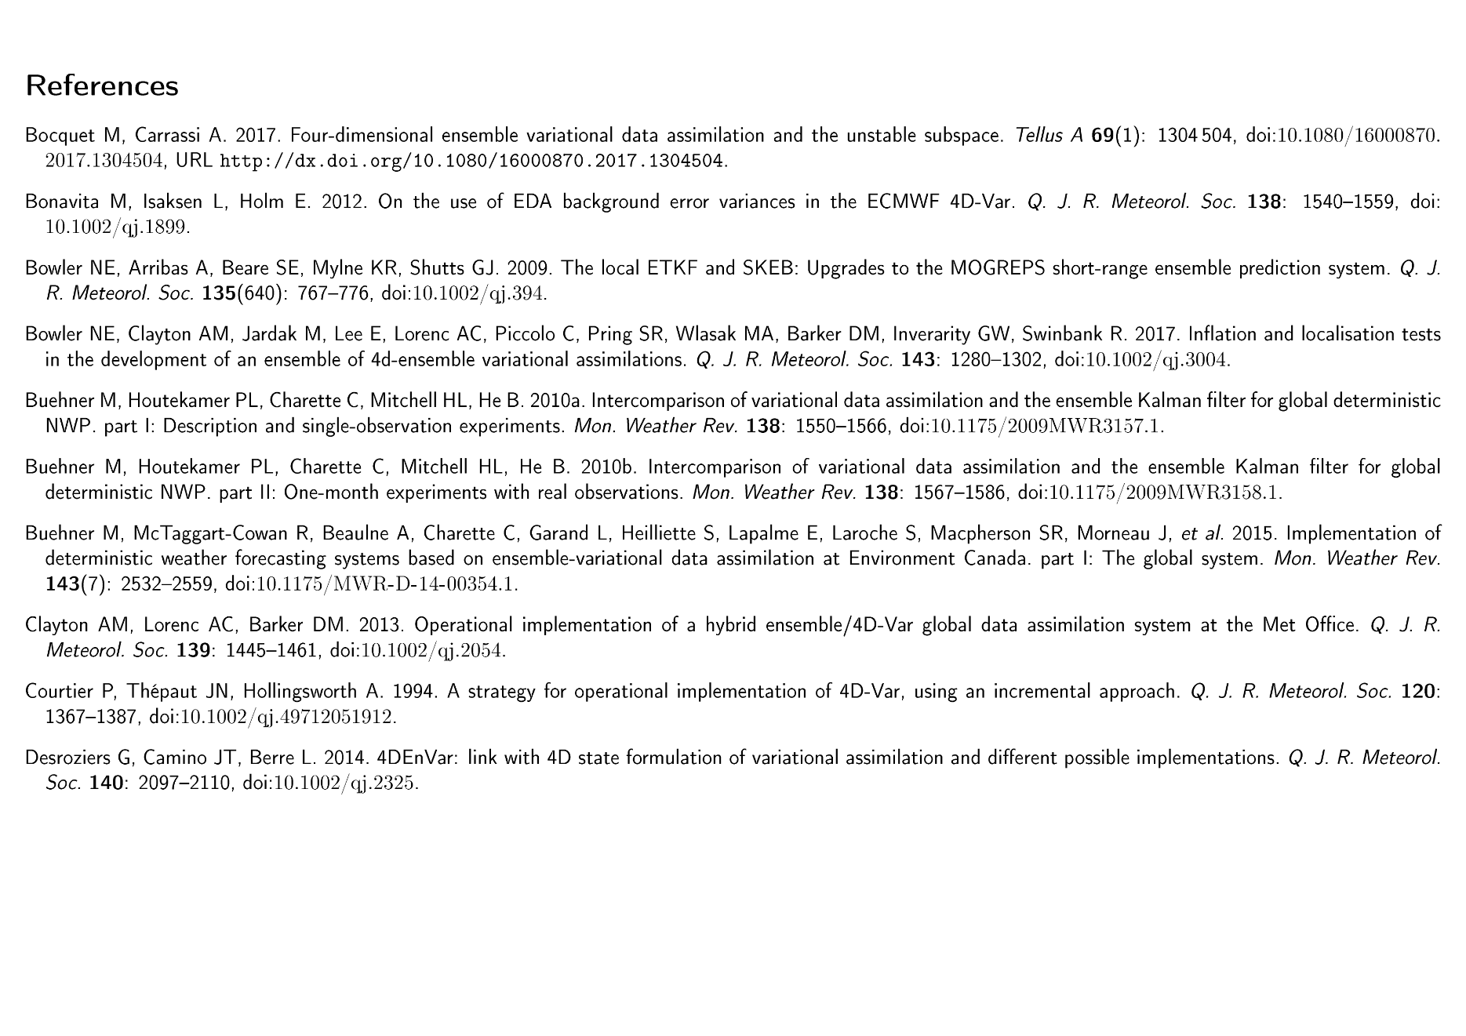

Slide 54
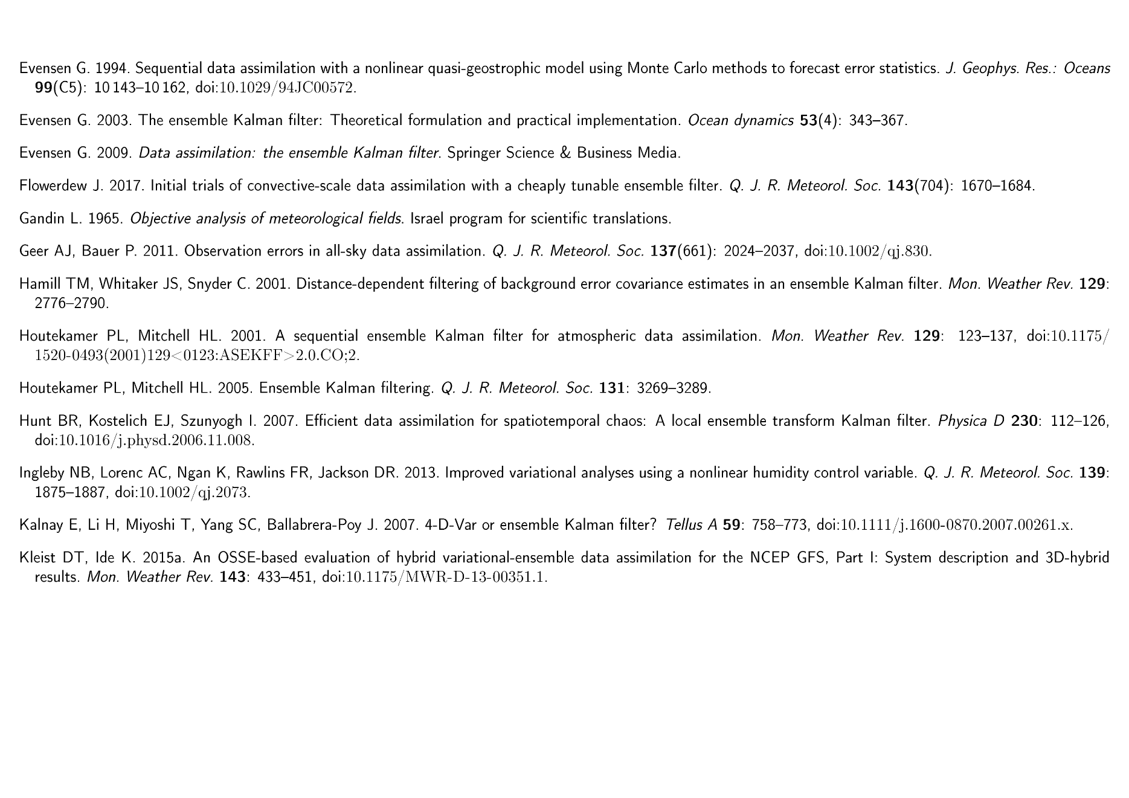

Slide 55
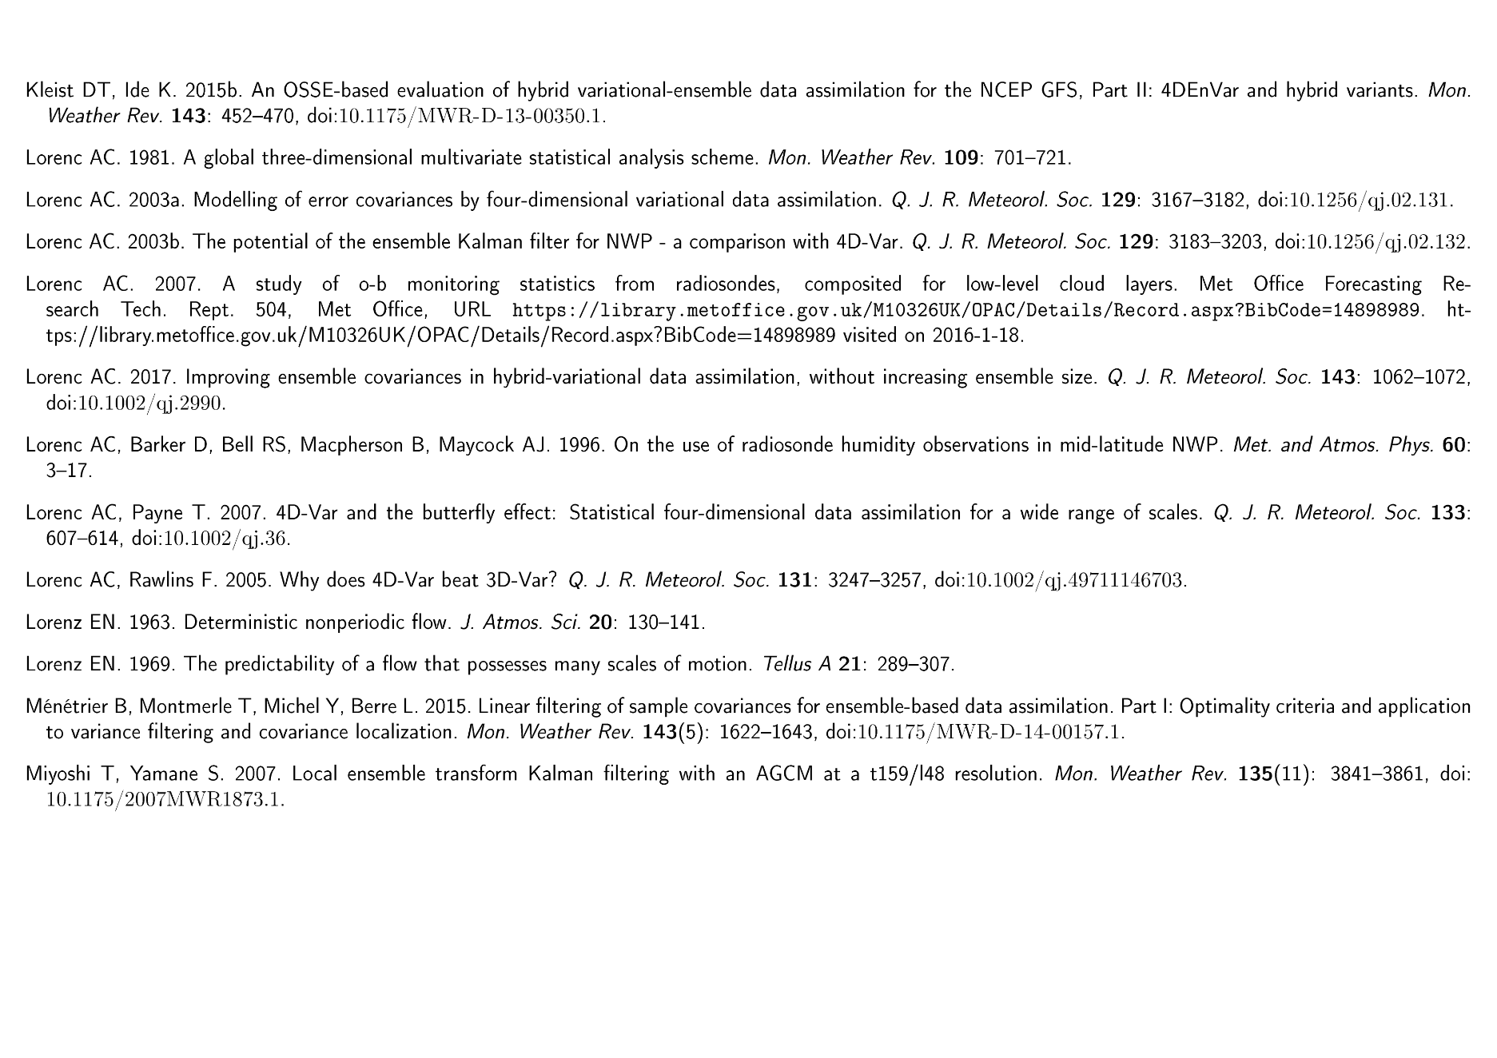

Slide 56
