Slide 1
An adjoint-informed study of tropical cyclone intensity change: Irma (2017)
Michael C. Morgan and Zhaoxiangrui He
University of Wisconsin - Madison

Slide 2
Motivation
Three key questions regarding TC intensity:
What is the maximum intensity a TC may achieve in a given environment?
What factors prevent a TC from reaching its maximum intensity?
At what rate will a TC change its intensity in a given environment?

Slide 3
Motivation
Three key questions regarding TC intensity:
What is the maximum intensity a TC may achieve in a given environment? MPI
What factors prevent a TC from reaching its maximum intensity? Riemer et al. (2010): “that a frustration of the energy cycle yields a decrease in [TC] intensity.”
At what rate will a TC change its intensity in a given environment?

Slide 4
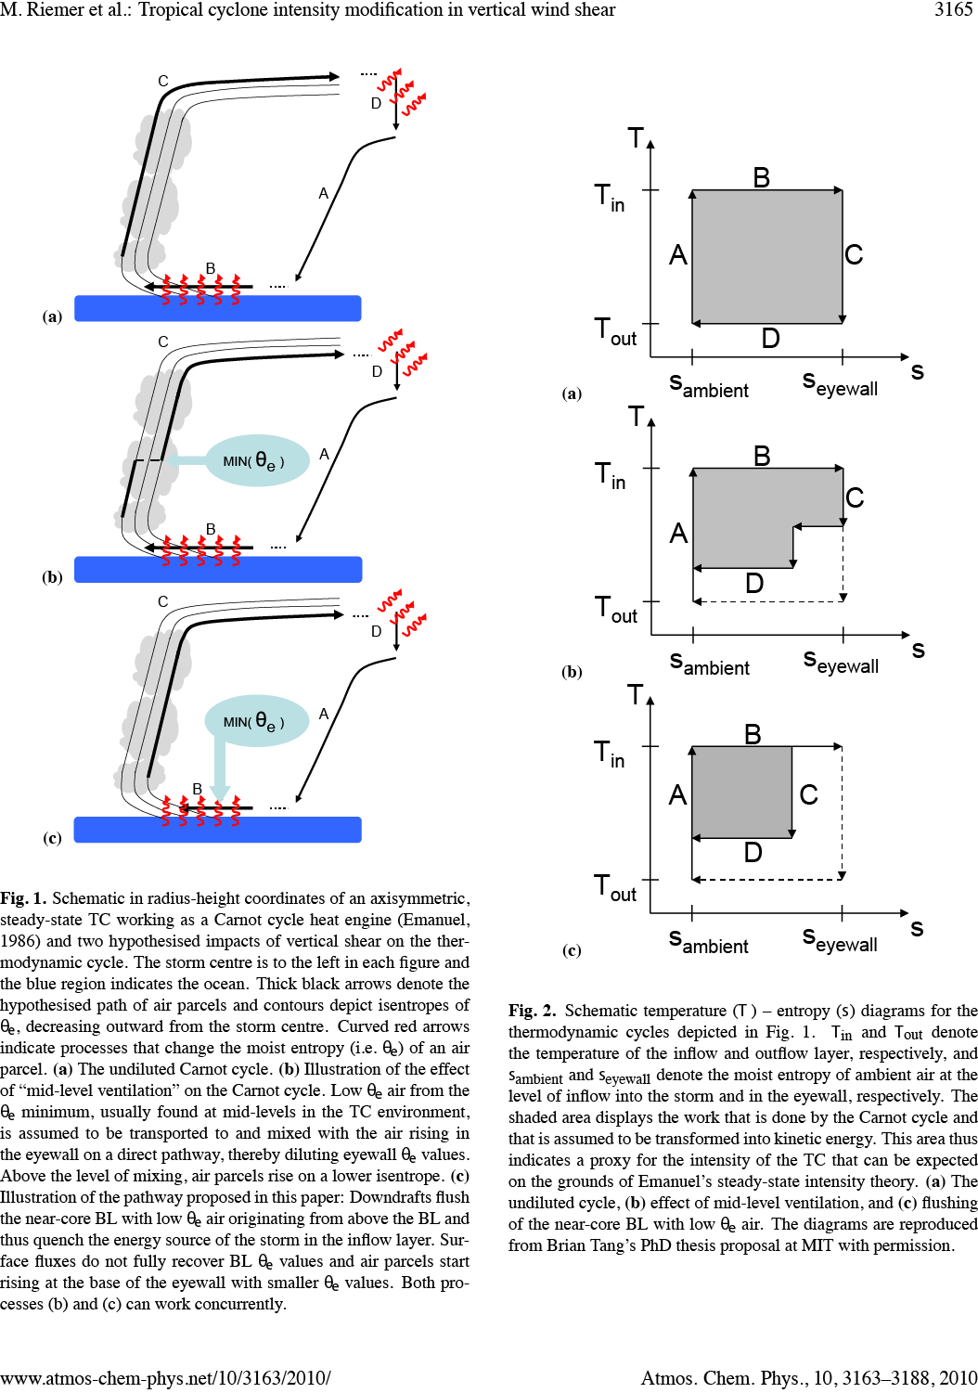
Carnot view of TC energetics
Along the inflow leg, air parcels acquire heat from the ocean surface (B).
Riemer et al. (2010)

Slide 5
Carnot view of TC energetics
Then, the air parcels rise moist-adiabatically in the eyewall and flare outward at upper-levels (C).
Along the inflow leg, air parcels acquire heat from the ocean surface (B).
Riemer et al. (2010)

Slide 6
Carnot view of TC energetics
At large radii it is assumed that air parcels lose enough heat through radiative cooling to return to their ambient θ_{e} value and that angular momentum is restored (D).
Then, the air parcels rise moist-adiabatically in the eyewall and flare outward at upper-levels (C).
Along the inflow leg, air parcels acquire heat from the ocean surface (B).
Riemer et al. (2010)

Slide 7
Carnot view of TC energetics
At large radii it is assumed that air parcels lose enough heat through radiative cooling to return to their ambient θ_{e} value and that angular momentum is restored (D).
Then, the air parcels rise moist-adiabatically in the eyewall and flare outward at upper-levels (C).
The cycle is closed along an absolute vortex line (A) along which the thermodynamic contribution is assumed to be small
Along the inflow leg, air parcels acquire heat from the ocean surface (B).
Riemer et al. (2010)

Slide 8
Carnot view of TC energetics
At large radii it is assumed that air parcels lose enough heat through radiative cooling to return to their ambient θ_{e} value and that angular momentum is restored (D).
Then, the air parcels rise moist-adiabatically in the eyewall and flare outward at upper-levels (C).
The cycle is closed along an absolute vortex line (A) along which the thermodynamic contribution is assumed to be small
Along the inflow leg, air parcels acquire heat from the ocean surface (B).
Riemer et al. (2010)

Slide 9
Carnot view of TC energetics
Possible sinks of energy:
mixing of low θ_{e} air into eyewall convection or into the inflow layer from convective downdrafts from above
work to expand outflow anticyclone*
Riemer et al. (2010)
* not accounted for in MPI theory

Slide 10
Thermodynamic “frustration”
Tropical atmosphere is characterized by a mid-tropospheric θ_{e} minimum
Entrainment of this low theta-e air into a TC eyewall can weaken eyewall convection and ultimately the cyclone itself
Downdrafts flush the near-core BL with low θ_{e} air thereby quenching the energy source of the storm in the inflow layer
Riemer et al. (2010)

Slide 11
Dynamical “frustration”
The expansion of the outflow layer and formation of the outflow anticyclone is at the expense of the primary cyclonic circulation.
This work is dependent on the difference between the angular momentum of the outflow and that of the far environment.
This resistance to outflow expansion is related to the inertial stability of the outflow later, the (absolute) vorticity.
Any process that can lower the vorticity in the outflow layer, will allow the hurricane to reach a greater intensity.

Slide 14
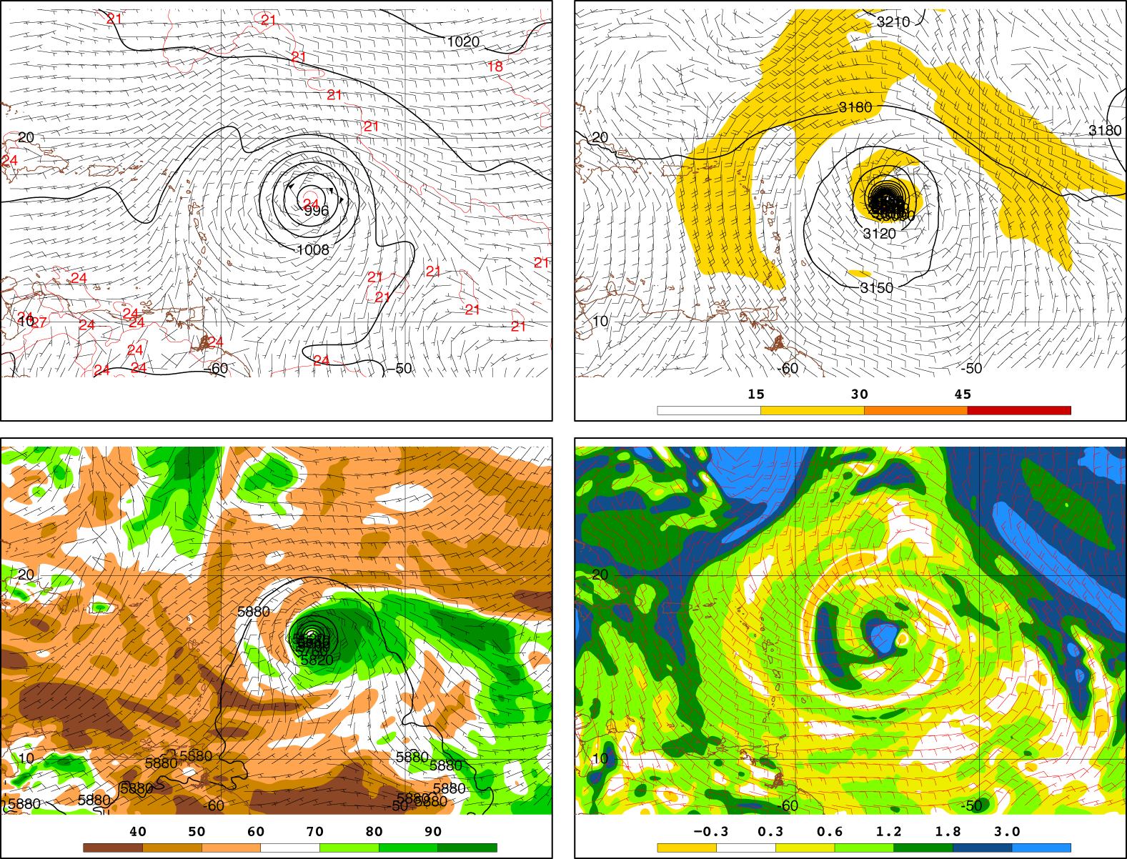
0000 UTC 5 September

Slide 15
0000 UTC 5 September

Slide 16
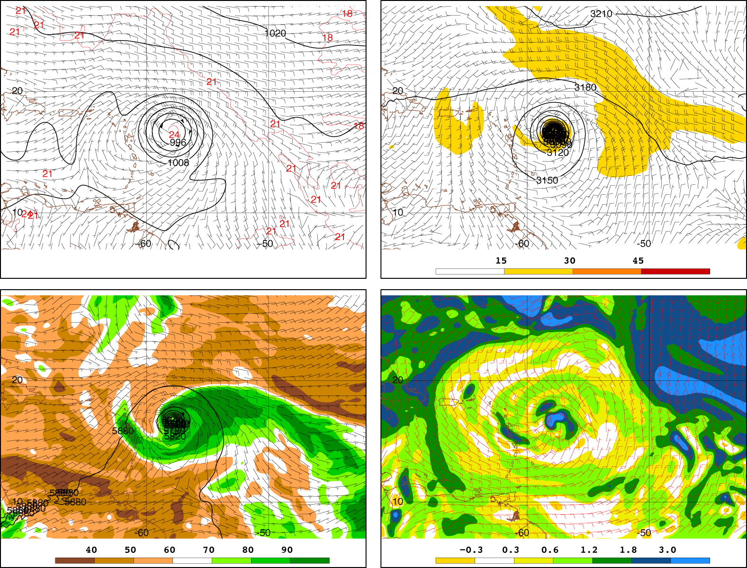
1200 UTC 5 September

Slide 17
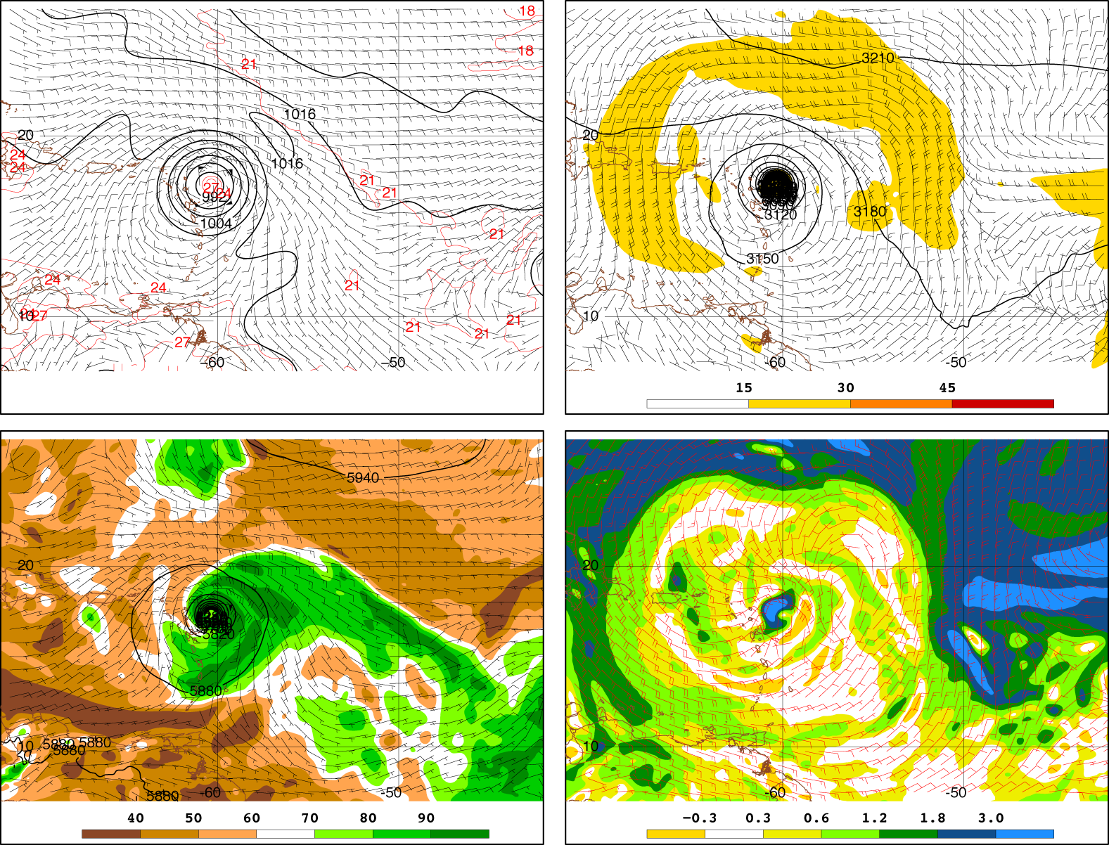
0000 UTC 6 September

Slide 18
WRF V3.8.1 and WRFPLUS V3.8.1
40 evenly spaced levels
30 km grid spacing
Kessler microphysics, large-scale condensation
Initialized with GFS “final analyses” on 0.25° grid
24 h forward/adjoint beginning 0000 UTC 5 September 2017

Slide 19
Response function
24h response function, R defined as minus the average (dry air) mass = -(p_{sfc} - p_{top}) in a 20 x 20 box centered on the TC

Slide 20
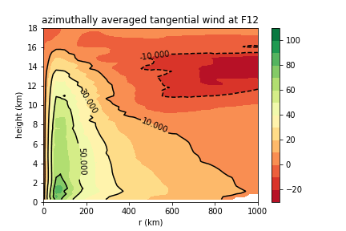
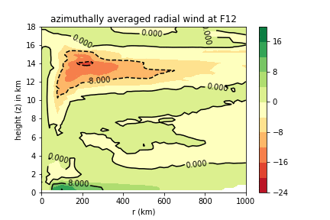
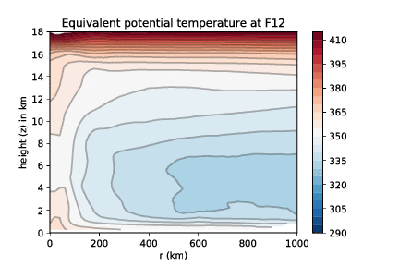
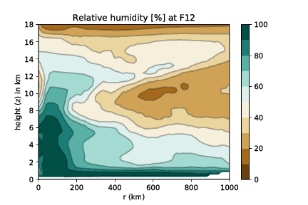
u_{θ} , u_{r} , θ_{e}, and RH F12

Slide 21
u_{θ} , u_{r} , θ_{e}, and RH F12
◉
○
✕
DRY
Θ_{e} minimum

Slide 22
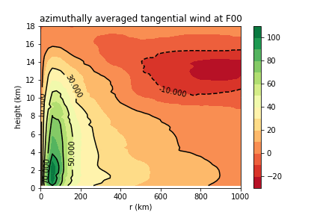
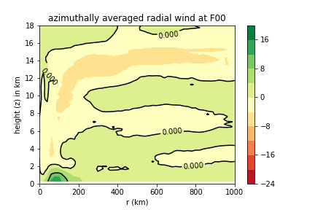
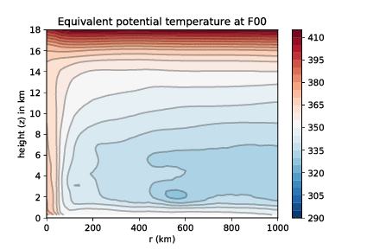
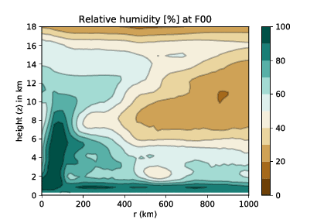
u_{θ}, u_{r} , θ_{e}, and RH evolution

Slide 23
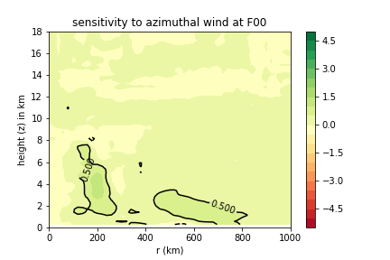
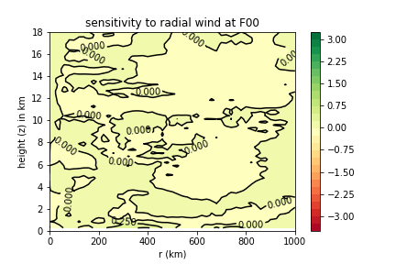
Sensitivity to u_{θ} and u_{r}
Sensitivities to the azimuthal wind are maximized at a radius of 750 km at t = -24h, and gradually contract for shorter adjoint integrations.
Increases to primary circulation in annulus about TC increases subsequent intensity
Sensitivities to radial wind are incoherent until t = 6h

Slide 24
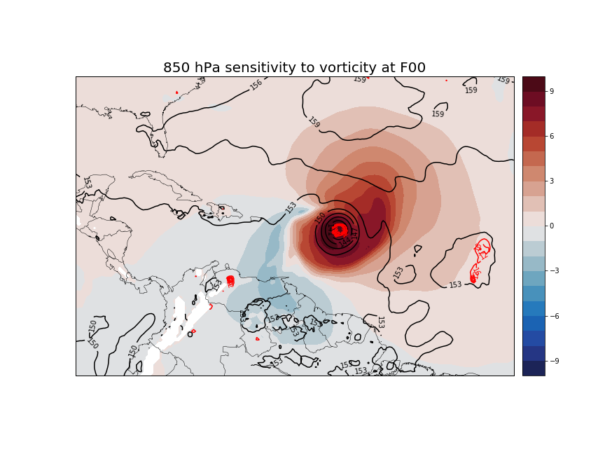

Slide 25
Note how the sensitivities appear to spiral anticyclonically inward to the cyclone center

Slide 26
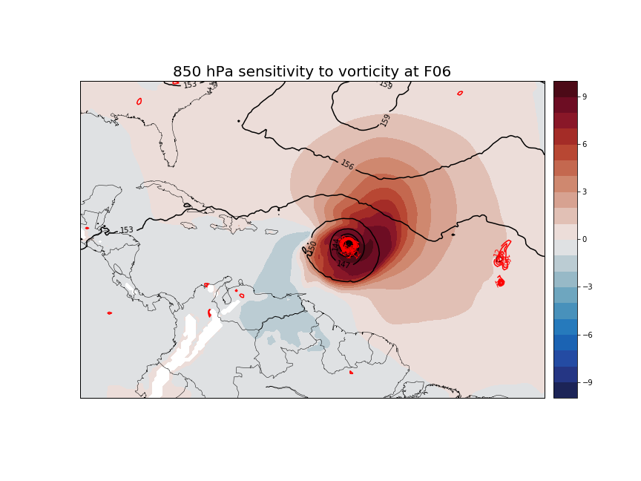

Slide 27
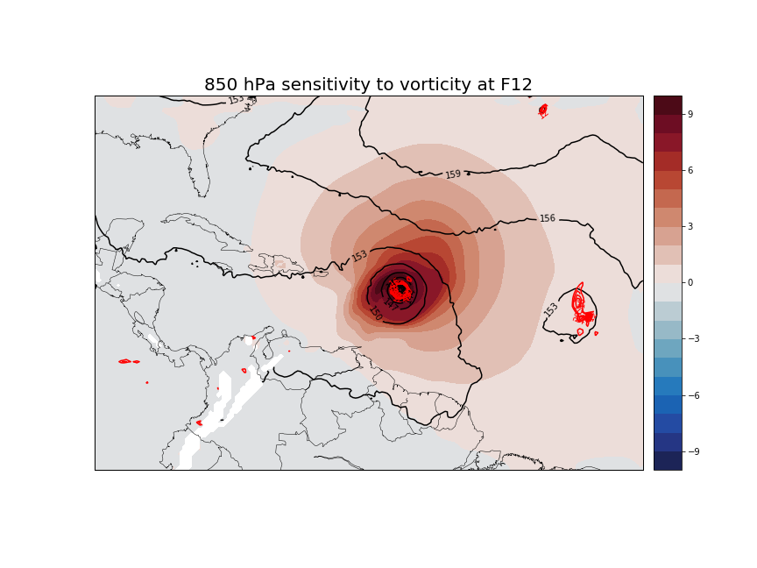

Slide 28
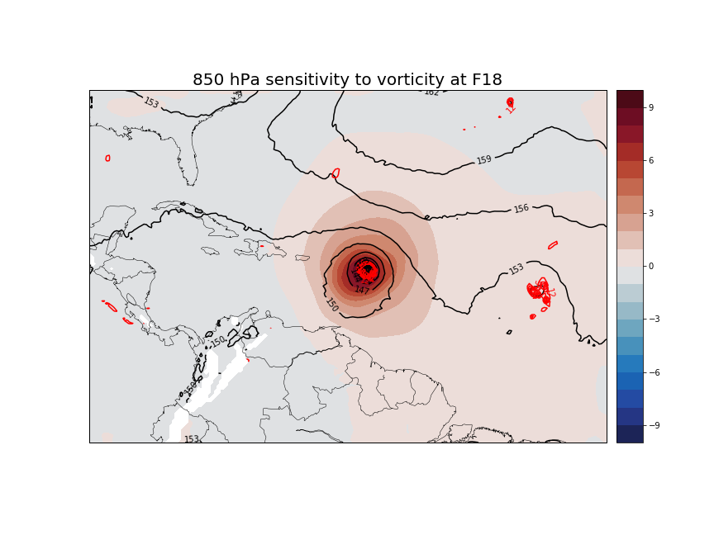

Slide 29
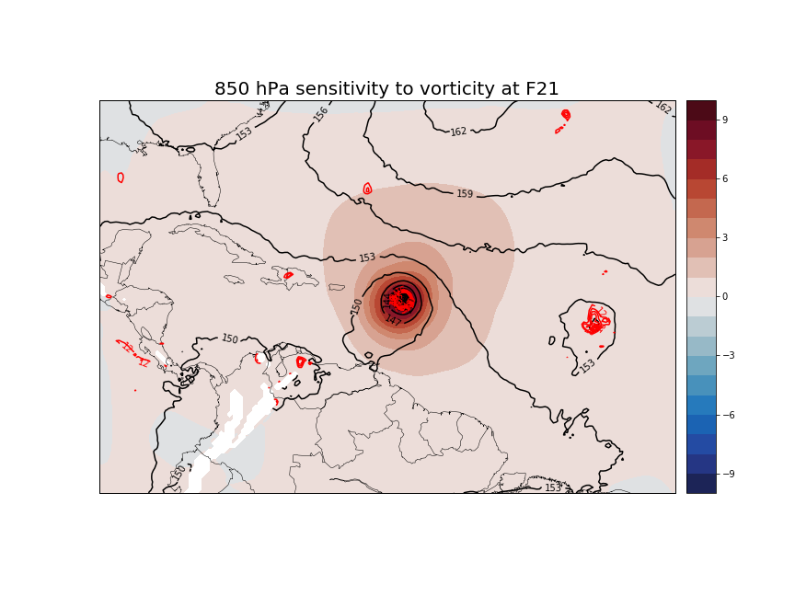

Slide 30
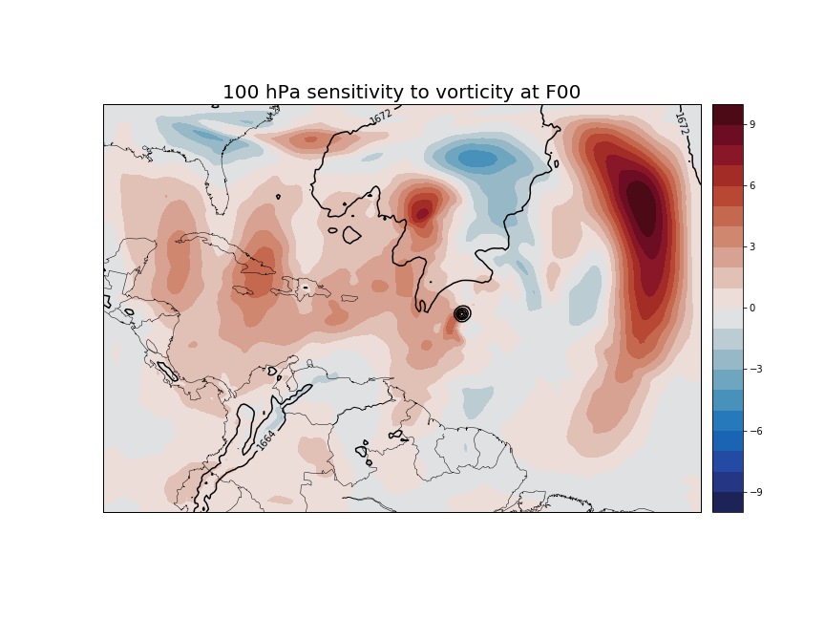

Slide 31
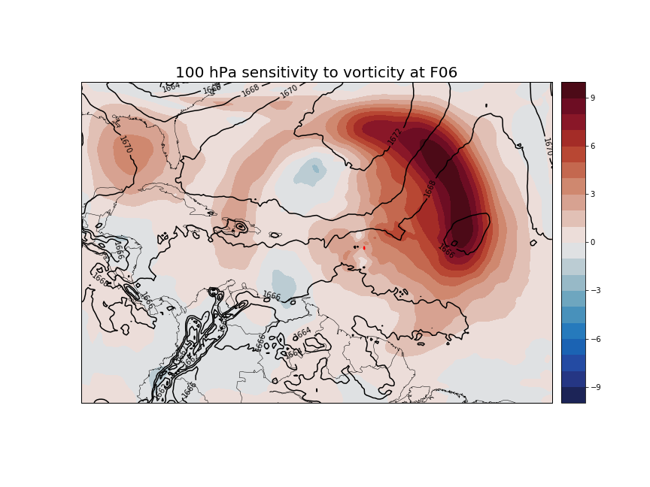

Slide 32
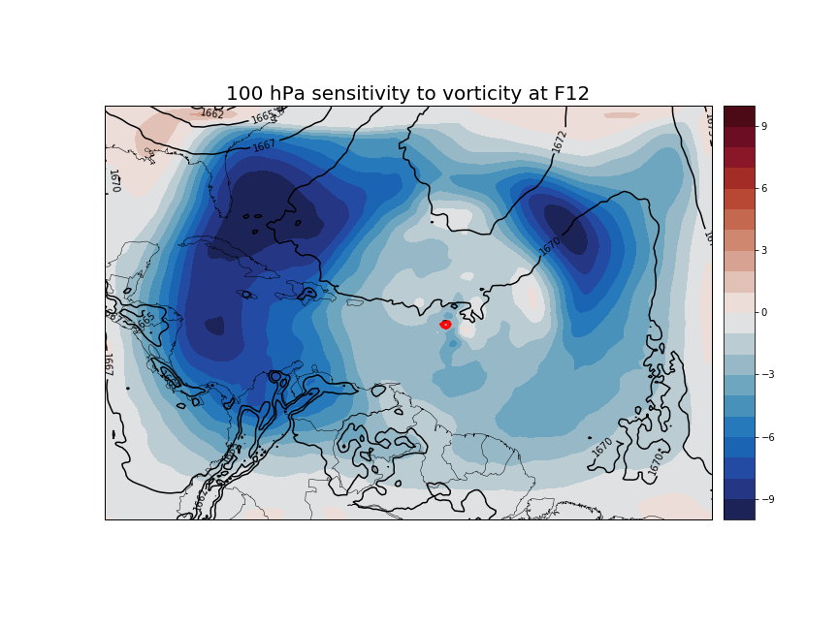
Note development of broad negative sensitivities to vorticity – suggestive of weakening inertial stability in outflow layer

Slide 33
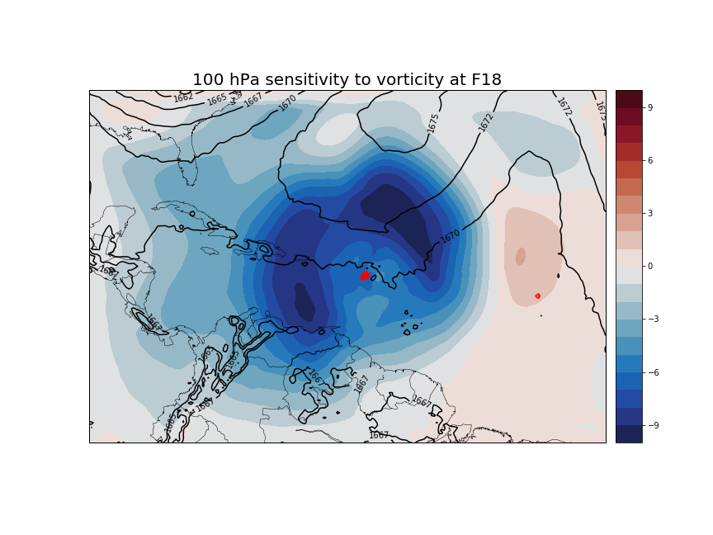

Slide 34
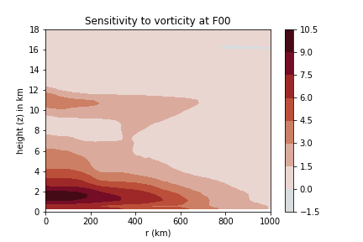
Evolution of sensitivity to vorticity
Note the initially broad distribution of dR/dζ confined mostly to the lower troposphere; the contraction of the maximum sensitivities toward the TC center and the development (though not persistence) of a broad negative sensitivity in the upper-troposphere

Slide 35
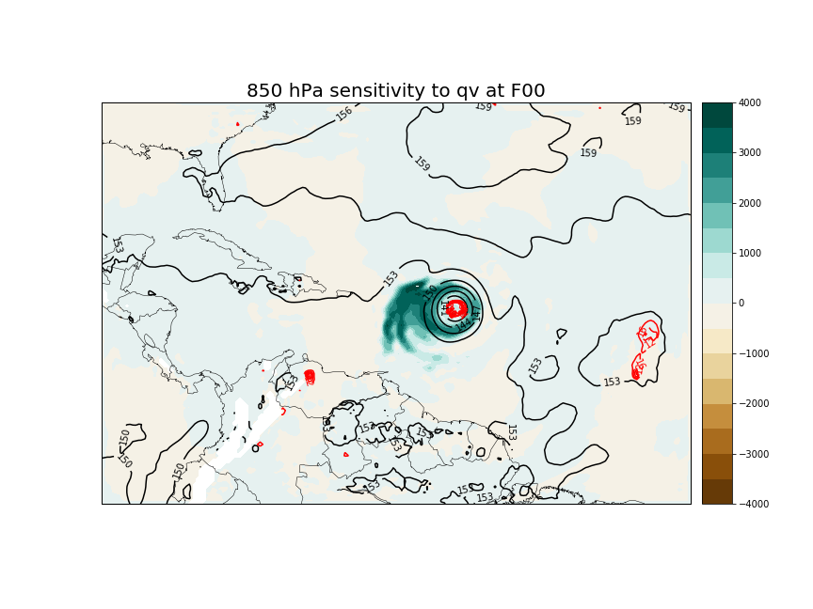
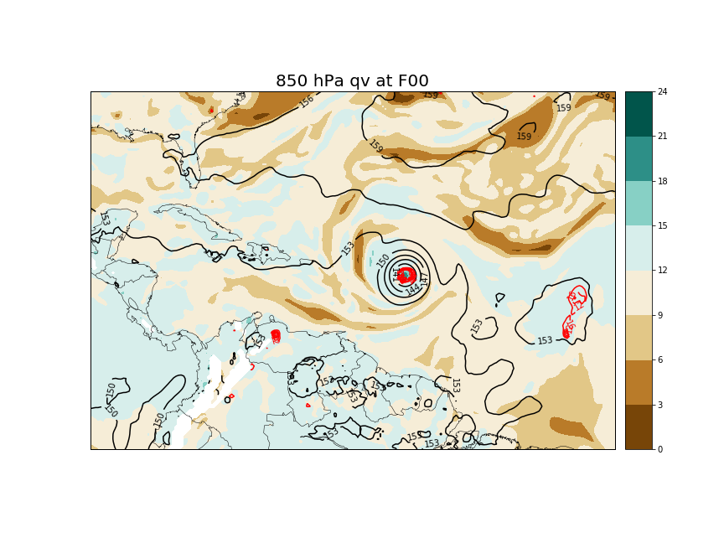
850 hPa
at t = 0
at t = 0

Slide 36
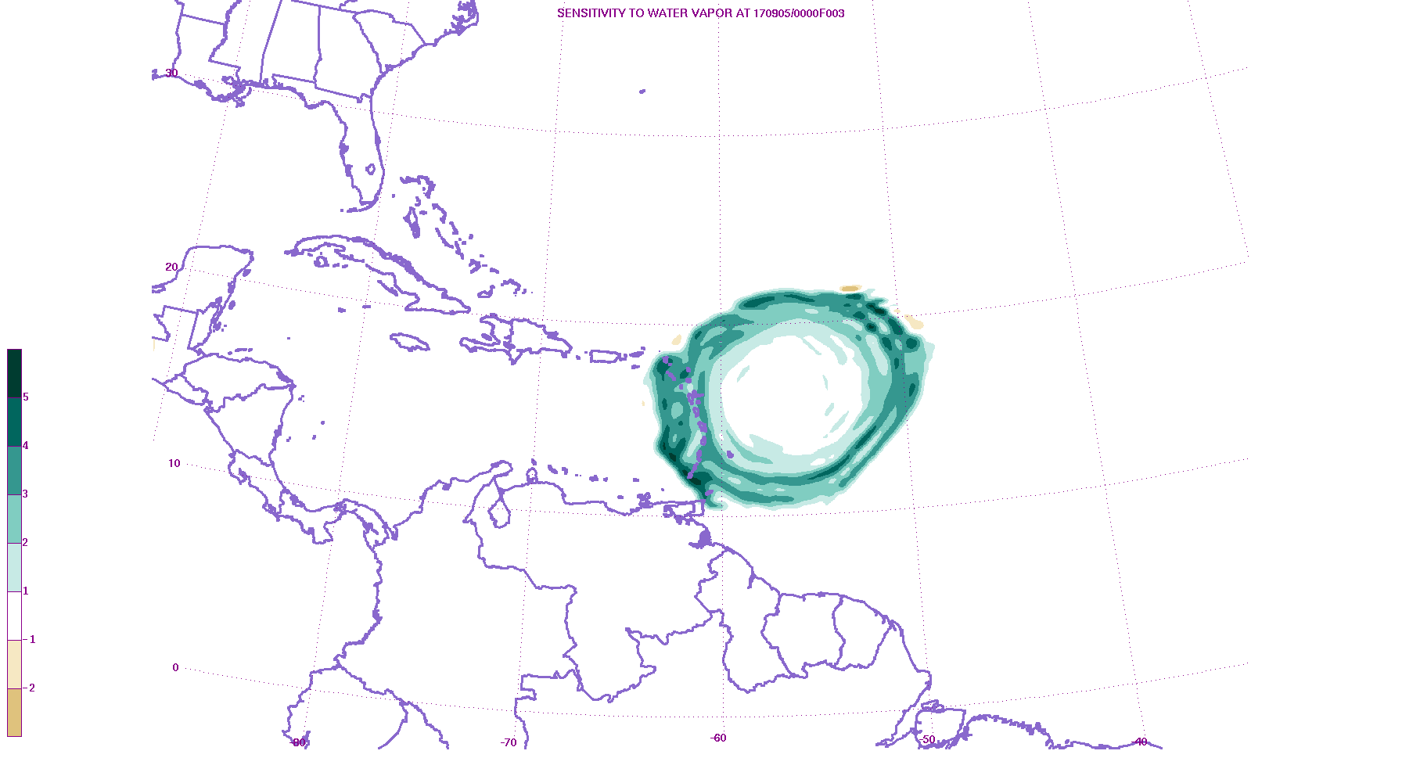
Evolution of near surface

Slide 37
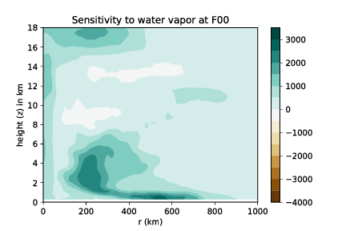
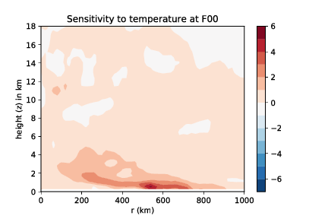
Sensitivity to q_{v} and T
Note:
Similarities in distribution of sensitivities away from core
Contraction of sensitivities as adjoint integration shortens
Sensitivity to q_{v} maximum in eye region & above outflow (?!)

Slide 38
and basic state
Distribution of sensitivities to water vapor mixing ratio suggest moistening the atmosphere in the vicinity of the θ_{e} minimum near the TC core results in a stronger TC.

Slide 39
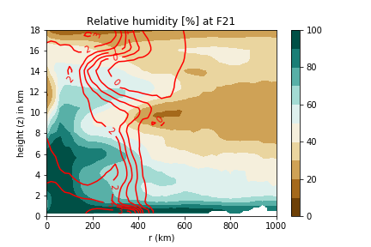
and basic state

Slide 40
Optimal Perturbations
Perturbations which have minimum energy, e, at the initial time and evolve to change response function by α πρεσχριβεδ αμουντ, δΡ

Slide 41
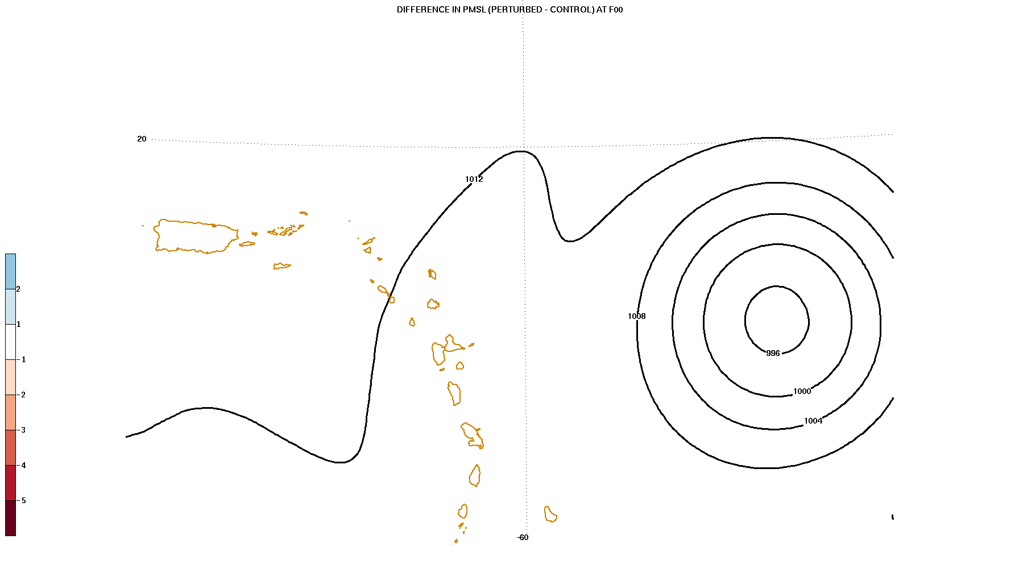
Evolution of optimal perturbation (KE)
Initial perturbation size:

Slide 44
Results: Sensitivity to wind/vorticity
Sensitivities to the horizontal wind field reveal that cyclonic perturbations to the horizontal wind field (nearly centered on the TC location) prior to the response function time, results in a stronger cyclone.
Sensitivities to vorticity confirm this interpretation and an “Orr-like” mechanism at work
Consistent with inertial stability arguments for both the lower-troposphere and UT/LS
Sensitivity to radial flow shows no clear signal except for short-length adjoint integration

Slide 45
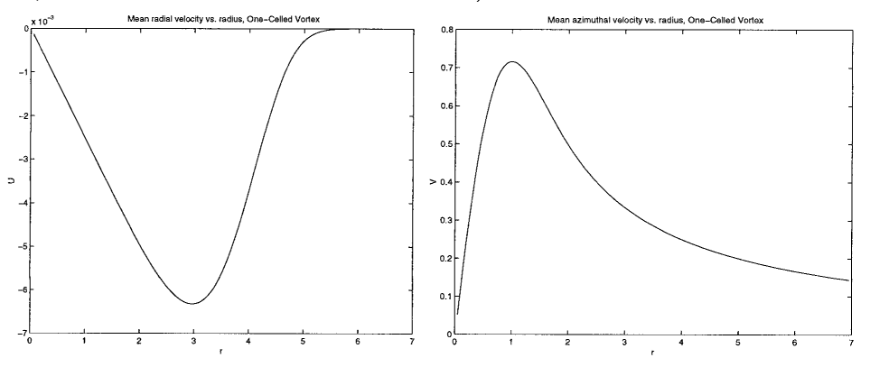
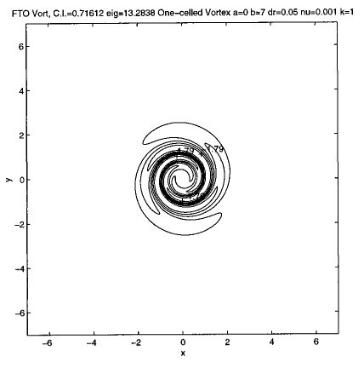
u_{θ}
u_{r}
finite-time optimal
Sensitivities are similar to those shown in Nolan and Farrell (1999): structures that spiral back against the flow of the vortex - indicative of how a perturbation must be initially configured so as to maximize the energy it acquires from the mean
Orr (1907) originally observed, the growth of a perturbation in linear, inviscid shear flow is determined solely by how far back against the shear the disturbance is originally tilted.
Nolan and Farrell (1999)

Slide 46
Results: Sensitivity to water vapor
Generally positive at all locations, maximizes in the eyewall region for shorter adjoint integrations, more distributed further out in the lower- and mid-troposphere for longer integrations
Distribution at the initial time appears to favor a more moist environment where the analysis is relatively dry.
Supports the notion that a more moist environment will support a stronger storm later and consistent with ideas of more moist environment will discourage downdrafts in the spiral band region

Slide 47
Results: Sensitivity to temperature
Very similar distribution to sensitivities to water vapor mixing ratio
Taken together, suggests increasing the equivalent potential temperature (not necessarily the relative humidity) in the outer band part of the TC at earlier times and the near-TC environment for shorter adjoint integrations.
Maximized nearest the surface

Slide 48
Minimum central pressure vs. time

