Slide 1
Using the Ensemble Forecast Sensitivity to Observations (EFSO) technique for global observing system experiments (OSEs)
*Akira Yamazaki (JAMSTEC, Japan) yzaki@jamstec.go.jp
Takemasa Miyoshi (RIKEN)
Takeshi Enomoto (Kyoto U)
Nobumasa Komori (JAMSTEC)
Jun Inoue (National Institute for Polar Research)
5 July 2018
Workshop on Sensitivity Analysis and Data Assimilation in Meteorology and Oceanography (Aveiro, Portugal)

Slide 2
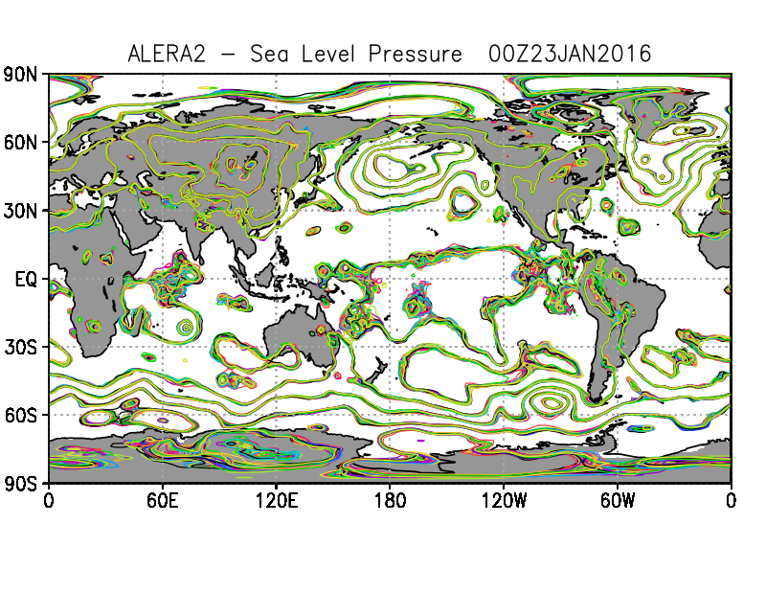
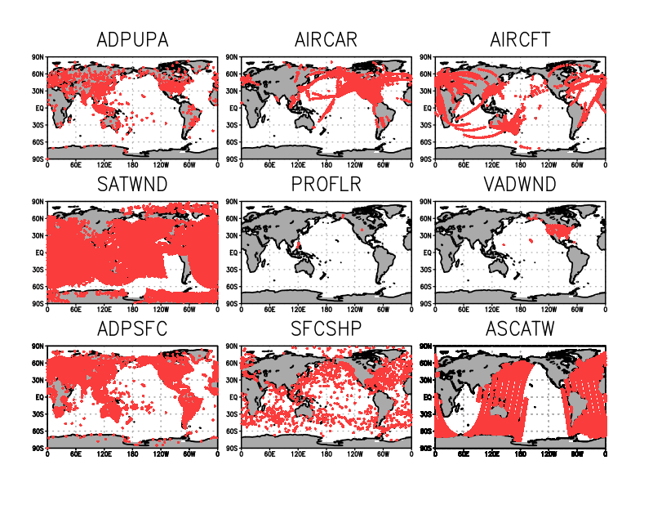
AFES-LETKF experimental global ensemble reanalysis（ALERA）
 | ALERA
model | AFES (Atmospheric GCM) T119L48 (~1°×1°, up to ~3 hPa)
DA scheme | LETKF
Ensemble size | 63
Localization | 400 km (horizontal) / 0.4 lnp (vertical)
covariance inflations | 10% (uniform)
Observations | Conventional analysis (sonde, aircraft, surface obs, ship) + satellite wind (NCEP PREPBUFR)
Assimilation window | 6 hour
(re)analysis period | July 2008–May 2018 (ongoing)

Slide 3
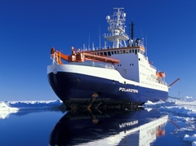
Global observing-system experiments (OSE) using ALERA
Fcst from data-denied analysis
Analysis (ALERA)
Forecast w/ radiosonde obs by a ship.
Case of the ‘great’ Arctic cyclone in August 2012 (Yamazaki et al. 2015 JGR-A)
Various OSE (data denial) exps to estimate impacts by special obs campaigns (espacially radiosondes) using ALERA: http://www.jamstec.go.jp/alera/alera.html
Data sparse region => obs impacts would be large
Can we determine optimal observation regions/periods w/o conducting OSEs (data denial exps)?

Slide 4

EFSO (Ensemble-based FSO) Kalnay et al. (2012 Tellus), Ota et al. (2013 Tellus), Hotta et al. (2017 MWR)
EFSO:
Verifying truth: LETKF mean analysis
Evaluation lead time: 6 hour (Hotta et al. 2017)
Error norm: Moist total energy [J/kg]
The moving localization scheme (Ota et al. 2013)
↑
Evaluation time
EFSO values (Δe²) estimate impact of each obs against 6-hr forecast w/o recycling DA cycles.
How quantitatively the EFSO can estimate the obs impact for global OSE (data denial) studies?
Notes:
To help the OSE studies using ALERA, we newly introduce or implement EFSO diagnosis to the ALEDAS.
FSO technique enables for the quantification of how much each observation has improved or degraded the forecast.
FSO formation was originally developed by using adjoint approach which requires the adjoint of both the model (M) and of the Kalman gain (K).
Kalnay et al. proposed a new approach to substitute the ensemble forecast perturbations in model space (X^f) and analysis ensemble perturbations in observation space (Y^a) for the adjoint part.
In this formulation, the Kalman gain is approximated by the covariance of forecast perturbation in model space and analysis perturbation in the obs space.
If we exchange the forecast perturbation for the analysis perturbation, we can obtain the increment by specific observations, so that if we have Y^a observation impacts can be estimated diagnostically without actual data denial experiments.
Here is the settings for EFSO in our DAS.
We evaluate the EFSO impact with 6-hour evaluation time.
The norm C used here is the moist total energy, thus we hereafter compare the EFSO and diagnostic DD impacts with the mertic of the MTE.

Slide 5
Total (global) EFSO values

Slide 6
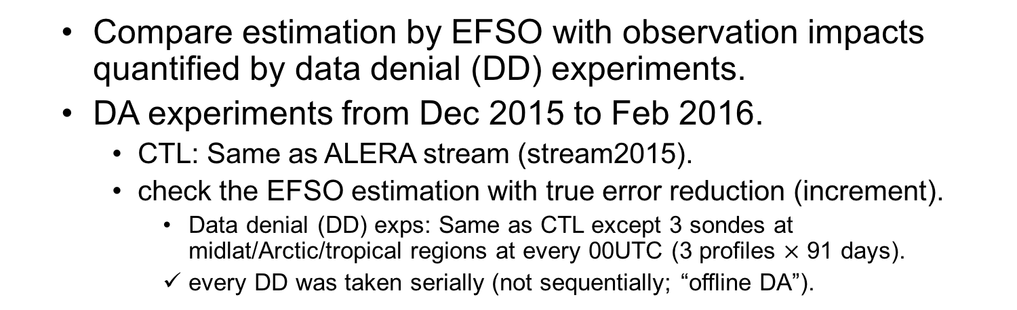
Data denial experiments for 3 radiosondes
Compare estimation by EFSO with observation impacts quantified by data denial (DD) experiments.
DA experiments from Dec 2015 to Feb 2016.
CTL: Same as ALERA stream (stream2015).
check the EFSO estimation with true error reduction (increment).
Data denial (DD) exps: Same as CTL except 3 sondes at midlat/Arctic/tropical regions at every 00UTC (3 profiles $×$ 91 days).
every DD was taken serially (not sequentially; “offline DA”).
1 Dec | 2 Dec | 3 Dec | … |  |  | … | 29 Feb
Analysis stream (CTL)
data denial (91 times)
DD analysis
Day 0
Day 1
Day 2
Day 7
Fcst
91 times
includes 2 runs
from CTL & DDexp
Day 0
Day 1
Day 2
Day 7
Day 0
Day 1
Day 2
Day 7
Notes:
O(10⁷)， O(10²–10³)
O (8$×$10⁵)

Slide 7
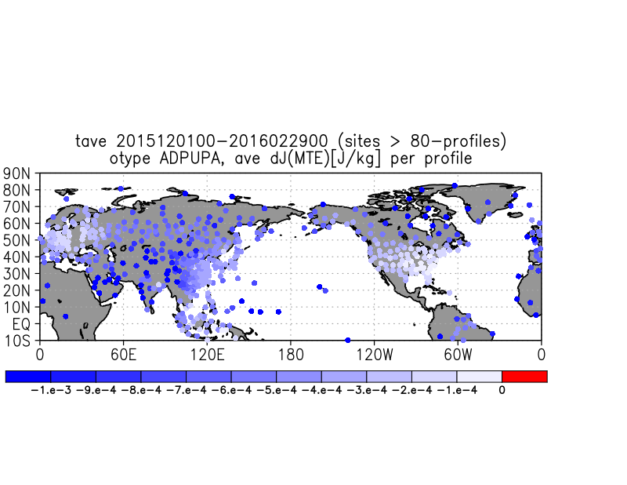
EFSO values (radiosondes) and DD sondes
pol4
pol2
pol3
pol
mid
Jpn
mid2
mid3
tro
tro4
tro2
tro3
EFSO values are not determined only by obs density.

Slide 8
Time sequences of EFSO and fcst diff (DD_{pol})
Fcst diff: total moist energy (DDexp – CTL fcsts)
Truth: DD–CTL
obs impacts
EFSO value
1-day fcst
larger
Fcst diff
6-day fcst
Larger
Notes:
EFSO values of some radiosondes show positive obs impacts in average and time variations in 1–3 day scale.

Slide 9
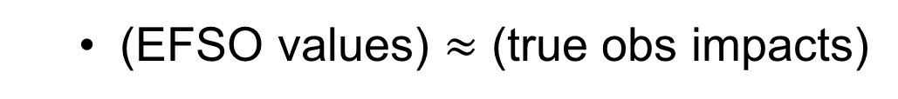
Truth (CTL–DDexps) vs EFSO value
ave. 91 days (times)
midlatitudes
Tropics
Arctic
(EFSO values) $≈$ (true obs impacts)

Slide 10
Fcst diff of CTL–DD (Ave.)
ave. 91 days (times)
Larger
Fcst diff
(CTL–DD)
in moist TE
[J/kg]
Fcst diff
midlatitudes
Tropics
Arctic
6
Valid fcst time [hr]
(In our reanalysis system) obs in the Arctic regions have the largest impacts for 7-day fcsts.

Slide 11
cont’d
Arctic
midlatitudes
Tropics
6
= Evaluation time
Relative differences in initial impacts (at 6-hour) tend to remain during the forecasts.

Slide 12
Corr. (EFSO estimation, truth)
sample number: 91
6
Obs impacts are more correlated with truth for Arctic and tropical obs than those in midlatitudes.

Slide 13
cont’d
Initial high correlations (at 6-hr) tend to remain.

Slide 14
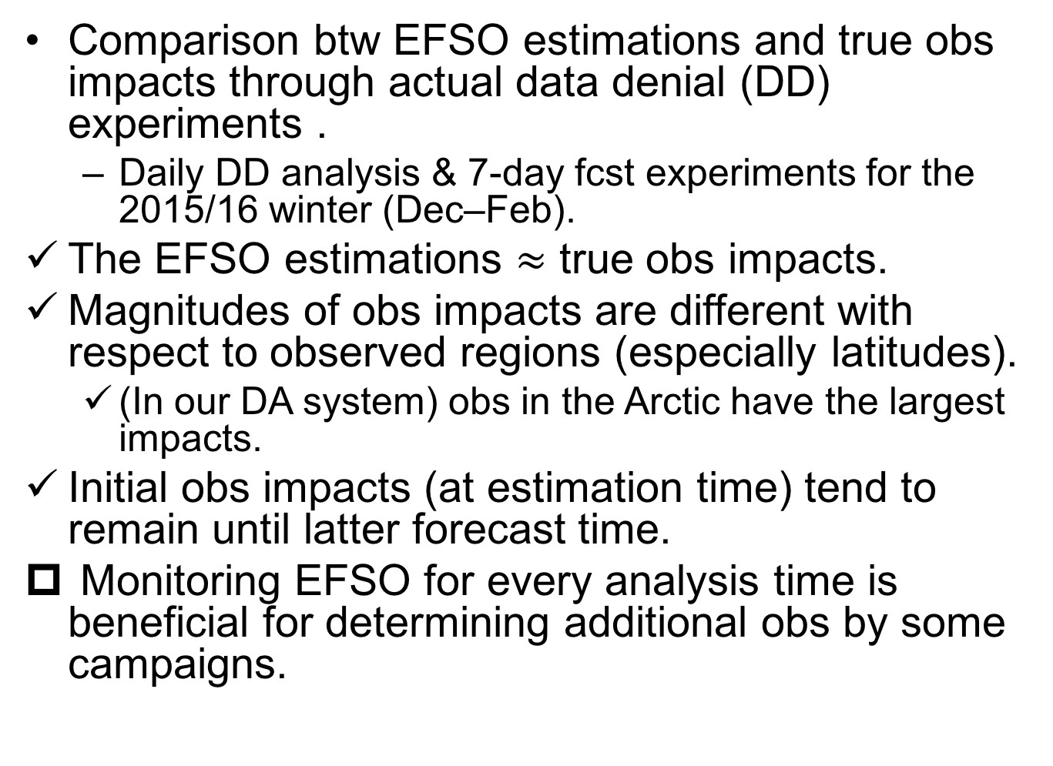
Conclusion
Comparison btw EFSO estimations and true obs impacts through actual data denial (DD) experiments .
Daily DD analysis & 7-day fcst experiments for the 2015/16 winter (Dec–Feb).
The EFSO estimations $≈$ true obs impacts.
Magnitudes of obs impacts are different with respect to observed regions (especially latitudes).
(In our DA system) obs in the Arctic have the largest impacts.
Initial obs impacts (at estimation time) tend to remain until latter forecast time.
Monitoring EFSO for every analysis time is beneficial for determining additional obs by some campaigns.

Slide 16
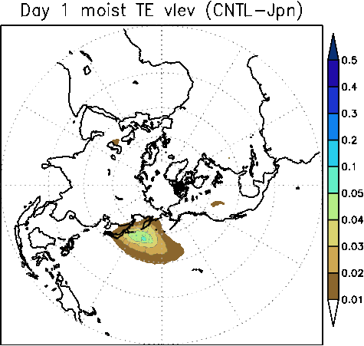
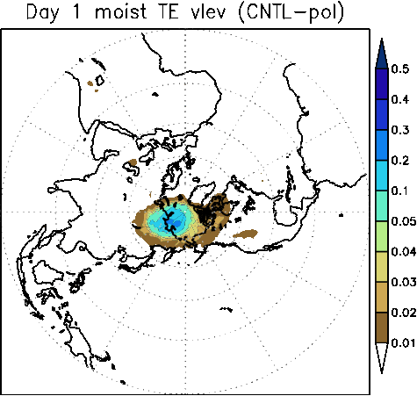
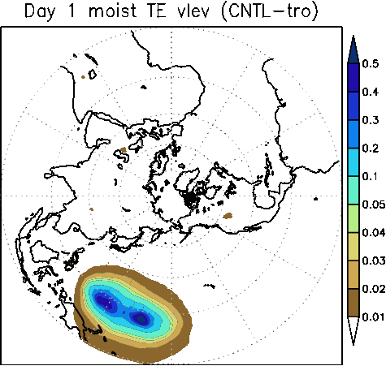
Time evolutions of CTL–OSE (Moist TE)
Jpn
Pol
Tro

Slide 17
Jpn
CTL–OSE [J/kg]
Pol
Tro

Slide 18
Performance of ALERA
[gpm]
ALERA vs ERAI
JRA-55 vs ERAI
Notes:
Here I show a performance of ALERA by comparing with other high-performance reanalysis datasets.
We can find global SLP patterns and absolute values in ALERA have good agreement with those in ERAI.
Right panel shows the time series of the RMS difference in Z500 between ALERA and ERAI during Jan – Feb of 2014-2016.
The difference btw ALERA and ERAI is about 14-15 gpm.
The difference btw JRA-55 and ERAI is 4gpm, so that error of ALERA is about 3-4 times as large as difference in the high-performance reanalyses.
The error would be permissible to reproduce for synoptic- and large-scale atmospheric phenomena for global OSE studies.

Slide 20
AFES(AGCM)-LETKF experimental Ensemble ReAnalysis: ALERA
 | ALERA (version 2)
Model | AFES T119L48 (~1°×1°, up to ~3 hPa)
Analysis scheme | LETKF
Ensemble size | 63
localization | 400 km (horizontal) / 0.4 lnp (vertical)
Inflation | 10% (fixed)
Observation | NCEP PREPBUFR
Boundary condition | OISST/ICE daily ¼°
DA window | 6 hour
References | Miyoshi & Yamane (2007 MWR); Miyoshi et al. (2007a;b SOLA); Enomoto et al. (2013); Yamazaki et al. (2017 SOLA)
Implement EFSO
2008 | 2009 | 2010 | 2011 | 2012 | 2013 | 2014 | 2015 | 2016 | 2017
ALERA (version 1)
May 2005–January 2007
stream2008
stream2013
ongoing
(until ~1/2 month before)
stream2010
stream2015
1 Aug 2010
5 Jan 2013
30 Sep 2015
Notes:
Using the AFES-LETKF data assimilation system, an experimental atmospheric global, ensemble reanalysis has been generated, called ALERA.
As will be mentioned after, this DAS and reanalysis have been mainly used for OSE studies to some obs campaigns.
This is the description of the DAS.
AFES is a typical AGCM whose physics schemes are common to many forecast and climate models.
Analysis scheme is the LETKF originally proposed by Miyoshi and Yamane (2009) but with distance-based covariance localization
For the obs, NCEP PREPBUFR are used which includes conventional atmospheric observations (surface pressure reports, radiosondes, wind profilers, and aircraft reports) and satellite-based wind data except satellite radiances.
Now this ensemble reanalysis is the second generation, and the previous reanalysis was conducted for May 2005-Jan2007.
Using the 2nd generation of the DAS, we have conducted DA experiments from 2008 to early 2017. and it will reach almost real-time soon provided the observation & BC data can be available.
Continuing to conduct reanalysis, we have taken several minor updates of the DAS when switching streams of the reanalysis dataset.
After the stream started at Sep 2015, we have implemented the ensemble-based FSO into the DAS, and added new outputs related to the FSO into the reanalysis dataset.

Slide 24
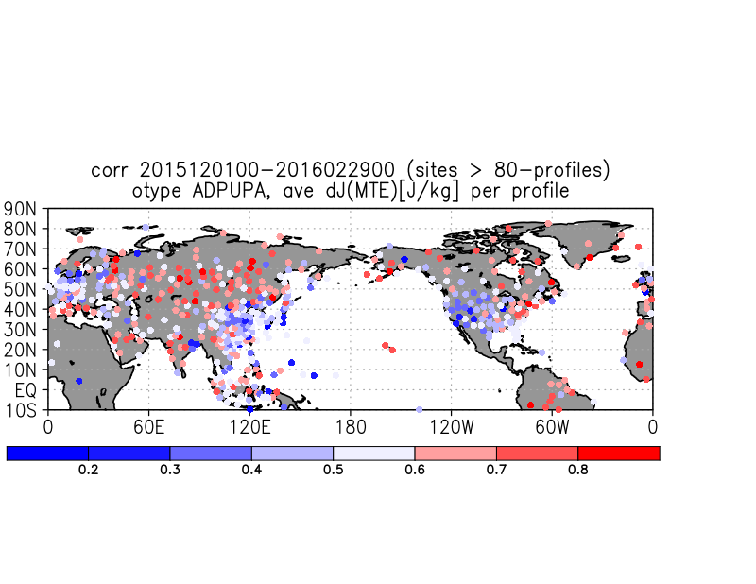
Corr (Δe², Δd²)
Δd =

Slide 25
Estimation: Corr (Δd², Δe²)
Corr (FT06_diff, Δe²)
diag DD impact estimation: Δd =

Slide 29
