Slide 1
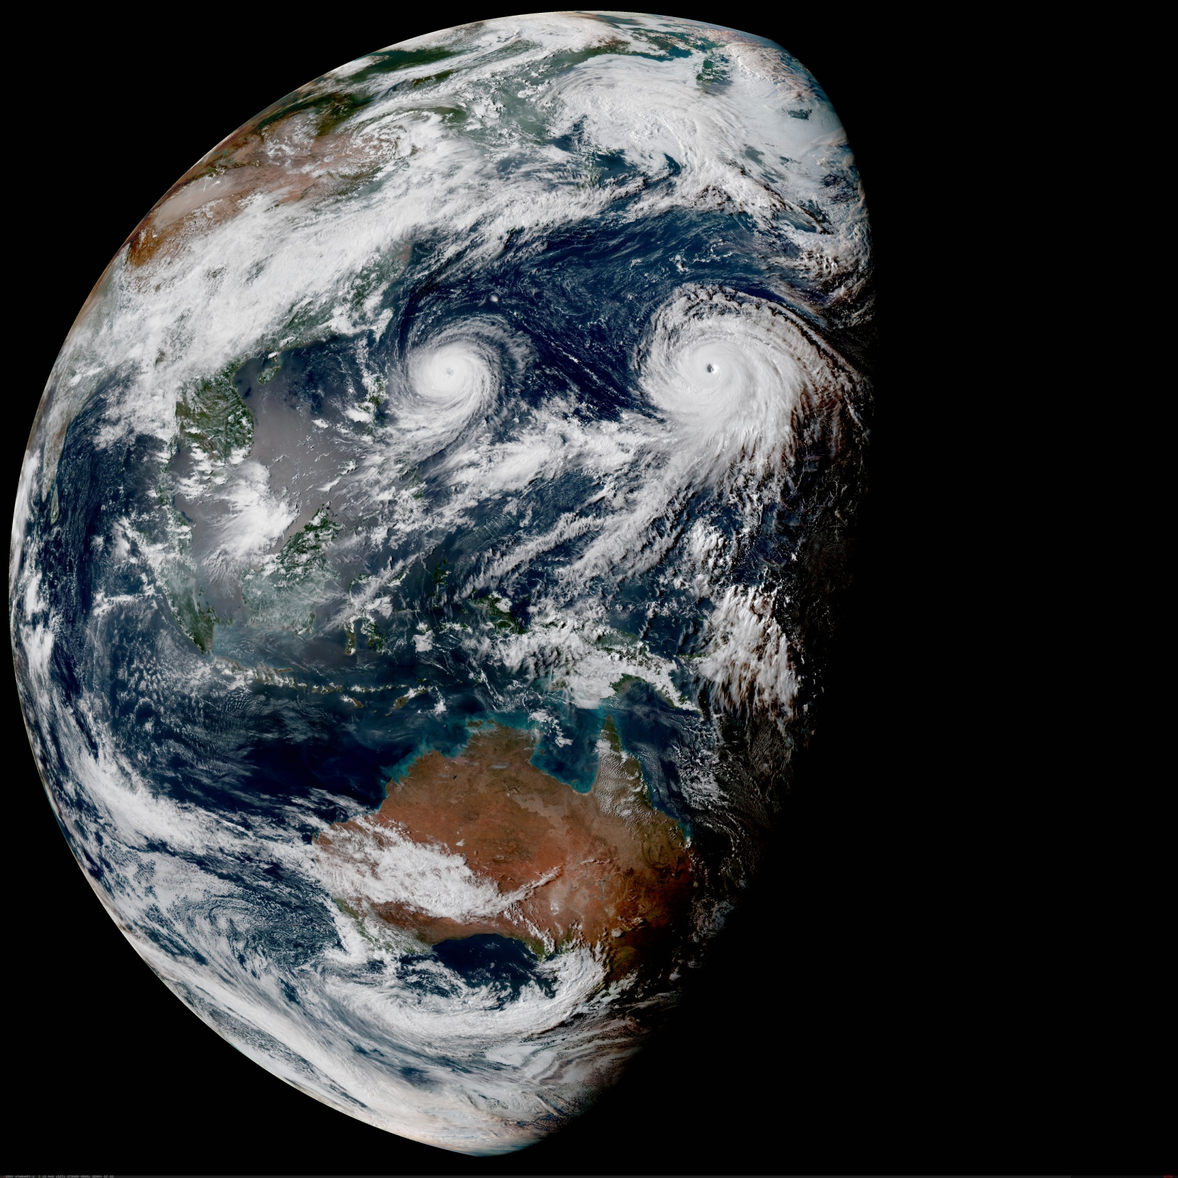



Variational assimilation of GPS radio-occultation observations in cloudy conditions
François Vandenberghe, JCSDA
Thomas Auligné, JCSDA
JCSDA Science Workshop, Boulder, May 29 -June 1st, 2018

Slide 2
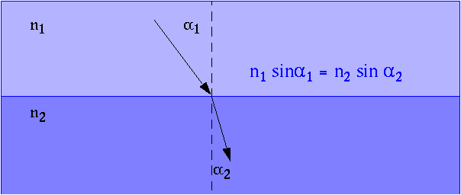
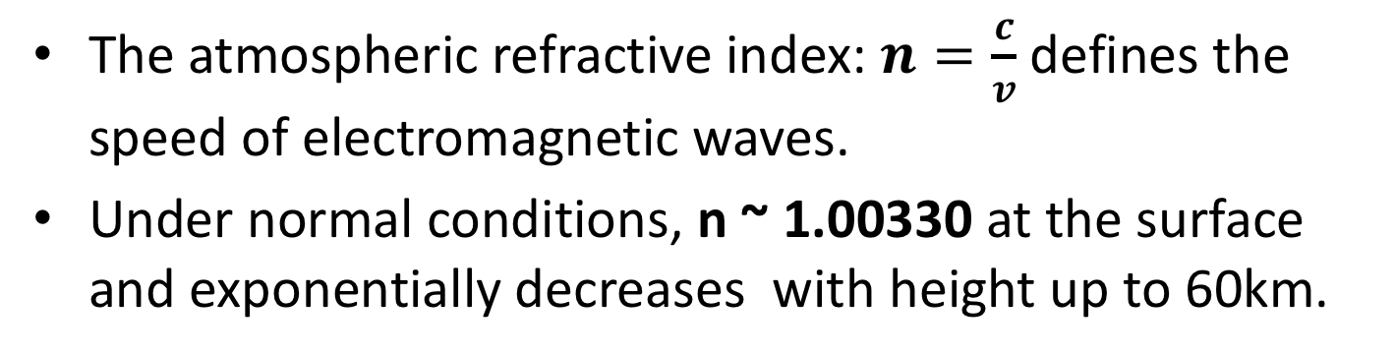
Electromagnetic Propagation
The atmospheric refractive index: $n=\frac{c}{v}$ defines the speed of electromagnetic waves.
Under normal conditions, n ~ 1.00330 at the surface and exponentially decreases with height up to 60km.
Electromagnetic Propagation in the Atmosphere

Slide 3
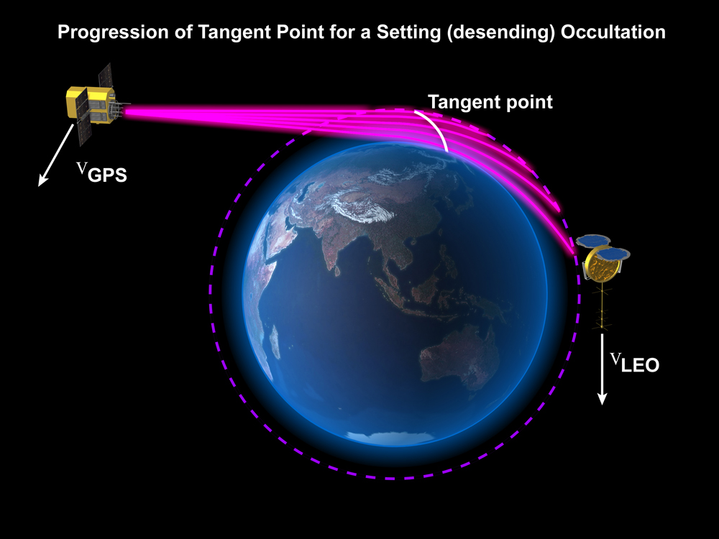
Radio Occultation with GNSS
basic measurement:
Precise measurement in time of phase delay and amplitude
Notes:
… so once the orbits have been determined well it is possible to determine atmospheric profiles.
The lower right panel on this slide shows a birds-eye view of the CHAMP satellite in LEO. The white line indicates the ray to the GPS satellite, which is not shown and the white dot shows the location of the tangent point introduced in the top left panel.
As the tangent point descends through the atmosphere, the temperature profile is shown in the little panel to the right of the globe.
The temperature profiles are obtained in post processing.

Slide 4
Radio-Occultation Geometry

Slide 5
Radio-Occultation Retrievals
Phase delays L¹ & L²
Precise orbit determination
Doppler shifts f_{d}¹ & f_{d}²
Snell Law
n_{GPS}sin𝜶_{GPS}=n_{LEO}sin𝜶_{LEO}
Bending angles a¹ & a²
Ionospheric Correction
n ~ 1/f ²
Bending angle a
Abelian Inversion
spherical symmetry
1D operator
2D
operator
Refractivity profile n
1D-VAR
prior information
1D operator
P, T, Q

Slide 6
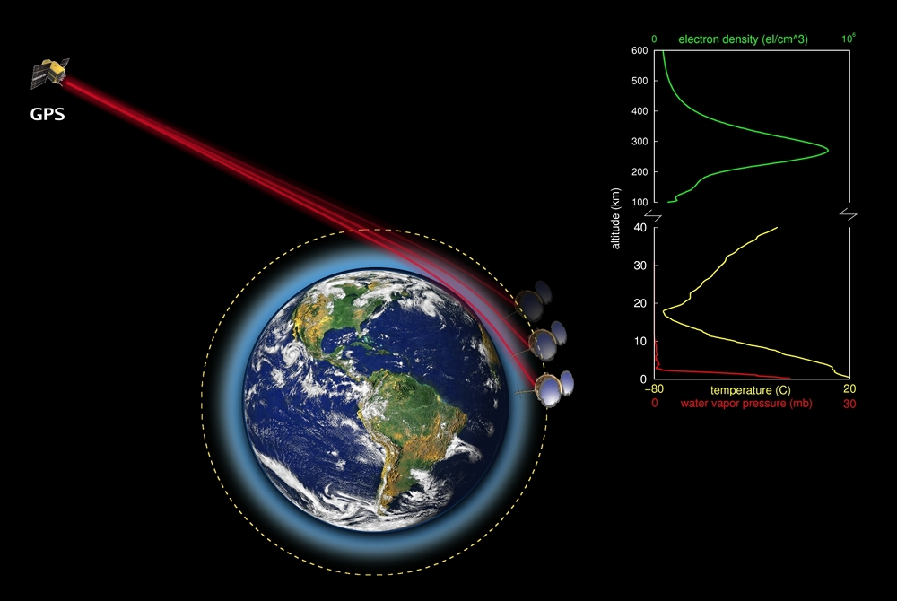
GPS Radio Occultation 1D Inversion

Slide 7
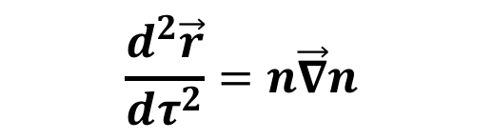
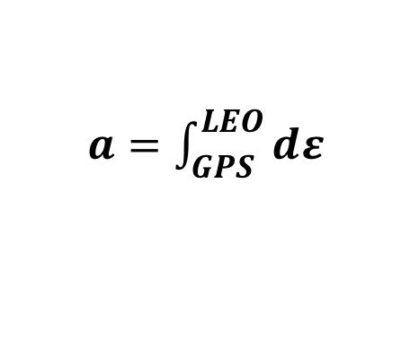



Radio-Occultation Forward Operator
(2-D raytracing)
n_{ij+1k+1}
n_{i+1j+1k+1}
1) Refractivity
n_{i+1j+1k}
$$n=f(P,T,Q)$$
n_{ij+1k}
$$dε$$
2) Ray Equation
$$n\vec{∇}n$$
n_{i+1jk+1}
$$\frac{d^{2}\vec{r}}{{dτ}^{2}}=n\vec{∇}n$$
n_{i+1j+1k}
3) Bending angle
$a=\int_{GPS}^{LEO}{dε}$
n_{ijk}
n_{i+1jk}

Slide 8




Radio-Occultation Assimilation
(2D-operator)
n_{i-1j+1k+1}
n_{ij+1k+1}
n_{i+1j+1k+1}
n_{ij+1k}
n_{i+1j+1k}
n_{i-1j+1k}
$$dε$$
$$n\vec{∇}n$$
n_{i-1jk}
n_{ijk}
n_{i+1jk}
$$\frac{d^{2}\vec{r}}{{dτ}^{2}}=n\vec{∇}n$$
Ray equation
$a=\int_{GPS}^{LEO}{dε}$
Bending angle

Slide 9
Radio-Occultation Assimilation
(2D-operator)
Refractivity N = 10⁶(n-1) along a ray with perigee near 800hPa

Slide 10
Atmospheric Refractivity
Atmospheric refractivity N = 10⁶(n-1):
cloud effects
90%
9%
< 1%
Cloud liquid and ice contributions are small and have been neglected in operational implementations

Slide 11
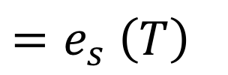
Water Vapor Pressure
Water vapor pressure for non saturated air:
Water vapor pressure at saturation:
${=e}_{s}$ $\left(T\right)$

Slide 12
Unsaturated/saturated vapor pressure
Studies with collocated CloudSat data show 0.5~1K colder retrievals when saturation is ignored in presence of clouds at perigee points (Yang et al 2013)
Similar errors can be expected with 1D operator in assimilation.

Slide 13
Unsaturated/saturated vapor pressure
Accounting for saturation in assimilation with 2D operators poses some challenges:
  Clouds in the first guess must be at the right locations along the ray.
  Hydrometeors must be control variables, with moist physics.

Slide 14
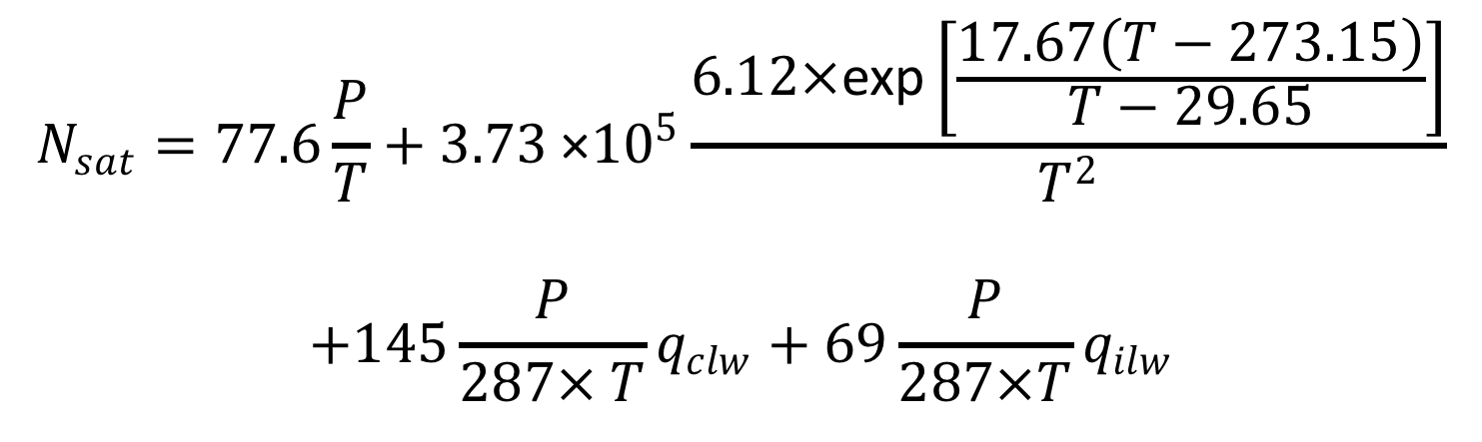
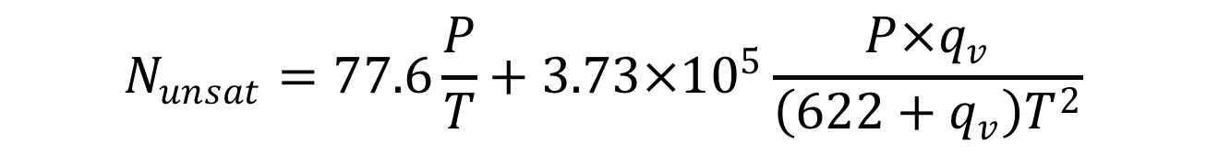
N as function of model variables
Refractivity for non saturated air:
$$N_{unsat}=77.6\frac{P}{T}+3.73×{10}^{5}\frac{P×q_{v}}{\left(622+q_{v}\right)T^{2}}$$
Refractivity at saturation:
$$N_{sat}=77.6\frac{P}{T}+3.73{\text{ ×}10}^{5}\frac{6.12×\text{exp}\left[\frac{17.67\left(T−273.15\right)}{T−29.65}\right]}{T^{2}}$$
$$+145\frac{P}{287× T}q_{clw}+69\frac{P}{287×T}q_{ilw}$$

Slide 15
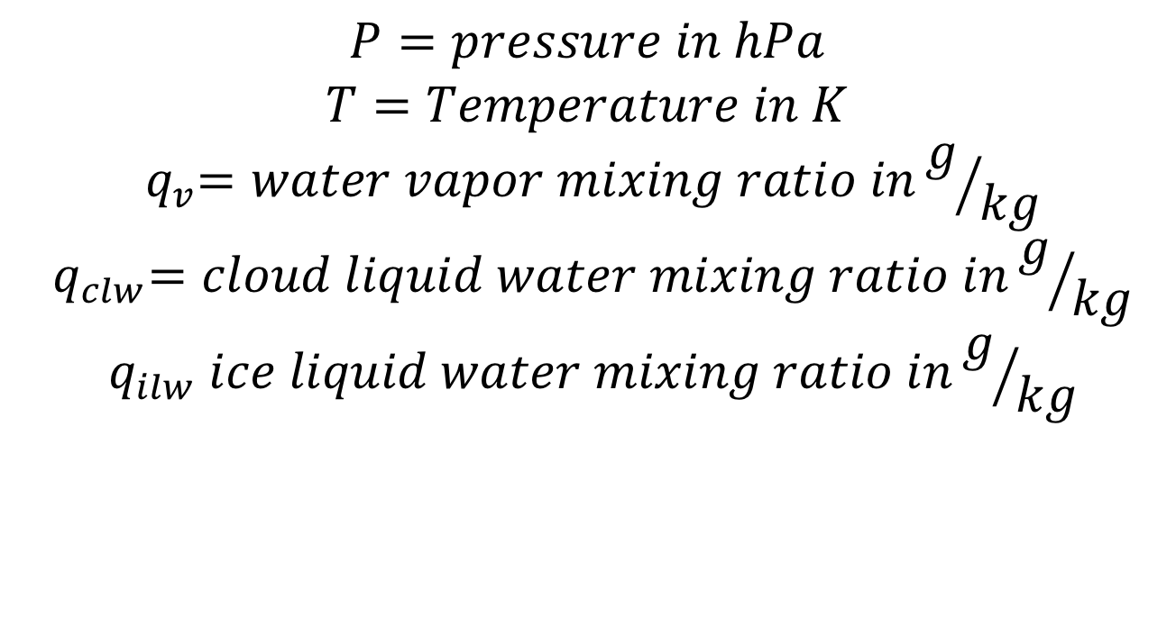
Assimilation of GNSS-RO
$$P=pressure in hPa$$
$$T=Temperature in K$$
$${ q}_{v}=water vapor mixing ratio ing/{kg}$$
$${ q}_{clw}=cloud liquid water mixing ratio ing/{kg}$$
$${ q}_{ilw} ice liquid water mixing ratio ing/{kg}$$

Slide 16
Refractivity as Function of RH

Slide 17
Refractivity as Function of RH

Slide 18

Smoothing
Refractivity for non saturated air:
$$N=\frac{1}{2}\left(\begin{aligned}(tanh\left[RH−RH^{∗}\right]+1){∗N}_{sat} \\ −{(tanh{[RH−RH^{∗}]}−1)∗N}_{unsat}\end{aligned}\right)$$

Slide 19
Refractivity as Function of RH

