Slide 1

The Joint Effort for Data assimilation Integration
What is JEDI?
Yannick Trémolet
Joint Center for Satellite Data Assimilation (JCSDA)
Adjoint Workshop – 3 July 2018

Slide 2
Joint Effort for Data assimilation Integration
General idea and design
Where we are
Infrastructure and working practices
Notes:
White background is probably better for the remainder of the slides.

Slide 3
JEDI: Motivations and Objectives
The Joint Effort for Data assimilation Integration (JEDI) is a collaborative development between JCSDA partners.
Develop a unified data assimilation system:
From toy models to Earth system coupled models
For research and operations (including R2O/O2R)
Unified observation (forward) operators (UFO)
  Share operators between JCSDA partners
  Faster use of new observation platforms
  Build a community app-store of observation operators
Share as much as possible without imposing one approach
  Not a new data assimilation method

Slide 4
Abstract Design: separation of concerns
Abstract Layer - OOPS
Generic
Applications
Forecast
4D-Var
EnKF
PF
…
Uses
Abstract building blocks
State
Model
Covariance
Observations
Implements
Systems
Lorenz
FV3 + GSI
MOM6
…
Abstract interfaces are the most important aspect of the design

Slide 5
Generic Programming: Why not Fortran?
module generic_min
interface min
module procedure min_int, min_real
end interface
contains
function min_int(x, y) result (z)
integer x, y, z
if (x<y) then
z = x
else
z = y
endif
end function min_int
function min_real(x, y) result (z)
real x, y, z
if (x<y) then
z = y
else
z = x
endif
end function min_real
end module generic_min
It is possible to write generic subroutines or functions in Fortran
However, the code is repeated for each implementation
In C++ the code is not repeated:
template<class T>
T min(const T x, const T y) {
if (x < y) {
return x;
} else {
return y;
}
}
The advantage becomes obvious when the function is long and complex: 4D-Var cost function…

Slide 6
Model Design: x_{t}=M(x₀)
grid.create(…)
model.create(…)
Setup
(lots of stuff)
model.initialize(…)
model.initialize(…)
A model step determines the time resolution for DA
Going inside the model is outside the scope of JEDI
Time Loop
Timestep
model.step(…)
Clean-up
(sometimes)
model.finalize(…)

Slide 7
Observation Operators
State
Observations
Obs. Operators
In most existing systems, observation operators directly access state/model data
Observation operators, and as a result DA systems, are very model specific

Slide 8
UFO: the interface advantage
Obs. Locations
Variables
State
Obs. Operators
Observations
Field Values
at Locations
JEDI/UFO introduces standard interfaces between the model and observation worlds
Observation operators are independent of the model and can easily be shared, exchanged, compared

Slide 9
Joint Effort for Data assimilation Integration
General idea and design
Where we are
Infrastructure and working practices
Notes:
White background is probably better for the remainder of the slides.

Slide 10
Observation Space Interfaces Status
Initial implementation of interface classes
  Locations
  Variables
  GeoVaLs (Geophysical Values at Locations)
Currently (May 2018):
  Radiosonde, aircraft
  CRTM radiances (tested for AMSU-A) and AOD
  GNSSRO in progress
  Marine observations
  Interface for QC filters
Interface for Observation Data Access (IODA) v0 based on NetCDF4

Slide 11
Models Interfacing Status
 | State | 3D H(x) | M(x) | 4D H(x) | 3D-Var | TL/AD | 4D-Var
FV3-GFS (NOAA) | X | X | X | X | X | N/A | X
FV3-GEOS (NASA) | X | X | X | X | X | X | X
MPAS (NCAR) | X | X | X |  | X | N/A
WRF (NCAR/NOAA) | X
LFRic (UKMO) | X | X |  |  | X | ?
NAVGEM (NRL) | X
NEPTUNE (NRL) | X |  |  |  |  | ?
CICE5 (JCSDA/NOAA) | X | X |  |  | X | N/A
MOM6 (JCSDA/NOAA) | X | X |  |  | X | N/A
X = technically working X = in progress
Note: these are technical results, other aspects in progress or to come:
B matrix on Unstructured Mesh Package (BUMP, B. Ménétrier).
Observation error covariance, QC, bias correction

Slide 12
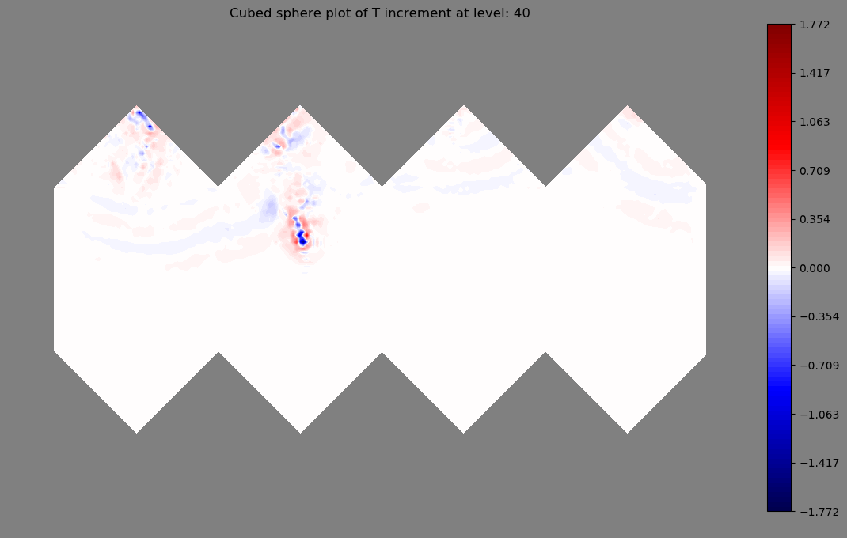
4D-Var with FV3 and AMSU-A
4D-Var on native cube-sphere grid
4D-Var on native cube-sphere grid
First 4D-Var run with satellite data, no adjustments
Use FV3 TL/AD from GMAO

Slide 13
Joint Effort for Data assimilation Integration
General idea and design
Where we are
Infrastructure and working practices
    What we are doing differently
Notes:
White background is probably better for the remainder of the slides.

Slide 14
Code and repositories
FV3GFS
GEOS
CRTM
MOM6
OOPS
UFO
MPAS
IODA
LFRic
Utilities
NEPTUNE
Observation and Model
Spaces are independent

Slide 15
Collaborating: Repositories
NRL
EMC
JEDI core
Forks
Central repo.
Push +
Pull request
GMAO
ESRL
Community
controlled
.edu
NCAR
Lab. controlled
Permission to fork repository are very easy to obtain
Contributing code is very controlled:
Pushing a branch requires write permission on central repository
Pull request triggers code review and approval for merging to higher level branch

Slide 16
Infrastructure, working practices
Project methodology inspired by Agile/SCRUM
  Adapted to distributed teams and part time members
Collaborative environment
  Easy access to up-to-date source code (github)
  Easy exchange of information (Confluence, zenhub)
Documentation, tutorials, JEDI Academy
Enforce software quality (coding norms, code reviews)
Notes:
White background is probably better for the remainder of the slides.

Slide 17
Infrastructure, working practices
Flexible build system (cmake-based)
Continuous Integration, Testing framework (coming)
  Toolbox for writing tests
  Automated running of tests (on push to repositories)
Effort on portability
  Automatic testing with several compilers
  JEDI available in containers (singularity)
Change in working practices takes time… but it’s happening

Slide 18
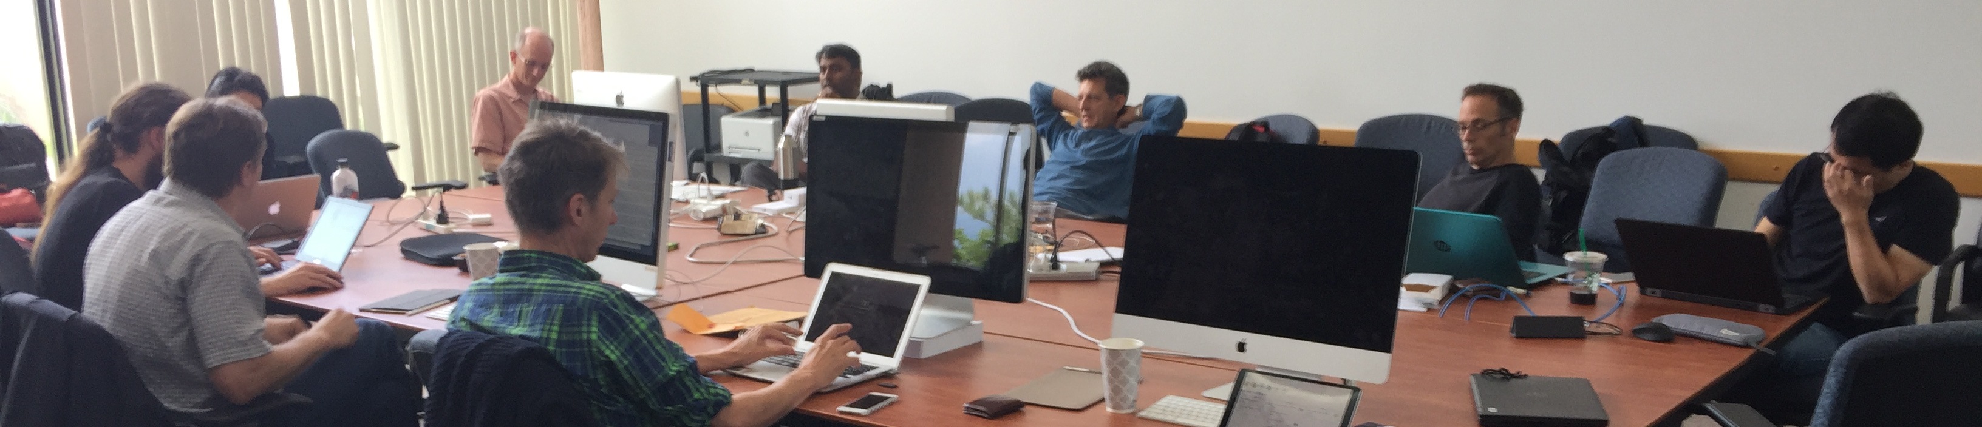
Code Sprints
Involve people from all partner institutions in project
Gather 8-10 people in a room for 2 weeks
  B Matrix (Aug. 2017, Aug. 2018), Observation Operators (Nov. 2017), Marine UFO (Apr. 2018), GNSSRO (Aug. 2018)…
Efficient use of time, especially for part time contributors
Very motivating (before, during, after)
Notes:
White background is probably better for the remainder of the slides.

Slide 19
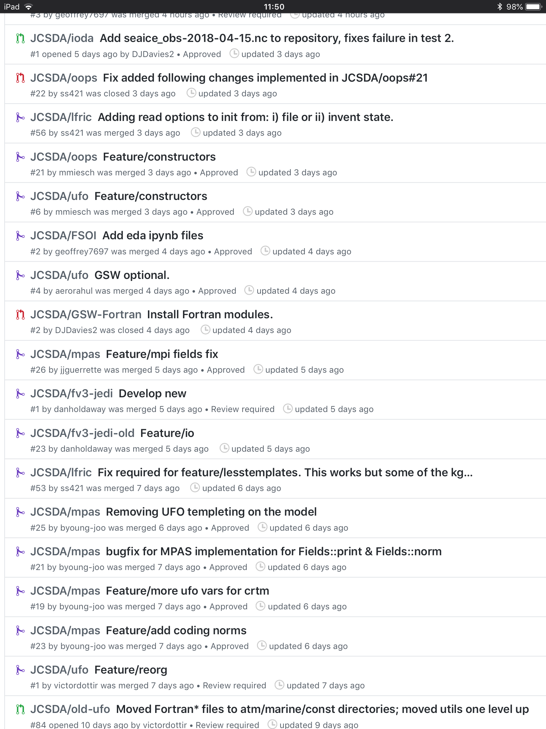
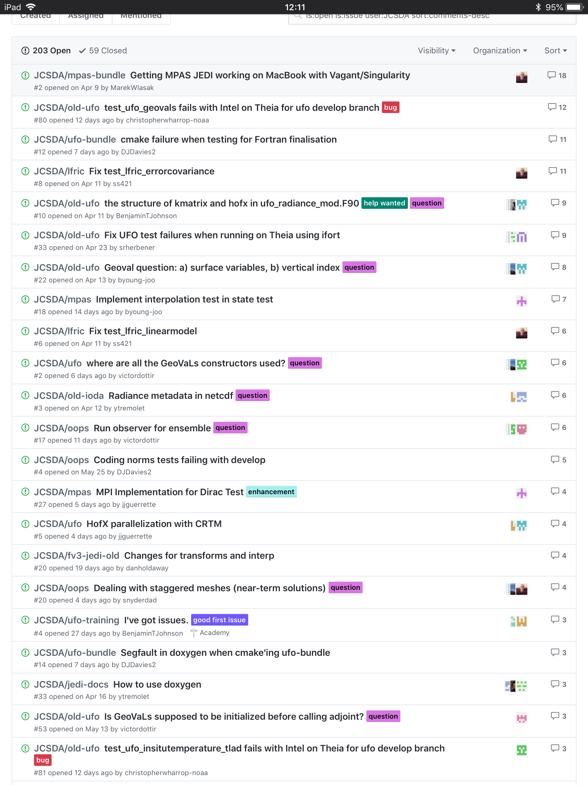
Collaborative work (not working groups)
Pull
Requests
(past week)
Discussions about issues

Slide 20
Thanks to all involved in developing JEDI
Anna Shlyaeva, Ben Johnson, Benjamin Ménétrier, BJ Jung, Bryan Flynt, Chris Harrop, Clara Draper, Dan Holdaway, David Davies, David Rundle, François Vandenberghe, Gael Descombes, Guillaume Vernières, Jeff Whitaker, Jing Guo, Marek Wlasak, Mariusz Pagowski, Mark Miesch, Ming Hu, Rahul Mahajan, Ricardo Todling, Sarah King, Scott Gregory, Sergey Frolov, Steve Herbener, Steve Sandbach, Tom Auligné, Xin Zhang, Yannick Trémolet…

