Slide 1
Observation Informed Generalized Hybrid Error Covariance Models
Workshop on Sensitivity Analysis and Data Assimilation in Meteorology and Oceanography
1-6 July 2018
Aveiro, Portugal
  Elizabeth Satterfield¹, Daniel Hodyss¹,
  David D. Kuhl², Craig H. Bishop¹
¹Naval Research Laboratory,
Monterey, California, USA
²Naval Research Laboratory,
Washington, DC, USA

Slide 2
Introduction
In a chaotic system like the atmosphere, the true error covariance of short term forecasts is highly flow dependent. Ensembles can capture such flow dependence, however limited ensemble size and imperfections in methods used for initial condition and model error perturbations mean that ensemble covariances are inevitably inaccurate.
Hybrid error covariance models, which combine flow dependent (localized, ensemble-based) and quasi-static (climatologically-based) error covariance estimates, have been shown to yield superior data assimilation performance.

Slide 3
Introduction
A primary aim of this work is to investigate the extent to which optimal hybridization parameters can be derived from an archive of (observation-minus-forecast, ensemble-variance) pairs generated by a single long run of a hybrid data assimilation scheme.
Such an approach is attractive due to its simplicity and flexibility, benefits from the use of observational information, and has the potential to greatly reduce the amount of time required to tune hybrid error covariance models

Slide 4
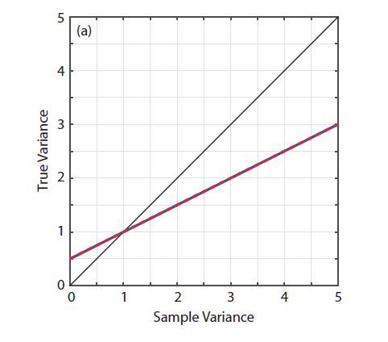
Regression Based Model for the True Prior Variance
Bishop and Satterfield (2013) detail a distribution of true variances, given an imperfect ensemble estimate.
Here, we generalize this idea by estimating the mean of this conditional density using the techniques of regression.
Although, in practice, the true error variance is unknown, this quantity can be estimated as the difference between the innovation variance and the observation error variance, where observation error variance estimates are obtained using methods of Desroziers et al. (2005) among others.
Binned Sample-True Variance
Linear Regression Fit
Flow
Dependent
Static

Slide 5
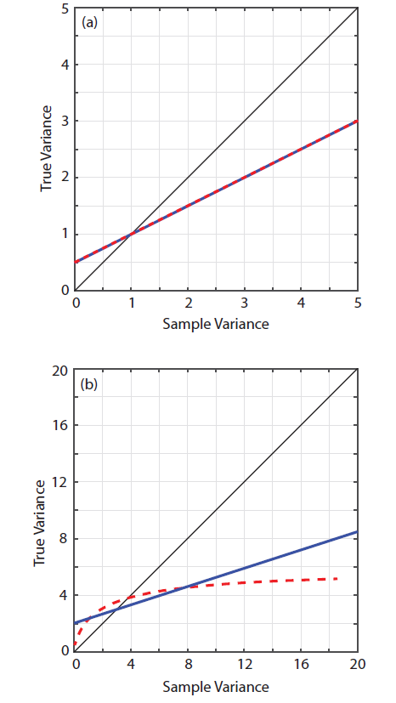



Regression Based Model for the True Prior Variance
A traditional linear model would take the form:
A nonlinear relationship between the ensemble variance and true error variance implies a more general form,
Binned Sample-True Variance
Linear Regression Fit
    σ_{t}²~Г⁻¹(α_{t}=3 β_{t}=2),
    σ_{t}²~a+bu, u~U(0,1)
Notes:
D represents nth power of the corresponding element in the diagonal matrix of variances

Slide 6
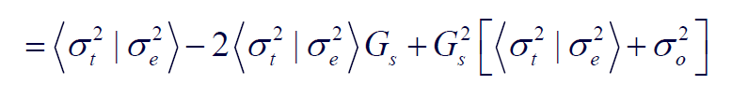
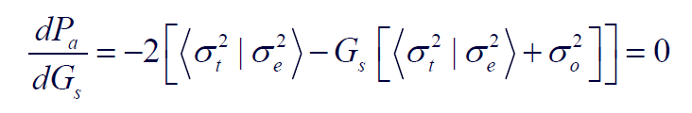
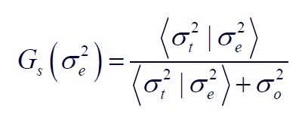
Defining the Kalman Gain
Average error variance in a Kalman state estimate is
We perform the standard operations to derive the Kalman gain, G, that minimizes the posterior error. We take the derivative of P_{a} with respect to G and set the result equal to zero.
Solving for G:
The gain that minimizes the posterior variance uses the expected true prior variance given an ensemble variance
Notes:
We did not know that this was the right gain to minimize the posterior MSE
Now we have proved that for the Gaussian priors and non-Gaussian priors when only accounting for sampling error in the variance
If prior is Gaussian we can account for sampling error in true prior mean by inflating the true prior variance given an ensemble variance by (1+1/N)
For non-Gaussian priors, the situation is more complicated since sampling error in mean and variance are correlated.

Slide 7
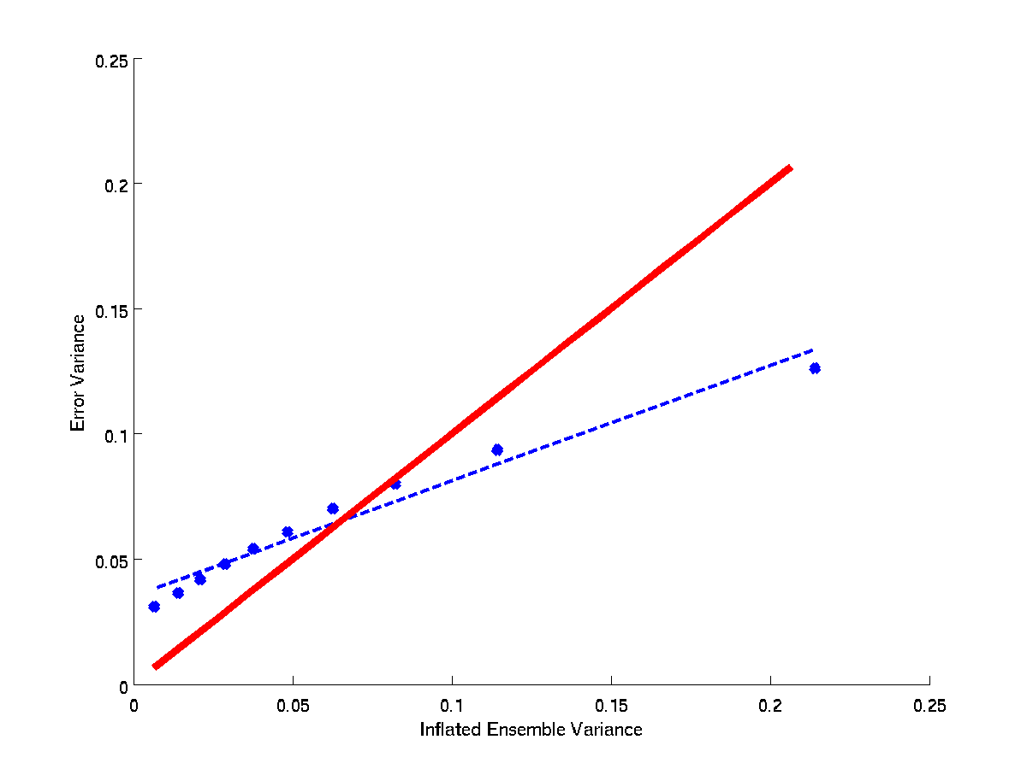
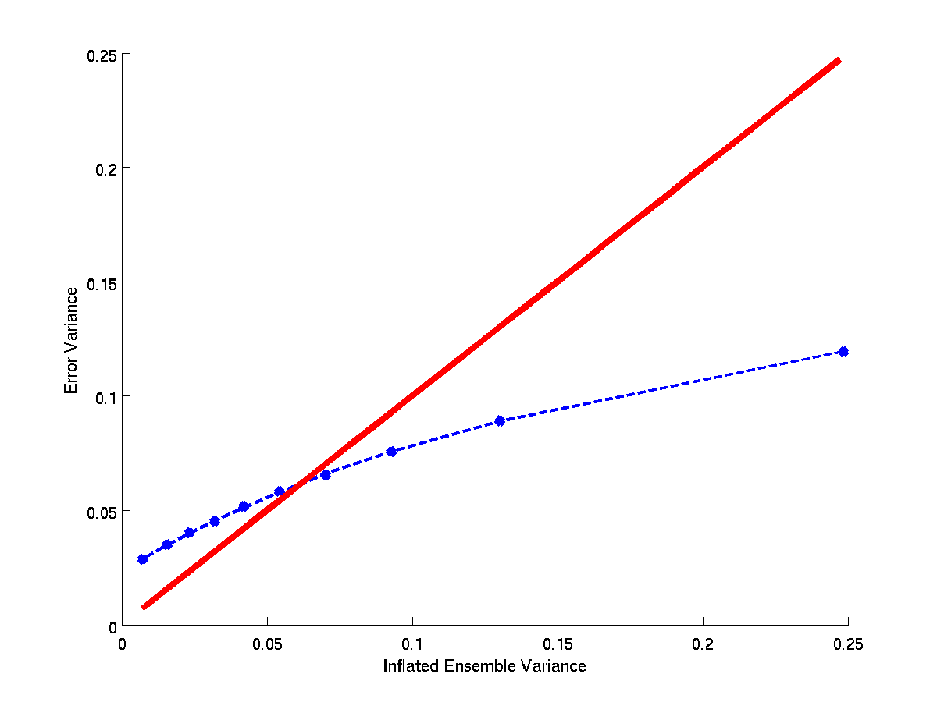
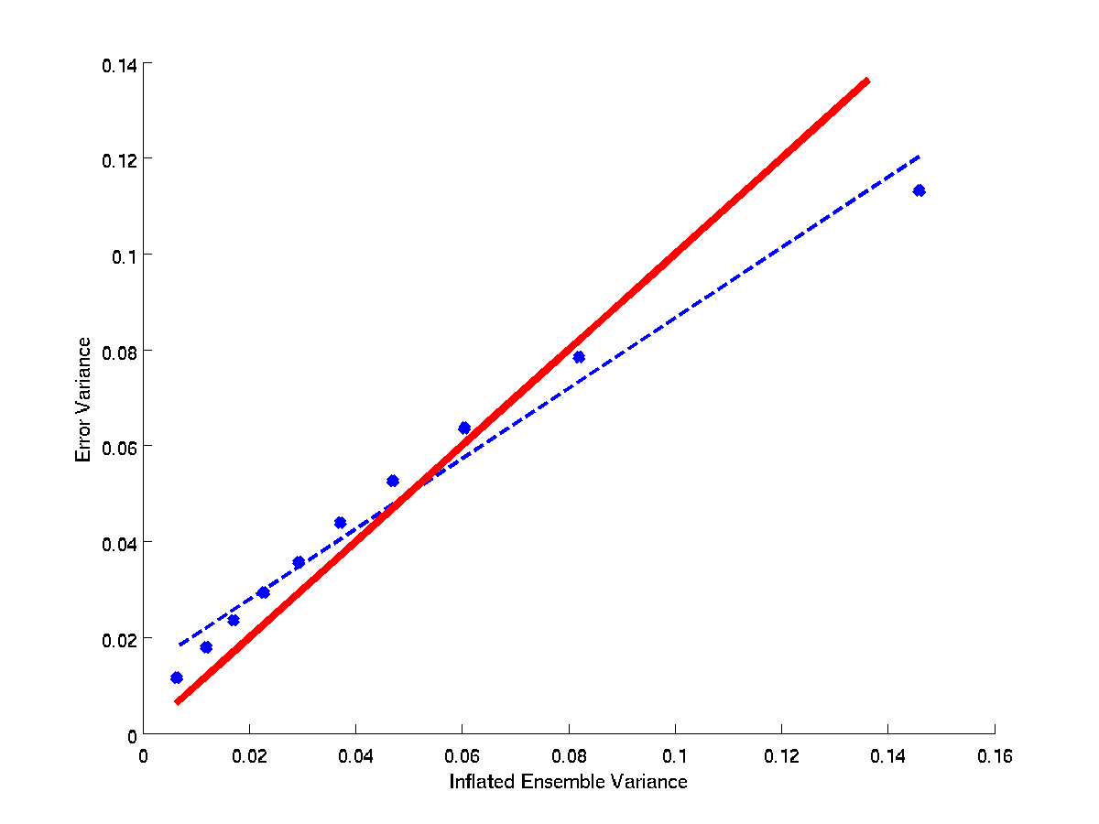
Lorenz ’96 Model Experiments
One-to-One
Binned Sample-True Variance
N_{e}=5
We assess the regression based models of hybrid error covariance using an implementation of the perturbed observations form of the Ensemble Kalman Filter (EnKF) on a 10-variable version of the Lorenz ’96 model.
Gaspari-Cohn localization is applied to the ensemble based covariance matrix
Every grid point is observed at each time step
Multiplicative variance inflation is used to ensure that the ensemble variance approximately equals the mean squared error.
A static error covariance matrix is generated from a 100,000 time step run of fully ensemble based system
Cubic regression gives a better fit than linear for 5–member case
linear
N_{e}=5
cubic
True Error Variance
For larger ensemble sizes, errors in the linear approximation are not as large
N_{e}=10
linear
Inflated Ensemble Variance

Slide 8
Lorenz ’96 Results: Tuning versus Regression Based Models
N_{e}=5
Linear regression underestimates the optimal w_{e}=0.7 found by “brute force” tuning
The cubic regression based hybrid shown in red gives a lower RMSE than any of the linear models.
w_{e}
Notes:
RMSE as a function of ensemble weighting for N=5
Also shown are the RMSE based on a linear regression (magenta) and cubic regression.
Lines indicate the mean of iterations 4-9 and error bars show the 95% confidence interval.
All experiments use an entirely ensemble based static.
For the N=5 “brute force” tuning experiment we get a minimum RMSE when alpha=0.6.
Due to the fact that the spread-skill relationship is curved the ensemble weights for linear model are underestimated in this case.
The cubic regression based hybrid shown in red gives a lower RMSE than any of the linear models, as would be expected based on the spread-skill plots.

Slide 9
Lorenz ’96 Results: Influence of Model Error and Observation Density
Brute force now finds minimum posterior error with w_{e}=0.6 consistent with a less accurate ensemble
Include model error by changing the forcing in the nature run from F=8 to F=10
Little difference is seen between the cubic and linear fits
Brute force minimum posterior error (calculated over all points) with w_{e}=0.7
Observe only 50% of the grid points
The cubic and linear fits converge
Notes:
In all the cases considered in this section, the cubic fit has either equally performed or outperformed the optimal weights found through brute force tuning. It is also found that the degree to which the cubic outperforms the best linear model is based on the curvature of the spread skill relationship, which depends on the performance of the ensemble.
These two results together indicate that there may be a range in which a higher order polynomial fit is preferable.

Slide 10
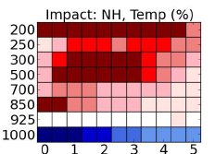
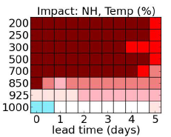
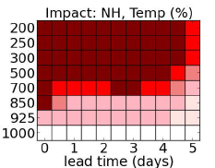
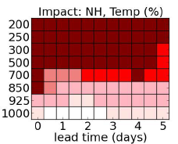
NAVGEM Results: Tuning versus Regression Based Models
Alpha=1.00
Alpha=0.75
Alpha=0.50
Alpha=0.25
Brute force tuning
Red indicates improvement
400 hPa
600 hPa
Linear
Regression Analysis with Prior Variance from Deszroiser Method
Cubic
400 hPa
600 hPa
Notes:
Top row: Percent improvement over static (using ECMWF as verification). Operationally we currently use alpha=0.25 at all levels.
Bottom Rows: We used some care in defining observation error, using only RS92 type radiosondes and restricting to levels where:
We had a reasonable agreement between H-L and Desroziers methods
We had > 600 points per bin
The assumed to estimated R and B ratios fell between [0.5, 3.5]
We are encouraged by the rough agreement by regression and brute force tuning. This gives us a viable option for weights that vary with region, season and altitude and will further consider
How many regional patches are needed
Temporal variation
How to best estimate the errors in the prior
And continue with testing.

Slide 11
Main Conclusions
In this study we built on the findings of Bishop and Satterfield (2013) to show that the expected true prior variance given an ensemble sample variance is consistent with regression.
Theory was developed to show that (when only the sampling error in the ensemble variance was considered) the gain that minimizes the posterior error variance uses the expected true prior variance given an ensemble sample variance.
We demonstrated that, after a single run of a fully ensemble data assimilation scheme, one can use regression to obtain a model of optimal hybrid variance.
Notes:
*Extended control variable form (Lorenc 2003) and Hamill and Snyder (2000) form (as in NAVGEM) can be shown to be equivalent (Wang 2007)
*Further work is needed to implement in serial filter

Slide 12
Main Conclusions
For the idealized univariate data assimilation and multi-variate cycling ensemble data assimilation considered here, it was found that, when the relationship between the ensemble variance and true error variance is linear, linear regression closely approximates the optimal weights found through the simple, but computationally expensive process of testing every plausible combination of weights.
For the case that the relationship between the ensemble variance and true error variance is nonlinear, we introduce a hybrid model defined by higher order polynomial regression and demonstrated that such a scheme outperformed any plausible linear model.
The degree to which higher order polynomial regression outperforms the best linear model is dependent on the performance of the ensemble. Typically, fitting to a higher degree polynomial is most important when the ensemble variance more accurately tracks the true error variance.
Notes:
*Extended control variable form (Lorenc 2003) and Hamill and Snyder (2000) form (as in NAVGEM) can be shown to be equivalent (Wang 2007)
*Further work is needed to implement in serial filter

Slide 13
Future Work
The focus of this work has been on hybrid formulations which form a hybridized error covariance matrix (e.g. Hamill and Snyder, 2000) and for filters which assimilate all available observations at once. Additional work would be needed to implement in serial filters.
The theory presented here has only been applied to variances and additional work is needed to account for correlations, although similar methodology could be applied.
These issues as well as application of this theory to the Navy Global Environmental Model (NAVGEM) are the subject of future work.

Slide 14
References
Bishop, C. H., E. A. Satterfield, 2013: Hidden Error Variance Theory. Part I: Exposition and Analytic Model. Mon. Wea. Rev., 141, 1454–1468.
Bishop, C. H., E. A. Satterfield, K. T. Shanley, 2013: Hidden Error Variance Theory. Part II: An Instrument That Reveals Hidden Error Variance Distributions from Ensemble Forecasts and Observations. Mon. Wea. Rev., 141, 1469–1483.
Desroziers, G., L. Berre, B. Chapnik, and P. Poli. Diagnosis of observation, background and analysis-error statistics in observation space. Quart. J. Roy. Meteor. Soc.,131:3385–3396, 2005.
Gaspari, G. and S. E. Cohn, 1999: Construction of correlation functions in two and three dimensions. Q. J. R. Meteorol. Soc., 125, 723–757.
Hamill, Thomas M., Chris Snyder, 2000: A Hybrid Ensemble Kalman Filter–3D Variational Analysis Scheme. Mon. Wea. Rev., 128, 2905–2919.
Lorenz, E.N., 2005: Designing Chaotic Models. J. Atmos. Sci., 62, 1574–1587.
Satterfield, E., D. Hodyss, D.D. Kuhl, and C.H. Bishop. “On the Likely Utility of Hybrid Weights Optimized for Variances in Hybrid Error Covariance Models”. Mon. Wea. Rev. In Review.

