Slide 1



Adjoint estimation of observation impact explored with an Observing System Simulation Experiment
5 July 2018
Nikki Privé
R.M. Errico

Slide 2
What is an OSSE?
An OSSE is a modeling experiment used to evaluate the impact of new observing systems on operational forecasts when actual observational data is not available.
A long free model run is used as the “truth” - the Nature Run
The Nature Run fields are used to back out “synthetic observations” from all current and new observing systems.
Suitable errors are added to the synthetic observations
The synthetic observations are assimilated into a different operational model
Forecasts are made with the second model and compared with the Nature Run to quantify improvements due to the new observing system
Notes:
2
2
Nature Run is preferably a free run of a forecast model rather than a sequence of analyses for the sake of dynamical and physical consistency in time. Nature Run should reproduce the phenomena of interest for the OSSE studies.
Errors include not just random errors, but also spatial and channel correlated errors. Observations and their errors can be calibrated through iterative testing in the OSSE framework.
Second model is preferably different from the Nature Run model to reduce incestuousness (insufficient or unrealistic model error)

Slide 3
GMAO OSSE
Nature Run: 2 years free forecast of the GEOS-5 model (G5NR)
  7 km horizontal resolution, 72L
  30 min output, 13 aerosols
Synthetic observations
  Generated from G5NR output fields
  Include G5NR cloud effects
  conventional, GPSRO, AIRS, IASI, CRIS, AMSUA, MHS, ATMS, SSMIS, HIRS4
Correlated and uncorrelated observation errors
  Calibrated and validated to match statistics of real data
Experimental model: GEOS-5 v. 5.17
  25 km horizontal resolution, 72L
  3DVar
Adjoint: moist physics available, total wet energy norm (TWE)

Slide 4
Adjoint estimation of observation impact
error
Analysis verification
obs
18Z
00Z
Forecast time
24h
Notes:
Normal adjoint estimation of impact – self analysis verification (zero error at initial time), compare forecasts started at adjacent cycle times

Slide 5
Adjoint estimation of observation impact
Truth verification
error
obs
Analysis verification
obs
18Z
00Z
Forecast time
24h
Notes:
But the real forecast error is not zero at the analysis time, the real forecast error is generally larger than the self-analysis verification error. Daescu showed a geometric argument for how uncertainty in the verification field can change the adjoint estimates of observation impacts.

Slide 6
How does the incestuous nature of self-analysis verification affect the adjoint estimate of observation impact?
Use the availability of the Truth (NR) in the OSSE to investigate.
Truth (NR) verification
error
obs
Analysis verification
obs
18Z
00Z
Forecast time
24h
Notes:
Since we know the ‘truth’ in the form of the NR in the OSSE, we can calculate the actual forecast error and use this in the adjoint calculations. We can quantify (within the realm of the OSSE) how much effect there is on the adjoint calculations due to the verification error.

Slide 7
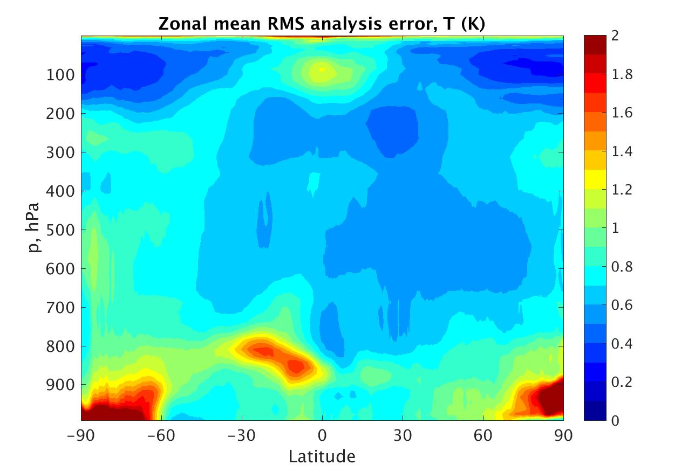
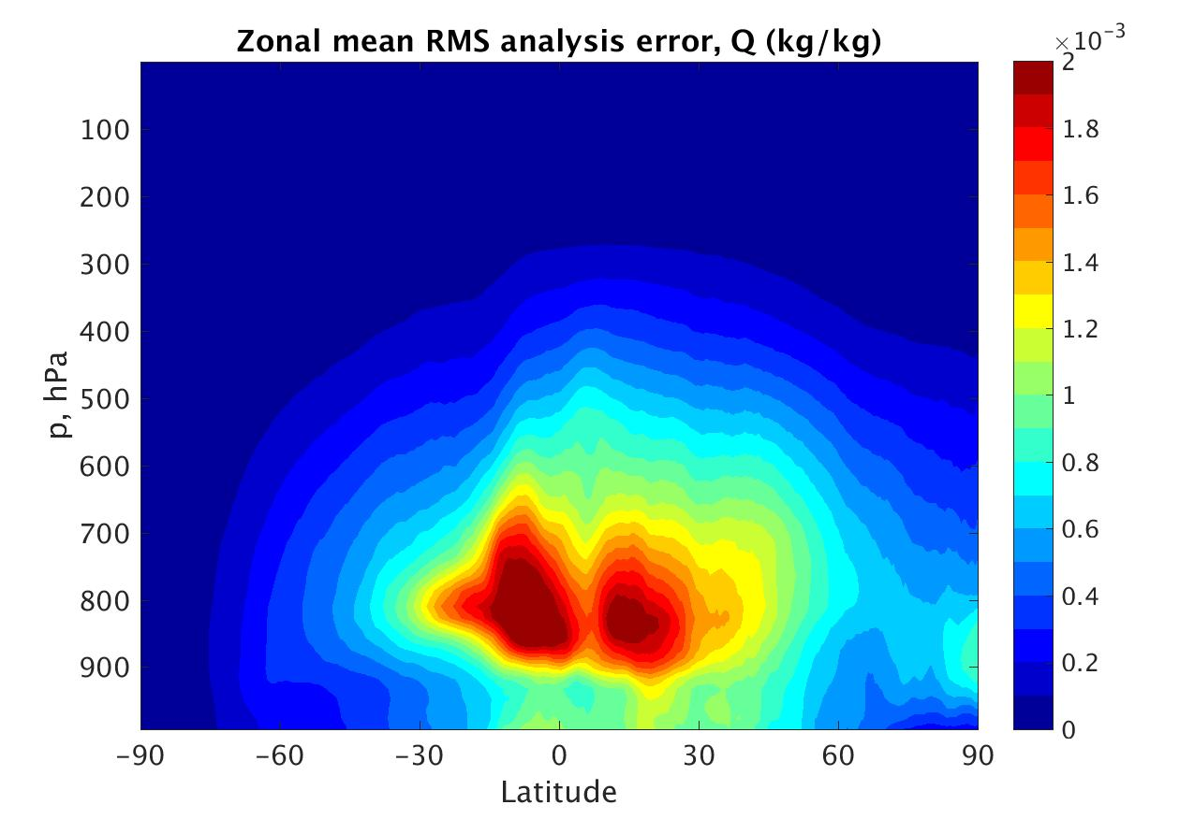
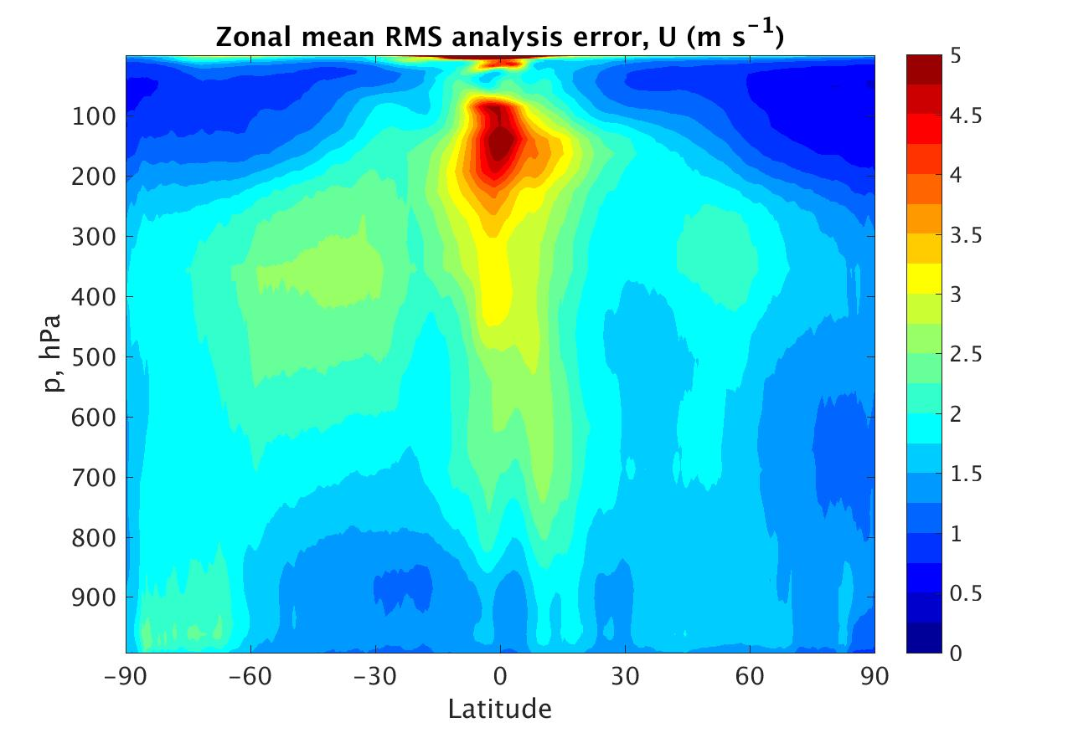
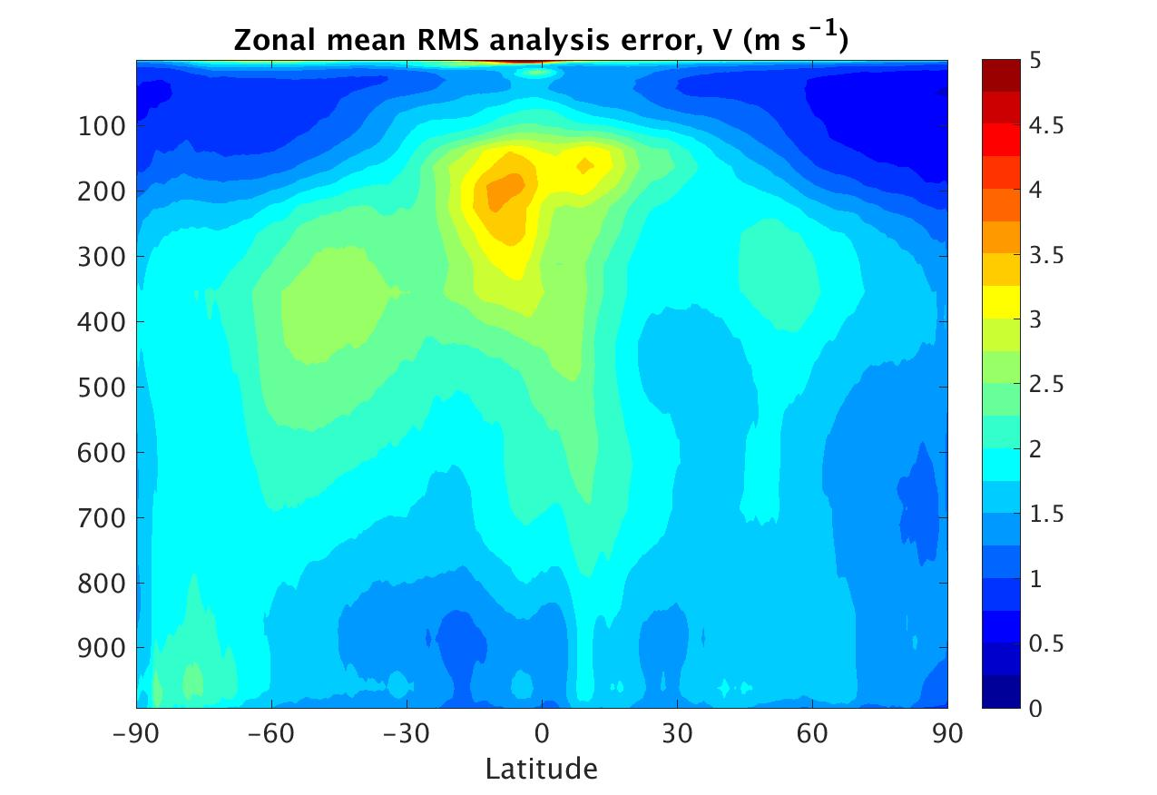
Analysis Error
Notes:
Analysis errors (ANA-NR): how much error is there in the verification fields for self-analysis?

Slide 8
Analysis Error
Notes:
Show T as an example for rest of talk

Slide 9
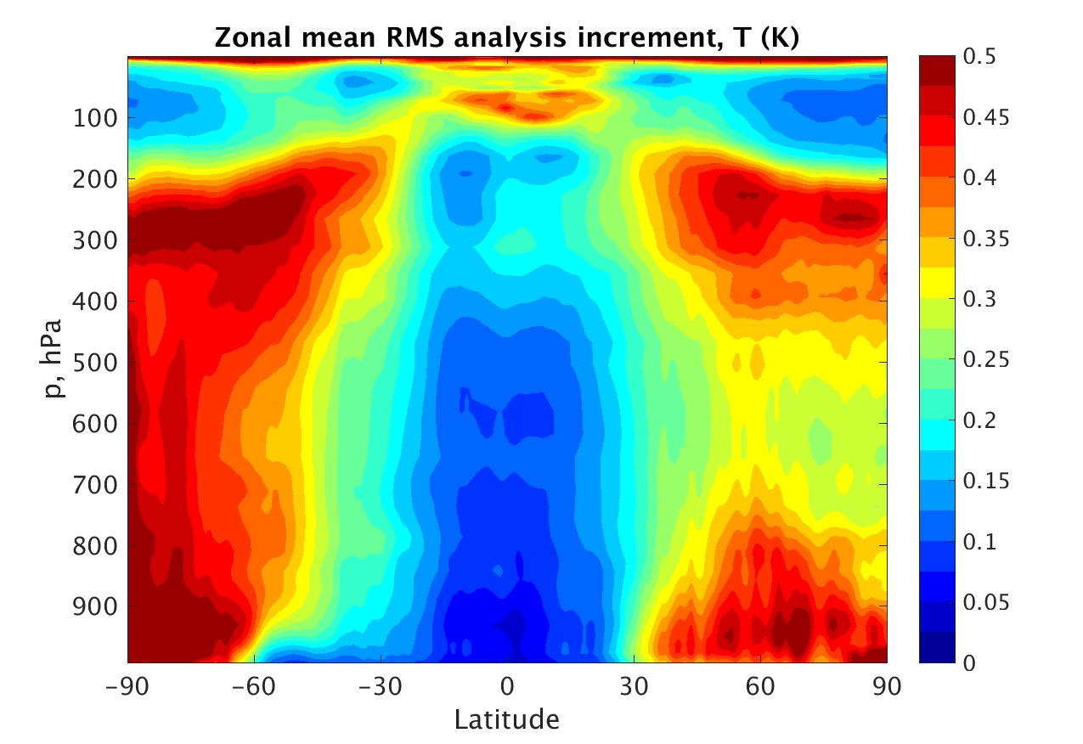
Analysis Error and Increment
Notes:
Analysis error vs increment

Slide 10
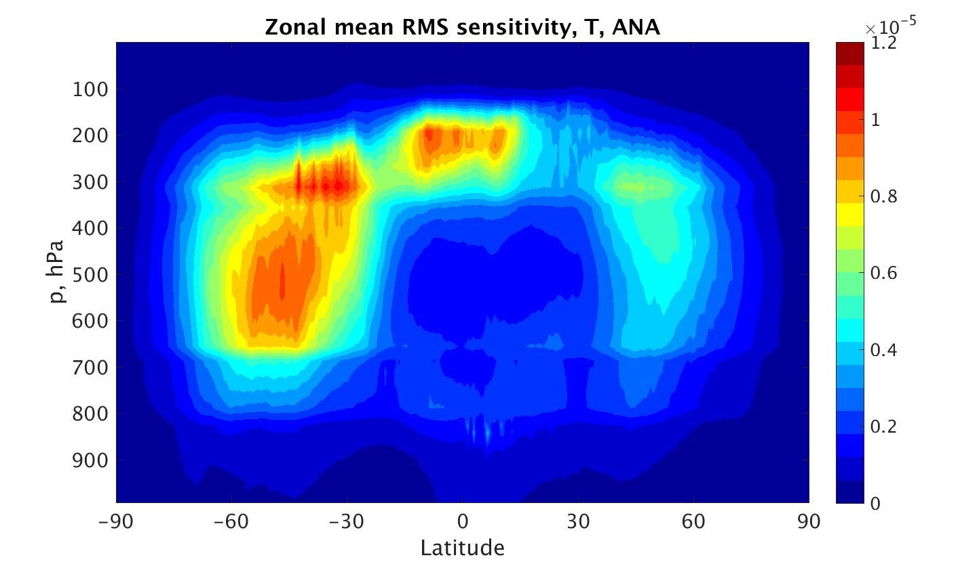
Sensitivity (Total Wet Energy norm)
J/K
Analysis Verification
Notes:
Sensitivity (to T), analysis verification

Slide 11
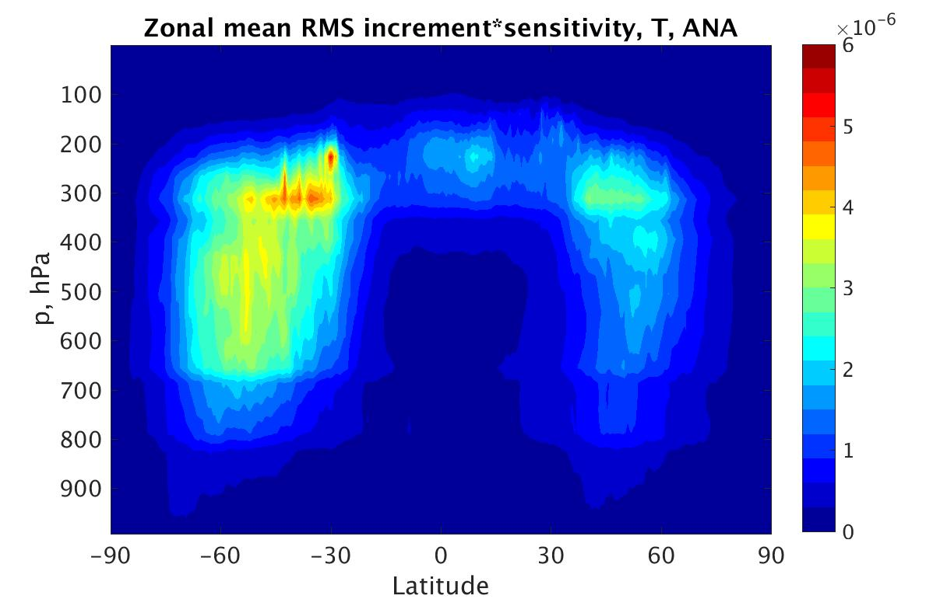
Analysis Increment * Sensitivity
J/K
J
Notes:
Sensitivity*increment – what obs actually do

Slide 12
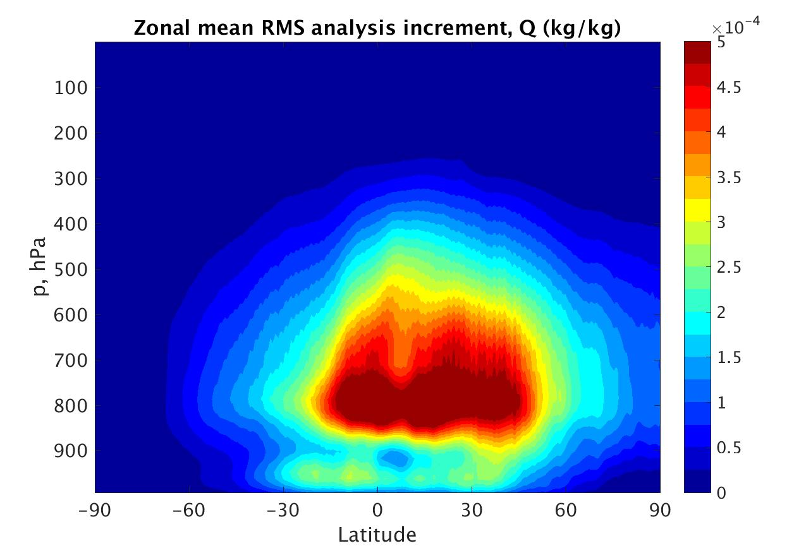
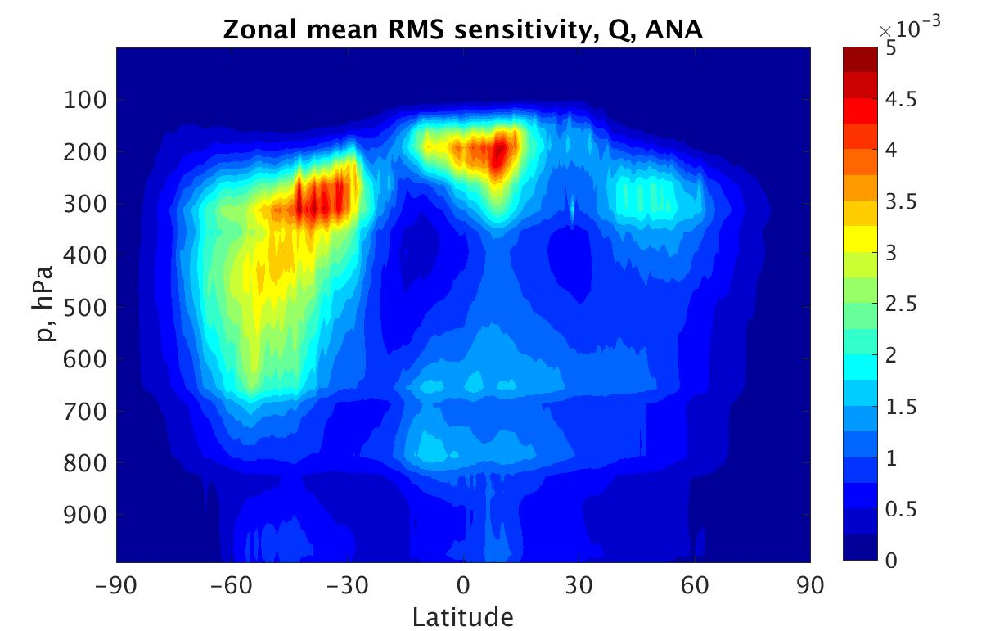
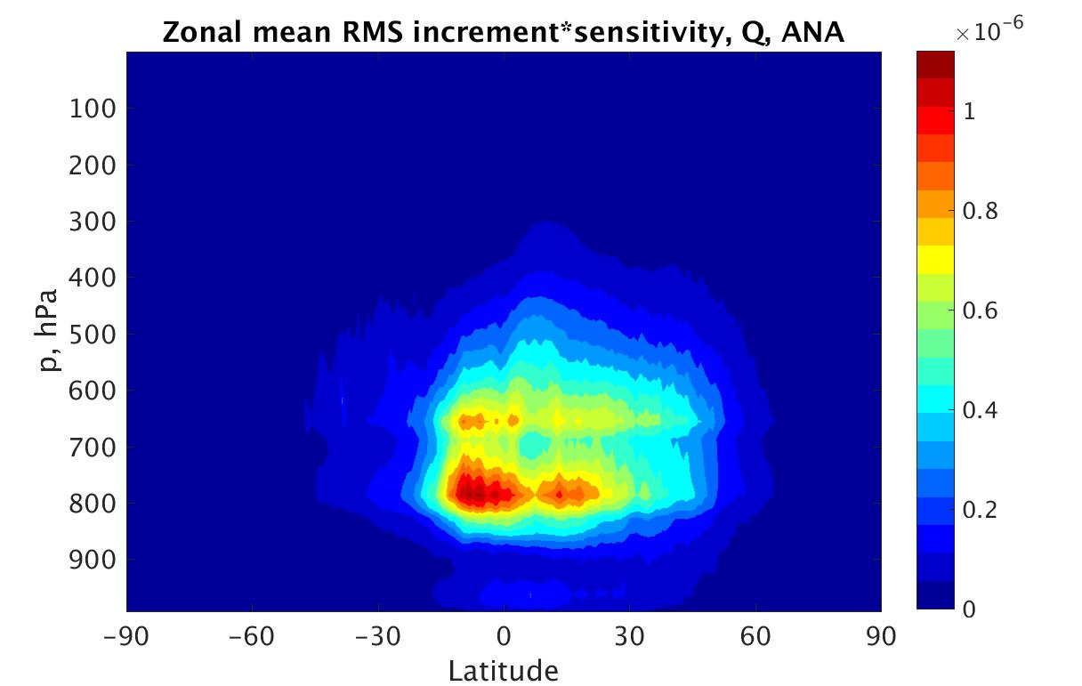
Specific Humidity

Slide 13
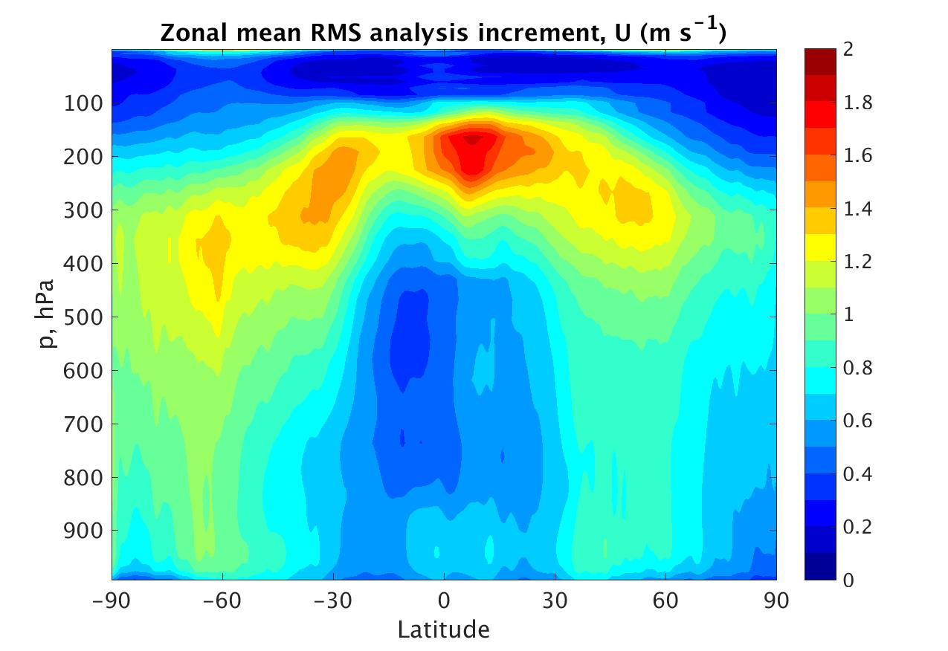
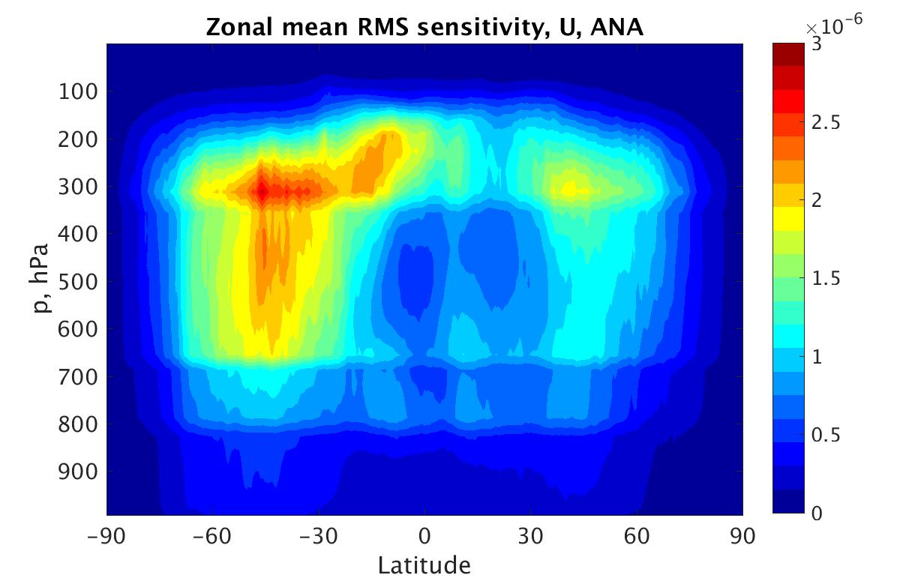
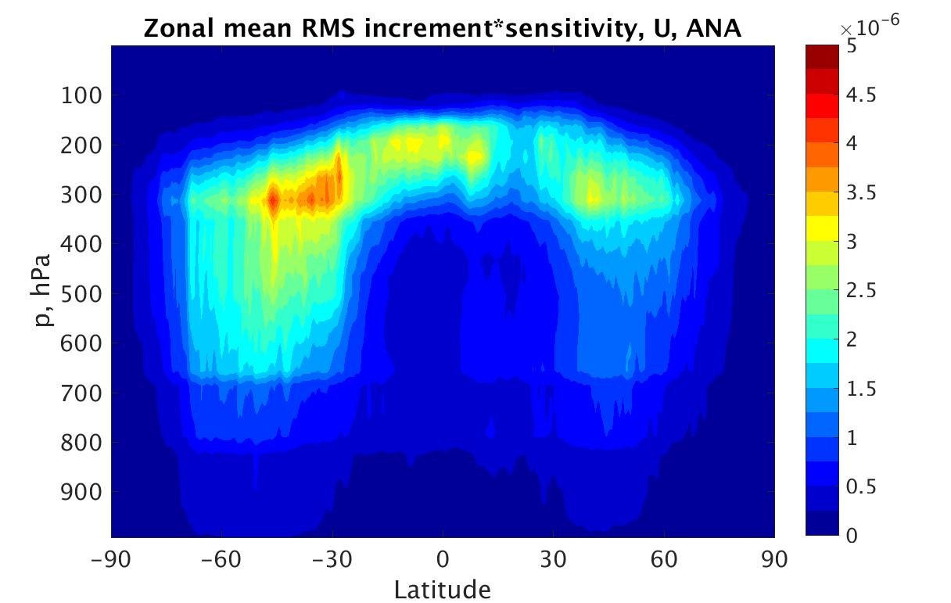
Zonal Wind

Slide 14
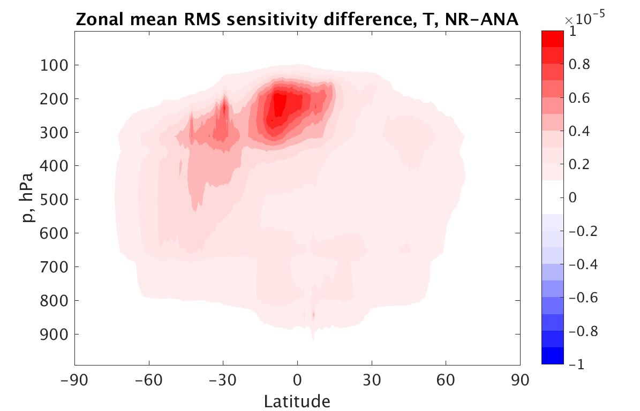
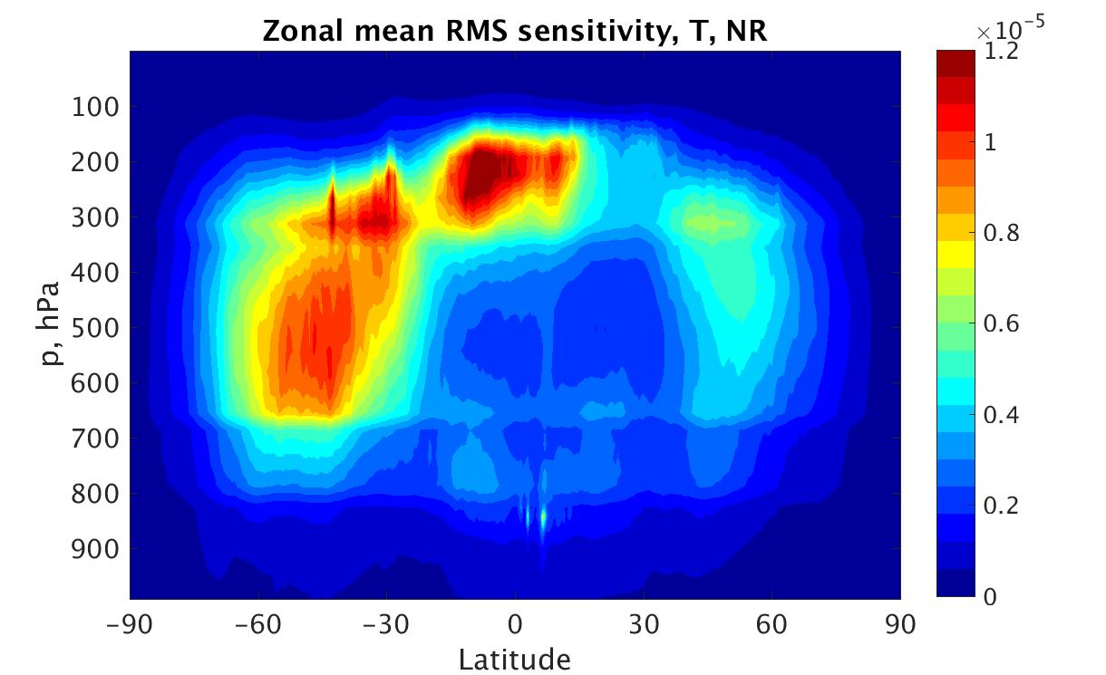
Sensitivity: Analysis vs NR Verification
J/K
J/K
J/K
Notes:
Difference in sensitivity NR vs ANA verification

Slide 15
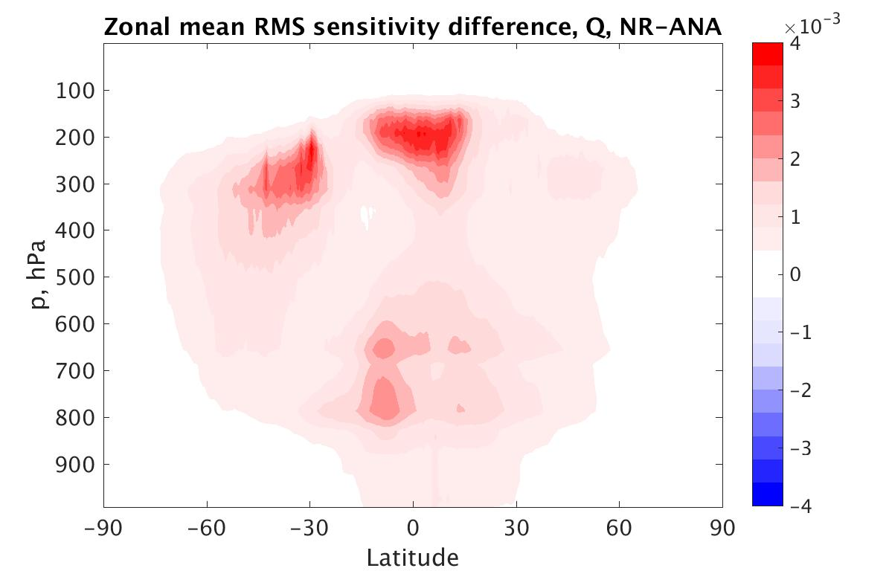
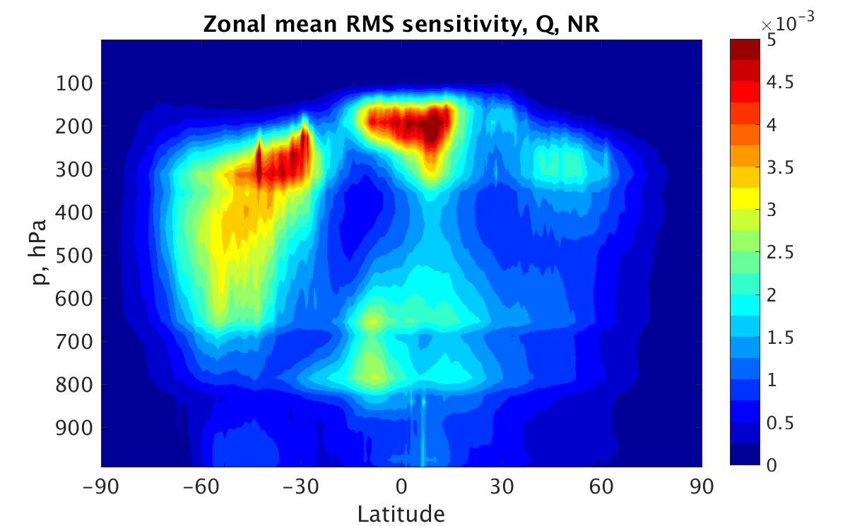
Sensitivity: specific humidity
J/kg/kg
J/kg/kg
J/kg/kg
Notes:
Difference in sensitivity NR vs ANA verification

Slide 16
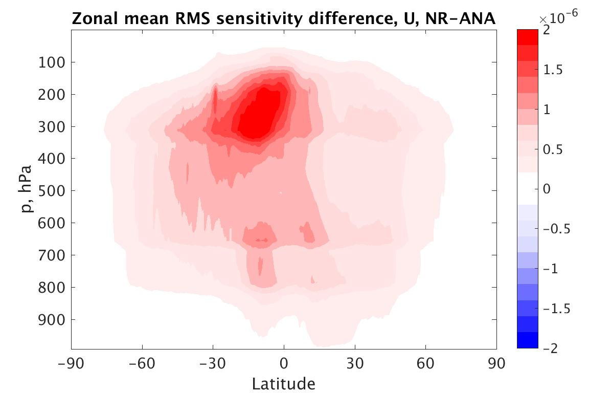
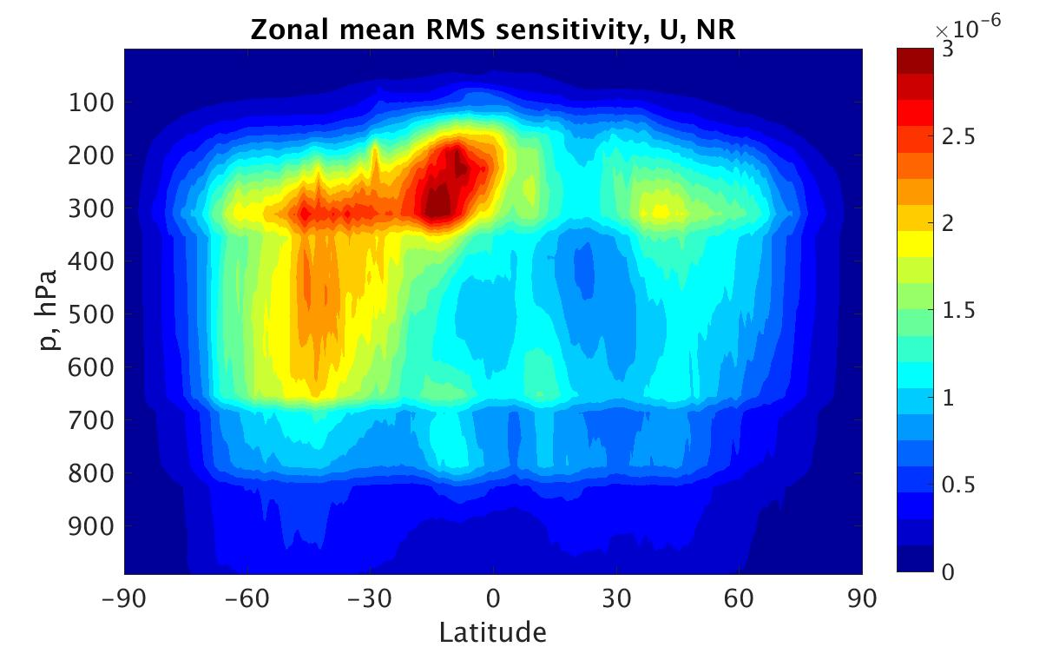
Sensitivity: zonal wind
J/m/s
J/m/s
J/m/s
Notes:
Difference in sensitivity NR vs ANA verification

Slide 17
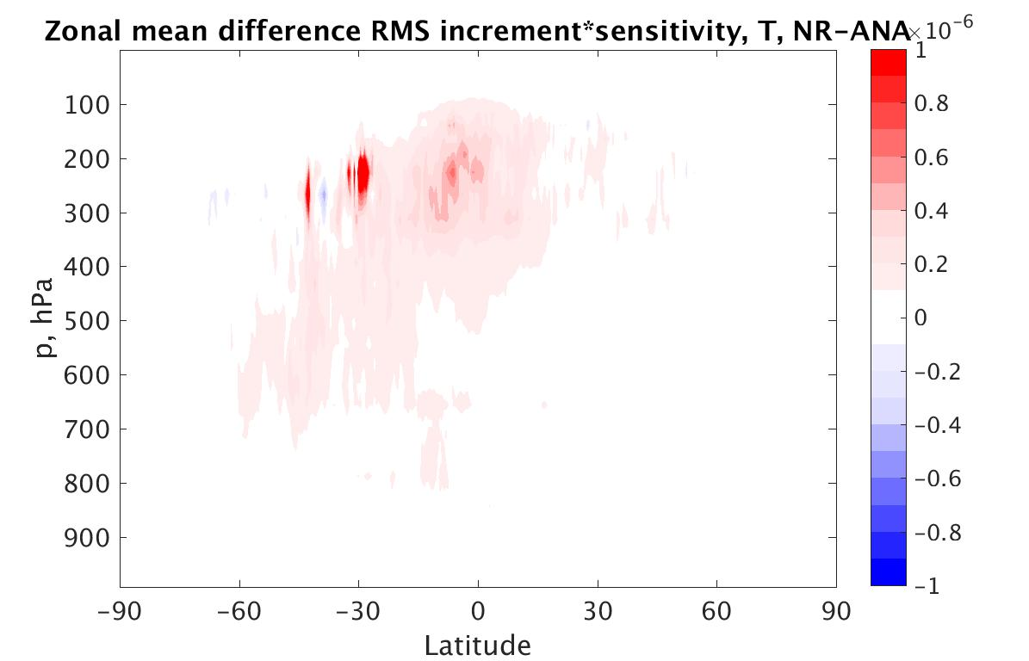
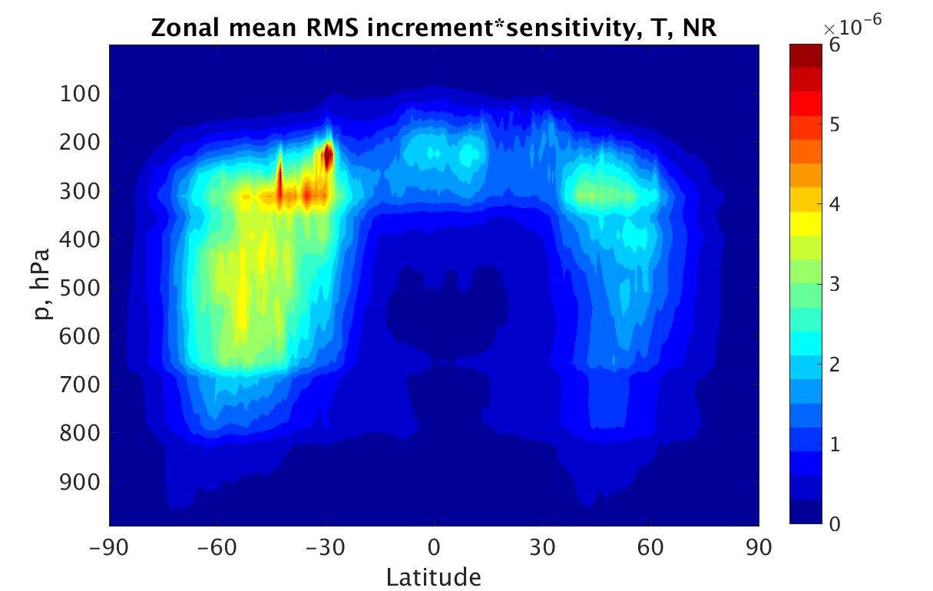
Increment *Sensitivity: Analysis vs NR Verification
J
J
J

Slide 18
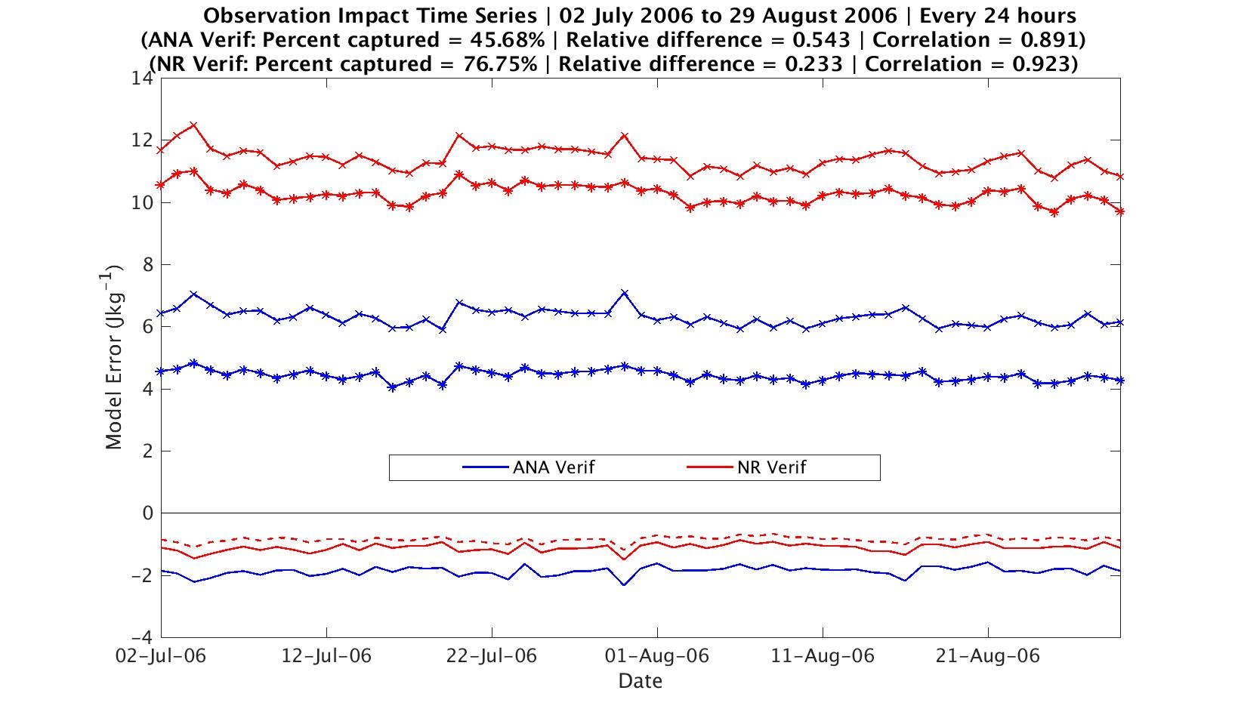

Slide 19
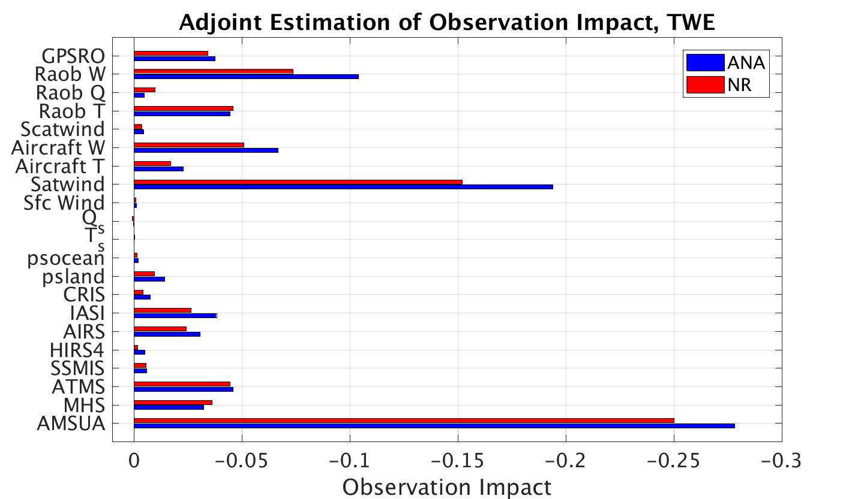
J/kg
NR Verification has smaller impact overall, especially winds (AMVs, Raob, Aircraft).
Humidity obs have higher impact exception (MHS, Q)
Notes:
Adjoint bars

Slide 20
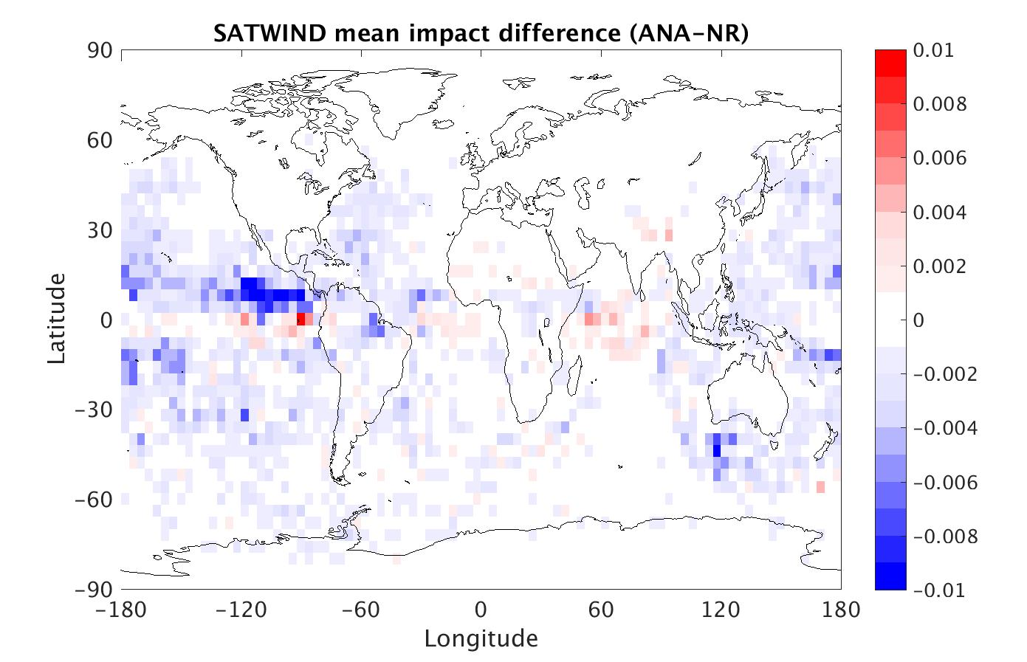
J/kg
Blue = weaker impact with NR verification

Slide 21
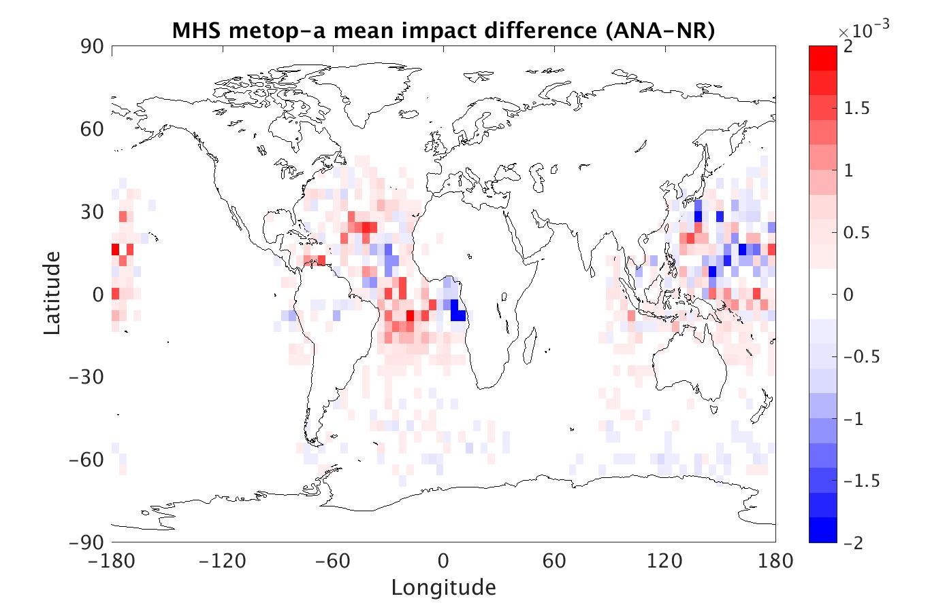
J/kg
Blue = weaker impact with NR verification
Notes:
Distribution of pos/neg impacts

Slide 22
Inconclusive Ideas
Greater sensitivity with Truth verification
  Quadratic nature of norm
Weaker impact with Truth verification
  But not a huge difference, fidelity of rank largely maintained
  Validity of using analysis verification supported overall
  Incestuousness of analysis verification inflates impact even though sensitivity is less?
What is different about wind vs humidity observations?
  Humidity observations have equal or greater impact with Truth verification, while wind observation have less
  Q field more incestuous than wind at synoptic and smaller scales in previous OSSE

Slide 23
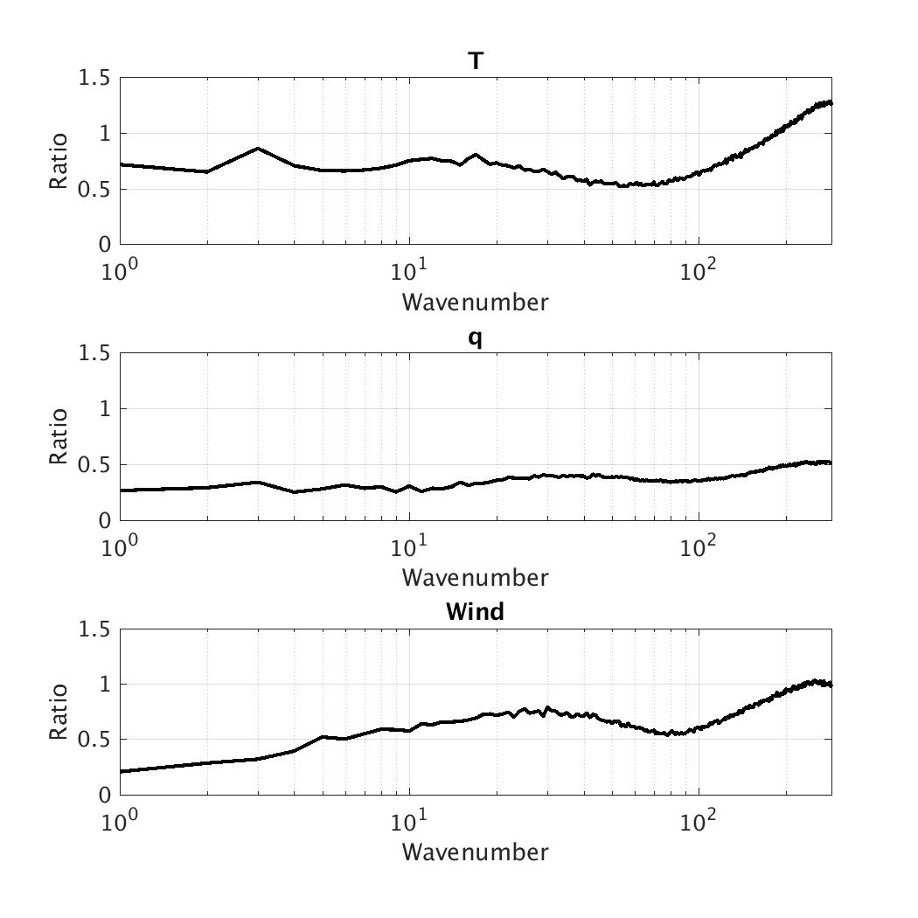
Incestuousness:
(from old NR/OSSE)
Ratio of 24 hour forecast error calculated with ANA verification vs NR verification. Lower ratio = more incestuous

