Slide 1

Growth of forecast uncertainties in global prediction systems and IG wave dynamics
Nedjeljka Žagar and Žiga Zaplotnik
Department of physics, Faculty of mathematics and physics, University of Ljubljana, Slovenia
Workshop on Sensitivity Analysis and Data Assimilation in Meteorology and Oceanography, 1-6 July 2018, Aveiro, Portugal

Slide 2
Outline
Scale-dependent growth of forecast uncertainties in a global ensemble prediction system
A new intermediate complexity model for moisture-wind-aerosol dynamics in 4D-Var (Žiga Zaplotnik PhD research)

Slide 3
Growth of global forecast uncertainties
Model level 45, ~150 hPa
Model level 55, ~300 hPa
+24-hour forecast
Spread (standard deviation) of the 50-member ensemble, ECMWF ENS
Zonal wind (in m/s) at 2 model levels
Mean of the ensemble spread over 2-week period in May 2015
How do the forecast uncertainties grow as a function of scale and as a function of flow?
Tellus A, 2017

Slide 4
Flow-dependent decomposition of ENS spread
Decomposition in terms of Hough harmonics
TOTAL
ROSSBY
EIG
WIG
Spread in 12-hr zonal wind forecast, level close to 250 hPa
A greater part of the WIG spread component is associated with mid-latitude baroclinic waves, whereas the the EIG component is larger in the tropics
MWR, 2016

Slide 5


Scale decomposition of global circulation
Modal decomposition using the 3D orthogonal normal mode functions
Statistics in modal space (MODES software)
Computation of the ensemble variance (J. Atmos. Sci., 2015):
Specific modal variance Σ²
Is equivalent to
specific variance in physical space S²
Forecast-error statistics: meridionally and vertically integrated spread
normalized forecast errors

Slide 6
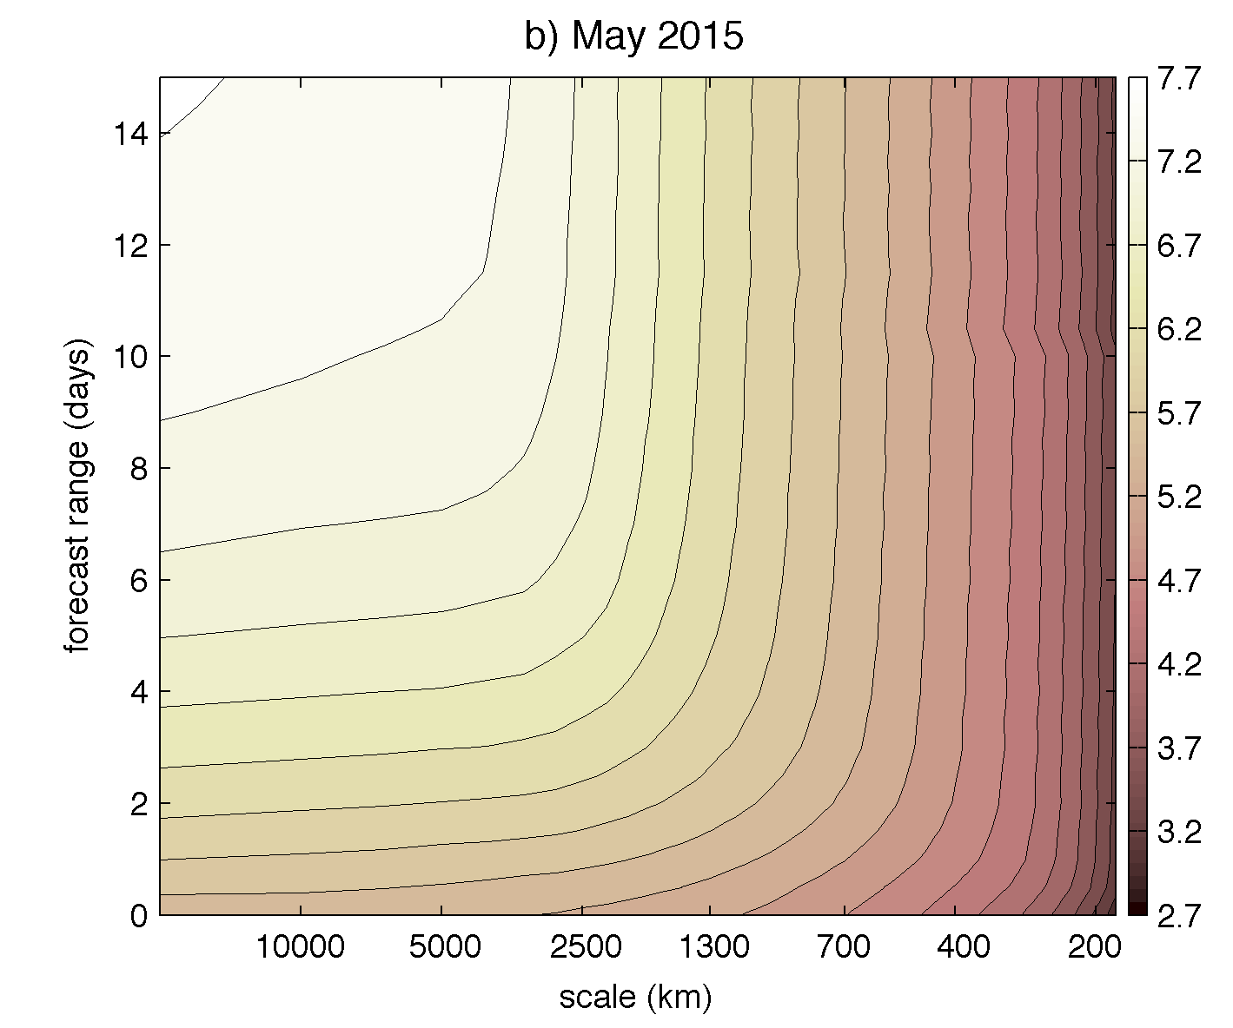
Scale-dependent growth of the ENS fc uncertainties
log[E(k,t)]
Meridionally and vertically integrated ensemble spread in wind, geopotential and surface pressure.
Scale:
Tellus A, 2017

Slide 7
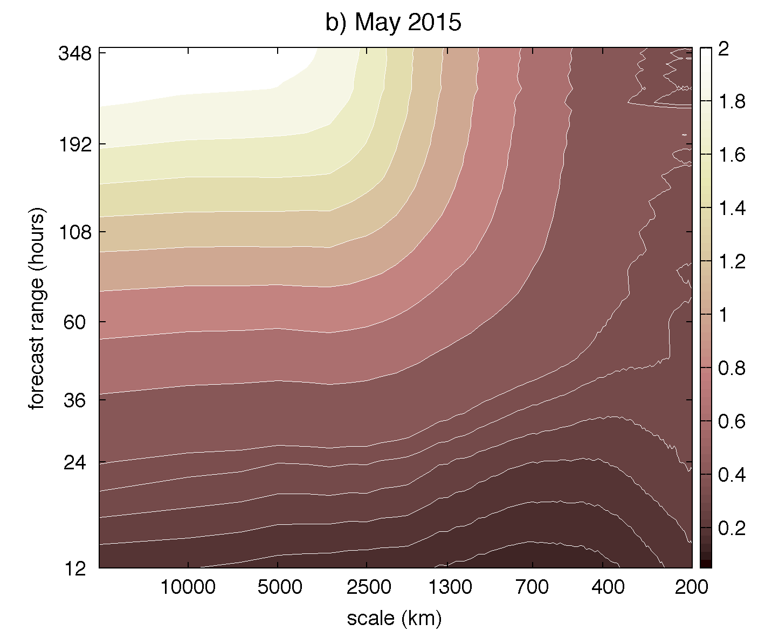
Scale-dependent growth of the ENS fc uncertainties
log[E(k,t)]
Log[E(k,t)/E(k,0)]
Scale:
May 2015 data
Tellus A, 2017

Slide 8
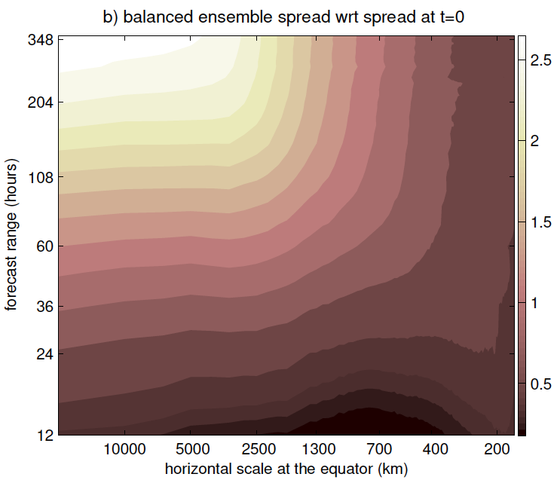
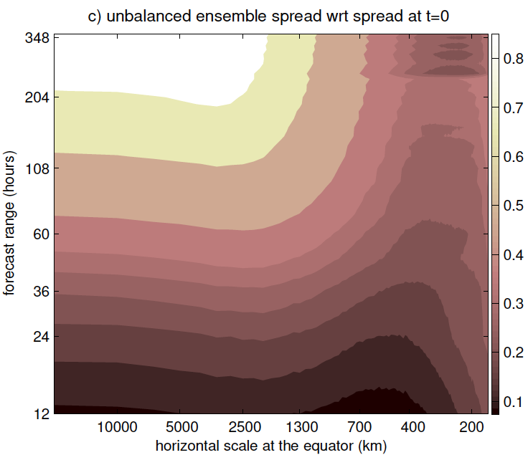

Scale-dependent growth of the ENS fc uncertainties
Log[E(k,t)/E(k,0)]
Balanced
IG
Total
spread
Wrt to initial spread
May 2015 ENS data
Log[E(k,t)/E(k,0)]

Slide 9
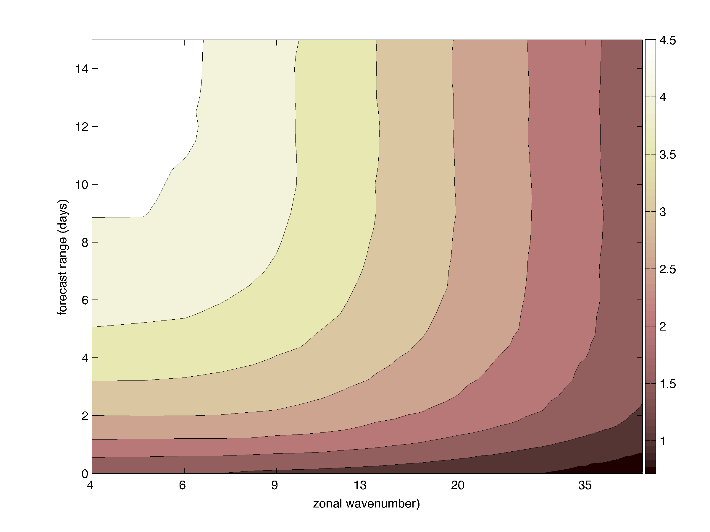
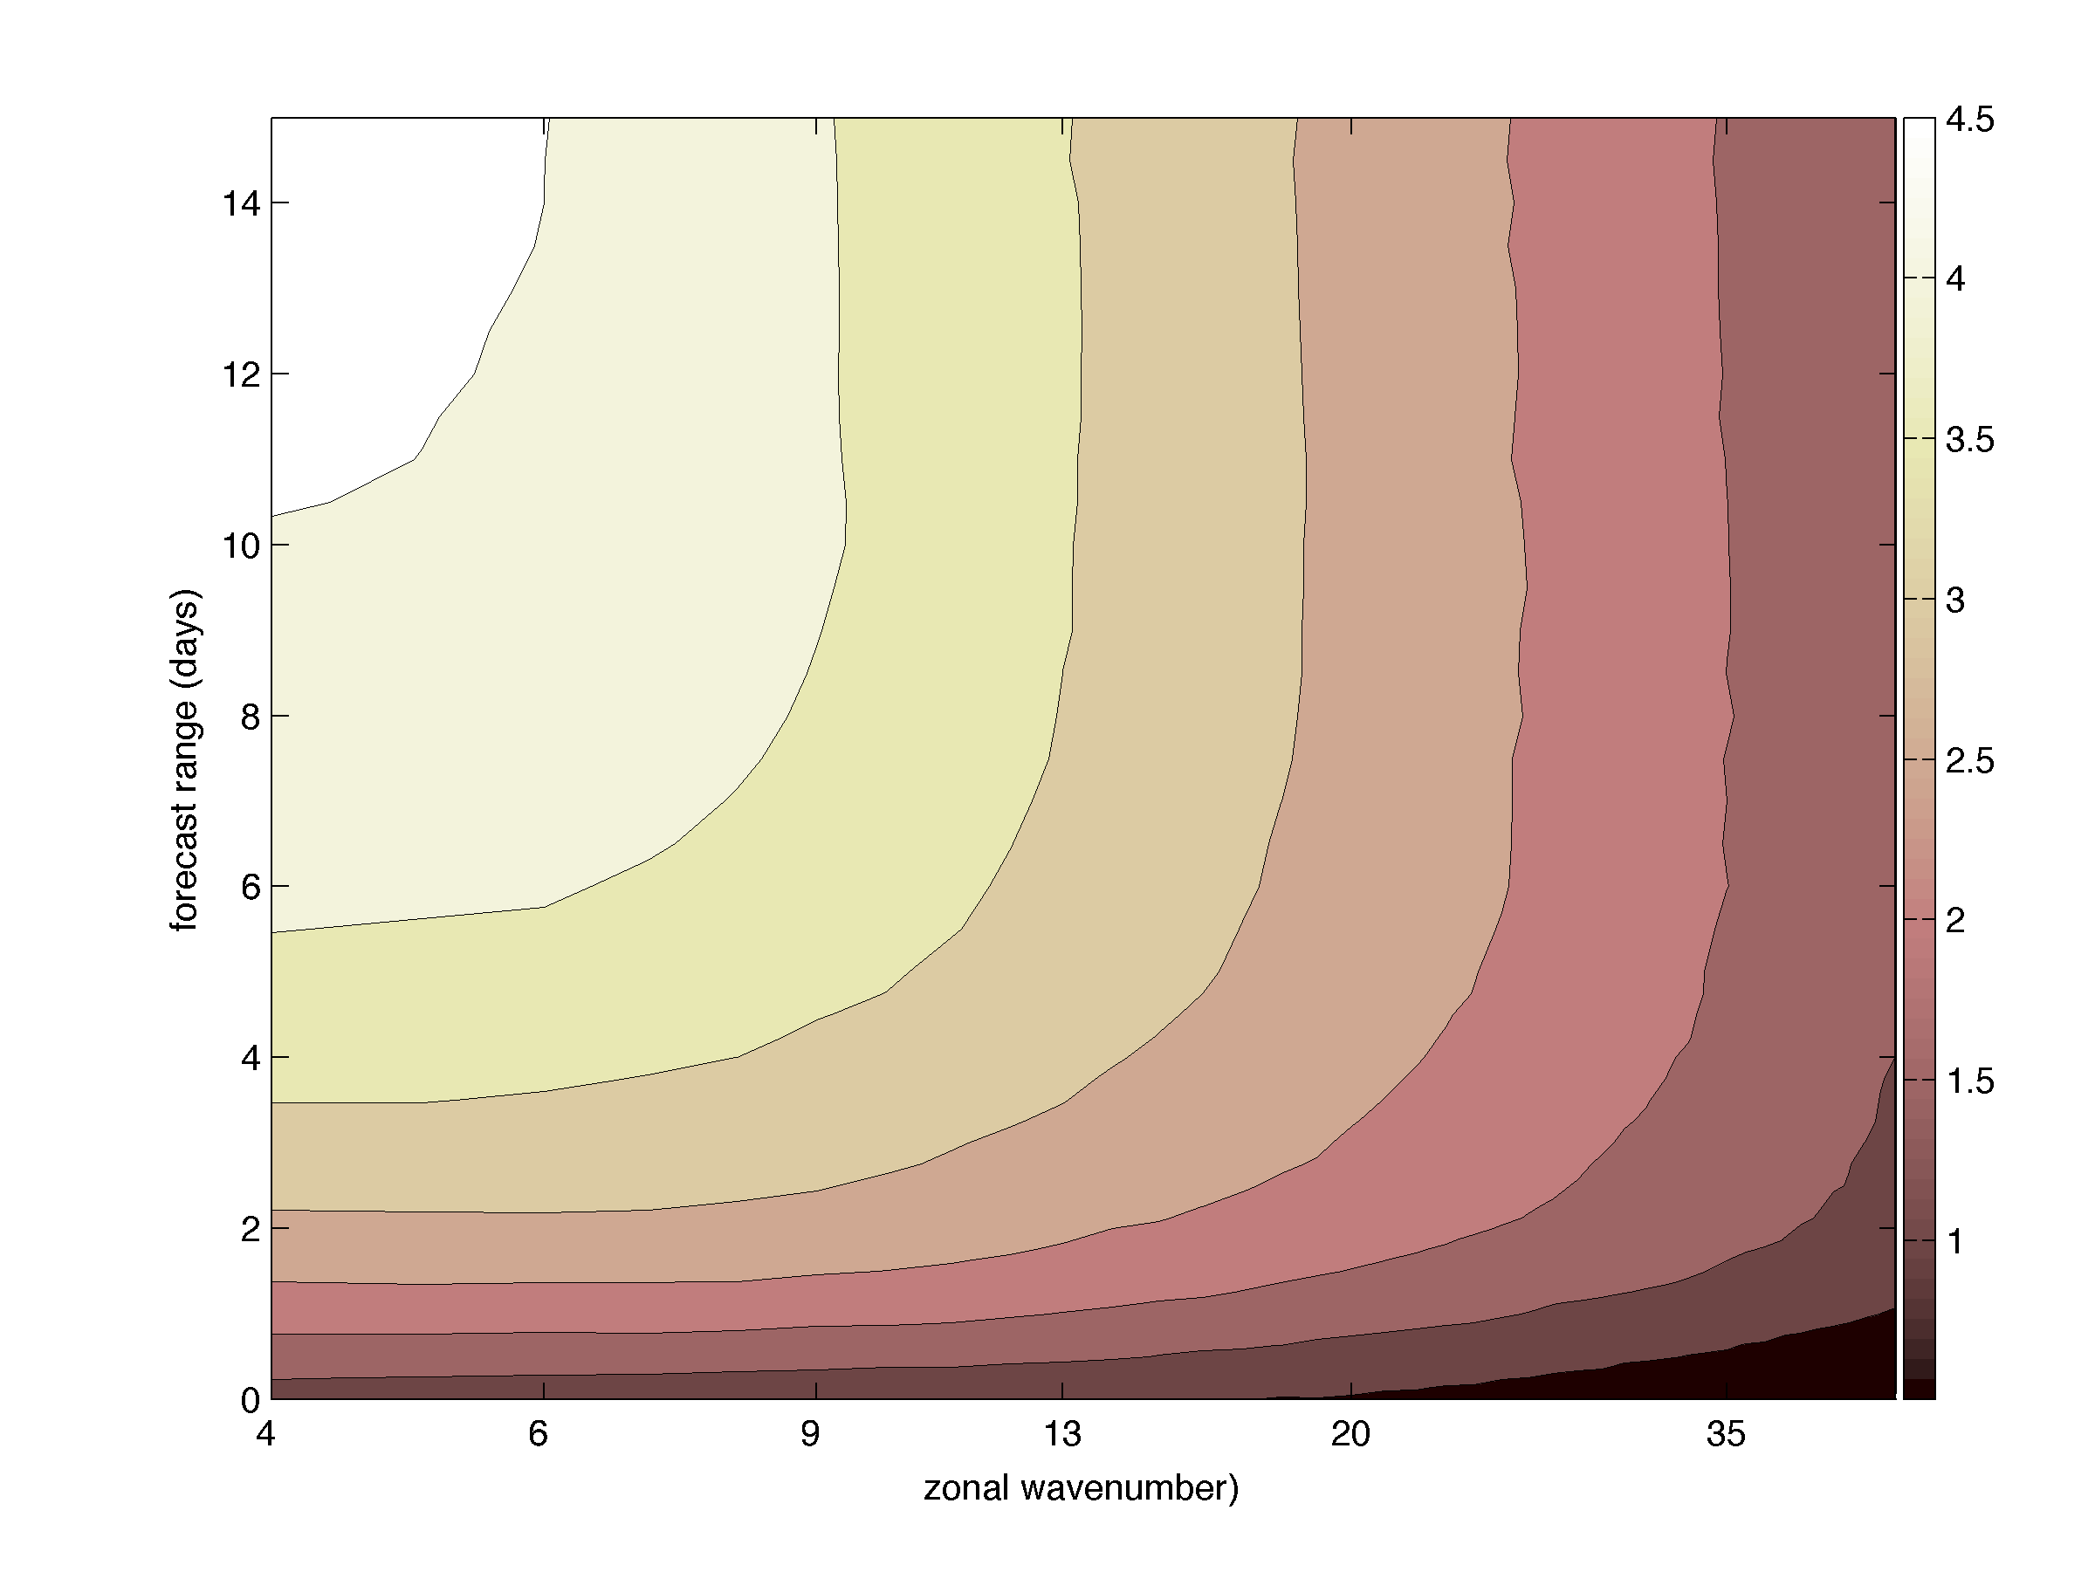
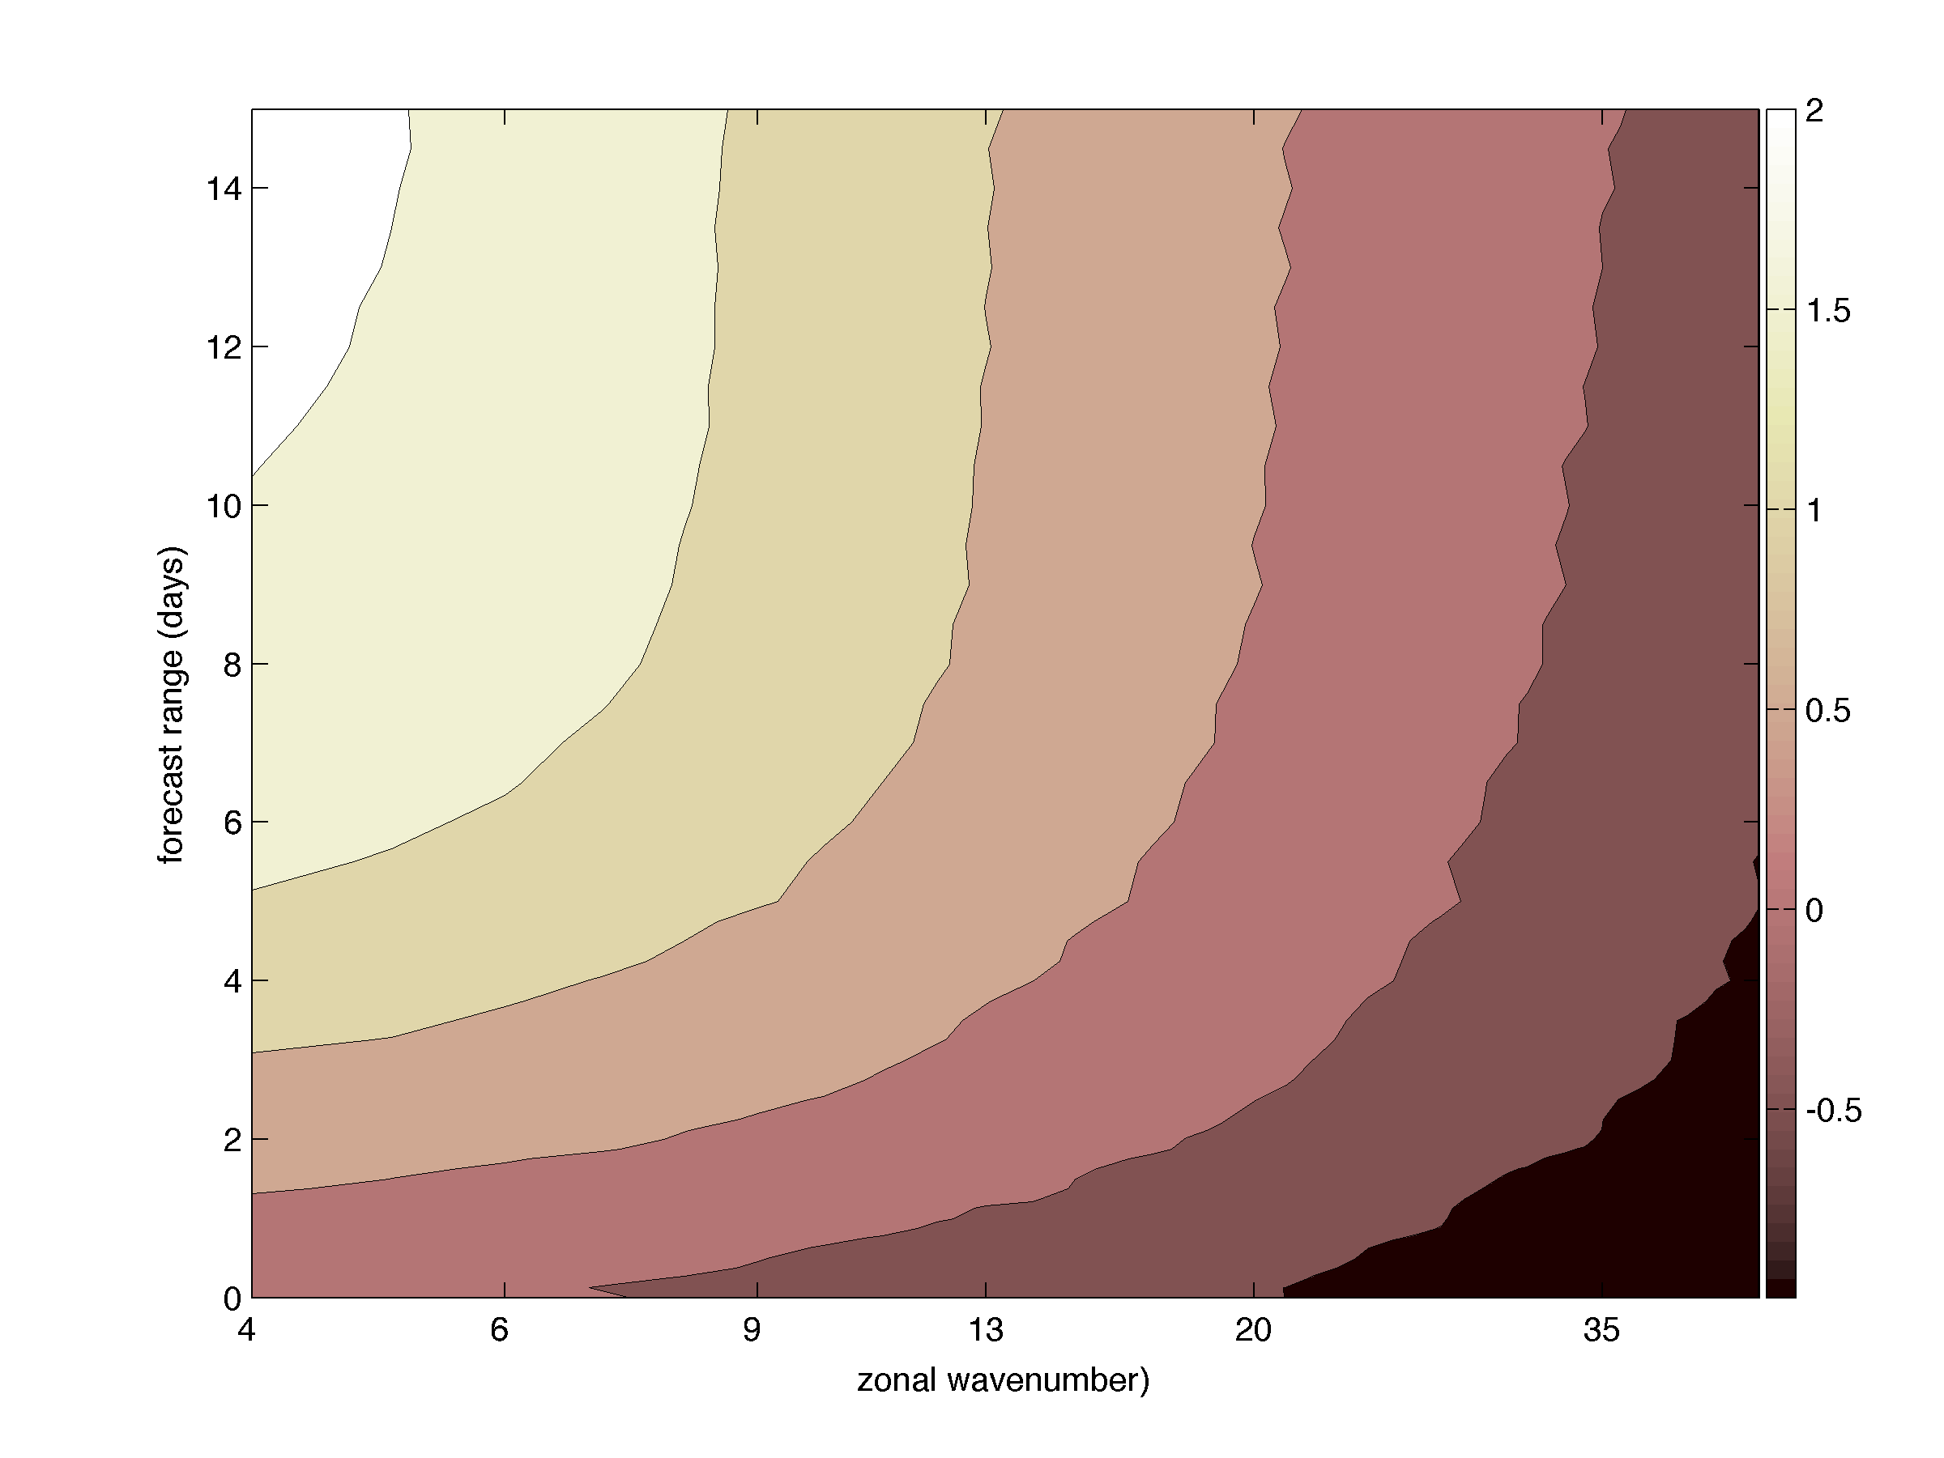
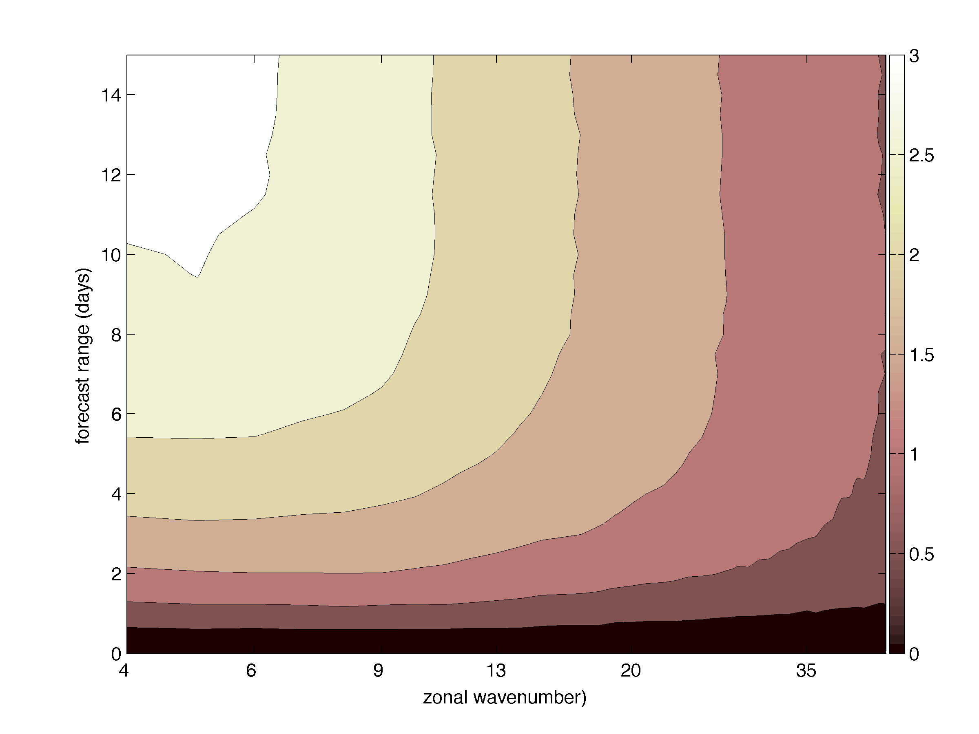
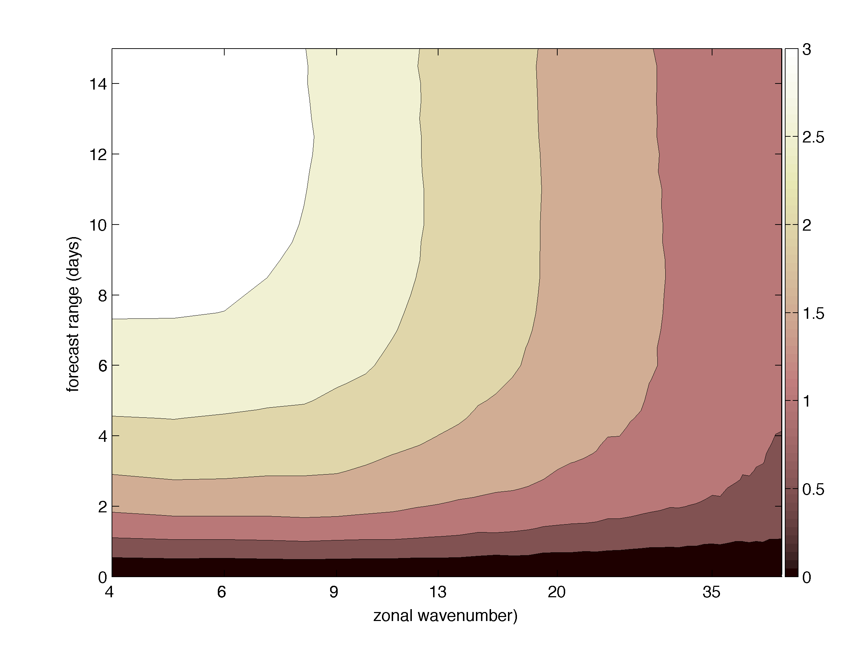
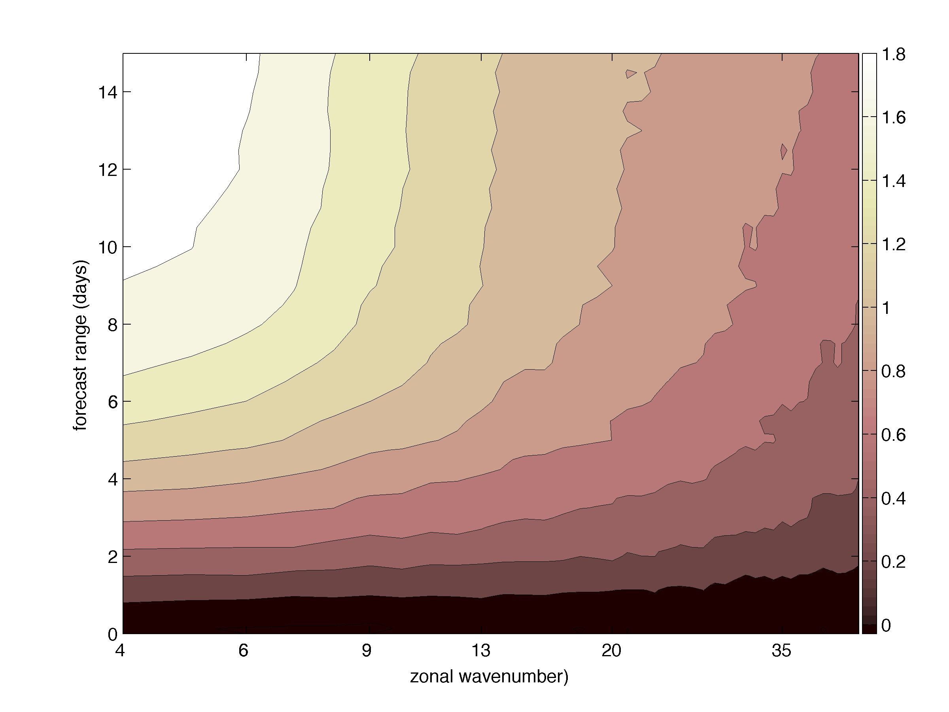
Scale-dependent growth of the ENS fc uncertainties
How the ENS system spread properties changed over 3 years?
Log[E(k,t)]
Total
Balanced
IG
Bottom row: spread is normalized by the spread at t=0 in each k: Log[E(k,t)/E(k,0)]
Waveband 3<k<50
June 2018 data

Slide 10



MADDAM: an intermediate complexity model with incremental 4D-Var for moisture-winds-aerosol dynamics
Spectral dynamical core
TL and AD of discretized equations
Incremental 4D-Var
Multivariate wind-temperature bkg-error variance model
Univariate moisture and aerosol assimilation incl. a transformed moisture control variable
Zaplotnik et al., 2018, QJRMS

Slide 11
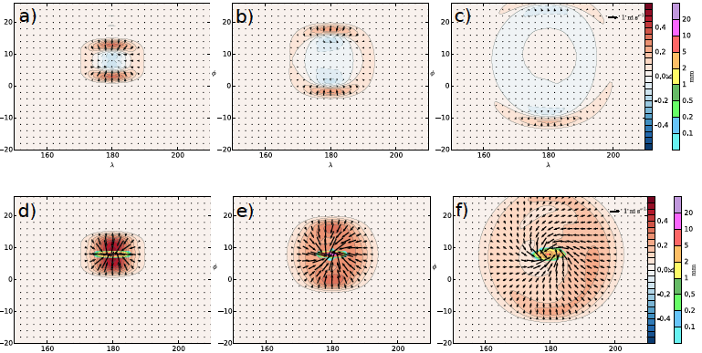
MADDAM: an intermediate complexity model with incremental 4D-Var for moisture-winds-aerosol dynamics
Spectral dynamical core
TL and AD of discretized equations
Incremental 4D-Var
Multivariate wind-temperature bkg-error variance model
Univariate moisture and aerosol assimilation incl. a transformed moisture control variable
Unsaturated bkg
+3
+6
+12
Adjustment to +1 K T perturbation in mid-troposphere over ITCZ
Saturated bkg: more intense IGW dynamics
+3
+6
+12

Slide 12
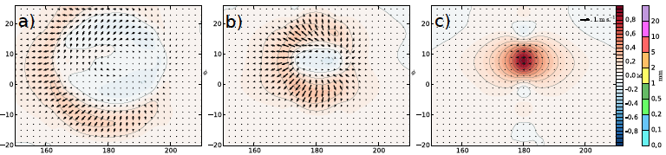
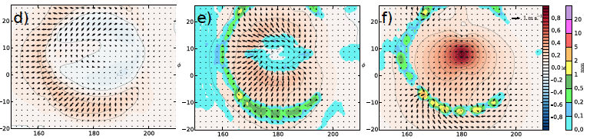
Inertio-gravity waves and 4D-Var
unsaturated
00
06
12
saturated
A single +2 K T obs at the end of 12-h window
+3
+6
+12
IGW propagates outward backward in time, in AD and inward in TL model
+3
+6
+12

Slide 13
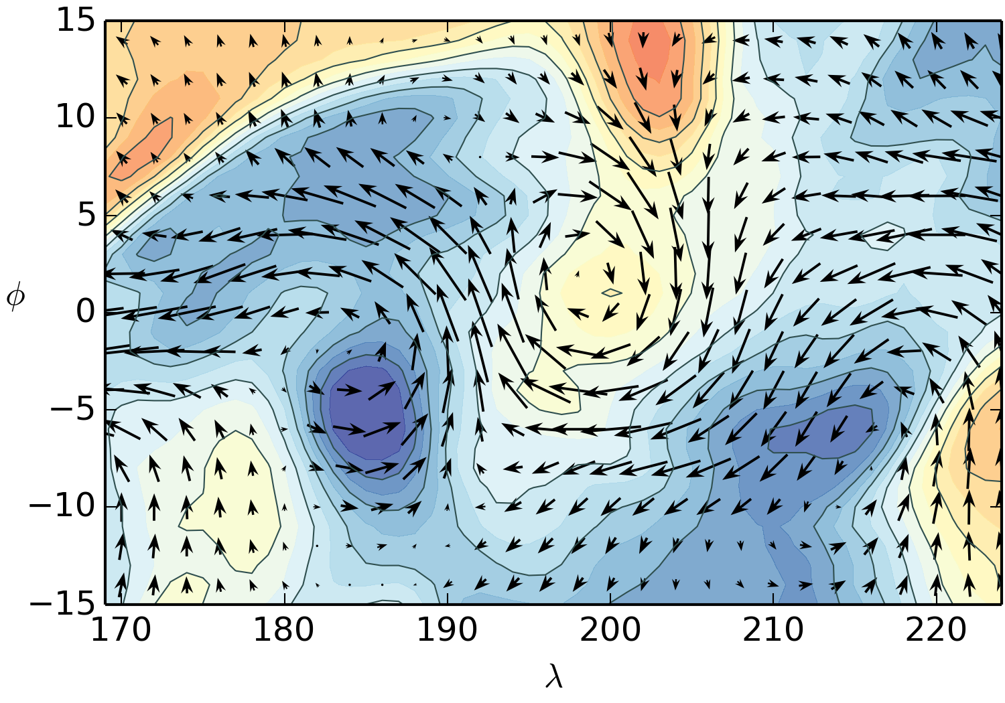
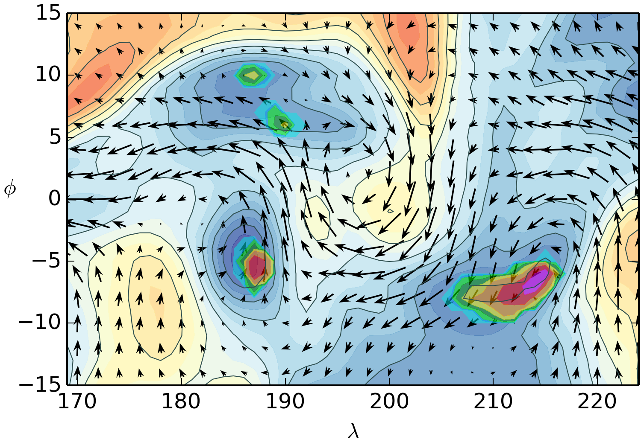
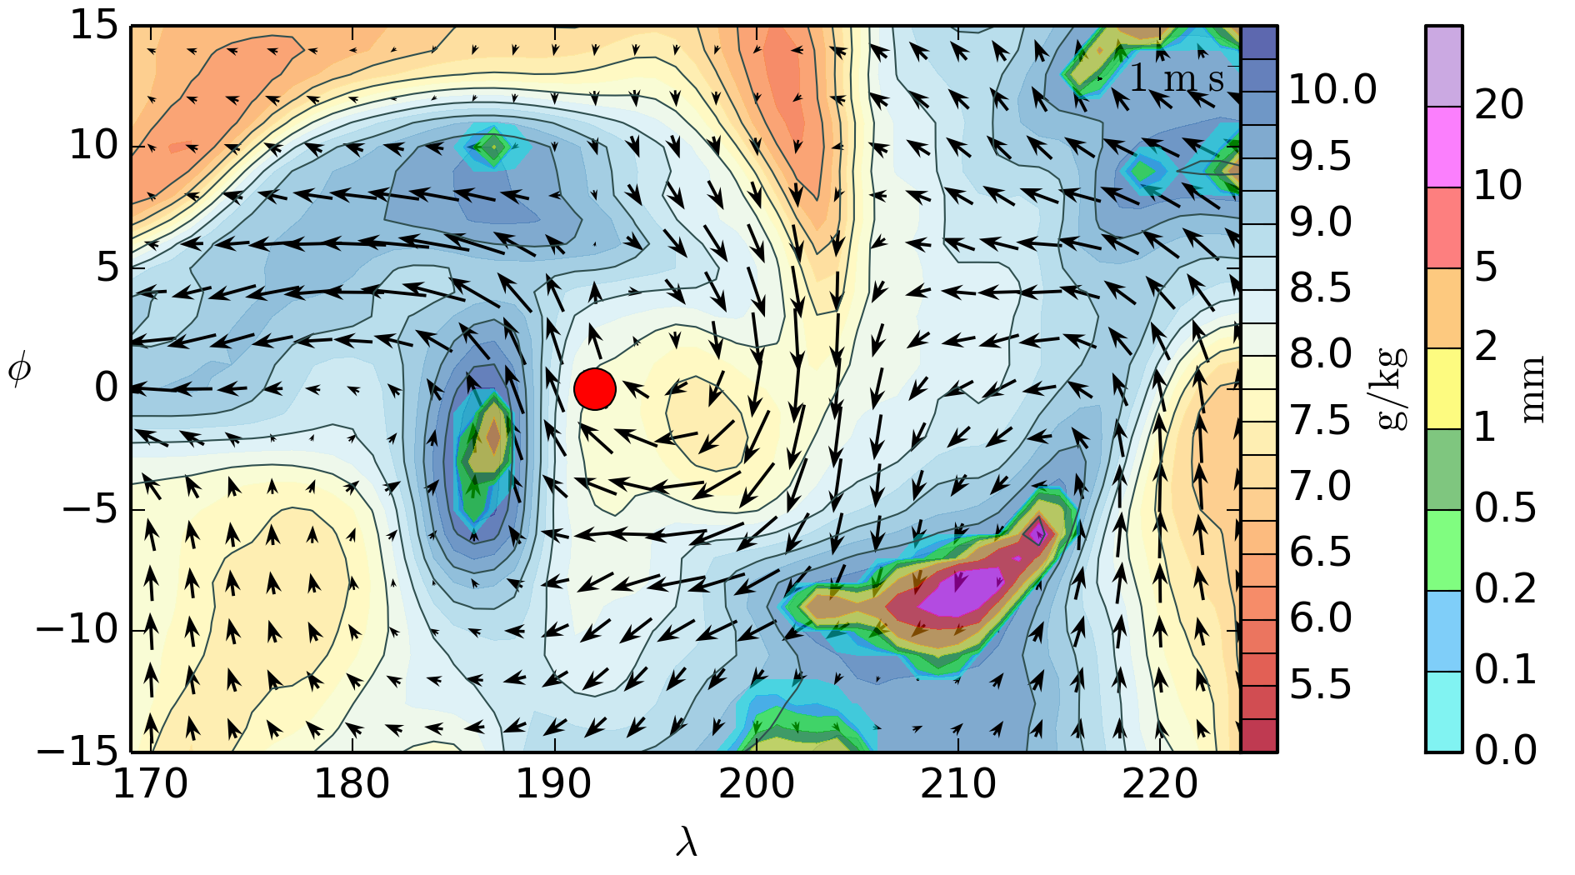
A single moisture observation in MADDAM 12-hour window 4D-Var
00
06
12
Single specific humidity observation (RED dot)

Slide 14
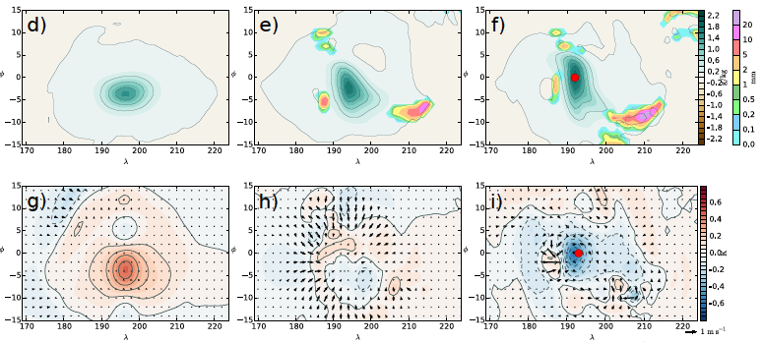
Single moisture observation in MADDAM 12-hour window 4D-Var
00
06
12
00
06
12
00
06
12

Slide 15
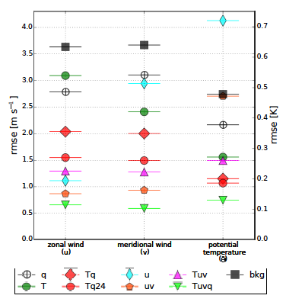
Impact of moisture observations on wind analyses in tropical 4D-Var
u
v
T
Moisture actively affects dynamics.
Wind retrieval from moisture in 4D-Var depends on
observation sampling of moisture spatial gradients, and
frequency of moisture observations which describes advection
Combined T and q obs in 4D-Var retrieve some useful wind information in areas with significant ∧q even in if the flow is highly nonlinear (precipitation)
Analysis RMSE in the middle of 12-h window for different obs types
Zaplotnik et al., 2018, QJRMS

Slide 16
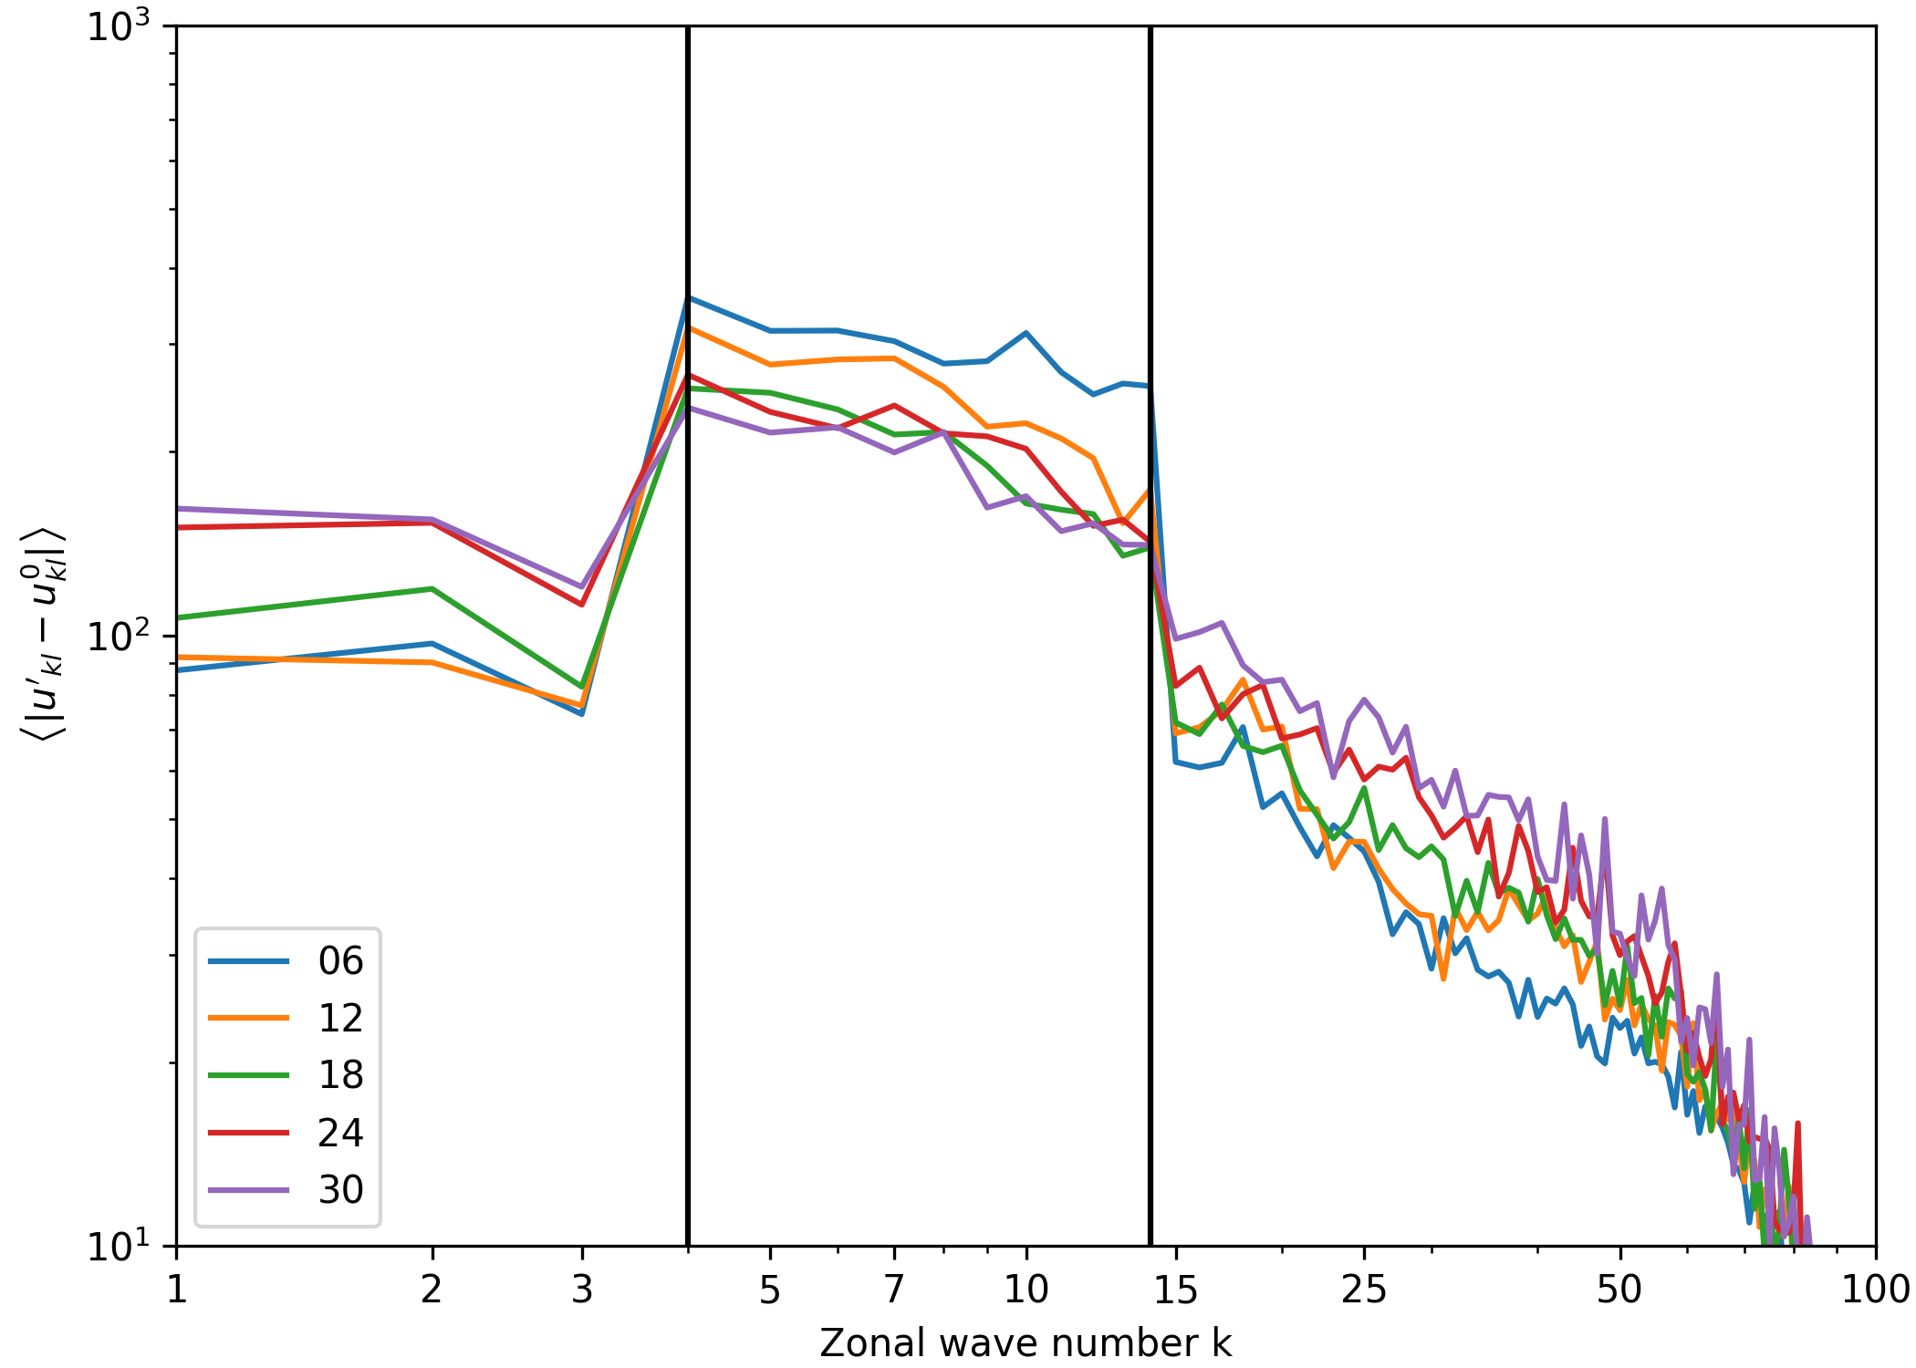
Downscale error propagation using MADDAM
Background: unstable multiscale flow in a channel (Nk=479 waves)
Perturbations introduced in synoptic scales: k=4-14
50-member ensemble, unsaturated atmosphere
Spectra of differences between perturbed and control simulations in time
Perturbations are propagating both downscale (subsynoptic scales) and upscale (planetary scales)
In continuation: projection of propagating perturbations to balanced and IG parts in moist atmosphere

Slide 17
Summary
A simplified model including the moisture-aerosol-dynamics coupling and 4D-Var data assimilation has been developed. It includes a number of features which mimic the NWP case including the incremental 4D-Var formulation and moisture control variable.
The new model – MADDAM has been applied to study the wind retrieval from moisture and tracer observations along with other mass-field data in 4D-Var.
It is used to address some properties of the growth of forecast uncertainties in global ensemble prediction systems and the IGW dynamics in 4D-Var
Thank you!

Slide 18
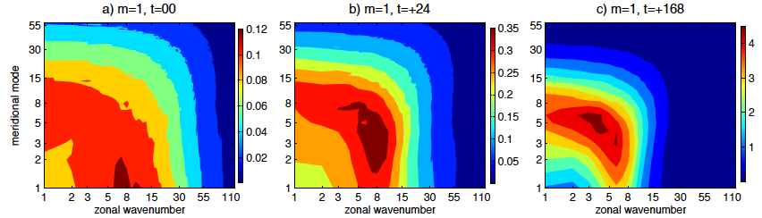
Scale decomposition of ENS spread
Based on model-level data from the operational ECMWF ENS in May 2015
Global analysis and forecast uncertainties in the first vertical mode as a function of the zonal wavenumber and meridional mode
Only spread associated with Rossby modes (balanced dynamics)
Tellus A, 2017

Slide 19
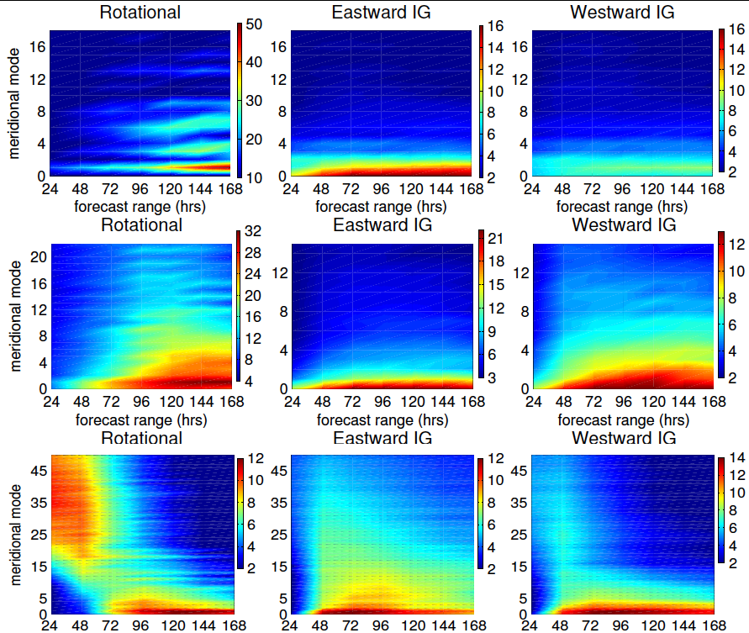
Modal representation of ensemble reliability
Comparison of ens spread with the control analysis
A lack of variability is initially seen in subsynoptic balanced scales, and lateron in all tropical modes, especially the Kelvin mode
J. Atmos. Sci., 2015

