Slide 1
Reduced-Rank Array Modes of the California Current Ocean Observing System
Andy Moore¹, Hernan Arango² & Chris Edwards¹
1: UC Santa Cruz
2: Rutgers University

Slide 2
Outline
Array modes – an idea borrowed from antenna theory
Reduced-rank Array Modes (RAMs)
RAMs of the California Current observing system
Overfitting of DA to the data – a useful stopping criteria
How effective are the observations in constraining the background errors?

Slide 3
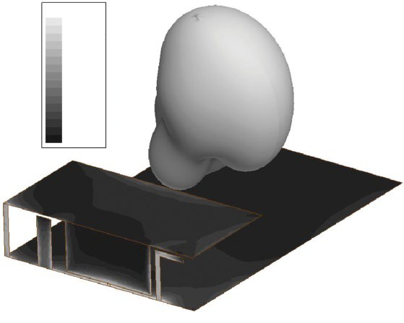
Characteristic Modes of an Antenna
Shorting post Parasitic elements
Figures from Chen and Wang (2015:
Characteristic Modes: Theory and Applications in Antenna Engineering)
40 mm
40 mm
Ground plane
Resonance ∝ 1/|λ−ω|
20 mm
10 mm
60 mm
Jsurf[A_per_m]
5.0000e+001
4.6430e+001
4.2860e+001
3.9289e+001
3.5719e+001
3.2149e+001
2.8579e+001
2.5008e+001
2.1438e+001
1.7868e+001
1.4298e+001
1.0727e+001
7.1572e+000
3.5870e+000
1.6788e–002
Geometry of a multiband planar inverted‐F antenna.
Oceanographic applications:
Bennett (1985)
Le Hénaff et al (2009)
Response∝ 1/λ
Current distribution and radiation pattern for a characteristic mode
with a resonant frequency of 4.1GHz
fiGUre 2.21 (Continued) (c) 4.1 Ghz, and (d) 4.7 Ghz.

Slide 4
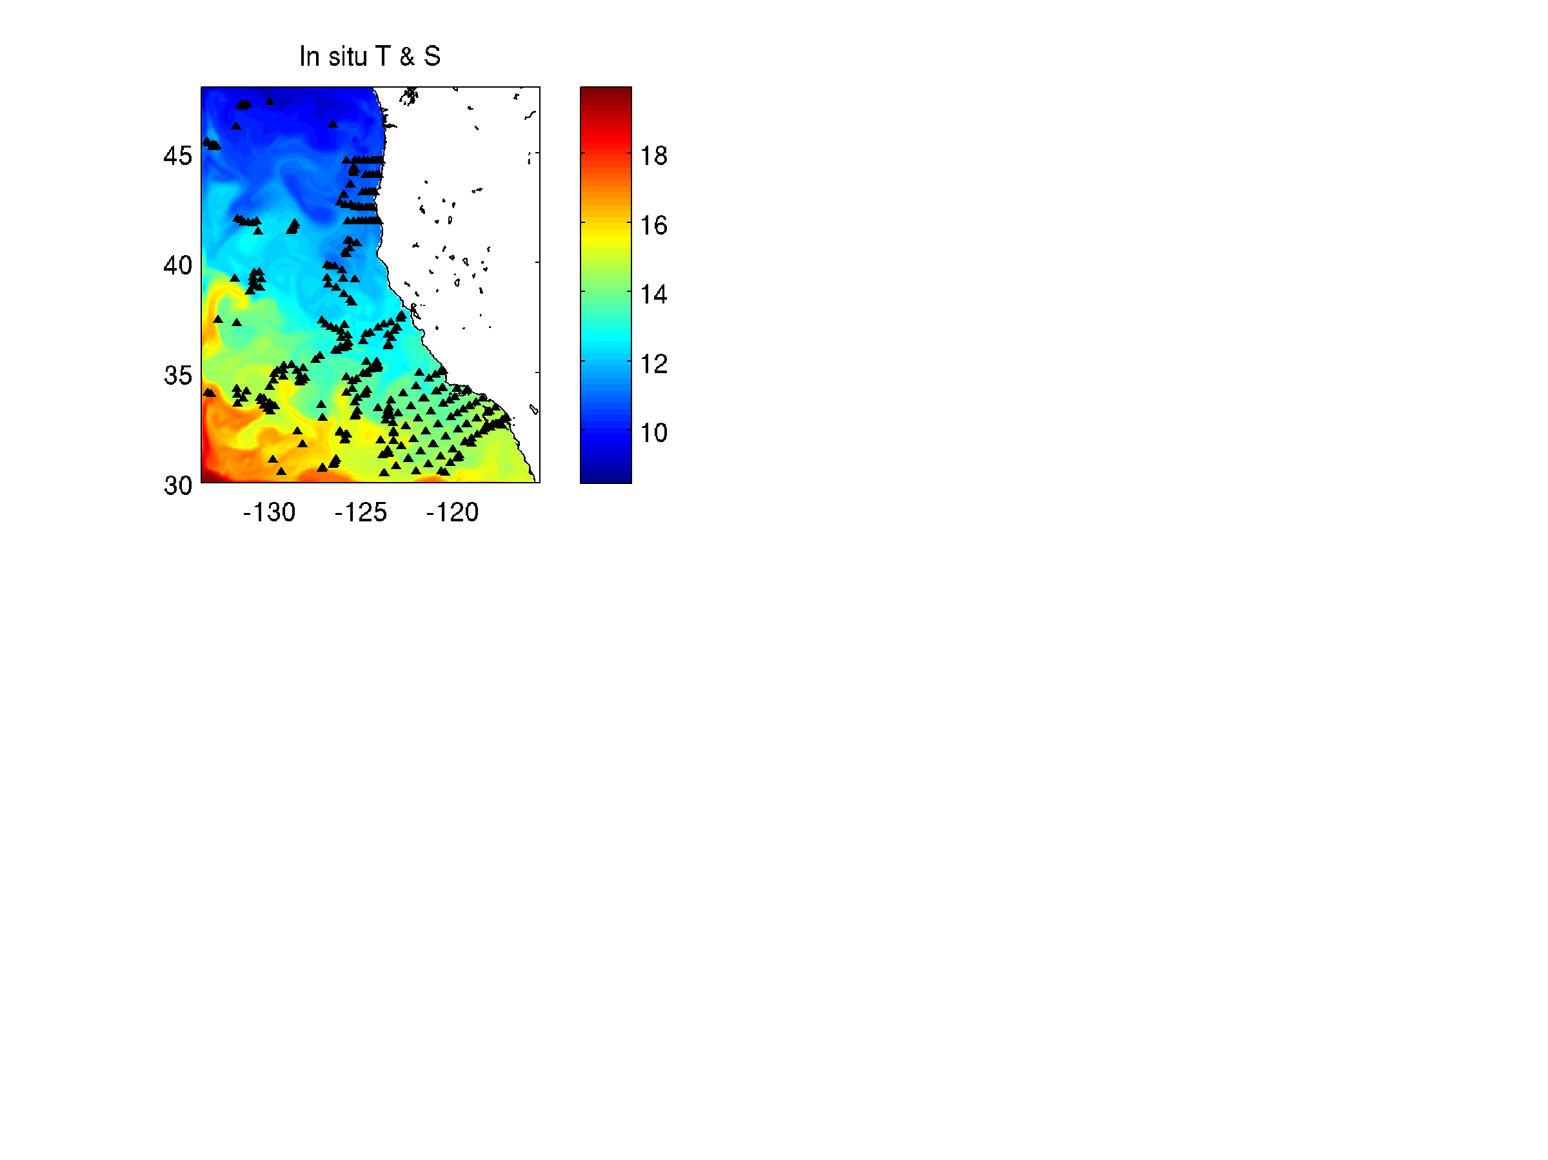
Array Modes: Assessing the Efficiency of the
CA Current Observing System
How well does the CA Current observing system “observe” the circulation given our prior hypotheses about the errors?
CCS observing system:
Satellite SST – daily
(AVHRR, AMSR, MODIS)
Aviso gridded SSH - daily
In situ T & S profiles
4 Jan – 18 April 2003
ROMS CCS domain

Slide 5
The Analysis Equation
Recall the analysis equation:
analysis
adjoint
obs operator
obs error
cov matrix
obs operator
background
background
error cov
matrix
obs
Analysis increment
Solved iteratively in ROMS 4D-Var system using the Lanczos formulation of the B-preconditioned RPCG.

Slide 6
(Reduced Rank) Array Modes (RAMs)
In ROMS 4D-Var the analysis equation is solved using the Lanczos algorithm:
≣(R⁻¹GBG^{T}+I)⁻¹ m=# of inner-loops
EOFs of (R⁻¹GBG^{T}+I)
This can be rewritten as:
where
are the “RAMs”
NOTE: The array modes depend ONLY on the obs locations, and NOT the obs values
Array mode amplitudes depend on the obs values, y
are the eigenpairs of T_{m}

Slide 7
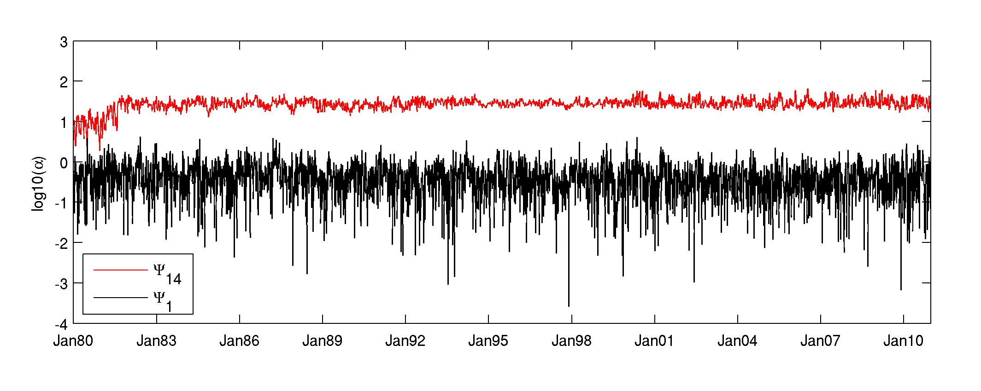
RAM amplitudes of the California Current system
~4 orders of magnitude
31 year sequence of 4D-Var analyses (1980-2010)
8 day overlapping windows
Obs assimilated: SST, SSH, in situ T and S
1 outer-loop, 14 inner-loops

Slide 8
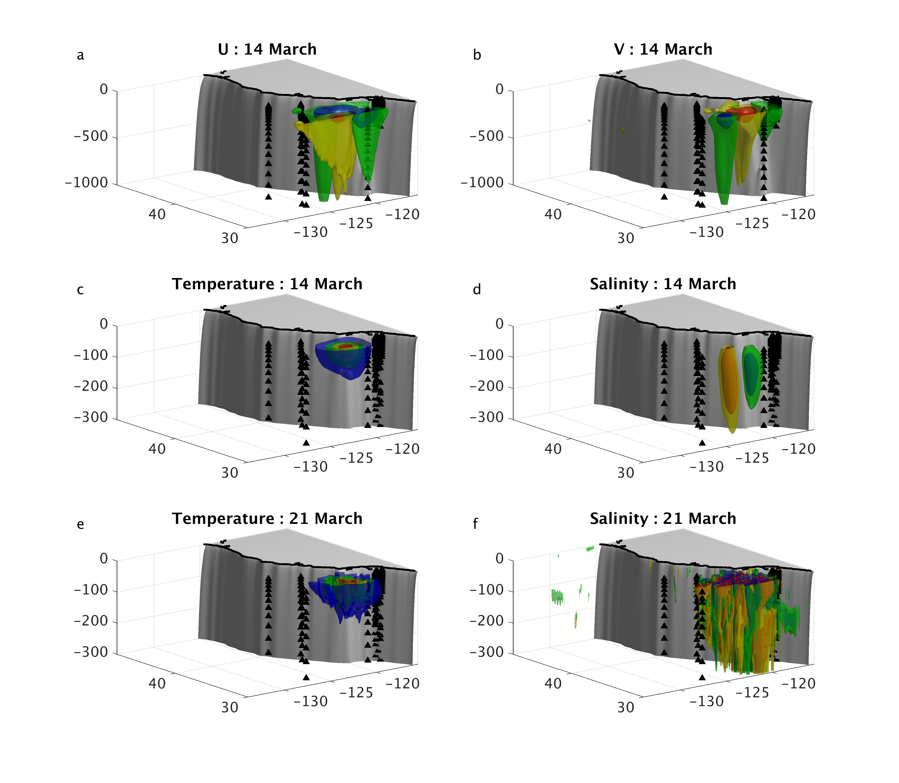
The sub-space activated by the obs & d.f.s
14 March, 2001
RAM 𝚿₁

Slide 9
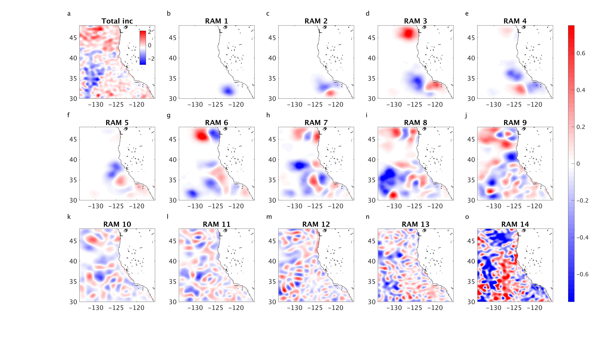
Overfitting of the Model to the Observations
Contribution of each array mode to the SST increment on 14 March 2001:
recall m=14 inner-loops.
The Bennett and McIntosh (1984)
“1% rule”:
Discard array modes with eigenvalues 1% or less of the max value.
SST
Reject based on 1% rule

Slide 10
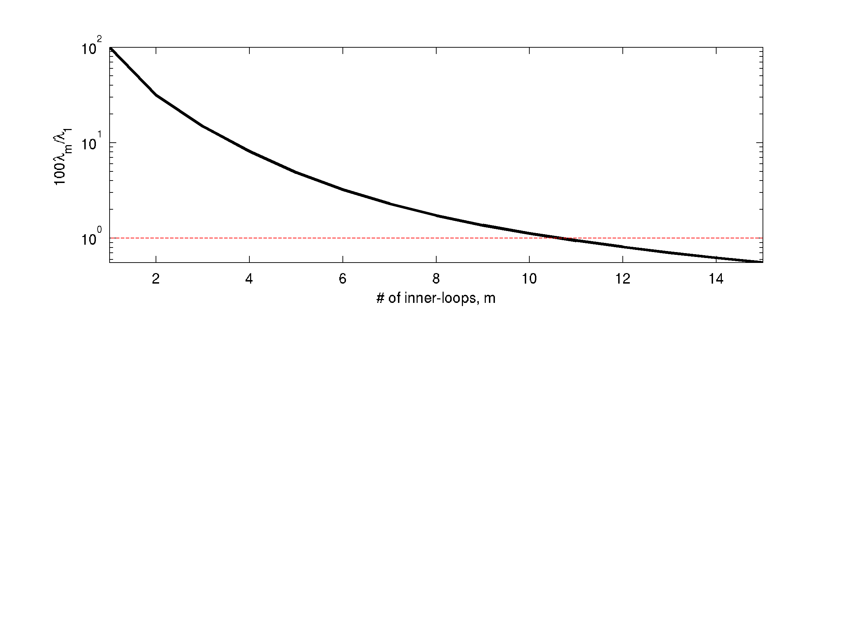
The “1% Rule” to avoid overfitting to the Observations
100λ_{m}/λ₁ vs m
(m=# of inner-loops)
Terminate 4D-Var
inner-loops here
100λ_{m}/λ₁=1
Average eigenvalue ratio for all cycles vs number of inner-loops employed:
(suggests we should use no more than 10 inner-loops to prevent over-fitting of the observations)

Slide 11
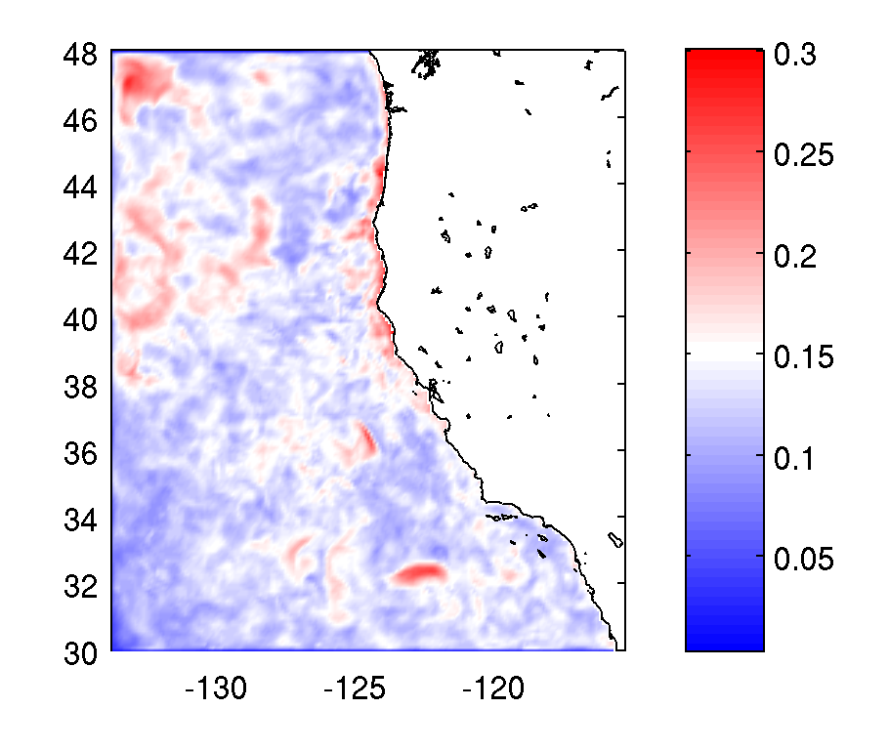
RMS SST difference (14 inner-loops minus 10 inner-loops) for 2001

Slide 12
RAMs: Assessing the Efficiency of the
CA Current Observing System
How effective is the CA Current observing system at constraining the circulation given our prior hypotheses about the errors B and R?
CCS observing system:
Satellite SST – daily
(AVHRR, AMSR, MODIS)
Aviso gridded SSH - daily
In situ T & S profiles
4 Jan – 18 April 2003
ROMS CCS domain

Slide 13
The Analysis Equation
Recall the analysis equation:
analysis
adjoint
obs operator
obs error
cov matrix
obs operator
background
background
error cov
matrix
obs
Analysis increment
The analysis increment resides in the space spanned by B !!!
Therefore, to reduce errors in x_{b}, the observing system must effectively observe (directly via G or indirectly via G^{T}) the dominant EOFs of B.

Slide 14
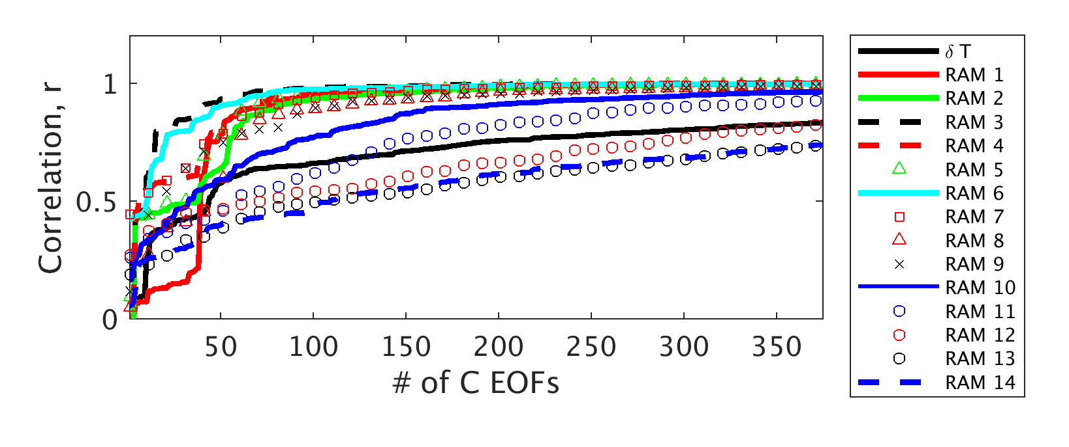
Projection of RAMs on the EOFs of B
B is O(10⁶×10⁶)
Number of EOFs required to recover RAMs << dim(B)
=> the observing system poorly constrains much of the space spanned by B

Slide 15
An Illustrative Example
Satellite
Swath
EOF of B
(localized region of
high background
error variance)
The satellite swath does not directly (G) or indirectly (G^{T}) observe the region of elevated background error variance associated with the EOF of B, so errors in this regions will not be corrected during data assimilation by the satellite observations.

Slide 16
An Illustrative Example
Satellite
Swath
EOF of B
(localized region of
high background
error variance)
Glider path
The glider path does directly observe the region of high error background error variance associated with the EOF of B, so errors in this regions will be corrected during data assimilation by the glider observations.

Slide 17
Summary & Conclusions
The RAMs identify the sub-space informed by the observations during 4D-Var
RAMs can be computed from archived 4D-Var output
RAMs with small λ will amplify obs errors
A useful practical stopping criteria identified for 4D-Var
The current array observes the EOFs of B rather poorly
Pseudo-observations could be used to optimize the observing system

