Slide 1
Ensemble variance loss in transport models:
Its relation with model numerical discretization
by Richard Ménard and Sergey Skachko
Environment and Climate Change Canada
Dorval, Quebec, CANADA
Workshop on Meteorological Sensitivity and Data Assimilation
Aveiro, Portugal, July 2, 2018

Slide 2
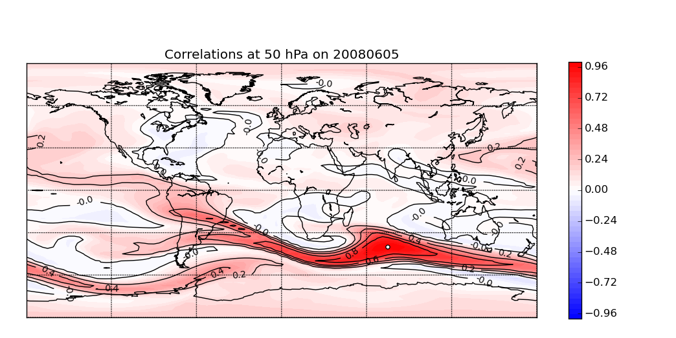
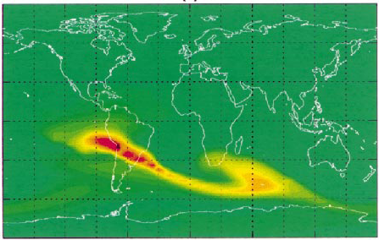
Motivation
The transport of information from one observation time to the next
is important for an optimal data assimilation system
Initial condition uncertainty is important to the forecast uncertainty
To what extent the numerical discretization of the model
influences the forecast uncertainty ?
We will examine this question with one of the simplest processes –
advection (and here linear advection – not Burgers equation )
After 5 days of pure transport , Ne = 500
and within an assimilation cycle
medium dense observations
coverage
sparse obs.
coverage
CLAES (IR emission)
HALOE (solar occultation)

Slide 3
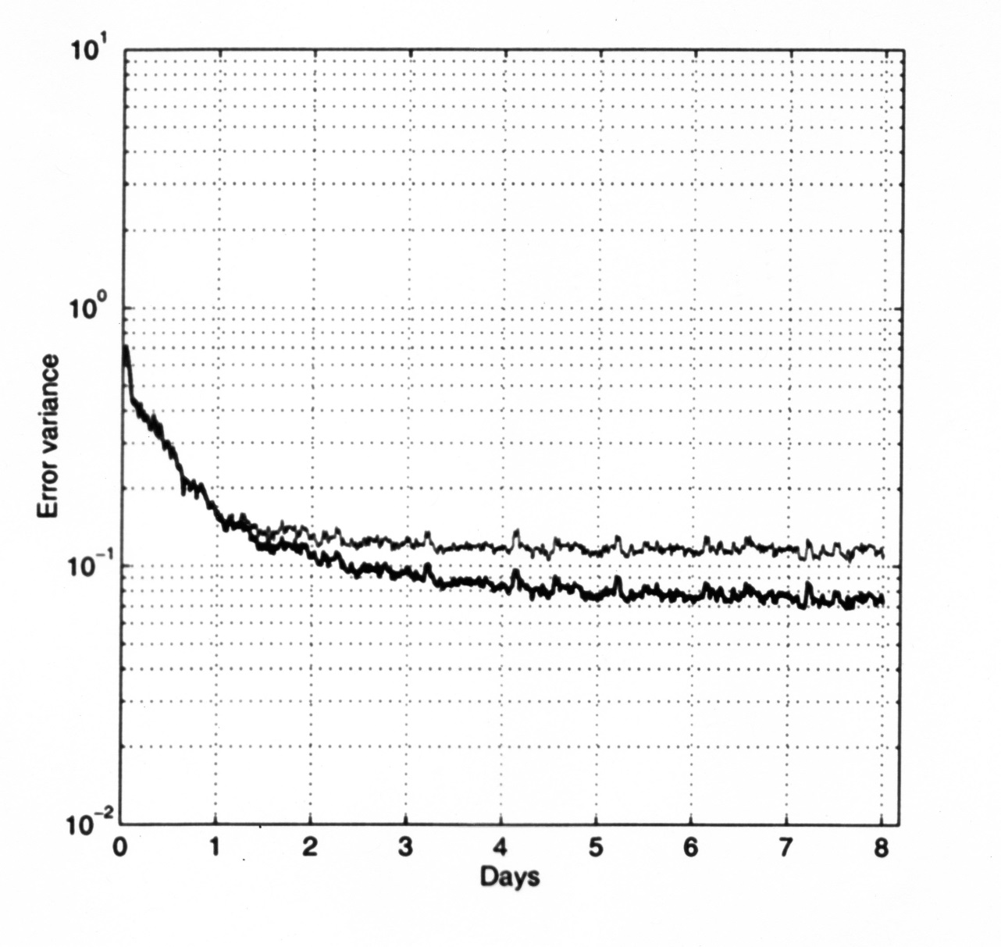
Motivation
When using different numerical schemes the model error variance t
can differ by a factor 2 (with a modestly dense observations)
Analysis error variance can also be different by a factor 2
standard KF
KF with variance correction
Ménard et al 2000 MWR, Ménard and Chang 2000 MWR

Slide 4
Transport of passive tracer
Eulerian coordinates
passive tracer, e.g. mass mixing ratio of an air constituent
Lagrangian coordinates
Let represent the position of fluid particles at t=0, and moving with the flow
The flow is given by the winds V

Slide 5
Conservative properties in Lagrangian coordinates
Assuming that the flow is known (i.e. deterministic) makes the advection
a linear problem.
●
Consider an ensemble of N_{e} initial
Tracer values for each fluid particles
●
The ensemble mean is conserved,
●
covariance between a pair particles is also conserved,
●
in fact the full pdf , p , is conserved in the Lagrangian coordinates. A nice
property it we were to apply it to particle filters.

Slide 6
But the Eulerian and the Lagrangian models may give widely
different uncertainties

Slide 7
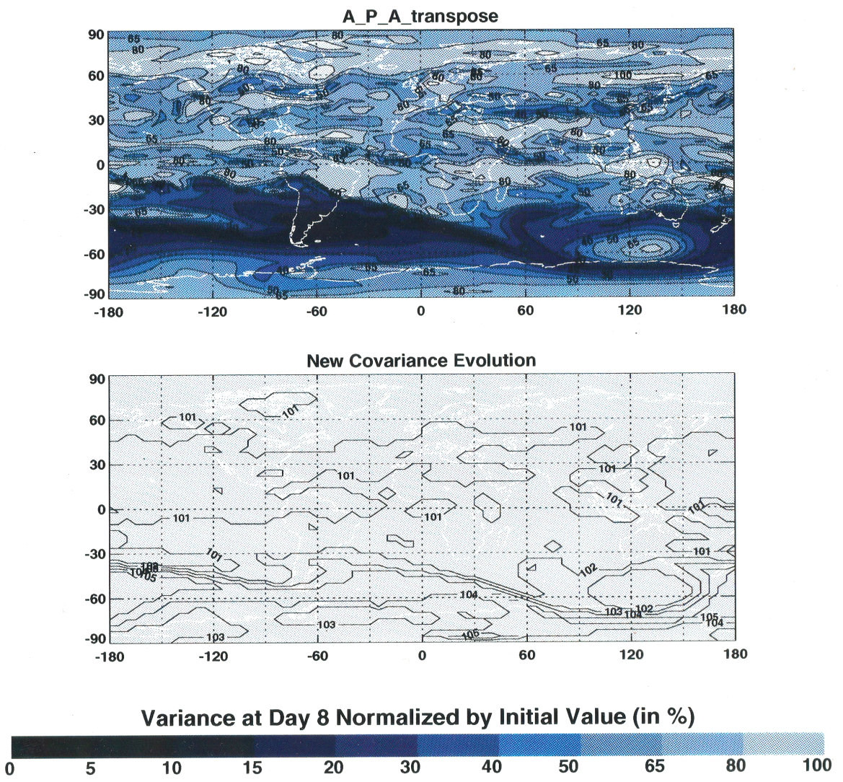

Same numerical model to evolve V and calculate P_{ii}
After 8 day of transport
evolving V (Lagrangian solution)
contours are for
each 1%
contours are for
each 10-20 %

Slide 8
Consider 1D advection uniform wind. Donor cell upstream or semi-lagrangian
where is the Courant number.
Time stepping of the error covariance is done by
in two steps
1) updating with respect to the x₁ coordinate
2) updating with respect to the x₂ coordinate
Remark: In matrix form, the result of step 1 and 2 is equivalent to
Specifically for the 1D advection transport scheme above

Slide 9
Combining those two equations and writing the result for i = j (the same point)
i.e. the error variance
(1)
Whereas from the Lagrangian description, the error variance should simply
be advected
(2)
The difference, equation (2) minus equation (1), is
a net loss of error variance
(3)
To recover the variance predicted by a Lagrangian description, the error variance
obtained from an Eulerian model need to be increased by the deficit (3), i.e.
This is an explicit form for inflation. Usually inflation is modeled as
multiplicative or additive or a combination of both.
But here we can see that inflation (correction) also depends on
the courant number and the correlation length

Slide 10
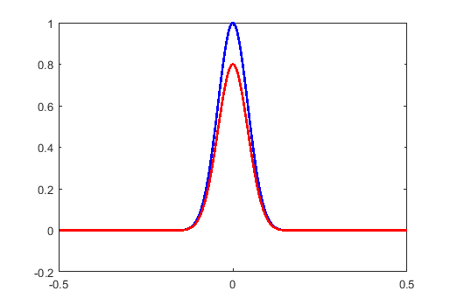
Inflation – illustration in a 1D case simple upstream scheme, uniform wind
EnKF numerical solution = Advection of variance + correction term
with a simple upstream scheme the
correction error term =

Slide 11
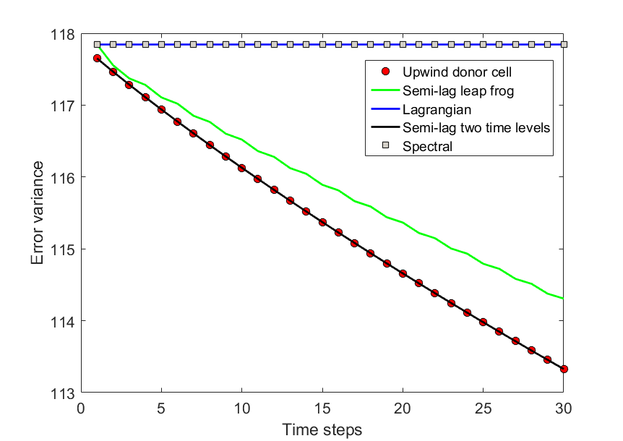
Variance evolution for different 1D models: uniform winds

Slide 12
Pdf evolution for ODE models: Liouville equation
Suppose we discretized the variable q into a N components (i.e. state space
of dimension N). The model evolution can be written in the form
The pdf evolution is given by forward Kolmogorov (or Fokker-Planck) equation
with no browning motion, i.e. Liouville equation
is a contracting of volume in phase space
conservation of volume in phase space.
The model equation is time reversible
Egger 1996, MWR

Slide 13
Evolution for discrete time models
The probability to find realizations in an N-dimensional volume in phase space,
should be equal to find the same realizations next time step in the evolved state
space volume
or to say that
The change in the N-dimensional volume is given by

Slide 14
So, let’s assume that the changes in error variance is linked with the changes in phase space volume
a piece of intuition
If we consider a phase space of dimension = 1, and a uniform distribution
is a measure of volume in phase space.
The variance of q is
a
b
Variance and volume in phase space are related.

Slide 15
Variance evolution for different 1D models: uniform winds
mean deformation per axis
scheme | determinant ^(1/N)
Lagrangian | 1
Spectral | 1
Semi-lag (2) | 0.6376
Upwind donor cell | 0.6376
semi-lag(2) and upwind
Courant | det^(1/N)
0.0 | 1.00
0.2 | 0.64
0.5 | 0.25
0.8 | 0.64
1.0 | 1.00
* results rather independent of N

Slide 16
Conclusions
Spatial discretization errors rather than time discretization errors
give rise (generally) to loss of error variance (i.e. information).
The spatial splitting error (not the time splitting) in the covariance
evolution is the critical to
Inflation used in EnKF compensates, at least in part, to the numerical
variance loss.
We derived an analytical form for the inflation for the semi-Lagrangian
and upstream scheme. This expression depends on the local courant
number, the covariance and the covariance length scale.
Pieces to finish this work
Refine and used other 1D models
Extend the uniform distribution argument to normal distributions
Ongoing work with a 3D transport models
Postdoc at Environment Canada
Air quality DA and chemical model reduction

Slide 17
Thanks for your attention

Slide 18
Evolution of covariance function
with
we get (as in Cohn 1993)
solution using the method of characteristics
Then
is a function of time only

Slide 19
Solution : variance function equation
for
then the characteristics remain coincident
x₁(t)
x₂(t)
x₁(0)
x₂(0)
the covariance at the same point (i.e. the variance)
is constant along the characteristics (or along the flow)

Slide 20
How does it relate to an EnKF ?
We start with
…………….(1)
discretize in space, and
solve the evolution by operator splitting (first-order), on and then on
We can show that this is equivalent to solving the covariance matrices as
……(2)
where M is the solution operator of

