Slide 1
A comparison of hybrid variational data assimilation methods in the Met Office global NWP system
Andrew Lorenc
11th Adjoint Workshop, Aveiro Portugal, July 2018

Slide 2
The Met Office VAR System
1993 Development started
1999 3DVar in global & mesoscale models
2004 4DVar in global model; 2006 NAE; 2017 UKV.
2011 Hybrid-4DVar in global; 2018? UKV.
2014 Hybrid-4DEnVar trialled in global,
En-4DEnVar for ensemble.
2016 Improved hybrid-4DEnVar ensemble covariances tested.
2017 Improved hybrid-4DVar ensemble covariances.
Lorenc et al. 2000
Lorenc & Rawlins 2005, Rawlins et al. 2007
Simonin et al. 2017
Clayton et al. 2013
Lorenc et al. 2015
Bowler et al. 2017a,b
Lorenc 2017
Inverarity et al. 2018
Old code, hardwired to regular grid.
2023 Trialling of replacement exascale system for new LFRic model.

Slide 3
Aim of this work
Repeat earlier comparisons in improved modern system:
    Static B v hybrid v ensemble B
    4DVar v 4DEnVar
    3D v 4D
Improved understanding of differences in performance
Inform priorities for what to try first in new system

Slide 4
Trials
Reduced resolution version of operational global NWP
(N320 model, N216 analysis increments).
sqrtB preconditioned VAR, allowing nonlinear H, no outer-loop.
Independent ETKF ensemble, Ne=44,
enhanced by lag-shift & scale-dependent localisation using 4 wavebands.
Full range of hybrid-weights evaluated for each variational method.
7 week in May-June 2015, assessed using
“NWP Index” differences averaged over last 42 days.

Slide 5
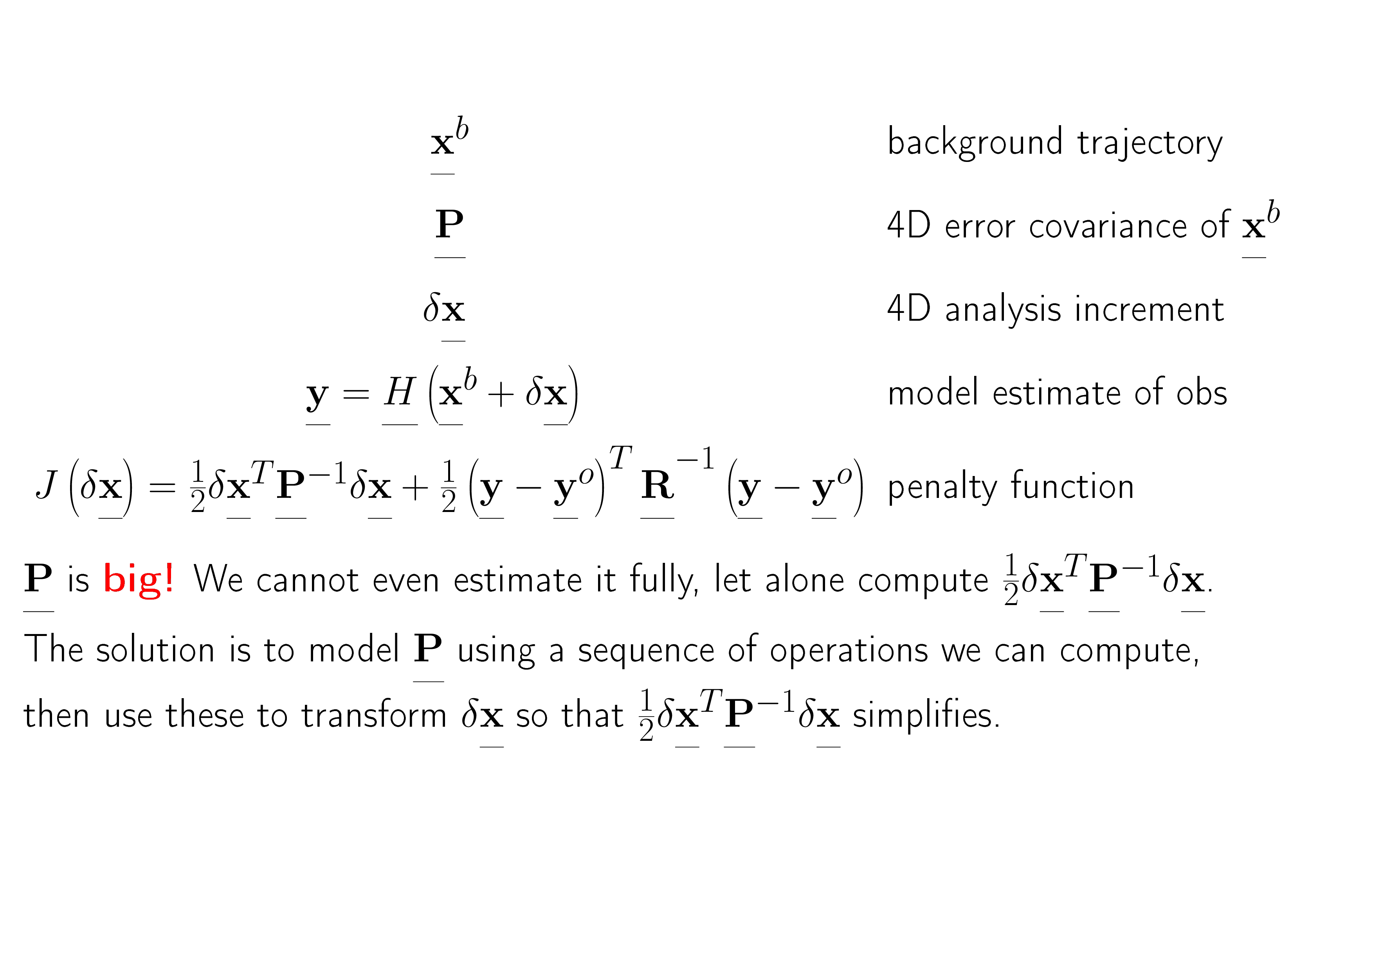
Idealised General Bayesian 4D DA

Slide 6
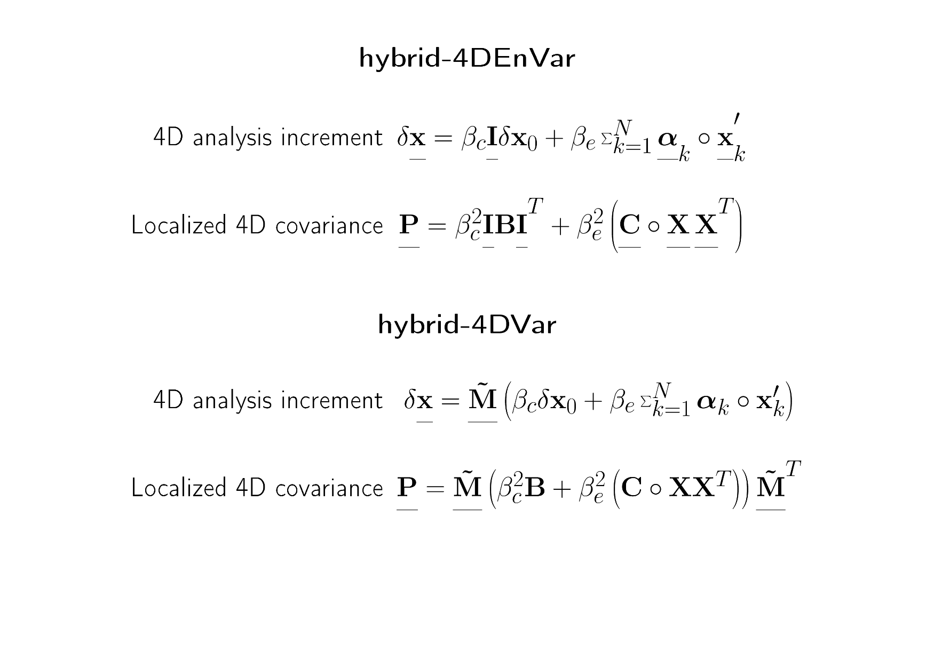
Summary comparison

Slide 7
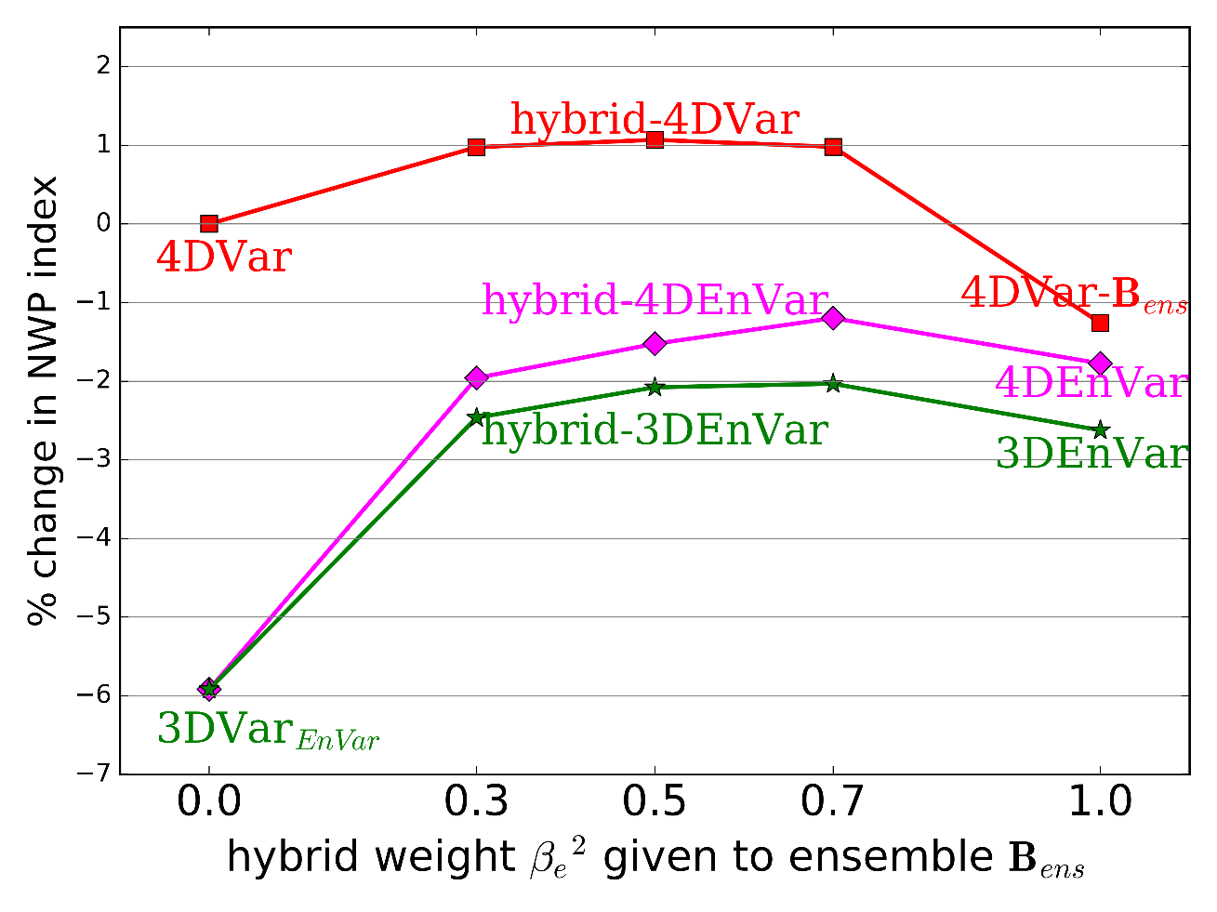
Comparison of hybrid-Var methods
4DVar improves on 3DVar using static B_{c} by 6%, but doesn’t much improve when using B_{ens}
‒ with β_{e}²=1 4DEnVar is as good
Allowing for the obs-time in 4DEnVar gains 1% over 3DEnVar
Hybrid-4DVar is 1% better than 4DVar and 2% better than best hybrid-4DEnVar
Lorenc & Jardak 2018

Slide 8
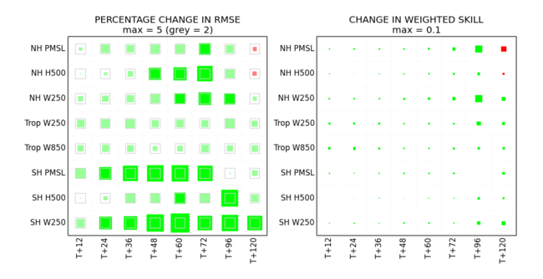
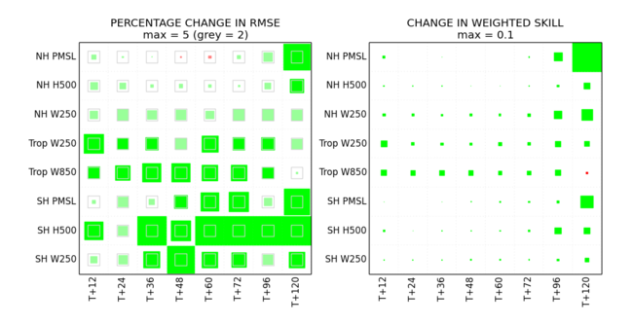
Scorecards for best method
Hybrid-4DVar with β_{e}²=0.5
beats 4DVar with β_{e}²=0.0
+1.1% on Index
Hybrid-4DVar with β_{e}²=0.5
beats hybrid-4DEnVar with β_{e}²=0.7
+2.2% on Index

Slide 9
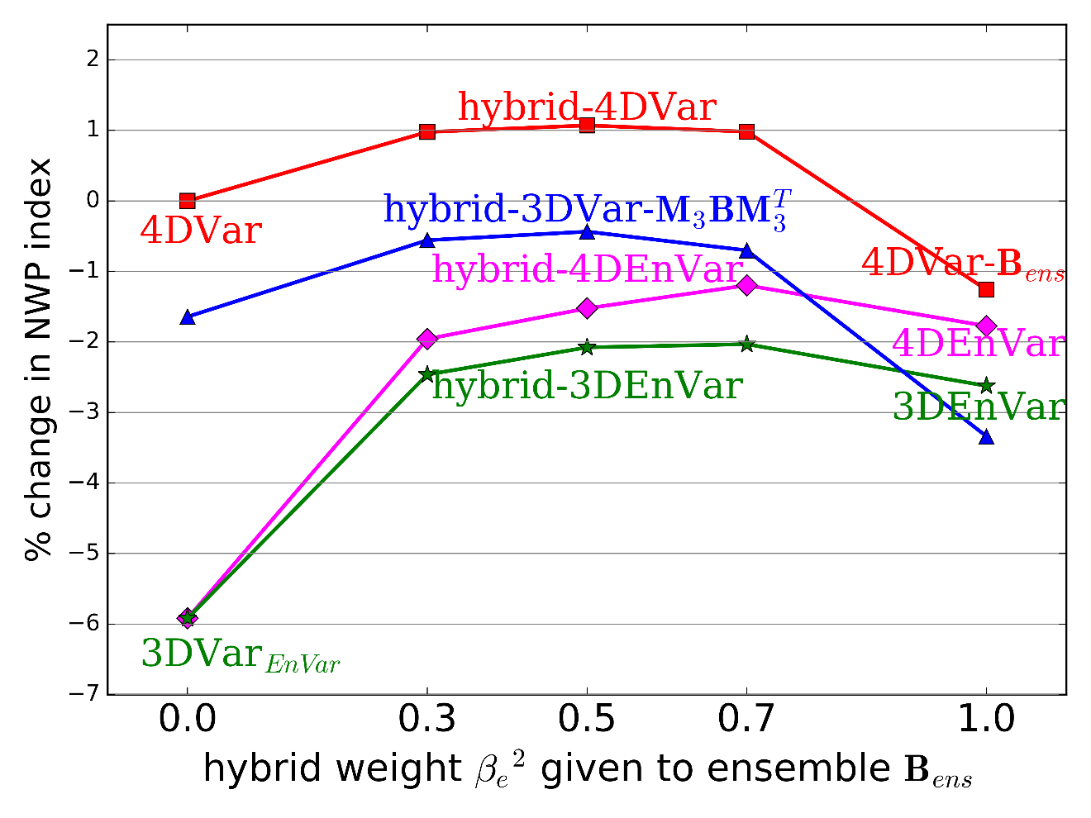
Comparison of hybrid-Var methods
Used 4DVar software to run 3DVar with covariances improved by 3hrs evolution (as in Lorenc & Rawlins 2005)
This improves static B_{c}, explaining most of the benefit of 4DVar
Allowing for the obs-time in 4DVar gains ~1% (like 4DEnVar over 3DEnVar)
Time-evolved M₃B_{ens}M₃^{T}
does not improve on B_{ens}
Lorenc & Jardak 2018

Slide 10
Explanation using ideas from nonlinear dynamics
For a perfect chaotic model, the errors from a Kalman filter based DA system
asymptote to the unstable–neutral subspace
Ensemble DA only works if N_{e} > dimensions of unstable-neutral sub-space
(Bocquet & Carrassi 2017). Our Ne=44 was too small, so needs augmenting by B.
4DVar methods work best when increments are in the unstable sub-space
(Trevisan et al. 2010)
Perturbations which grow typically slope ‒ our B model is isotropic.
So B has only a small projection on the unstable sub-space ‒ MBM^{T} does better.
The ideas above are only an idealised limiting case, based on small perfect models.
NWP models cannot be perfect because of the butterfly effect.
The dimension of the unstable sub-space is uncertain due to localisation.

Slide 11
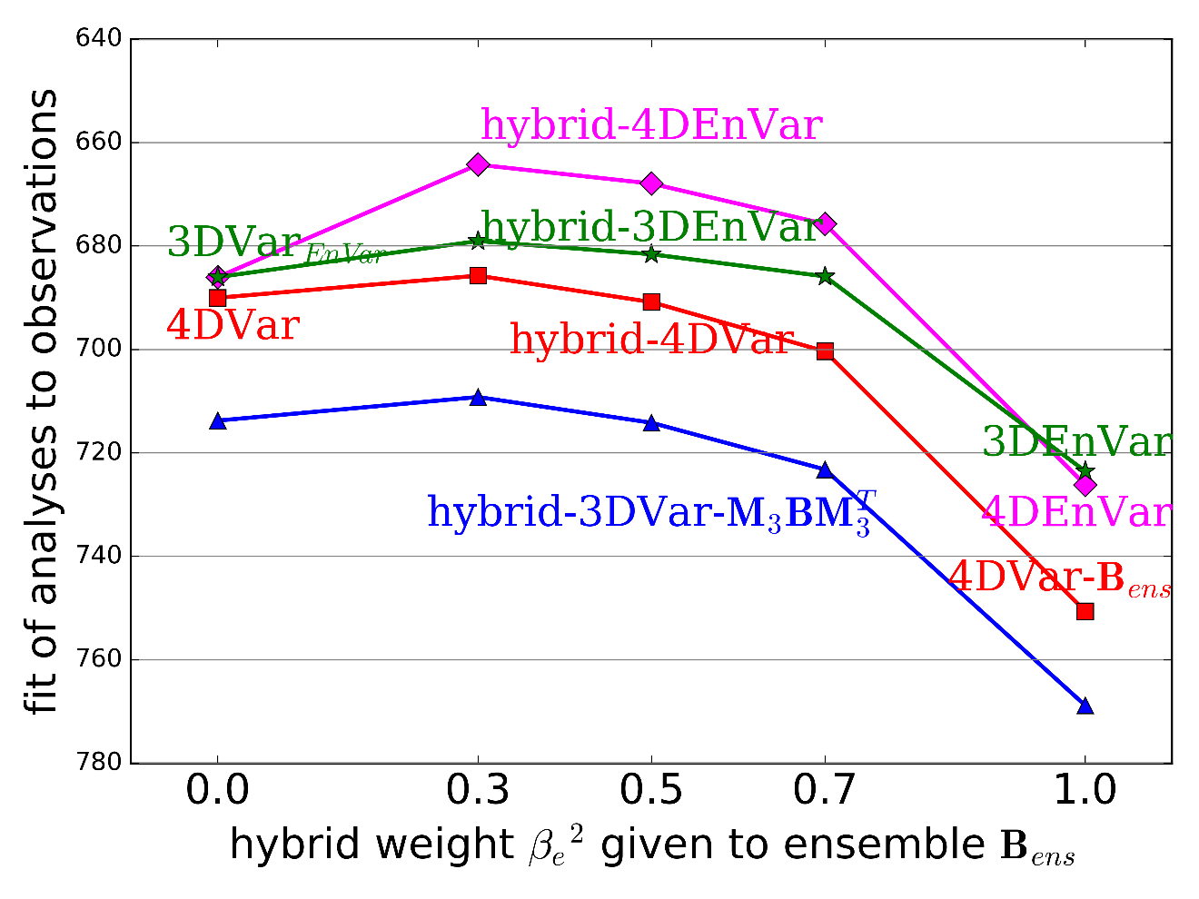
Analysis fit to observations
The ability to fit the observations
(to within their standard errors) is a necessary (but not sufficient) measure of a good analysis.
Even with waveband and scale‑dependent localisation, and augmentation by lagging & shifting, our 44 member ensemble covariance was not good at fitting the observations.

Slide 12
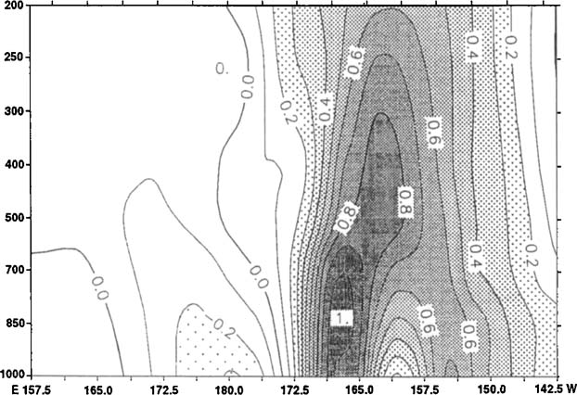
Dynamical structure functions in 4DVar
Thépaut et al. (1996)
Time evolution (in this case for 24hrs) produces structures that are tilted and look like singular vectors.
Our isotropic B-model (in which scale is independent of direction) cannot give preference to such growing structures.

Slide 13
Summary
By using ensemble covariances improved by wavebands and lag-shift
We have successfully compared 3DVar, 4DVar and 4DEnVar
for the full range of hybrid weights, with our Ne=44 ensemble.
Hybrid-4DVar still beats hybrid-4DEnVar in this system.
The time-propagated static B_{c} is the main reason 4DVar is better:
  Hybrid-3DVar and hybrid-3DEnVar are equivalent;
  When using pure ensemble B_{ens},
  4DVar-B_{ens} and 4DEnVar have similar performance.
Because?? B_{c} is complete,
propagation moves it towards unstable sub-space

Slide 14
Extra slides
Showing NWP Index from extra non-hybrid experiments
  Exploring the effect of changing the length of evolution of B
  Comparing detailed differences in our implementation.
Showing the average fit of backgrounds to observations, for the hybrid expts.
  a good measure of quality, correlating well with NWP Index.
Showing details of hybrid-4DVar & hybrid-4DEnVar algorithms.
Showing the regional variation in the split into wavebands.
  waveband-specific tuning caters for regional variation in coeffs.

Slide 15
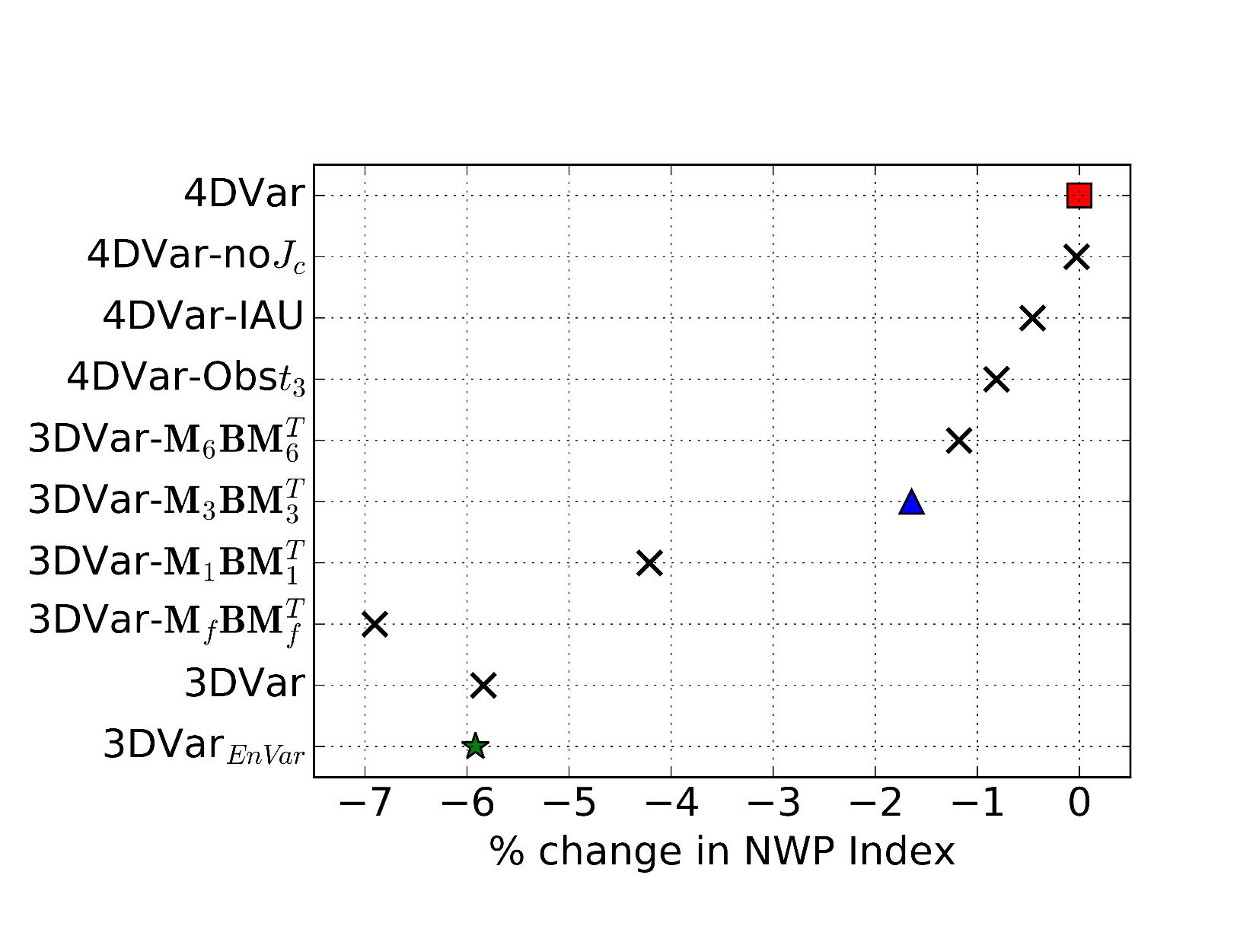
Extra non-hybrid experiments
Lorenc & Jardak 2018

Slide 16
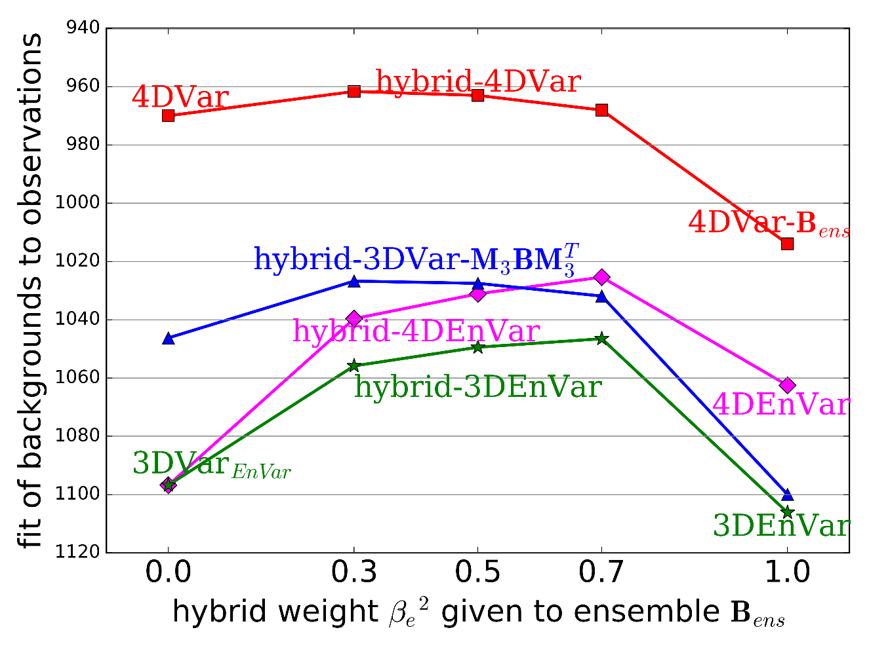
Background fit to observations
The ability to fit the observations
(to within their standard errors) is usually a reliable
measure of a good analysis.

Slide 17
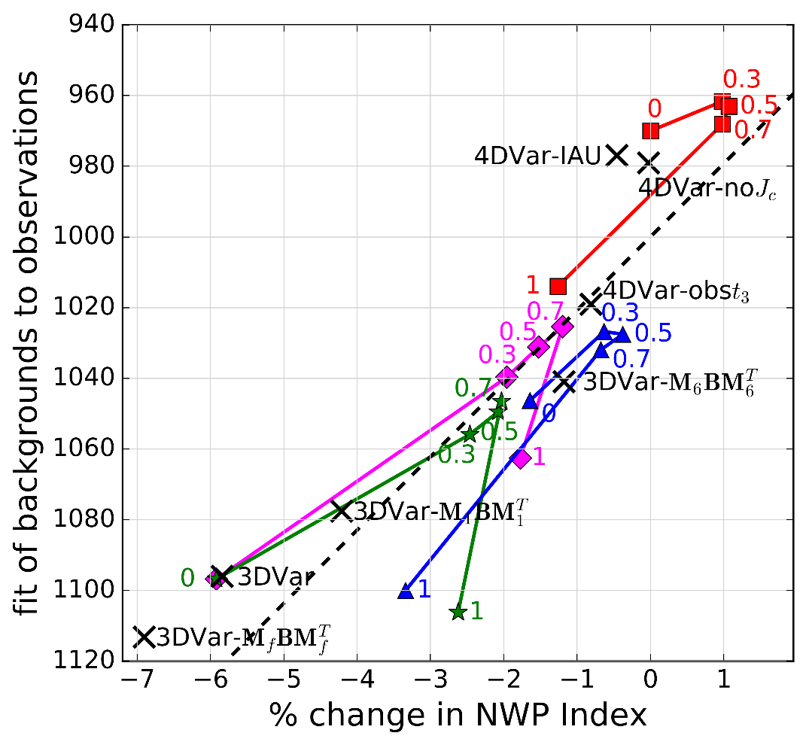
Background fit to observations
The ability to fit the observations
(to within their standard errors) is usually a reliable
measure of a good analysis.
This is shown by the high correlation with the NWP Index scores.

Slide 18
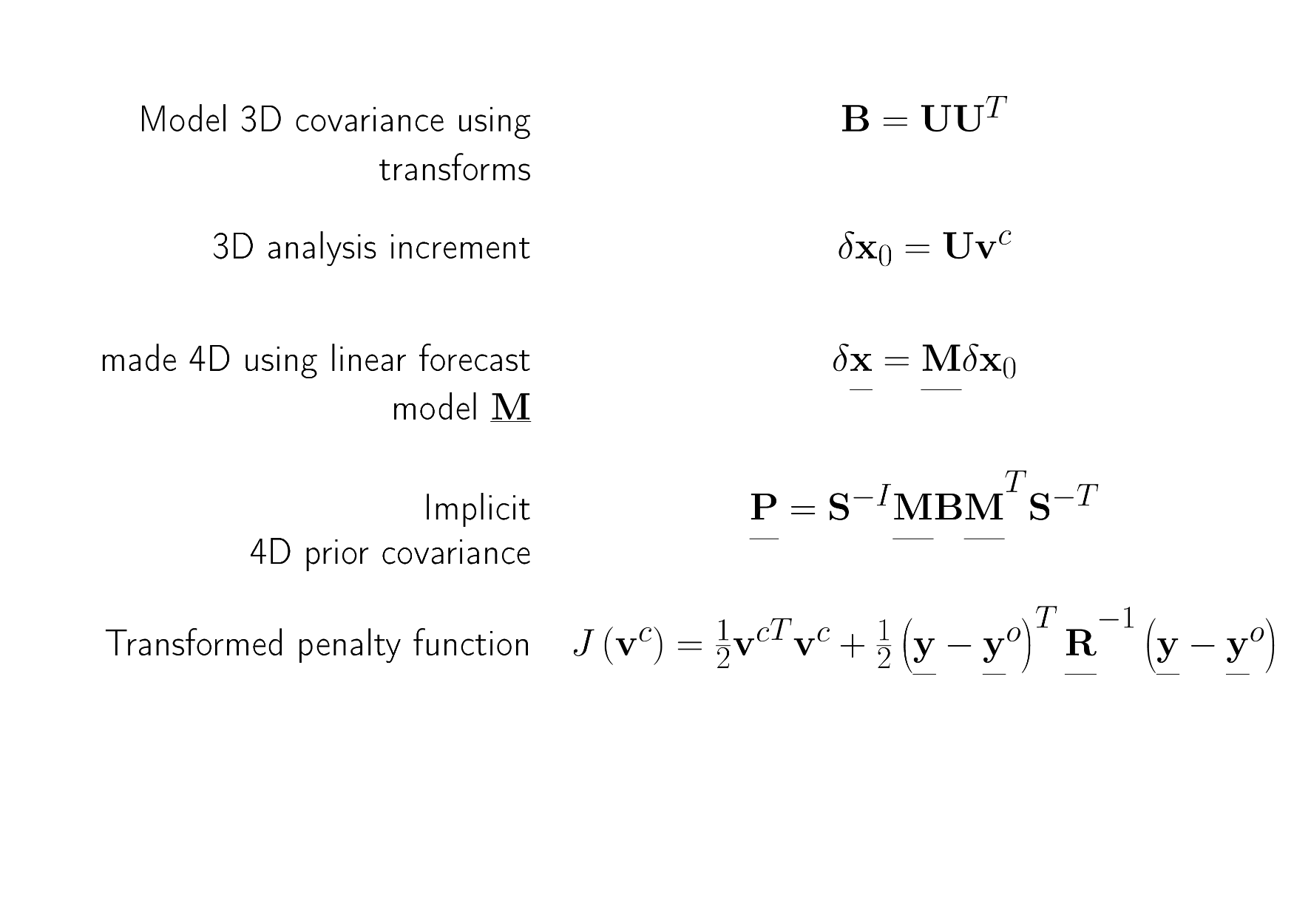
4DVar: using static covariance B

Slide 19
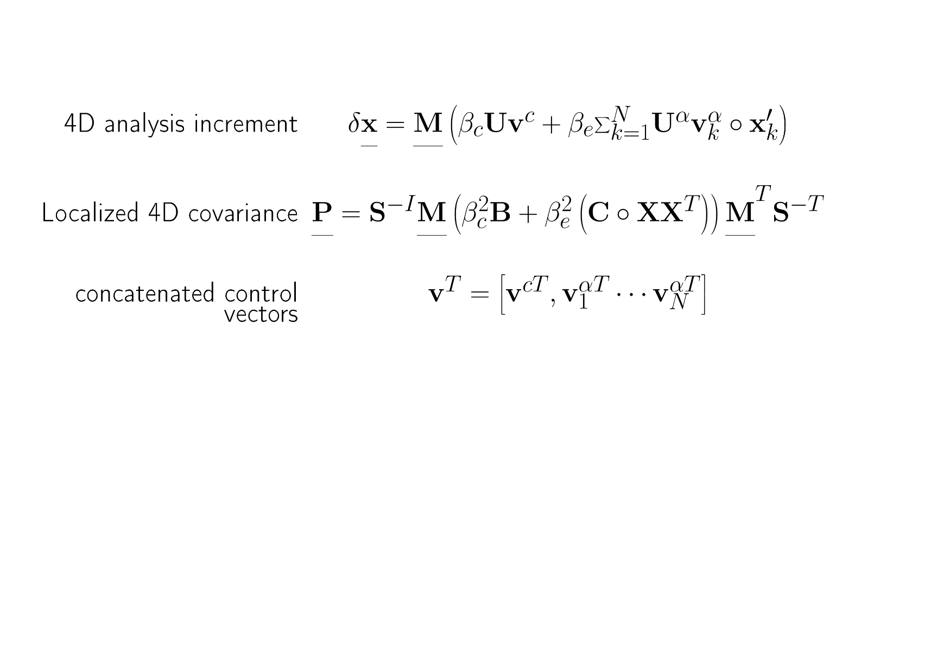
hybrid-4DVar
1% improvement in rms errors
when implemented at Met Office
(Clayton et al. 2013)

Slide 20
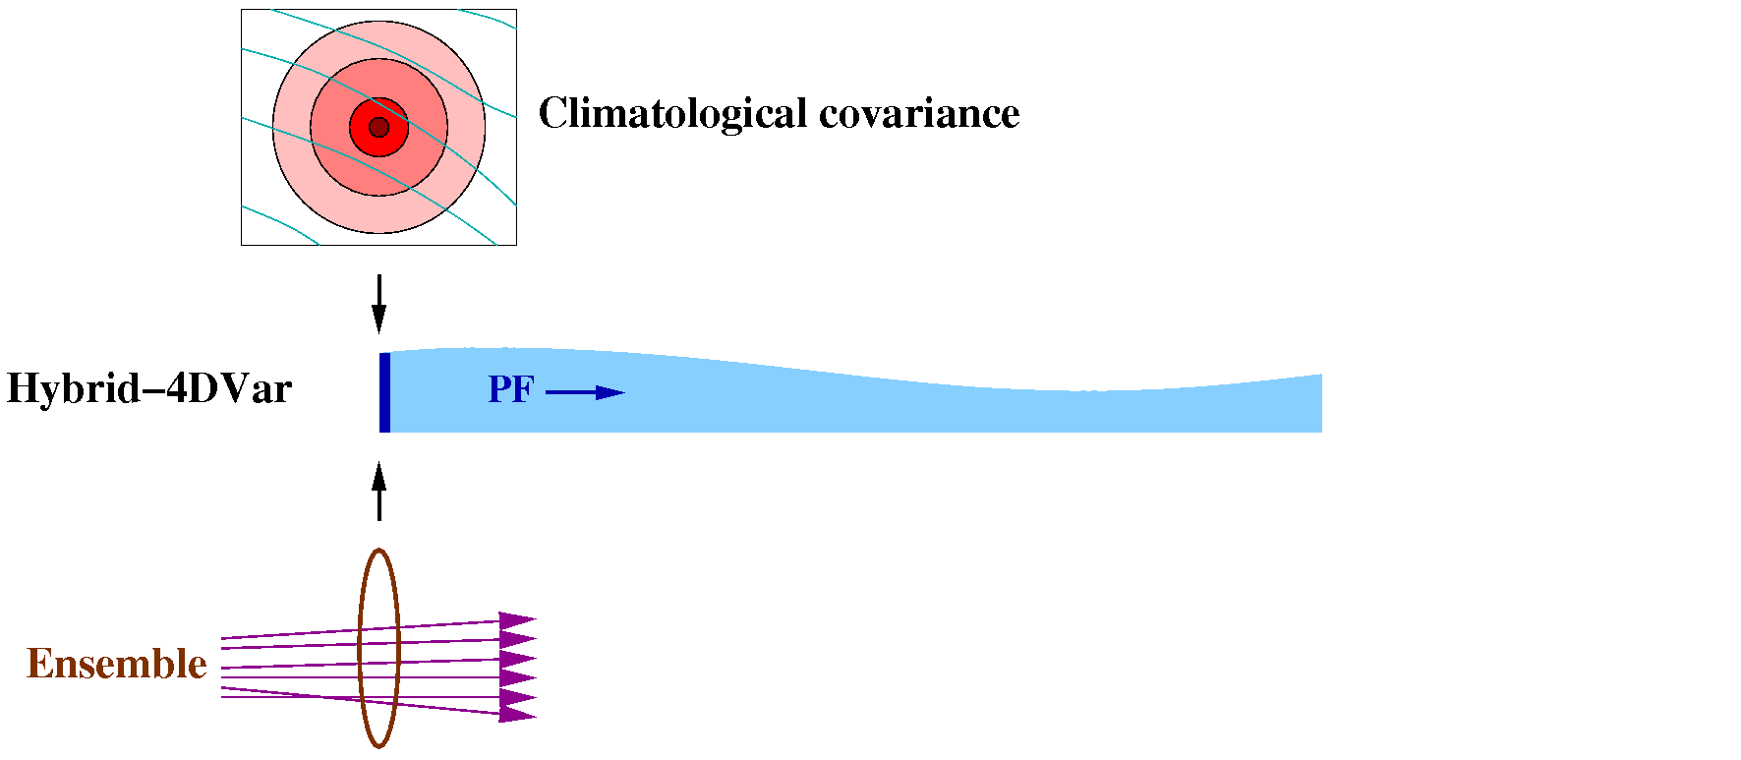
Hybrid-4DVar
(MOGREPS-G, based on localised ETKF. Currently 44 members.)
B implicitly propagated by a linear “Perturbation Forecast” (PF) model:
  ~100 PF + adjoint forecasts run serially.
  But PF model doesn’t scale well.
  And difficult to keep PF model in line with forecast model.
We need an alternative scheme for future supercomputers that excludes the PF model…

Slide 21
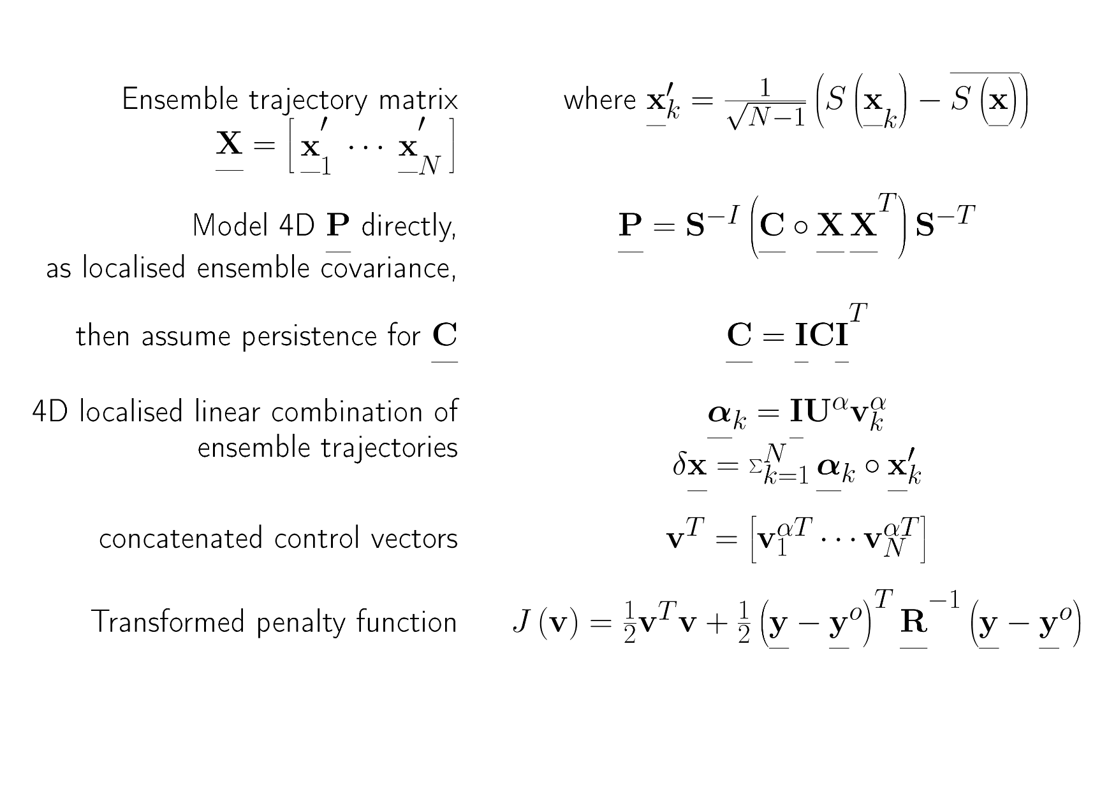
4DEnVar: using an ensemble of 4D trajectories which samples background errors

Slide 22
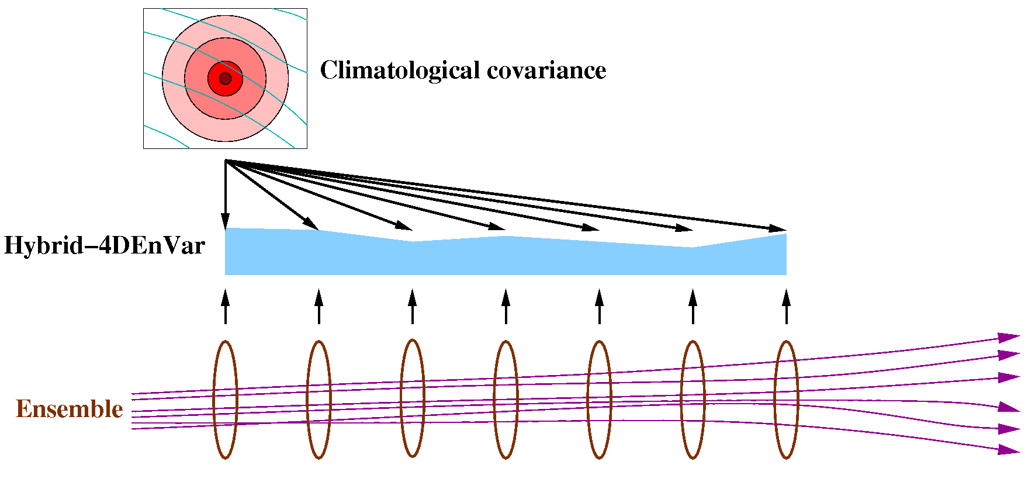
Hybrid-4DEnVar
No PF model, but much more IO required to read ensemble data:
  11 times faster with 22 N216 members and 384 PEs. (IO around 30% of cost)
Analysis consists of two parts:
  A 3DVar-like analysis based on the climatological covariance B_{c}
  A 4D analysis consisting of a linear combination of the ensemble perturbations.
Localisation is currently in space only: same linear combination of ensemble perturbations at all times.

Slide 23
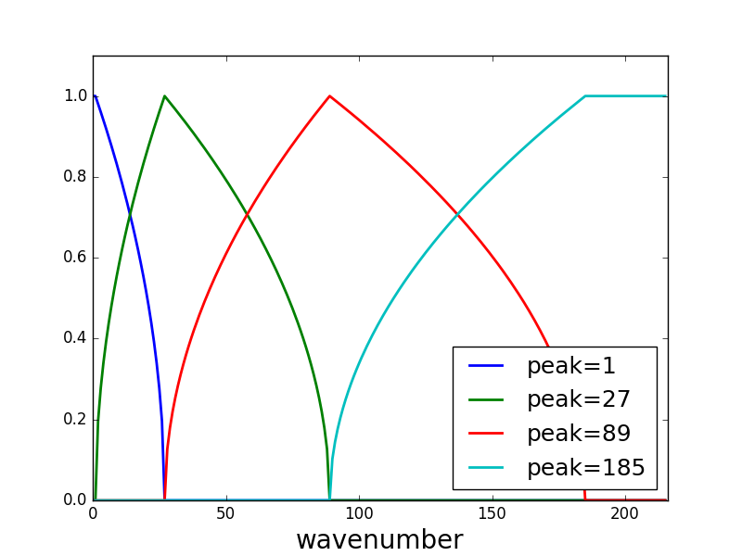
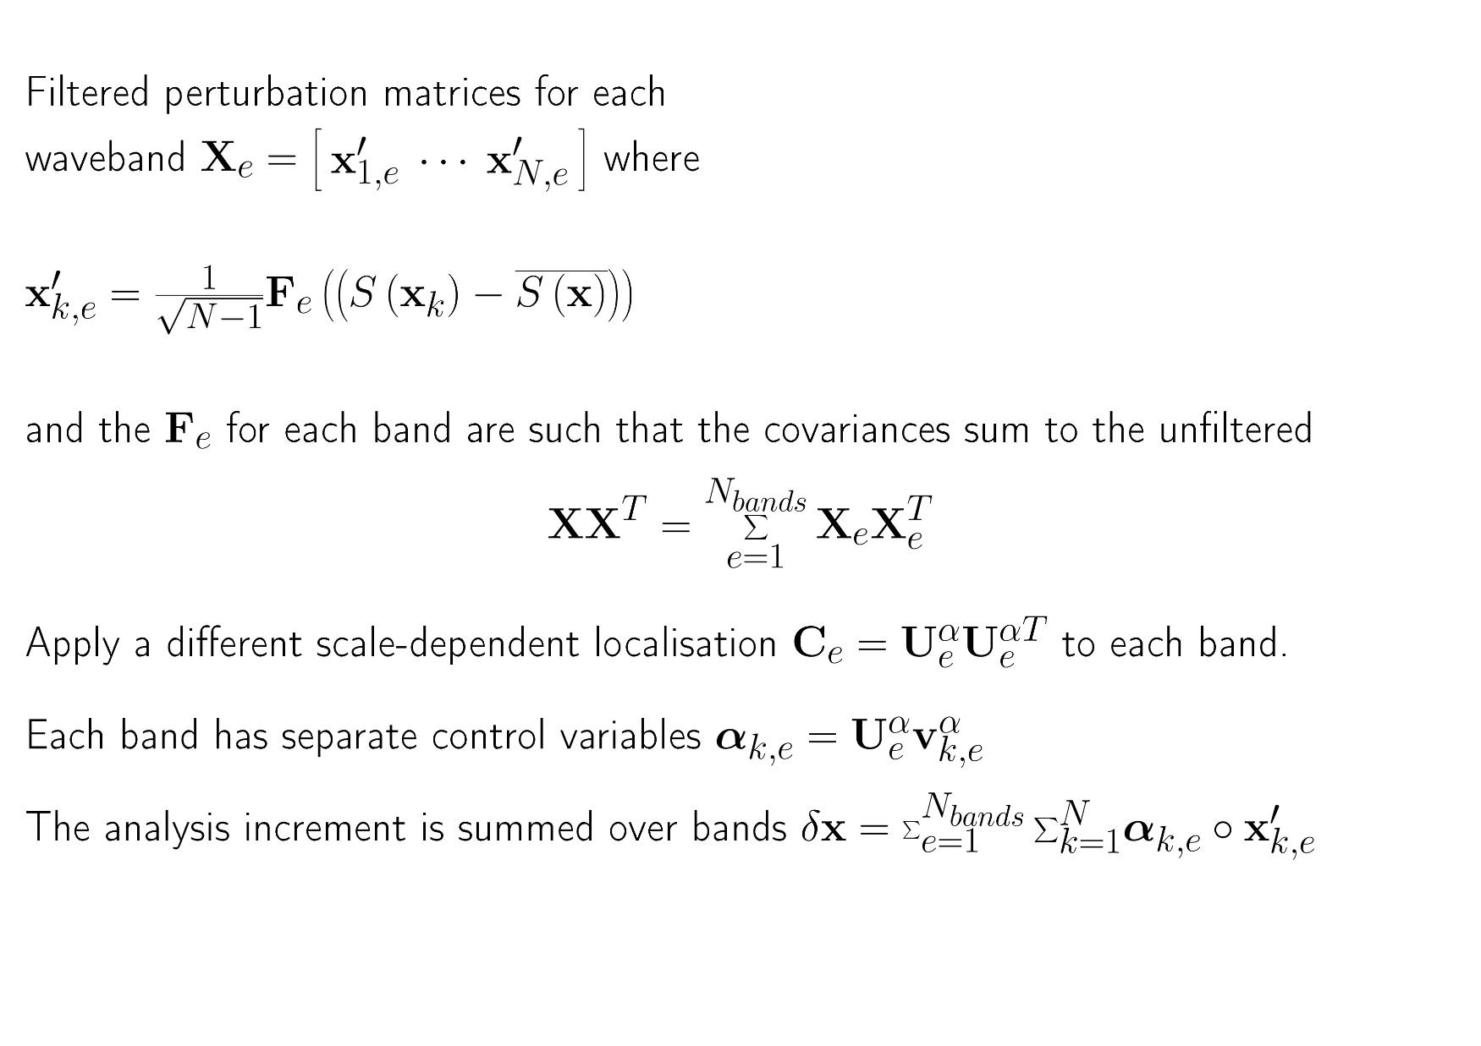
Scale-dependent localisation
& waveband filtering Lorenc (2017)
6241, 919, 389, 256km

Slide 24
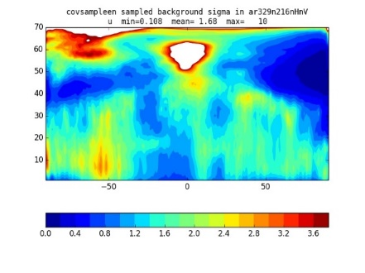

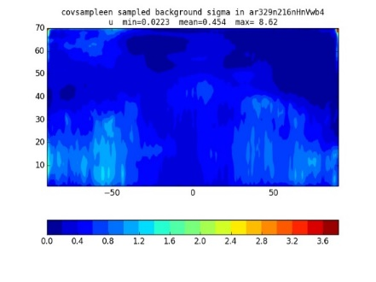
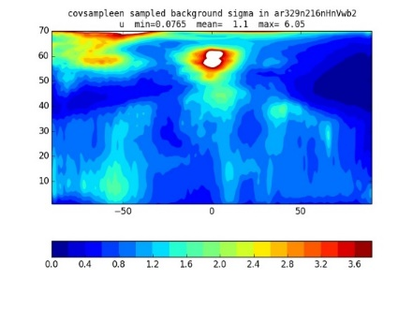
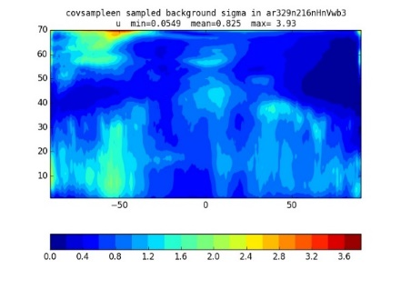
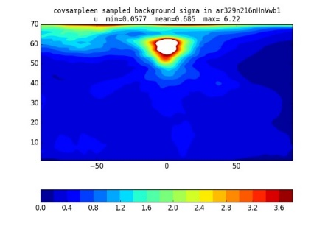
Wavebands copied from Lorenc (2017).
RMS zonal mean X-sections of u′
For a randomly chosen date in June
Raw ensemble
Sum of wavebands
waveband 1
waveband 2
waveband 3
waveband 4
Notes:
Wavebands were chosen to have width proportional to wavenumber.
Other variable have different distribution; e.g. Psi, chi have more in wb1 and humidity more in wb4. Overall, about an equal split.
We assume the bands are independent (i.e. Localise between them). The split preserves total covariance. There is some local smoothing (not visible in zonal means).

Slide 25
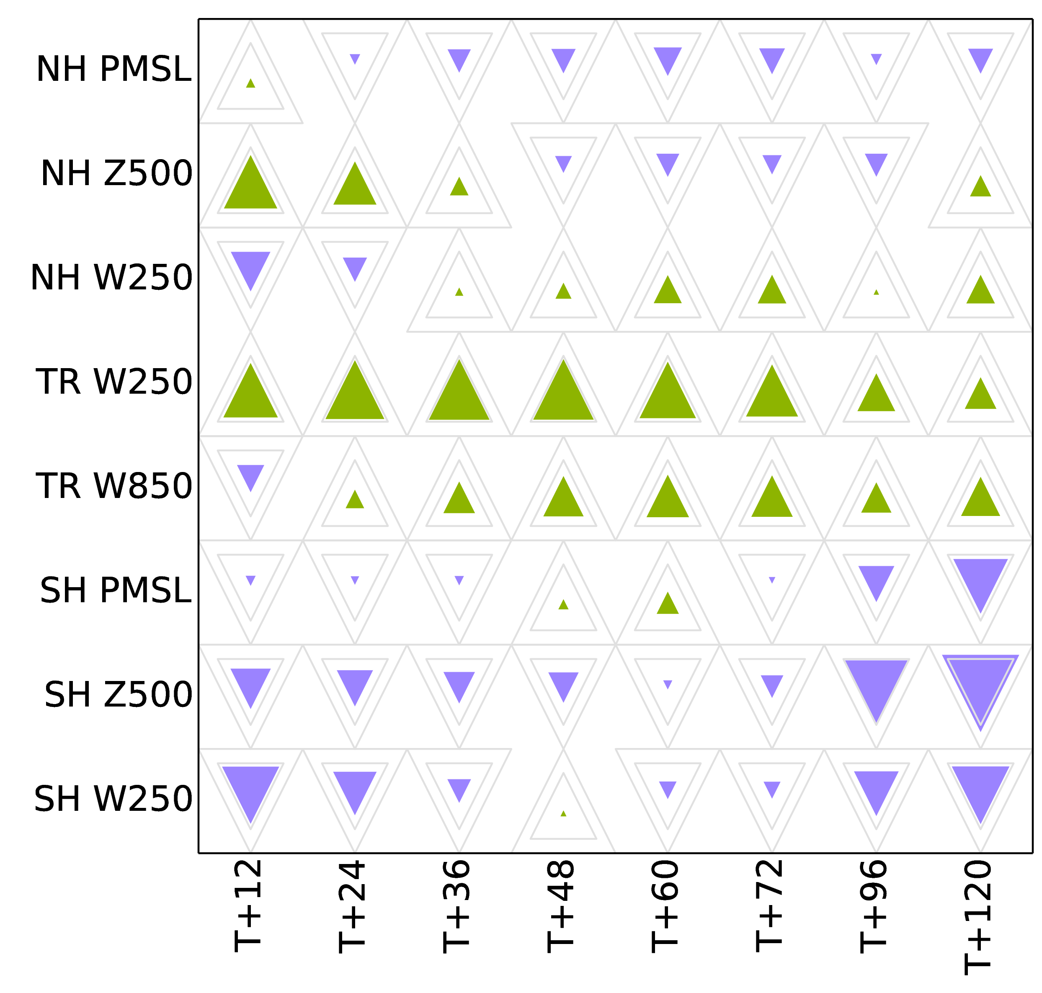
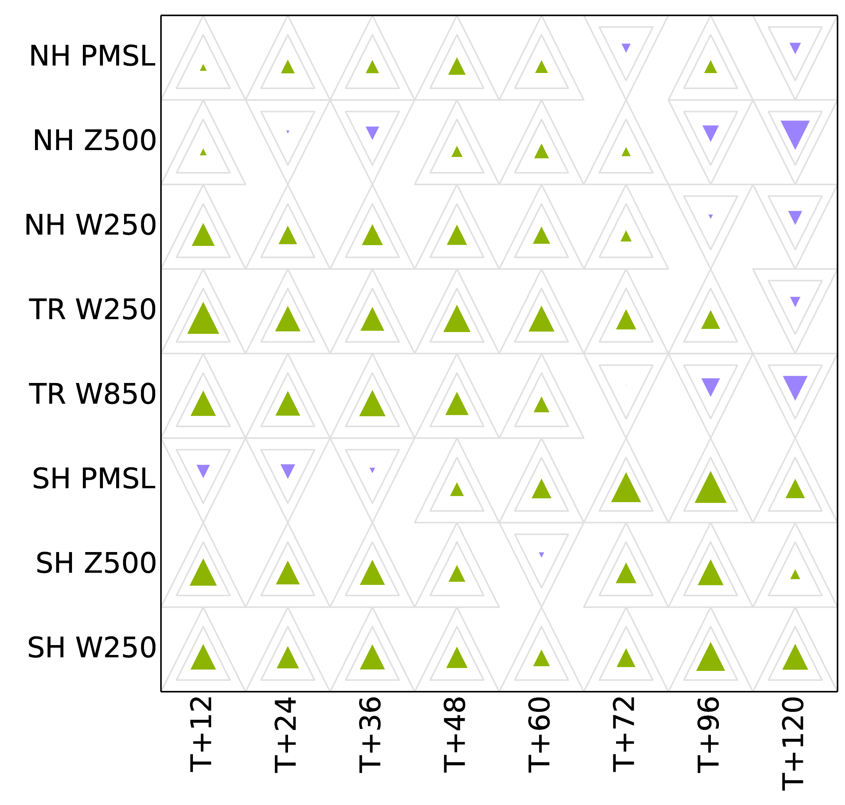
Wavebands & scale-dependent localisation help with some tuning!
Changing localisation scale (from 600km to 800km) has mixed benefit, depending on region,
when not using wavebands.
Changing all localisation scales (by factor 5/6) has consistent benefit when using wavebands with scale dependent localisation.
The regional variations in the split between wavebands
take care of many regional variations in optimal tuning. (Lorenc 2017)

Slide 26
References
Bocquet M, Carrassi A. 2017. Four-dimensional ensemble variational data assimilation and the unstable subspace. Tellus A 69(1): doi:10.1080/16000870.2017.1304504
Bowler NE, Clayton AM, Jardak M, Jermey PM, Lorenc AC, Wlasak MA, Barker DM, Inverarity GW, Swinbank R. 2017a. The effect of improved ensemble covariances on hybrid variational data assimilation. QJRMS 143: doi:10.1002/qj.2964.
Bowler NE, Clayton AM, Jardak M, Lee E, Lorenc AC, Piccolo C, Pring SR, Wlasak MA, Barker DM, Inverarity GW, Swinbank R. 2017b. Inflation and localisation tests in the development of an ensemble of 4d-ensemble variational assimilations. QJRMS 143: doi:10.1002/qj.3004.
Clayton AM, Lorenc AC, Barker DM. 2013. Operational implementation of a hybrid ensemble/4D-Var global data assimilation system at the Met Oce. QJRMS 139: doi:10.1002/qj.2054.
Inverarity GW, Wlasak MA, Jardak M, Lorenc AC. 2018. Deterministic data assimilation developments - July 2017. Met Office FR Tech. Rept. 625, Met Office.
Lorenc AC. 2017. Improving ensemble covariances in hybrid-variational data assimilation, without increasing ensemble size. QJRMS 143: doi:10.1002/qj.2990
Lorenc AC, Ballard SP, Bell RS, Ingleby NB, Andrews PLF, Barker DM, Bray JR, Clayton AM, Dalby T, Li D, Payne TJ, Saunders FW. 2000. The Met. Office global three-dimensional variational data assimilation scheme. QJRMS 126: doi:10.1002/qj.49712657002.
Lorenc AC, Bowler NE, Clayton AM, Fairbairn D, Pring SR. 2015. Comparison of hybrid-4DEnVar and hybrid-4DVar data assimilation methods for global NWP. MWR 143: doi:10.1175/MWR-D-14-00195.1.
Lorenc AC, Jardak M. 2018. A comparison of hybrid variational data assimilation methods for global NWP. QJRMS submitted.
Lorenc AC, Rawlins F. 2005. Why does 4D-Var beat 3D-Var? QJRMS 131: doi:10.1002/qj.49711146703.
Rawlins F, Ballard SP, Bovis KJ, Clayton AM, Li D, Inverarity GW, Lorenc AC, Payne TJ. 2007. The Met Office global four-dimensional variational data assimilation system. QJRMS 133: doi:10.1002/qj.32.
Simonin D, Pierce C, Roberts N, Ballard SP, Li Z. 2017. Performance of Met Office hourly cycling NWP-based nowcasting for precipitation forecasts. QJRMS
doi:10.1002/qj.3136
Thépaut JN, Courtier P, Belaud G, Lemaître G. 1996. Dynamical structure functions in a four-dimensional variational assimilation: A case study. QJRMS 122:
Trevisan A, D'Isidoro M, Talagrand O. 2010. Four-dimensional variational assimilation in the unstable subspace and the optimal subspace dimension. QJRMS 136(647): doi:10.1002/qj.571.

