Slide 1
Scale-dependent localization and weighting in the FV3-GFS hybrid data assimilation system
Daryl Kleist
NOAA/NWS/NCEP/EMC
Workshop on Sensitivity Analysis and Data Assimilation in Meteorology and Oceanography
Aveiro, Portugal, July 2-6, 2018
Ting Lei¹, Rahul Mahajan¹, Catherine Thomas¹, Deng-Shun Chen²
¹IMSG, NOAA/NWS/NCEP/EMC
²Taiwan Central Weather Bureau, National Central University

Slide 2
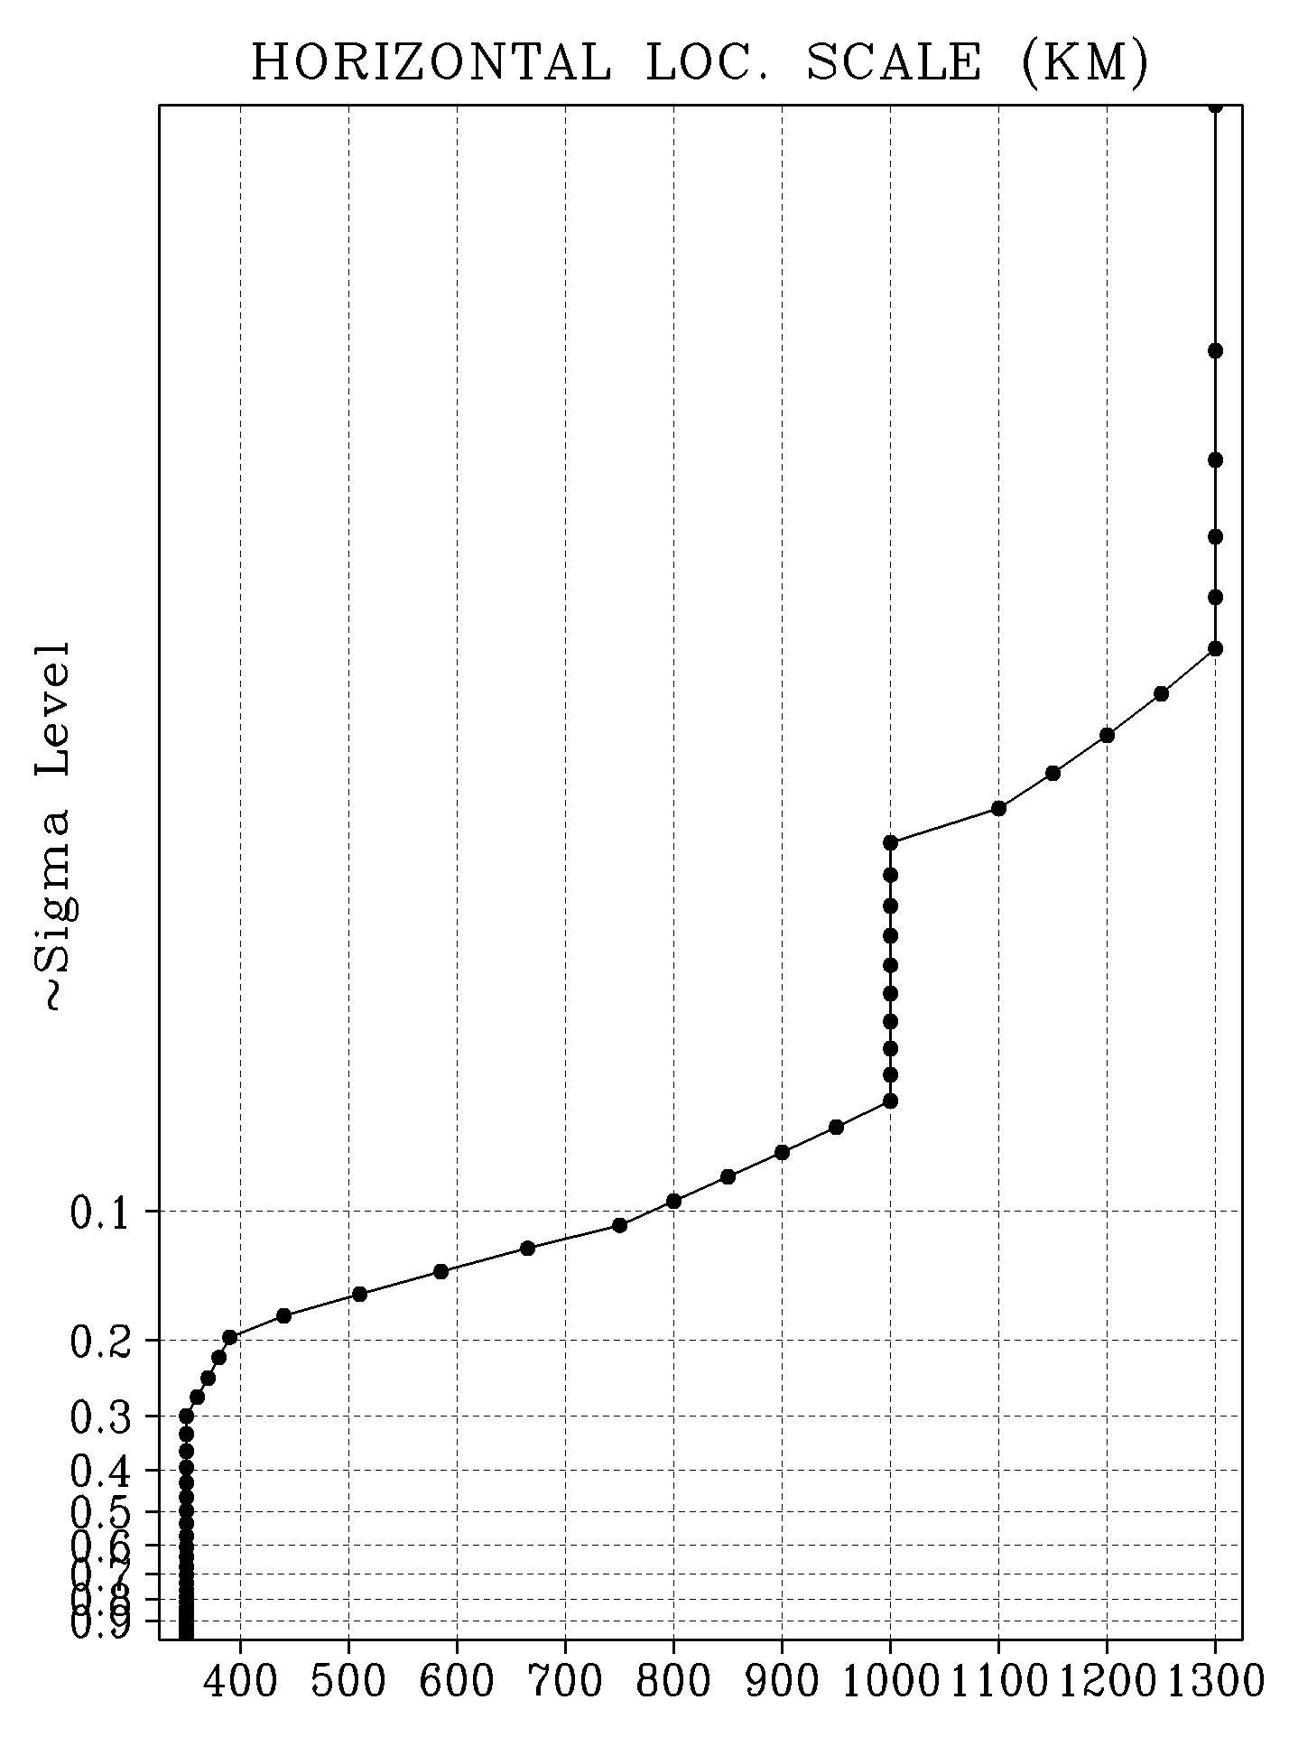
Current Operational GDAS Configuration
Hybrid 4DEnVar (May 2016)
T1534L64 Semi-Lagrangian GFS (GSM)
  80 member T574L64 EnSRF for data assimilation
  Level-dependent localization
  Stochastic physics to represent model uncertainty (SPPT, SKEB, SHUM) – Since January 2015
  Analysis increment at ensemble resolution
  Ensemble perturbations centered about hybrid analysis
    Ensemble mean state estimate replaced

Slide 3
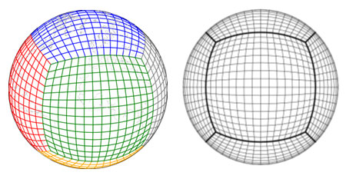
NGGPS/FV3-GFS
NOAA GFDL FV3 selected for dynamic core component of NGGPS
  Using non-hydrostatic option
  Initial prototyping with (mostly) GFS physics (new: GFDL MP)
  Same vertical levels and model top (~55km)
Courtesy: GFDL
Data Assimilation
  Adaptation of current hybrid 4DEnVar scheme
  Re-gridding to accommodate current DA infrastructure

Slide 4
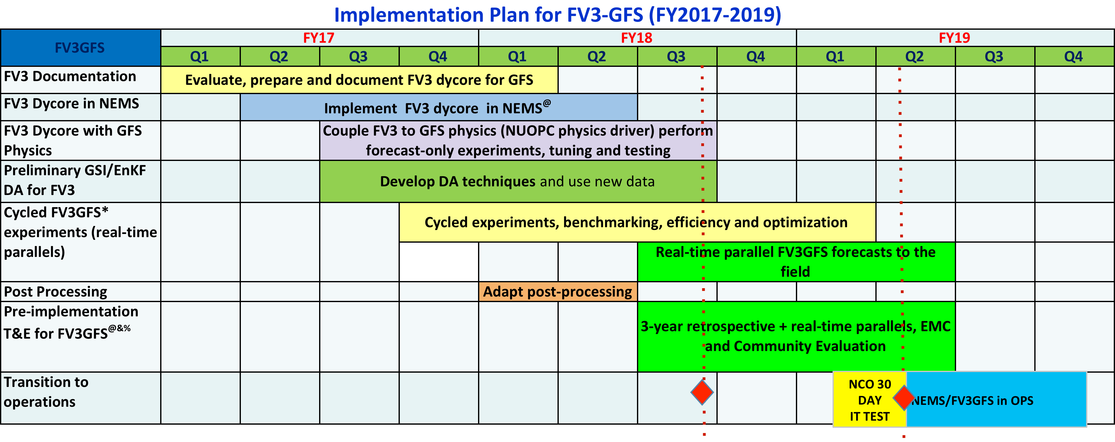
NGGPS: FV3 Timeline (proposed)
NOW
Proposed Implementation
24 Jan. 2019

Slide 5
Key Differences from Current Operations
Ensemble and analysis increment resolution
  While control remains ~13km, ensemble and increment resolution have been increased to ~25 km (currently ~39km)
Initialization
  Current GFS uses digital filter, NEMS-FV3GFS not yet using initialization
    Both use Tangent Linear Normal Mode Constraint
Treatment of system error
  GFS uses SKEB+SPPT+SHUM, FV3GFS utilizes SPPT+SHUM only
Modifications to upper levels (largely model, impacts DA)
  Reset stratospheric humidity to HALOE climatology (cold start only at beginning of experiment).
  New ozone and methane chemistry

Slide 6
Key Differences from Current Operations
New microphysics
  GFS analysis creates total cloud condensate increment and passes back to model
  FV3GFS engineered to make this work with new MP scheme (5 species), but does not pass cloud increment back to model
Observations
  Operational GFS and to-be operational FV3GFS evolving with new observing system (GOES16 AMVs, NOAA 20 CrIS and ATMS)
  FV3GFS will implement all-sky radiance assimilation for ATMS and additional water vapor channels from IASI
NSST (inline SST analysis)
  Background error has been recalibrated

Slide 7
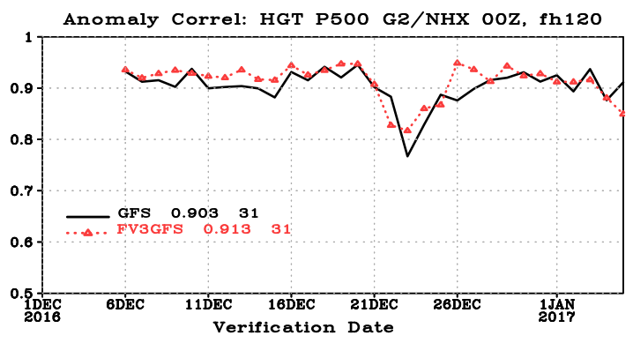
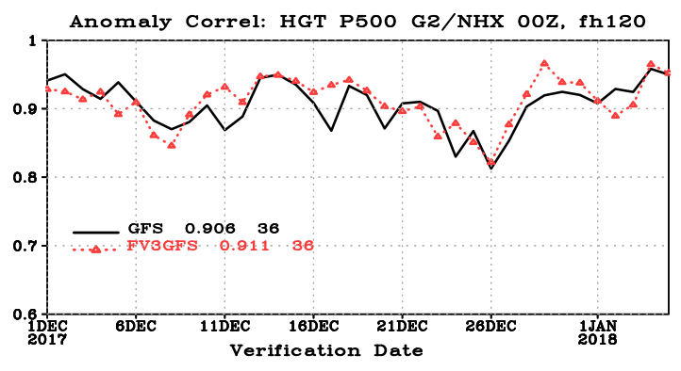
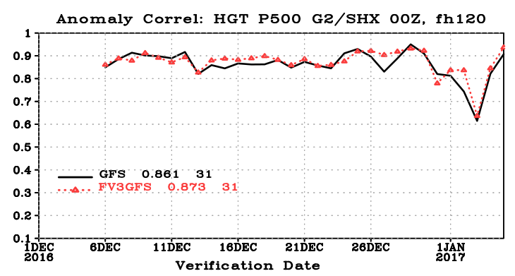
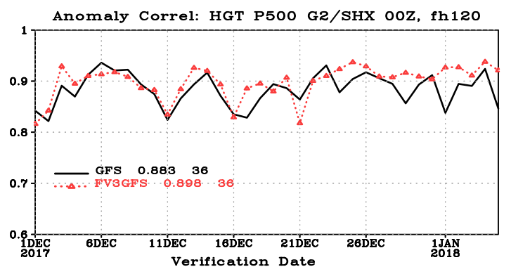
Retrospective Testing (Courtesy Fanglin Yang)
500 hPa AC
NH 500 hPa AC
OpsGFS
FV3GFS
SH 500 hPa AC

Slide 8
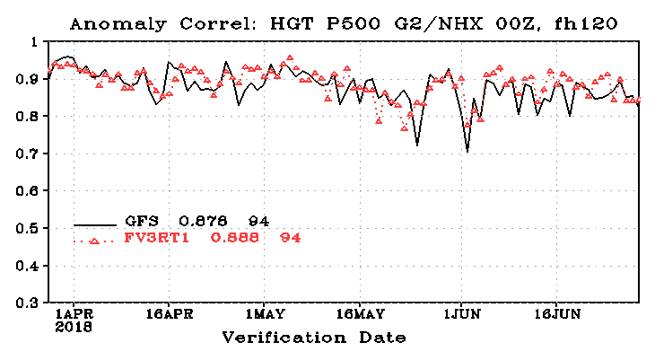
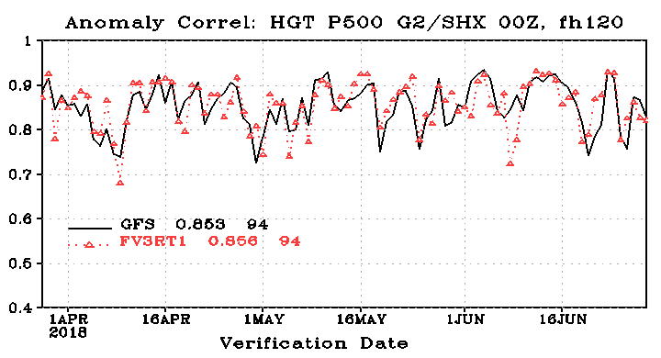
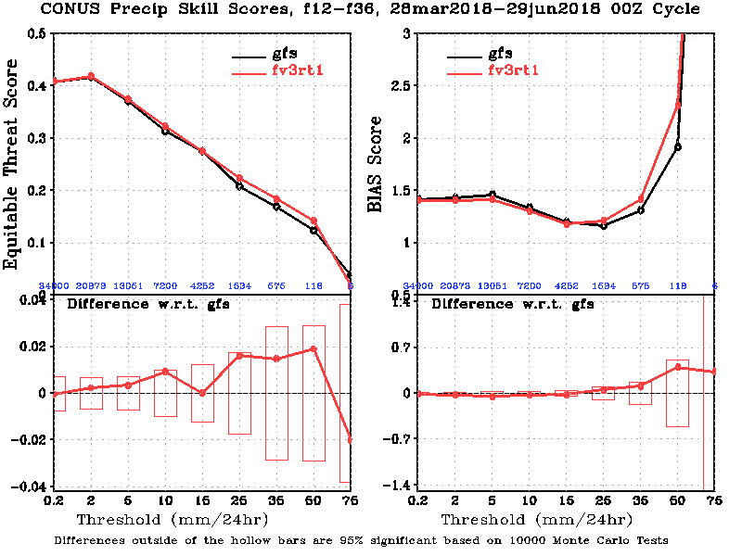
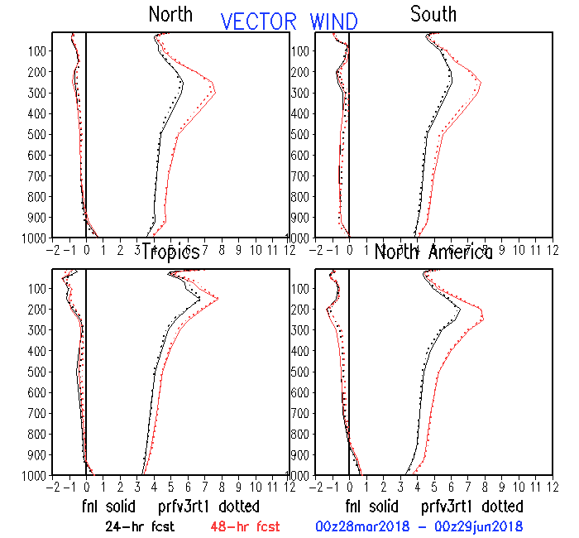
Near-Real Time Results

Slide 9
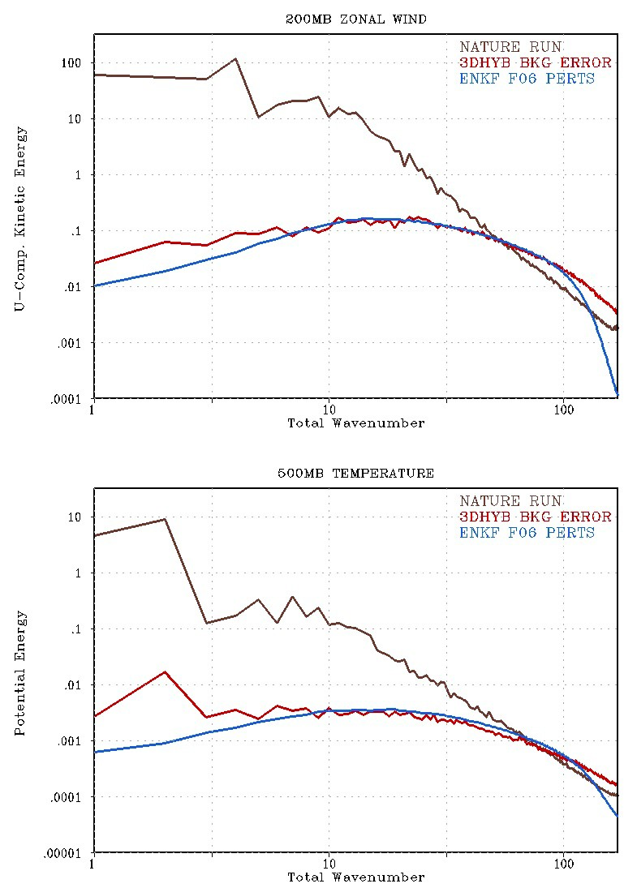
Hybrid DA System (OSSE-based):
Scale-Dependence
Dual-resolution hybrid
  Mismatch in power spectra of ensemble and actual background error
Potential remedies
  Scale-dependent weights
  Scale-dependent localization
  Dynamic constraints
  Scale-dependent inflation
3DHYB RMSE^{b}
EnKF |X^{b}| (low-res)
3DHYB RMSE^{b}
EnKF |X^{b}| (low-res)

Slide 10
Scale dependent localization (and weighting)
Following UKMO and ECCC, work underway at NCEP to test scale-dependent localization (SDL)
  Work by Ting Lei
Have been exploring scale-dependent hybrid weighting (SDW) for a while with some early success
  Collaboration with Taiwan CWB/Deng-Shun Chen
    Results from toy model experiments promising (not shown today)
    Currently testing with realistic NWP systems
Goal is to combine SDL and SDW into “multi-scale data assimilation system”

Slide 11
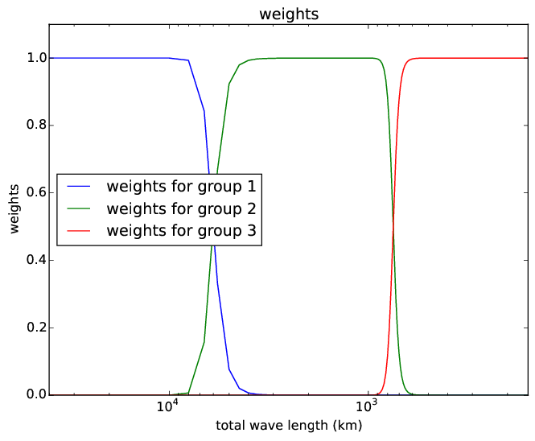
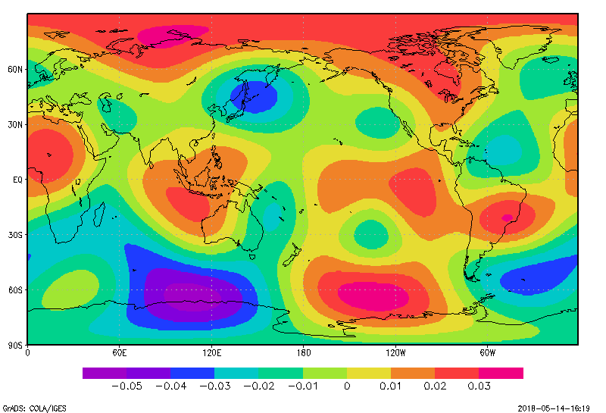
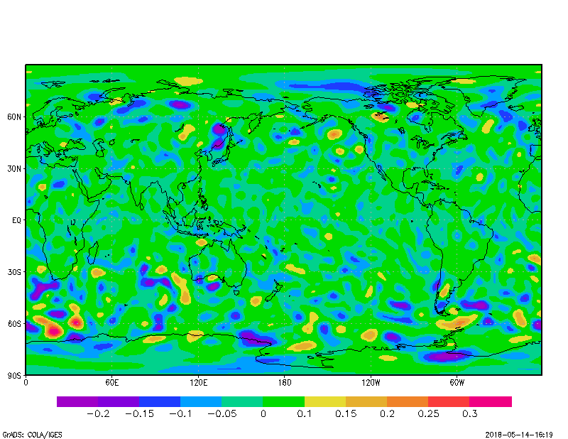
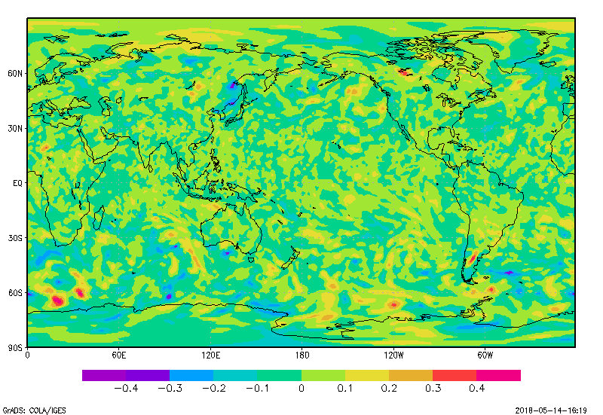
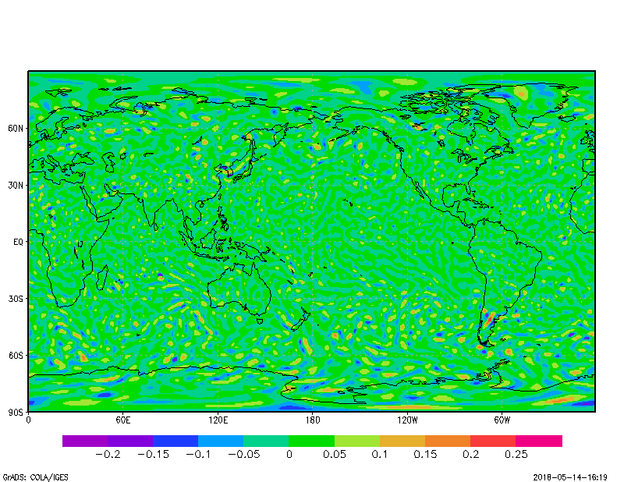
Partition ensemble into wavebands
Example: 500 hPa T (member 1)
Large
Medium
Small
Raw Perturbation
Ting Lei, EMC

Slide 12
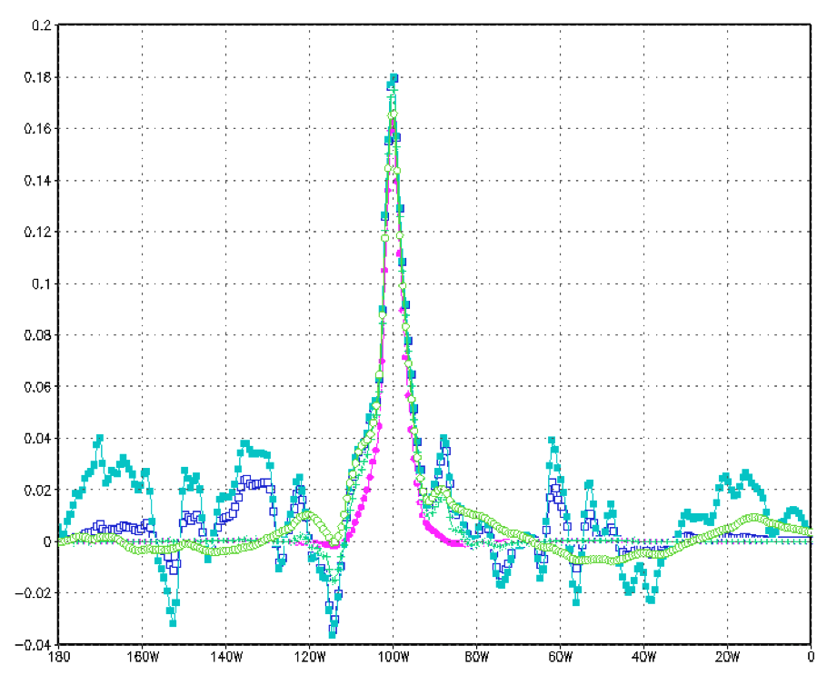
SDL Single Observation Example
Single scale localization experiments (cyan, blue, purple) compared to SDL scheme (green)
Ting Lei, EMC

Slide 13
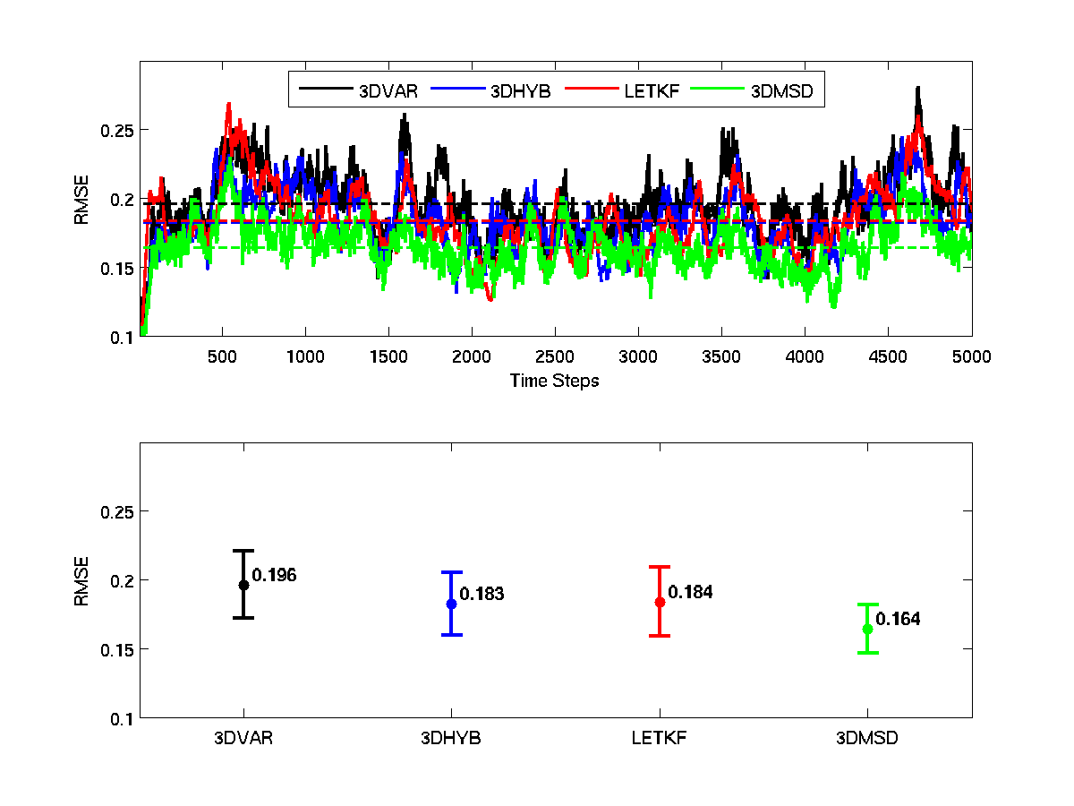
Demonstration of Scale-dependent Weighting
(Imperfect Toy Model – Lorenz 2005)
Test with dual resolution configuration (ensemble at “half resolution”)
Add in simple waveband dependent weighting
  Large influence from ensemble at larger scales.
  Larger influence from static B (with small correlation lengths) at small scales

Slide 14
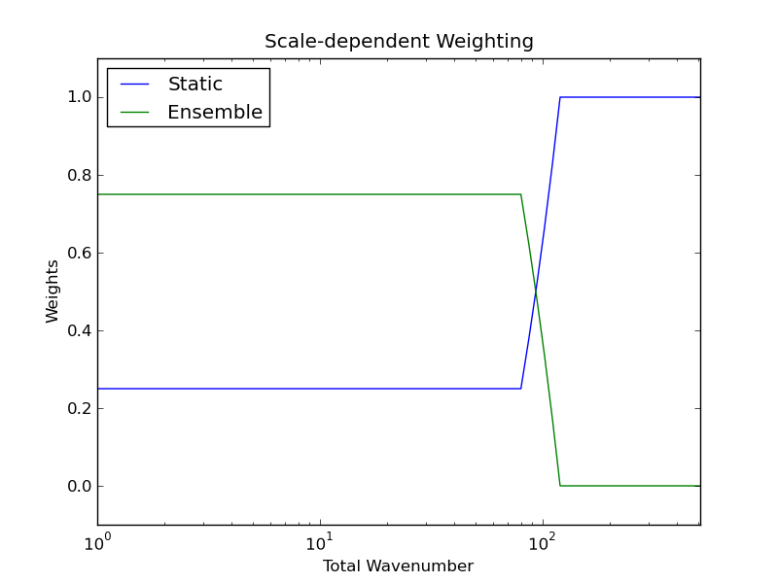
Dual Resolution Hybrid
Scale-Dependent Weighting Experiment
One month trial (15 March-15 April 2017) using CWB global modeling system (GSI-hybrid), 10 days ignored for spin-up
H3DCTL
  3D hybrid, 36 members, EnSRF, additive inflation
  Resolution T511L60(~25km) for analysis
  Resolution T319L60(~40km) for ensemble
H3DSDB
  H3DCTL + scale-dependent
  weighting
Baseline test to account for fact
that we know ensemble has
no information beyond T319

Slide 15
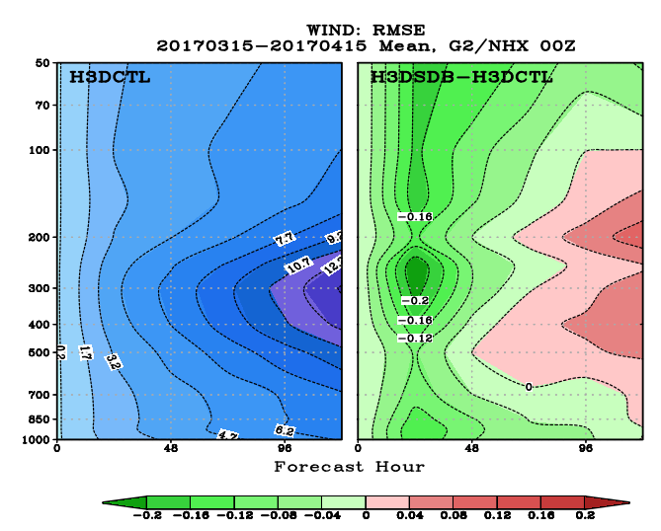
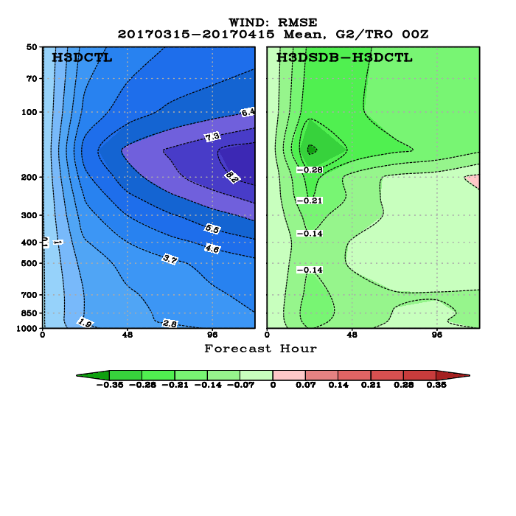
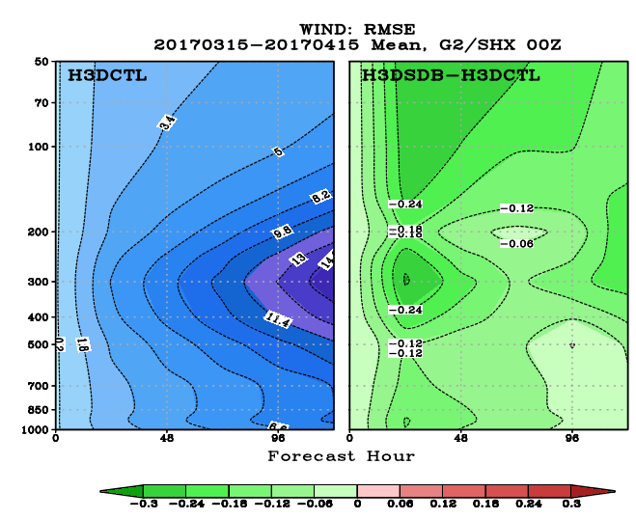
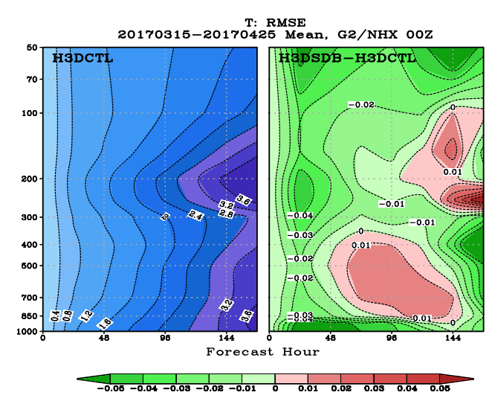
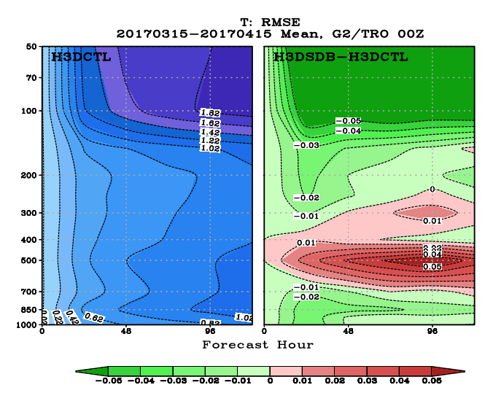
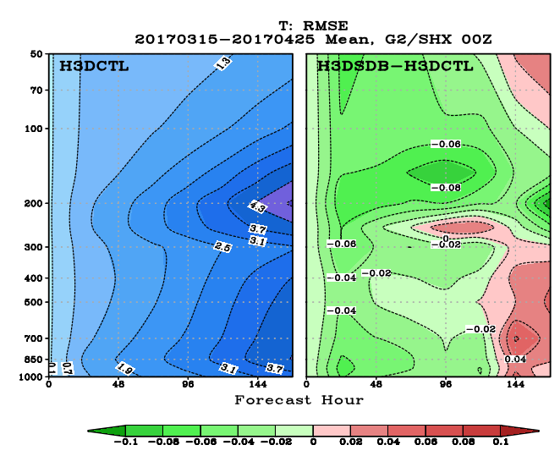
Forecast Impact (Self Analysis)
Wind (top) and Temperature (bottom) RMSE
NH
TROPICS
SH

Slide 16
Summary
Work to transition current operational DA infrastructure to new model largely successful
  Modest improvements, future enhancements coming (see next talk)
Ongoing work to continue to test/optimize scale dependent weighting & localization
  Future work will utilize “hyb_diag” to estimate weights/scales for wavebands
  Use within context of shifting/lagging
  Plan to include multi-resolution ensemble information

Slide 17
Final Comment
For those that may be unaware, John Derber is retiring on July 18
  If any of you have stories to share, I would be happy to include them at our “roast” on July 12. Please email me.
Thank you!

Slide 18
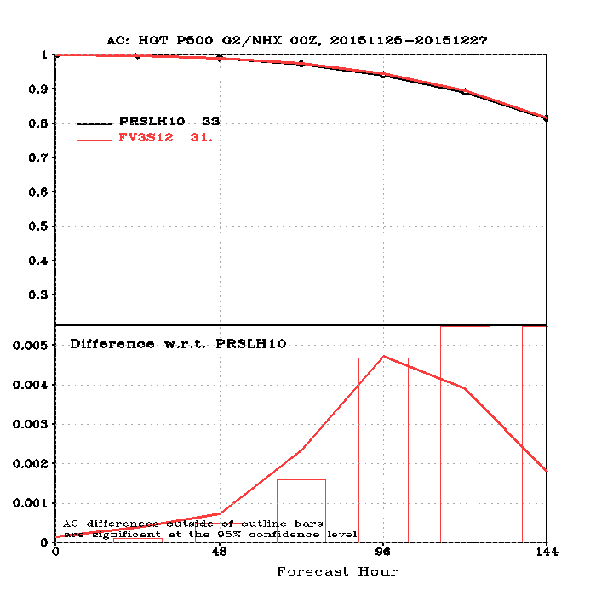
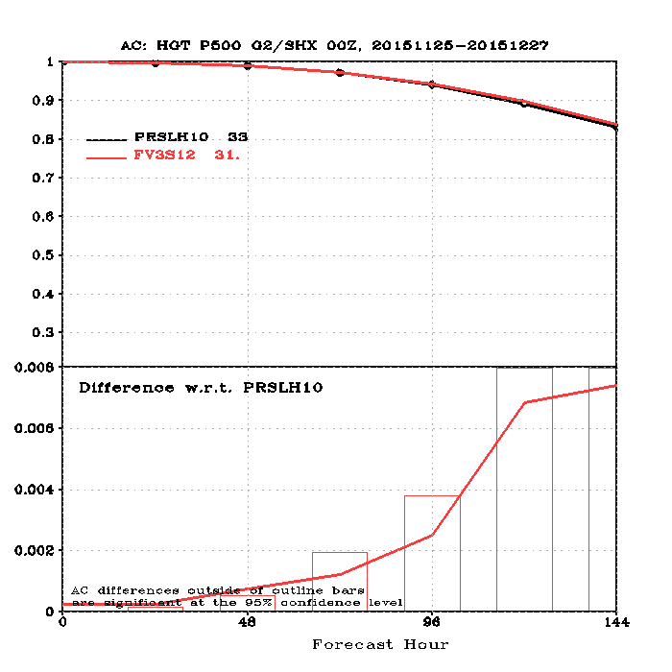
Low Resolution Prototyping
Experimental FV3GFS [FV3S12] DA experiments:
  2015112500-2015122700 (10 days ignored for spin-up)
  25km (50km ensemble)
  Non-hydro, some parameters tuned, SPPT/SHUM, hybrid 4DEnVar
  Compare with T670L64 (80 member EnSRF) GFS/GSM [PRSLH10]
500 hPa AC, Northern Hemisphere
500 hPa AC, Southern Hemisphere

Slide 19
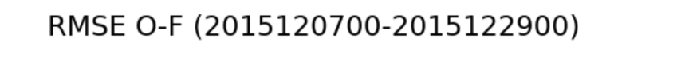
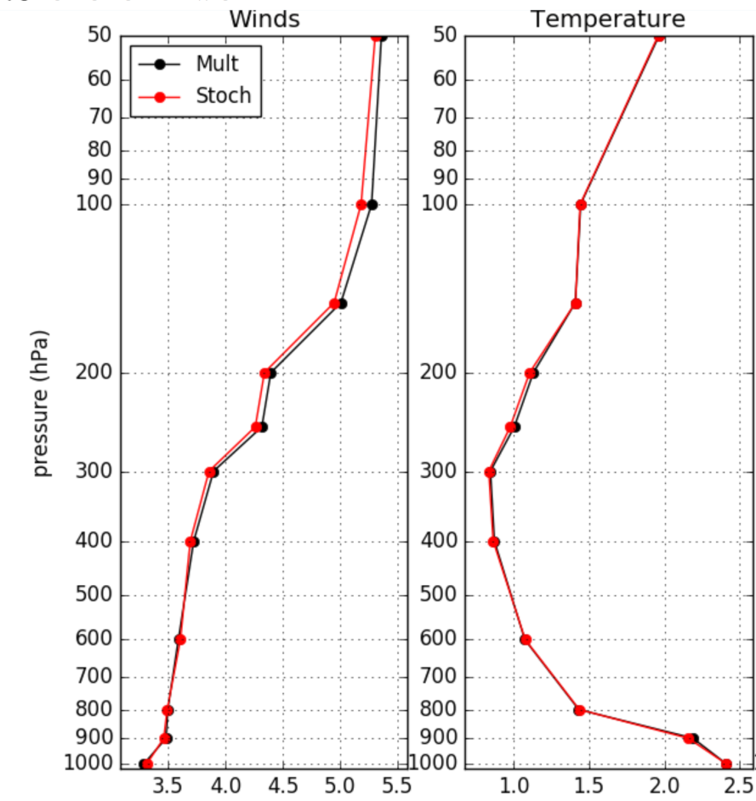
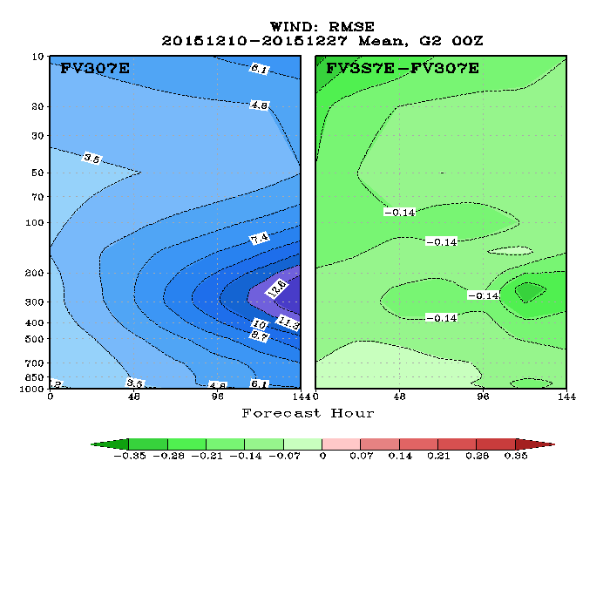
Impact of Stochastic Physics
C384 L64 cycled DA tests (3DHybrid)
Similar to tests from GFS/GSM, use of stochastic physics (SPPT/SHUM) show modest improvement in data assimilation experiments
  GFS/GSM also uses SKEB, work ongoing within FV3
Wind RMSE Difference, Global (EXP-SP minus Control)

