Slide 1
Well known and less obvious applications of adjoint models:
Do we explore enough their potential?
Marta Janisková, Philippe Lopez and Filip Váňa
ECMWF
Thanks to: C. Cardinali, S. Lang
11th Workshop on Meteorological Sensitivity Analysis and Data Assimilation
2-6 July 2018

Slide 2
Linearized models in NWP
different well-known applications:
  variational data assimilation like incremental 4D-Var
  singular vector computations initial perturbations for EPS
  sensitivity analysis forecast errors
first applications with adiabatic linearized model
nowadays, the physical processes included in the linearized model
4D-Var – Four-dimensional Variational Data Assimilation
EPS – Ensemble Prediction System

Slide 3
Linearized model with physical processes
Including physical processes can:
in variational data assimilation:
  reduce spin-up
  provide a better agreement between the model and data
  produce an initial atmospheric state more consistent with physical processes
  allow the use of new observations (rain, clouds, soil moisture, …)
in singular vector computations:
  help to represent some atmospheric features
  (processes in PBL, tropical instabilities, development of baroclinic instabilities, …)
in sensitivity analysis:
  allow a reduction of forecast error
adjoint of physical processes can also be used for:
  model parameter estimation
  sensitivity of the parametrization scheme to input parameters

Slide 4
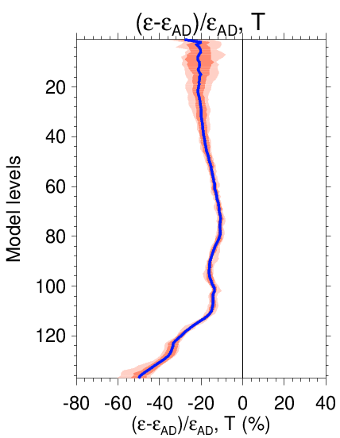
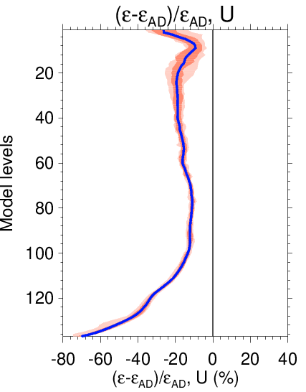
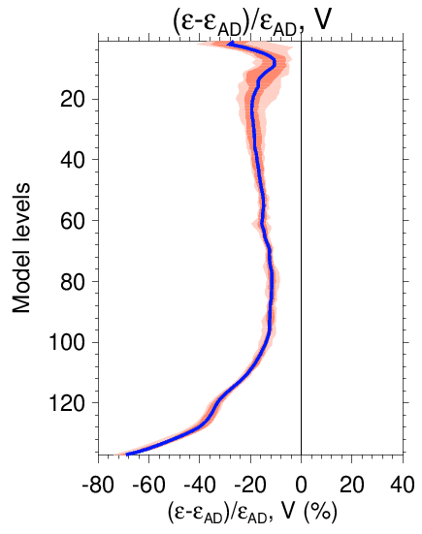
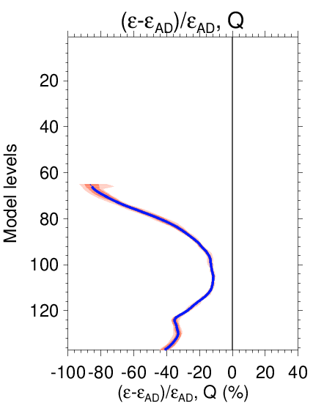
Impact of linearized physics on TL approximation
where
non-linear (NL) difference ↔ tangent-linear (TL) integration
Mean vertical profile of change in TL error when full linearized physics included in TL.
Relative to adiabatic TL run (50-km resolution; twenty runs, 12h integ.)
T
U
V
Q
TOA
< 0 = ☺
surface
Inclusion of linearized physics leads to better TL approximation.

Slide 5
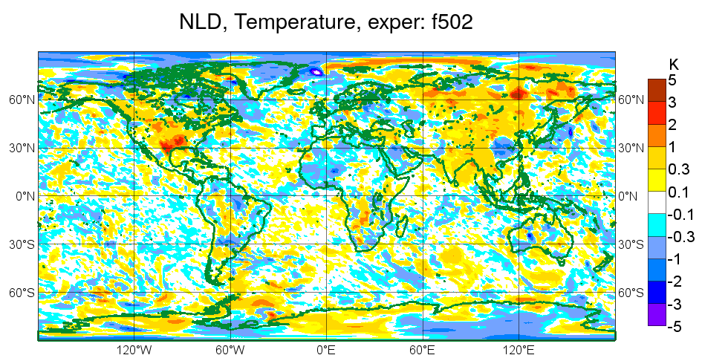
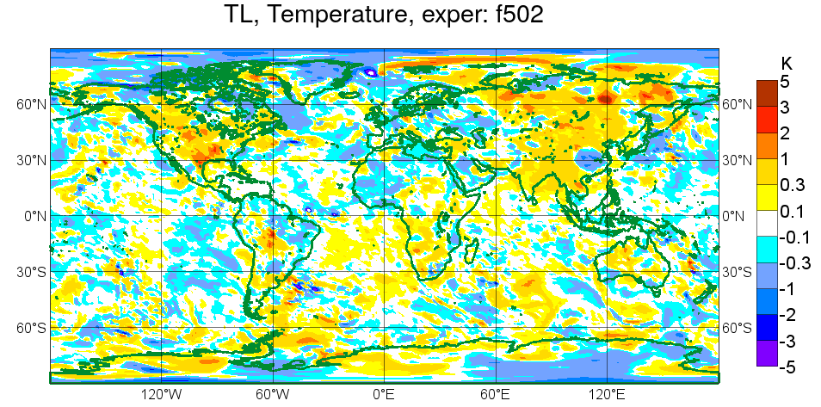
TL approximation at high resolution (~ 16 km)
Temperature at level 125
(~950 hPa) on 20140105 at 12Z.
Comparison of NL difference M(x+δx)−M(x) with perturbation evolved using the TL model M’δx after 12h of integration.
M(x+δx)−M(x)
Thanks to stabilization of both the dynamics and the physics in the TL model, resolutions as fine as 16 km might be considered in 4D-Var minimizations,
provided some (minor) sources of noise can be eliminated.
M’δx
TCo639, ~ 16 km

Slide 6
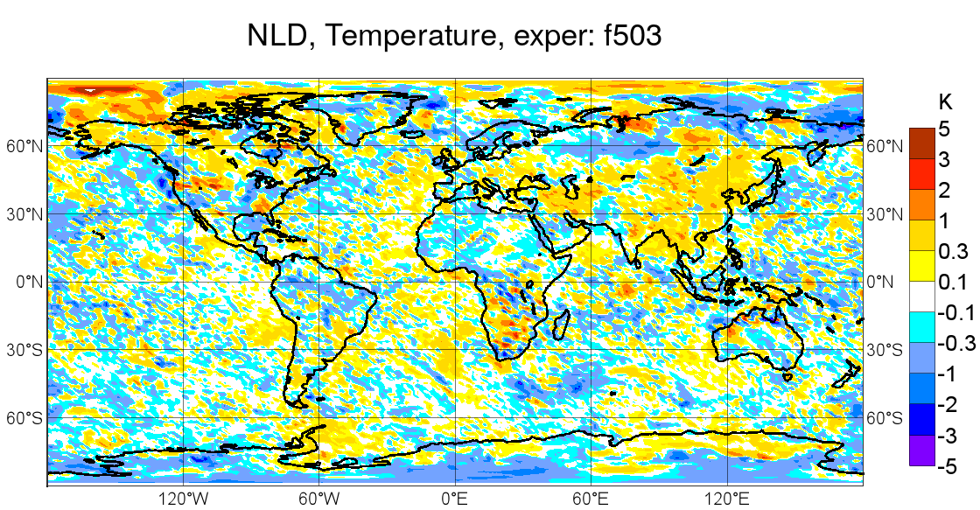
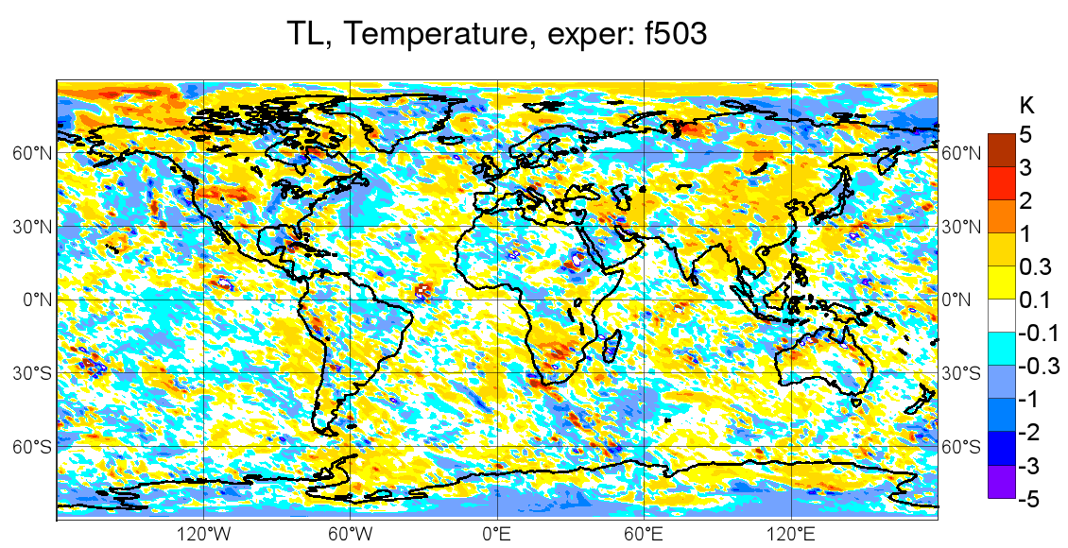
TL approximation at very high resolution (~ 9 km)
Temperature at level 129
(~980 hPa) on 20140105 at 12Z.
Comparison of NL difference M(x+δx)−M(x) with perturbation evolved using the TL model M’δx after 12h of integration.
M(x+δx)−M(x)
First time our TL model tested at such high resolution and the results surprisingly encouraging.
(Note: this single run required 320 nodes)
A few slightly unstable spots
M’δx
TCo1279, ~ 9 km

Slide 7
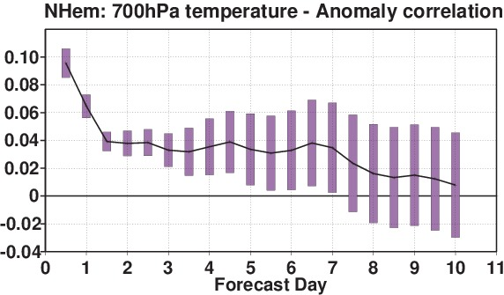
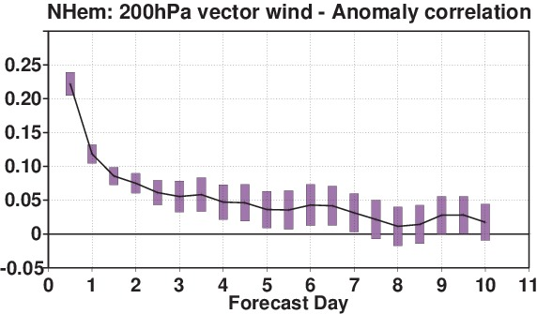
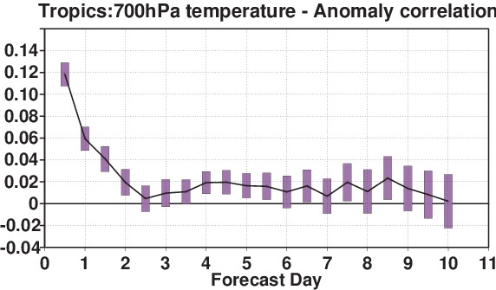
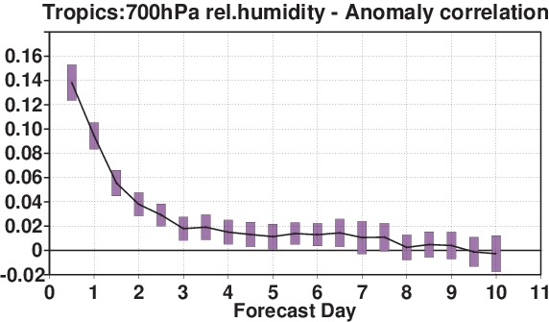
Direct relative improvement of forecast scores from linearized physics
Coming just from including the ECMWF linearized physics in 4D-Var (Janisková & Lopez, 2013)
NHem
700hPa temperature
NHem
200hPa vector wind
Tropics
700hPa temperature
Tropics
200hPa vector wind
_{> 0 = ☺}
Anomaly correlation – 3 month experiment: bars indicate significance at 95% confidence level
T511L91 FC run: Forecast scores against operational analysis

Slide 8
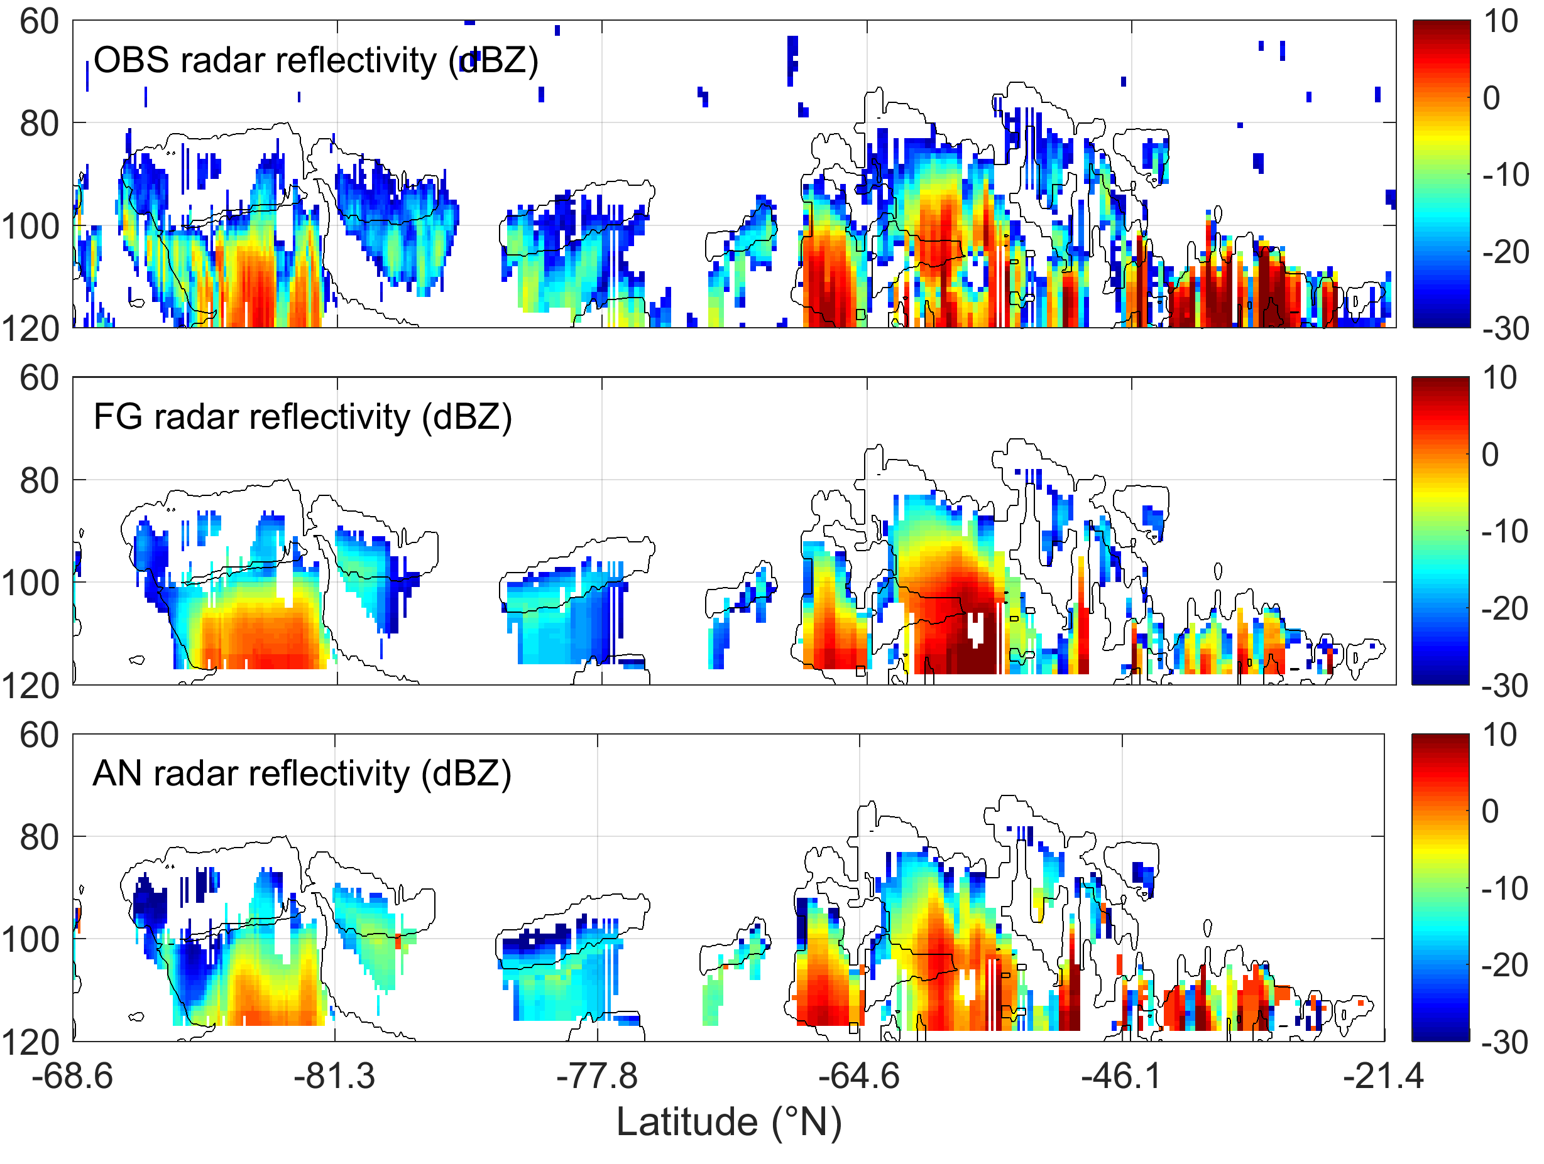
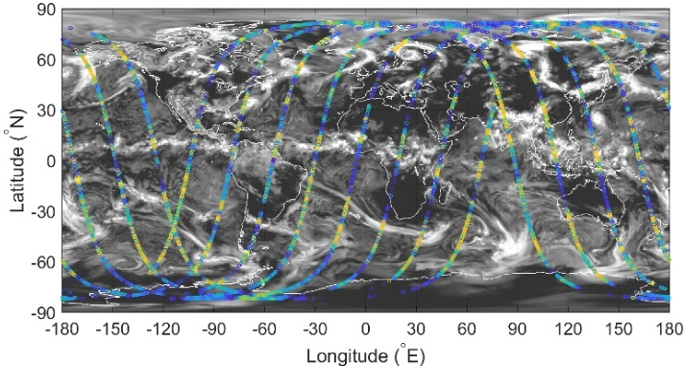
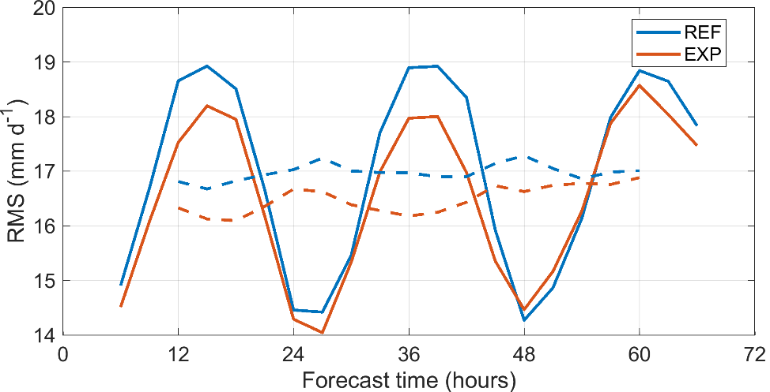
Indirect relative improvement of forecast scores from linearized physics
Using observations directly related to the physical processes (e.g. rain, clouds,…)
OBS radar reflectivity (dBZ)
Example: 4D-Var assimilation of CloudSat cloud radar reflectivity and CALIPSO cloud lidar backscatter
Situation: 20070801 00 UTC
Cloud radar
reflectivity
REF – all standard observations
EXP – all standard obs + cloud radar&lidar
Verification of forecast against TRMM data for 7 days of 4D-Var cycling:
Assimilation of CloudSat and CALIPSO obs:
  a positive impact on analysis fit to obs and subsequent short-term forecast
  improving forecast of rain rates in Tropics

Slide 9
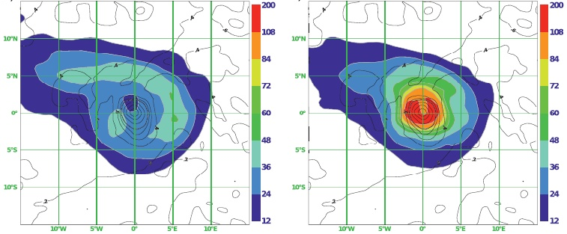
Using linearized physics in singular vector computation
Singular vectors (SVs) used to generate perturbations to the initial conditions in EPS of ECMWF
SVs = the fastest-growing perturbations over a finite time interval
→ sampling the dynamically most relevant structures to dominate
the uncertainty sometime in future
Composites of vertical integrated Total Energy of initial SVs 1-5
Tropical cyclone (TC) Helene (16 – 24 Sept. 2006)
SimpDry: T_{L}255 ≈ 80km
Dry+Moist: T_{L}255
With including more diabatic processes in SV calculation:
→ more SV structures associated directly with the TC than other flow features
→ baroclinic flow enhanced closer to the centre of TC when accounting for moist processes
If used to initialize EPS, higher resolution moist SVs → larger spread of wind speed, track and
intensity of TC
SimpDry = only very simple vertical diffusion
and surface drag of Buizza (1994)
Lang et al., 2012

Slide 10
Using adjoint model for sensitivity
adjoint models allow the computation of the gradient of one output
parameter of a numerical model with respect to all its input parameters
application in the study of sensitivity problems
Adjoint F^{T} of the linear operator F provides the gradient of an objective (cost) function J
with respect to x (input variables) given the gradient of J with respect to y (output variables):
or
Adjoint sensitivity applications:
For parametrization schemes – thorough evaluation of the relative importance of
different variables (i.e. identification to which variables the schemes are most sensitive)
Analysing sensitivity of a forecast error to initial conditions or any forecast aspect
(e.g. precipitation, cyclone, …) to the model control variables
In data assimilation systems – measuring sensitivity with respect to any parameter
of importance:
(e.g., as a diagnostic tool to monitor the observation impact on short-range forecasts)

Slide 11
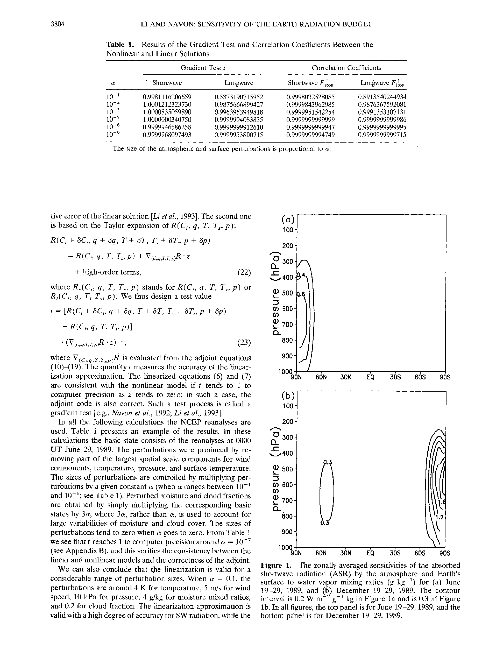
Examples of adjoint sensitivity for physical parametrization
Comparison with previous studies
ECMWF
Janisková and Morcrette, 2005
- 0.0125
- 0.025
- 0.05
- 0.1
- 0.3
- 0.6
- 0.9
- 1.2
- 1.5
- 1.8
- 2.1
Li and Navon, 1998
model levels
summer
- 0.0125
- 0.025
- 0.05
- 0.1
- 0.3
- 0.6
- 0.9
- 1.2
- 1.5
- 1.8
- 2.1
model levels
winter
Sensitivity of the shortwave upward radiation flux at the TOA w.r.t. specific humidity [ W.m⁻²/g.kg⁻¹ ]
CLEAR SKY

Slide 12
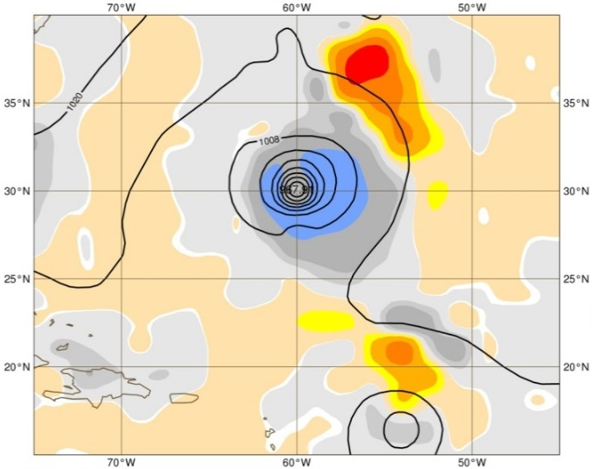
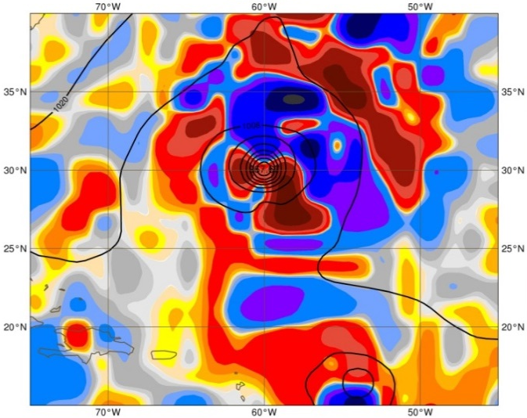
Adjoint sensitivity as data assimilation diagnostics
Adjoint sensitivity to initial conditions, i.e. analysis, ∂J/∂x, where J is a measure of the forecast error (e.g. energy norm, EN)
Dry processes + dry EN
All processes (including moist) + dry EN
20100828,21:00UTC, L91 (closest to surface)
Sensitivity to spec.hum.
J kg⁻¹ / (g kg⁻¹)
Using a more sophisticated adjoint model:
→ more flow-dependent
→ more realistic sensitivities
Using adjoint model for monitoring sensitivity of the cost function with respect to observations
→ i.e., measuring observation influence on forecast
Adjoint-based technique influenced by:
– simplified adjoint model used to carry the forecast error information backwards
→ impact of some observations increased when using moist processes
– selected total energy (TE) norm used for the sensitivity gradient
→ using moist norm can result in negative error contribution (i.e. impact) for some obs
Janisková and Cardinali, 2015

Slide 13
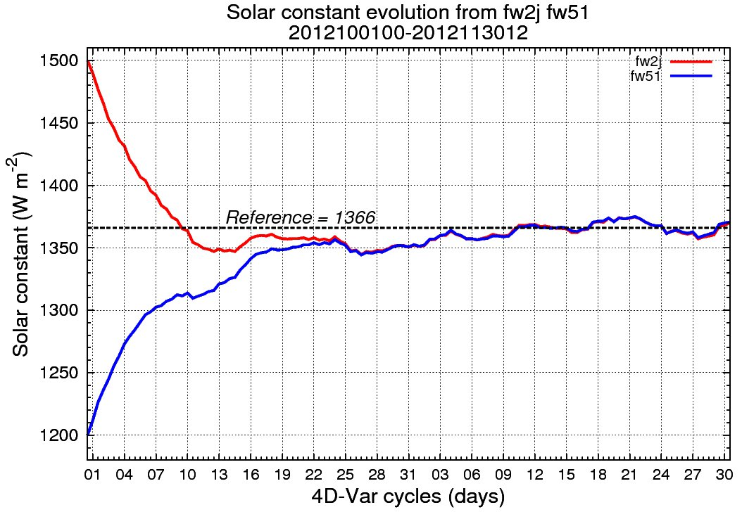
Physics parameter optimization using 4D-Var
Goal: to adjust the value of physics parameters (PP) by cycling 4D-Var data assimilation (typically over 1-2 months), under the constraint of all routinely available observations.
PPs to be optimized: added to the control vector of 4D-Var assimilation & its cost function
Limitations: – Only parameters present in both the forecast and the linearized model
(TL&AD) can be treated in this way.
– Discrepancies between the full NL and the TL & AD physics (used in
minimization of J) might lead to sub-optimal results.
4D-Var optimization of solar constant
4D-Var is able to converge towards the reference value after a couple of months.
New prospects for the objective optimization of some parameters of the model’s physics.
But to be tested whether the method successful when dealing with parameters:
  more uncertain or less well constrained by observations,
  associated with more non-linear processes (e.g. condensation)
Evolution of the optimized solar constant as a function of 4D-Var cycles with initial value:
1500 W m⁻²
1200 W m⁻²
ref: 1366 W m⁻²
T511 L91 4D-Var experiment
Period: Oct-Nov 2012
P. Lopez, 2015

Slide 14
Less and not obvious adjoint applications
Efficient debugging tool when writing TL and AD code line-by-line from the nonlinear (NL) version
→ coding errors in NL code discovered
Capable to discover erroneous or false sensitivities (NL model needs to be strictly deterministic – no random computational mode)
→ helping to improve often hidden problems in model
and/or observation operators
Excellent and powerful validation tool for NL model

Slide 15
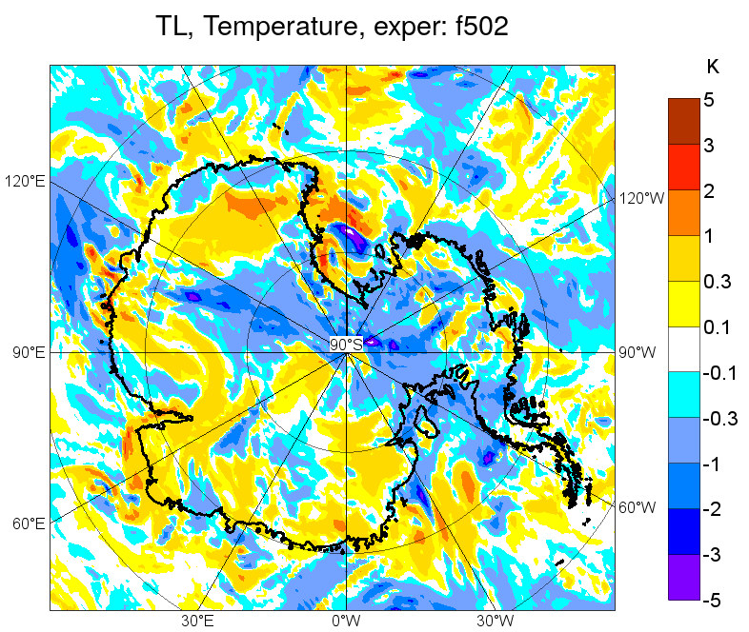
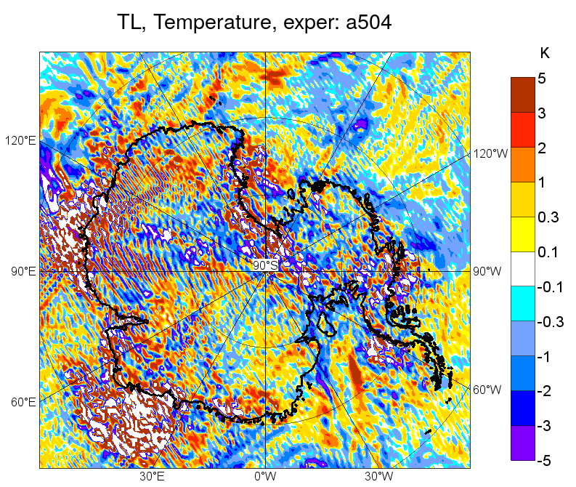
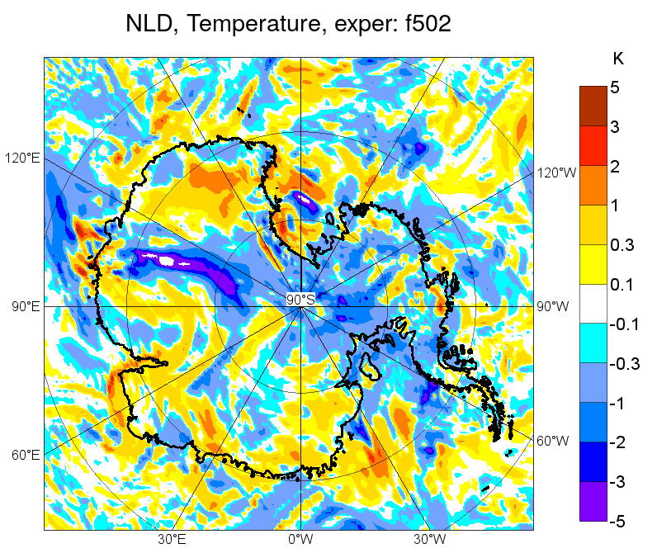
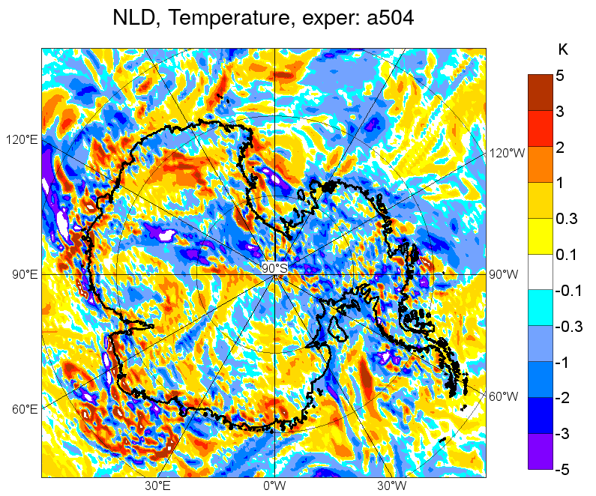
Assessment of TL approximation revealing hidden problems in NL model
M’δx with full physics
M’δx with dynamics only
Assessment of TL approxim. at very high resolution (TCo639, ~16 km, 12h).
Example: Temperature at level 129 on 20140520 at 12Z over Antarctica.
M(x+δx)−M(x) with full physics
M(x+δx)−M(x) with dynamics only
Runs with dynamics only in NL and TL are very noisy close to orography.

Slide 16
Detection of problems in NL model by TL diagnostics
When applying modifications in NL model
    → TL model can serve as an excellent validation tool
Simplifications in NL model which may not matter too much in NL computations itself, but introducing some numerical inaccuracy has potential:
  to damage derivatives in NL model
  lead to noise in TL
    → getting more pronounced because of increasing resolutions,
    number of iterations, getting steeper orography, …
TL diagnostics helped to identify and tune several problems in NL dynamics, leading to modifications such as:
  Introducing non-linear flow-dependent filter as a function of flow field deformation in the upper 20 hPa → when the flow is laminar the filter does nothing
  → with increased flow deformation, diffusivity increased locally
  When detecting time oscillation in vertical velocity at the top of atmosphere (above 50 hPa) → extrapolation of vertical velocity by 1st order scheme in time, otherwise
  2nd order is used in smooth transition
  Curvature term for vector variables computed exactly and not only interpolated
  Introducing higher order (4th) for SL trajectory research (better respecting wind flow)
D1
D2
SL – Semi-Lagrangian

Slide 17
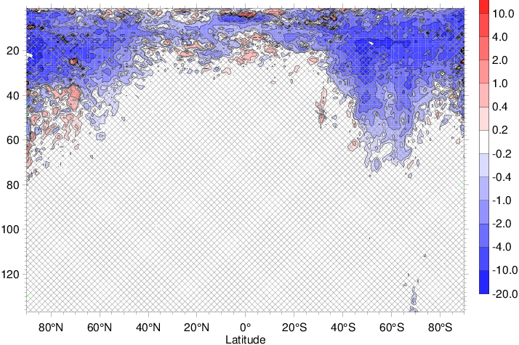
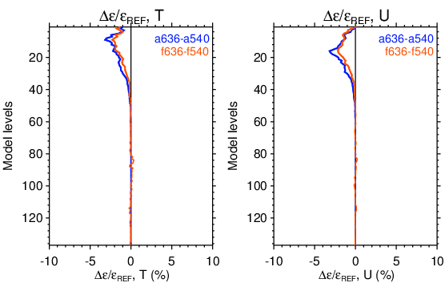
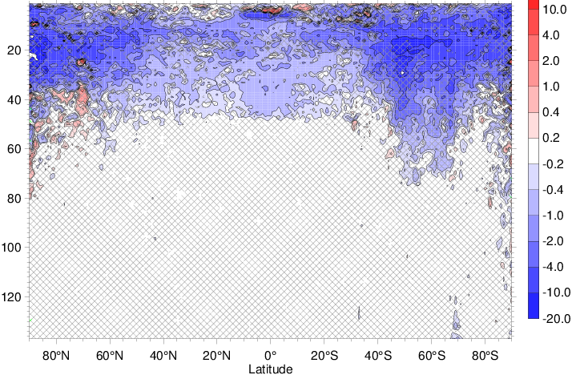
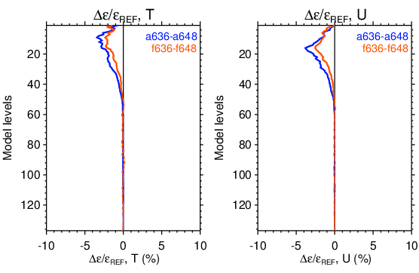
Improvements in TL approximation based on TL diagnostics
Relative change in TL error: (ε_{EXP} – ε_{REF}) / ε_{REF} (50 km resolution, 20 runs; after 12h integration)
D1
Zonal wind – Mean: -4.42e-01%
Blue = TL error
reduction = ☺
Temperature
Zonal wind
D1+D2
Zonal wind – Mean: -5.91e-01%

Slide 18
Potential of adjoint is great !!!
BUT
To be fully explored more manpower needs to be devoted to the subject !!!

Slide 19
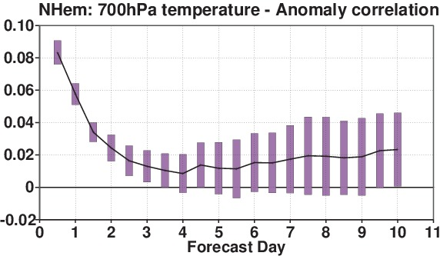
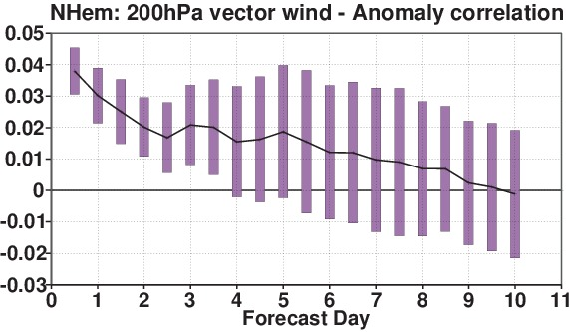
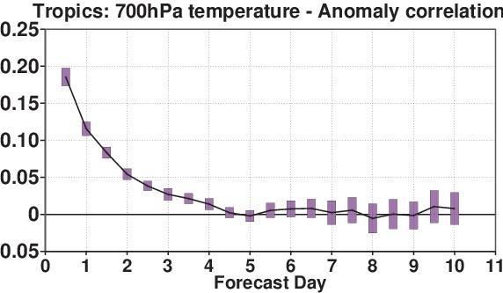
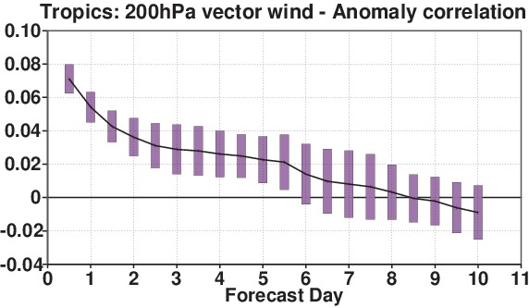
Indirect relative improvement of forecast scores from linearized physics
Using observations directly related to the physical processes (e.g. rain, clouds,…)
NHem
700hPa temperature
NHem
200hPa vector wind
Tropics
200hPa vector wind
Tropics
700hPa temperature
_{> 0 = ☺}
Anomaly correlation – June-Aug. 2014: bars indicate significance at 95% confidence level
T799L137 FC run: Forecast scores against operational analysis

Slide 20
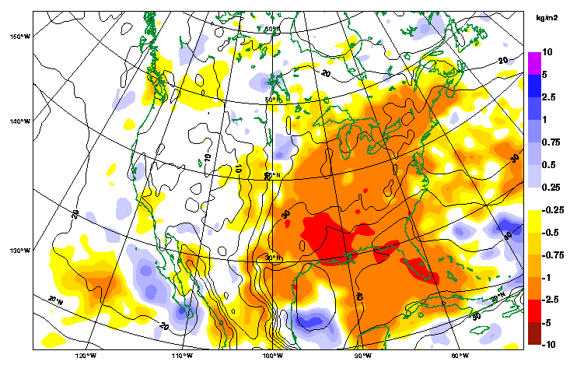
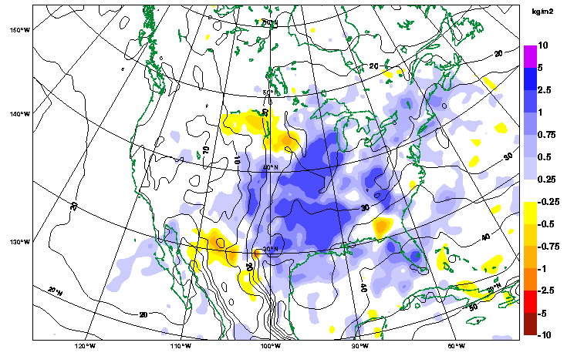
Assimilation of NCEP Stage IV hourly precipitation data over the U.S.A.
Own impact of combined ground-based radar & rain gauge observations
Three 4D-Var assimilation experiments (20 May - 15 June 2005):
CTRL = all standard observations.
CTRL_noqUS = all obs except no moisture obs over US (surface & satellite).
NEW_noqUS = CTRL_noqUS + NEXRAD hourly rain rates over US ( “1D+4D-Var”).
Mean differences of TCWV analyses at 00UTC
CTRL_noqUS – CTRL
NEW_noqUS – CTRL_noqUS
Lopez and Bauer (Monthly Weather Review, 2007)

Slide 21
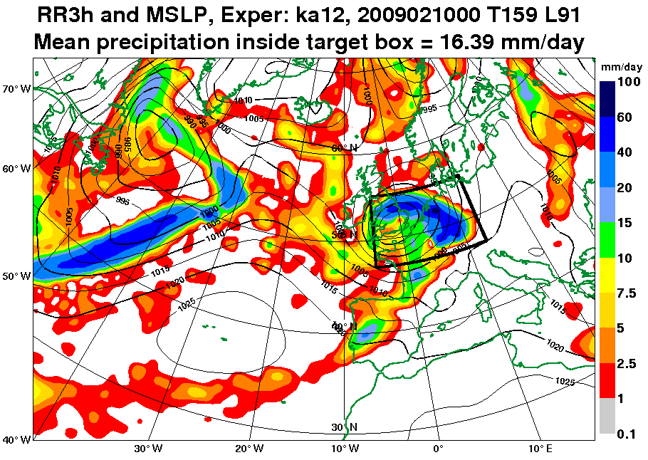
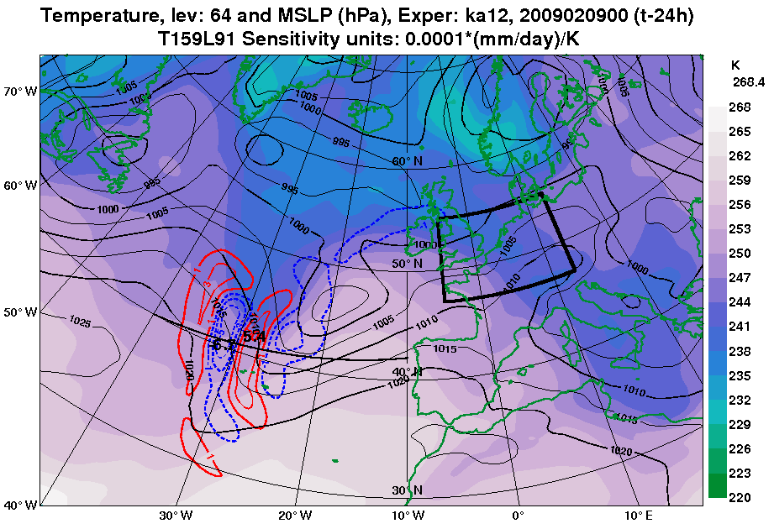
Adjoint sensitivity of a physical aspect to the model control variables
The time integration of the adjoint model allows the computation of adjoint sensitivities of any physical aspect (J) inside a target geographical domain to the model control variables (x) several hours earlier.
Adjoint sensitivities for a European winter storm:
J = mean 3h precipitation accumulation inside
black box.
∂J/∂x after 24 hours of “backward” adjoint integration
Sensitivity with respect to 500-hPa temperature
T159L91 Sensitivity units: 0.0001*(mm/day)/K
The dipolar pattern of sensitivities indicates that a strengthening of the cross-frontal temperature gradient would result in a precipitation increase inside the black box, 24 hours later.
Janisková and Lopez, 2013

Slide 22
Summary
Positive impact from including physical parametrization schemes into the linearized
model has been demonstrated.
Physical parametrizations become important components in current variational
data assimilation systems:
  positive impact on analysis and subsequent forecast
  enabling to assimilate observations related to physical processes (rain, clouds, ...)
Including linearized physical parametrization schemes into singular vector
computations can lead to:
  more of the SVs structures associated directly with some atmospheric processes
  better spread in EPS
Adjoint of physical processes used for sensitivity studies can provide:
  more flow-dependent and more realistic sensitivities
  different tool for the validation of parametrization schemes
  (sensitivity to all governing parameters obtained at minimal computational cost)
  diagnostic tool for:
    analyzing sensitivity of a forecast error to initial conditions
    monitoring the observation impact on short-range forecasts

