Slide 1

Progress towards hybrid 4DVar with the FV3 dynamical core
Daniel Holdaway,
Yannick Trémolet, Anna Shlyaeva, Mark Miesch,
Stephen Herbener, Guillaume Vernieres, Rahul Mahajan and Jong Kim
Joint Center for Satellite Data Assimilation (JCSDA)
NASA Global Modeling and Assimilation Office (GMAO)

Slide 2
Introduction
4D-Var and hybrid 4D-Var have been the algorithms of choice for the past 20 years.
With this in mind NASA’s Global Modeling and Assimilation Office (GMAO) has developed the tangent linear and adjoint of three different version of FV(3).
Hybrid 4D-Var with FV3 has so far proved illusive and currently NASA run hybrid 4DEnVar systems based on EnKF with 32 ensemble members.
The lessons learnt from GMAO’s progress towards 4D-Var with FV3 could be quite relevant to other centers considering 4D-Var with next generation models.
Recent attempts to decrease the performance gap between hybrid 4DEnVar and hybrid 4D-Var have not been successful (Bowler et. al. 2017) so developing efficient 4D-Var remains an appealing goal.
A number of factors motivate a further attempt at developing a 4D-Var for FV3 models at the current time.

Slide 3
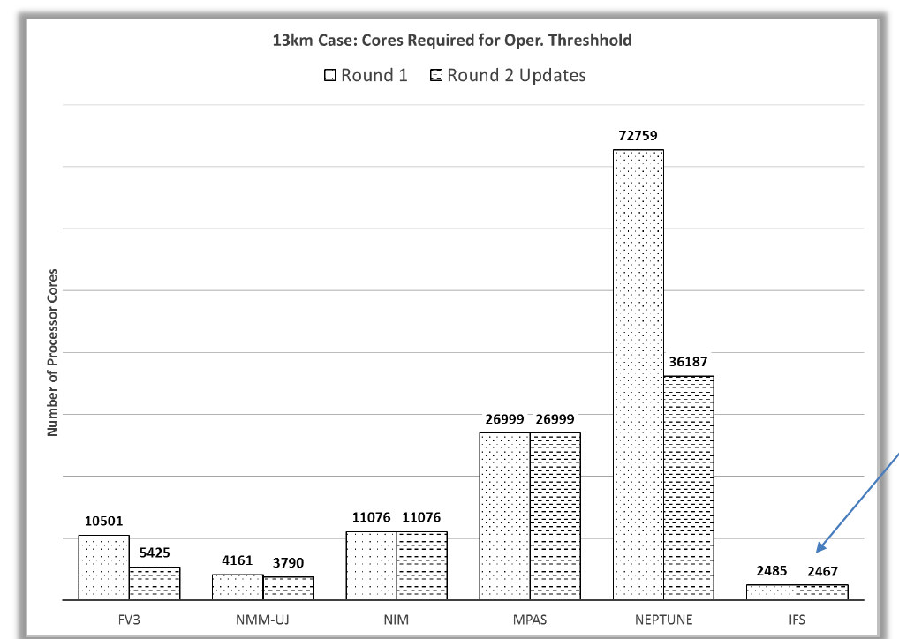
A new era of dynamical cores
GMAO has struggled to implement 4D-Var is in part because of being ahead in terms of modelling, having been using the FV3 dynamical core for nearly 10 years now.
DA with FV3 has been hard to work with due to its relatively short timestep (~60 seconds vs ~900 seconds GFS/IFS/MetOfficePF).
Changes were made in the TLM and adjoint to give efficiency gains but they came with a loss of accuracy.
Fortunately NGGPS forced lots of improvements to FV3 and these have been incorporated into a new adjoint version by NASA GMAO.
Single precision.
Tuning and clean up.
Intel 18 optimization for intel chip sets.
OpenMP.
Number of cores needed to meet NGGPS operational requirements
Previous GEOS config
~10,500
IFS
~2500

Slide 4
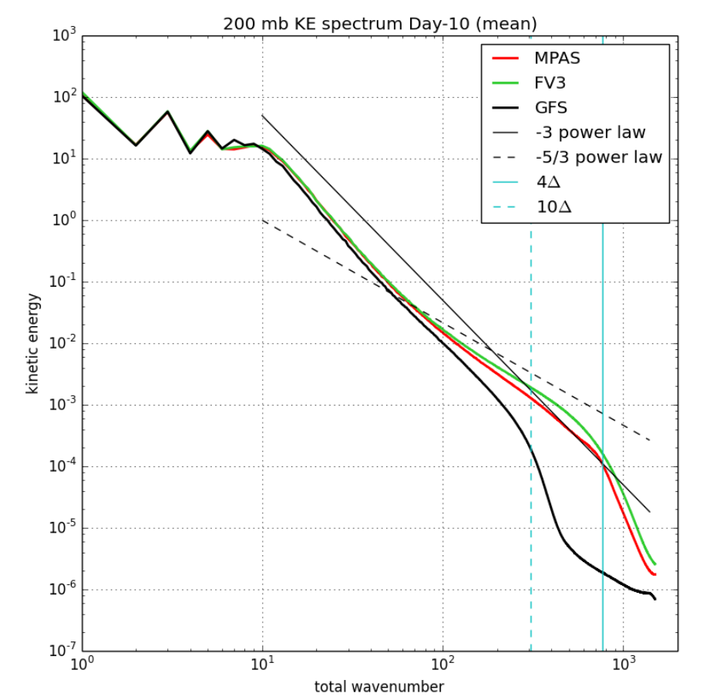
A new era of dynamical cores
200 mb KE spectrum Day-10 (mean)
In the NGGPS Dynamical Core Bake-off there was significant focus on the ‘effective resolution’ of the models. By design large time step models have lower effective resolution, e.g. GFS, IFS.
Though the challenges are large there’s big potential payoff from using a smaller timestep and resolving smaller scales and so other centers are moving to FV3 like non-hydrostatic dynamical cores.
NASA GMAO: FV3GEOS (NGGPS version)
NOAA NWS: FV3GFS
NCAR: MPAS
Naval Research Lab: Neptune
Met Office: LFRic
DWD: ICON
Is 4DVar with these kinds of models a reality?
FV3 and MPAS capture the -5/3 spectrum, GFS does not.
Higher effective resolution

Slide 5
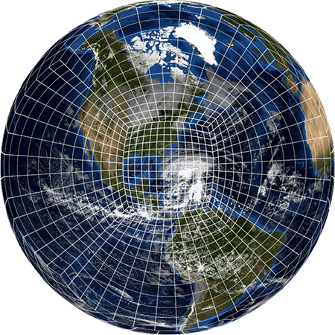
FV3 adjoint system
A new FV3 TLM & adjoint has been developed:
Based on NGGPS version of the FV3 core, now used at GMAO and NCEP in Jan 2019.
Capable of being run in single precision.
Non-hydrostatic dynamics can be exercised (unlikely to be useful outside of sensitivity studies for now).
Generated using Tapenade automatic differentiation to cope with community nature of the code.
But with custom trajectory saving subroutines to avoid excessive re-computation (if enough memory present), saving and to allow compile time (not adjoint generation time) precision choice (github.com/danholdaway/TapenadeCustomPushPop).
Linear advection/remapping with extra damping. Internal reference state can also be linear for speed up in 4D-Var.
Can run on Intel and GCC compilers for community use.

Slide 6
FV3 adjoint system: TLM correlations
Analysis increment correlation between nonlinear and tangent linear models.
Mean correlations:

Slide 7
FV3 adjoint system: FSOI % recovery
With new adjoint we recover an extra 10% or so of the observation impact.

Slide 8
GEOS adjoint timing in GSI
Adjoint running within GSI 4D-Var system.
70 iterations
C180 (50km) resolution
Sufficient number of cores to turn off forward calculation.
Starting to approach a reasonable running time at around 17-18 minutes. Not fast enough but doesn’t include:
Much manual refinement of Tapenade produced code.
OpenMP
Lower resolution inner loops as part of multiple outer loops.
Intel 18 optimization.

Slide 9
Fast, flexible, highly scalable DA
To run 4D-Var we will likely need to run the DA with a similar number of cores as the model (5400). Given the time needed by the adjoint this requires highly efficient and scalable DA.
GSI is run with far fewer cores than the forecast model at both NCEP and GMAO. As we’ve tried to run 4D-Var we’ve run into the issues that motivated this choice. Grid transforms, the recursive filter and variable transforms don’t scale well.
Cube to lat-lon and lat-lon to cube and their adjoints are an example of a current issue. This will be alleviated with a move to ESMF-7 but clearly avoiding these grid transforms would be beneficial.
When increasing number of procs the grid transforms (red) go from ~25% to ~85%. The FV3 part scales well.
C2LL
FV3 PARTS
MOIST PHYS PARTS
LL2C
600 PROCS
4374 PROCS
Not enough memory to turn of forward calculations, 3.5Tb of RAM.

Slide 10
JEDI
The Joint Effort for Data assimilation Integration (JEDI) is a new data assimilation system in development by the Joint Center for Satellite Data Assimilation (JCSDA) and in cooperation with NASA, NOAA, Met Office, ECMWF, Meteo France, NRL and NCAR
JEDI is based on grid agnostic data assimilation components OOPS, UFO and IODA with a model interfacing to perform DA on the native model grid.
We are currently working towards integrating the FV3 models, GEOS and FV3GFS into the JEDI framework. Currently we are at the point of performing data assimilation with sample observation data sets.
As well as hybrid 4D-Var we plan to implement hybrid 4dEnVar as well as numerous other flavors of data assimilation suitable for a wide variety of computing platforms.

Slide 11
3DEnVar software demonstration
Pure ensemble B matrix using BUMP.
10 member ensemble from FV3GFS.
Sample ROAB observations
2 outer loops
20/10 inner loops
2 hour assimilation window
C48 (200km) resolution.
Tested with up to 384 cores.

Slide 12
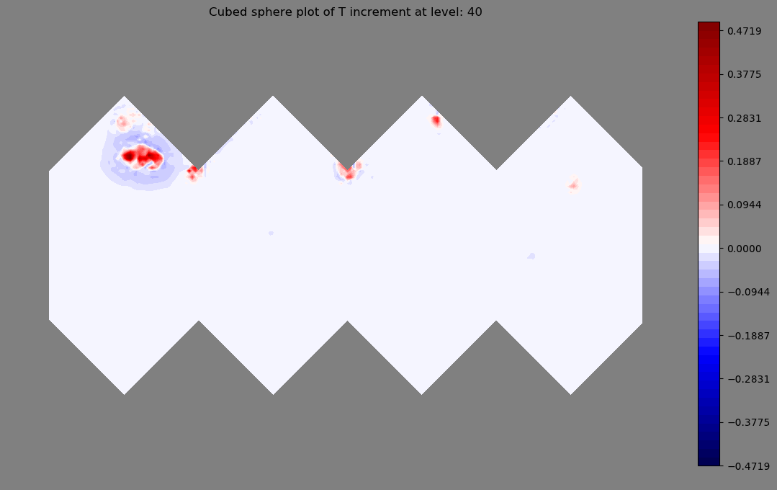
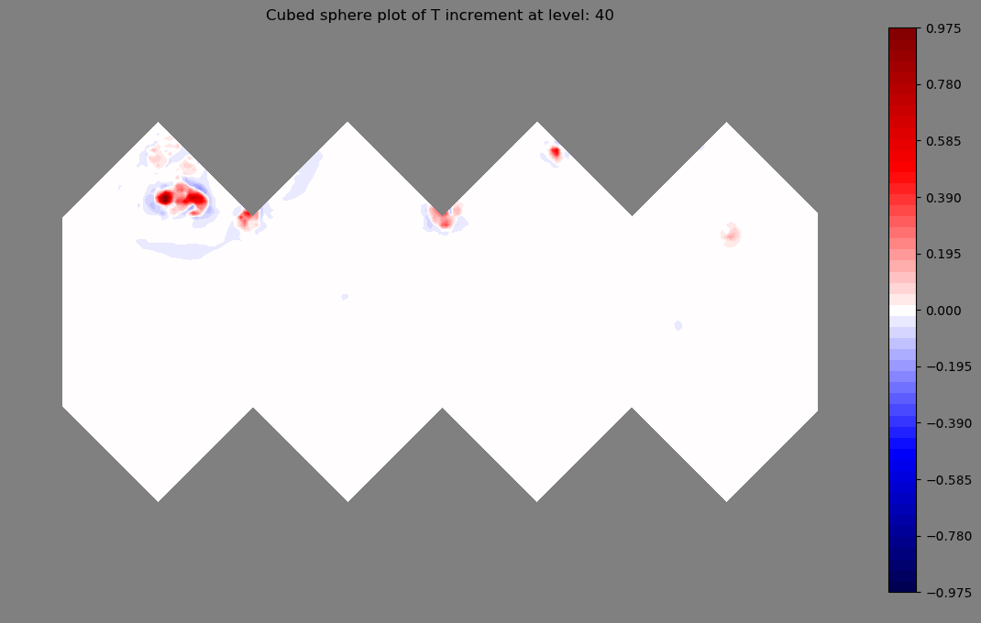
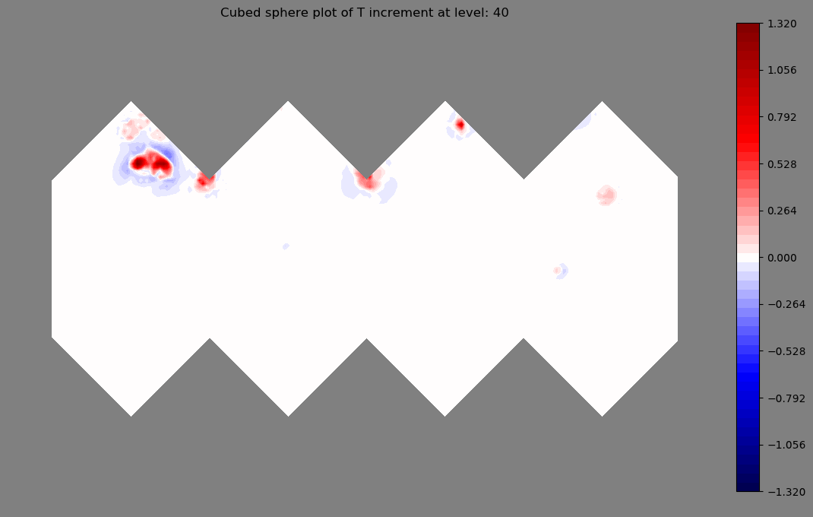
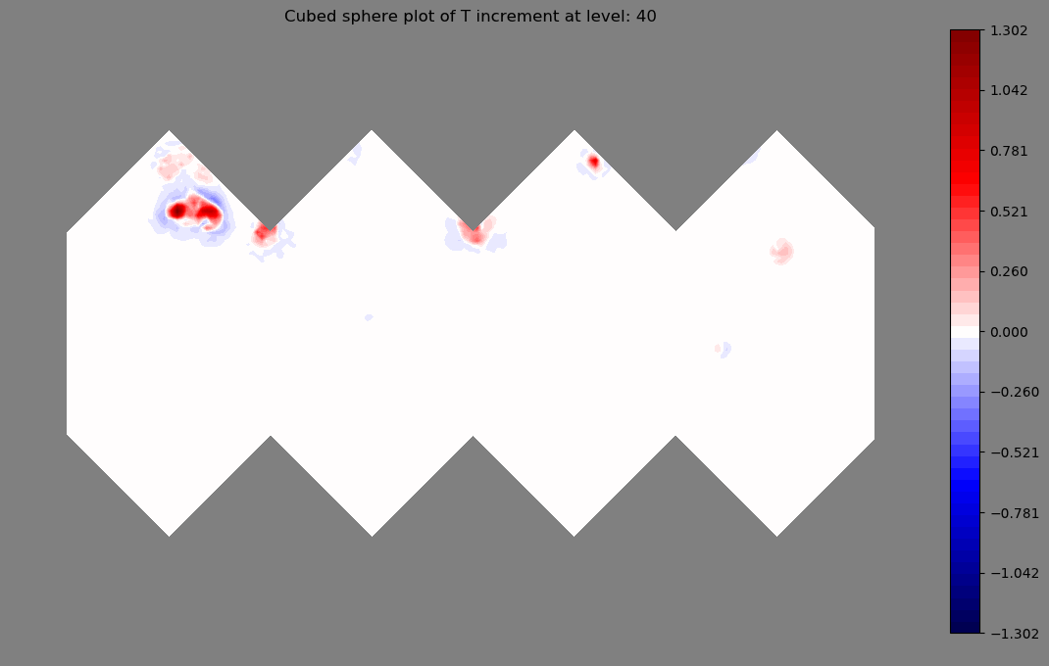
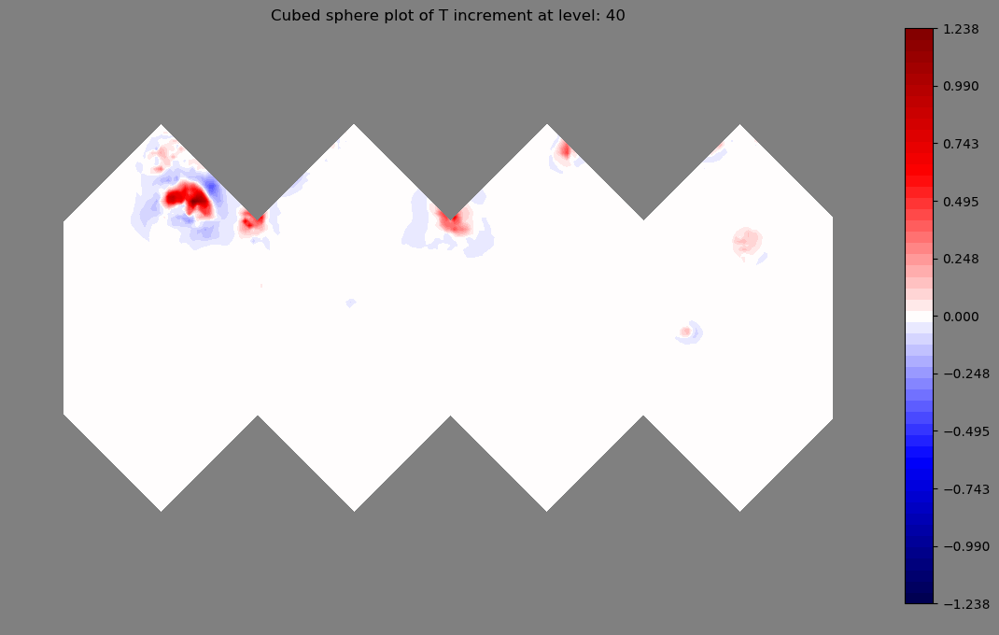
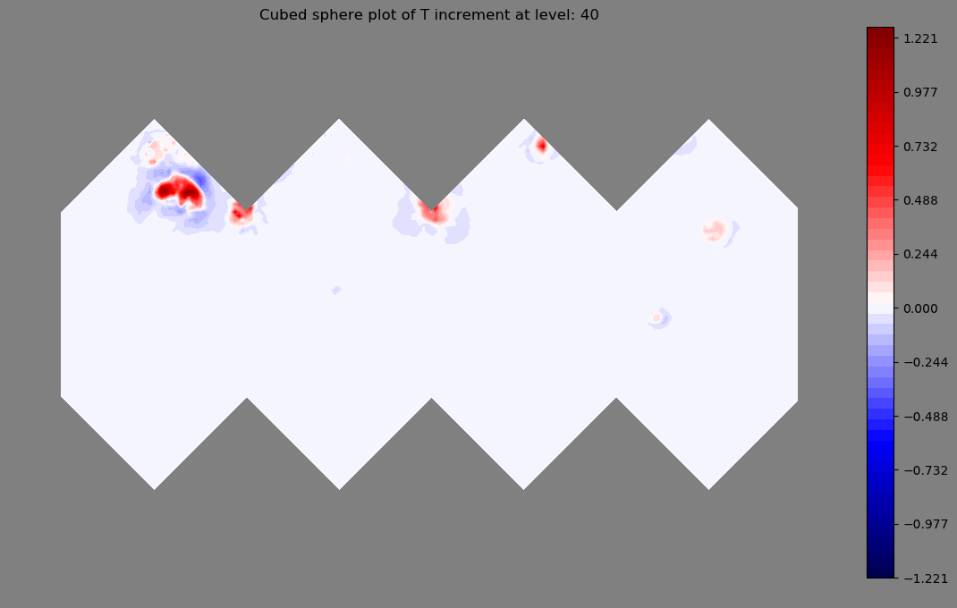
4D-Var RAOB software demonstration
6h window 4D-Var with FV3 dynamical core TLM/ADM but no physics.
1H
2H
3H
1H
4H
5H
6H

Slide 13
Upcoming work
JEDI DA
Develop native grid static B matrix for FV3-JEDI using BUMP (code sprint in August)
Complete interfacing to full FV3-GFS and GEOS models.
Complete interfacing to UFO (conventional, radiances and GNSS-RO).
Implement full TLM/ADM physics from GEOS.
FV3JEDI-TLM & Adjoint
Refine some of the Tapenade generated code to reduce in-loop checkpointing.
Implement custom checkpointing for the physics linearized using Tapenade.
Finish building and test a blended parallel approach…

Slide 14
Blended parallel approach
FV3 has a halo of three grid points around each patch
5400 in operations
These are potential target resolutions for inner loops of an incremental 4D-Var.
Using all the available cores is going to be key. However, seven halo points for every one compute grid point is not going to scale well.
It will be helpful for dynamical cores to utilize OpenMP as well as MPI domain decomposition. Some balance then needs to be struck between the number cores directed to each.
Fortunately FV3 uses MPI and has OpenMP embedded. Tapenade supports OpenMP but we haven’t tested it yet.
100km
Equivalent to range of ECMWF inner loops.
50km
25km (current analysis)
12km (Forecast)

Slide 15
Summary
Developing 4D-Var for a modern dynamical core has proven to be a significant challenge, due to the complex code structure, small time step and large memory requirements.
After almost a decade of use in the GEOS forecast model efficiency gains to FV3, paired with new software and hardware technologies, is making the possibility of FV3-based hybrid 4D-Var a reality.
A key new technology is the JEDI data assimilation system, which offers the ability to perform DA on the native grid, avoiding costly grid transforms.
JEDI is being designed from the ‘bottom up’ ensuring that it’ll be extremely efficient and scale well.
Recent advances in automatic differentiation and custom built wrappers facilitate short development lead times, making dynamical core adjoint development less of a burden (physics is another matter).
4D-Var for the next generation of models is possible but challenging, and highly interdisciplinary. Advanced dynamical core developers should be aware of DA needs and the adjoint should be developed in tandem with the nonlinear model.

Slide 16
FV3 in JEDI
FMS + FV3
GEOS/FV3GFS
TLM & ADJOINT
MODEL
LAYER
CLASSES
GEOMETRY
INCREMENT & STATE
(FIELDS)
COVARIANCE MATRIX B & LOCALIZATION
Solver/linear algebra instructions
Interpolation
innovations
Locations
OOPS
UFO
IODA
JEDI LAYER
(model agnostic)

