Slide 1



Some General and Fundamental Requirements for Designing
Observing System Simulation Experiments (OSSEs)
Ronald M. Errico and Nikki C. Privé
Goddard Earth Sciences, Technology and Research Center, Morgan State University
and
Global Modeling and Assimilation Office, NASA Goddard Space Flight Center

Slide 2
Data Assimilation of Real Data
Real evolving atmosphere with imperfect observations. Truth unknown
Analysis
Analysis
Analysis
Time
Analysis
Analysis
Analysis
Climate simulation with simulated imperfect observations. Truth known.
Observing System Simulation Experiment

Slide 3
Common Short-cuts
1. Observation locations inconsistent with characteristics of
real observations.
2. Ignoring important characteristics of the observations (e.g.,
by treating radiance observations as radiosondes)
3. Instrument or representativeness error absent
4. Inadequate validation of the NR or DAS control is performed.
5. The statistical nature of the DAS problem is ignored.
6. Error correlations not considered.
7. The control DAS uses no or very few observations.
8. The work is harmfully expedited at the demands of an
administrator or customer.
All of these can be seen in recent presentations or reported works.

Slide 4
Validation of the NR
1. The usual “climate statistics” should be examined.
2. Matches of all such statistics are neither necessary or sufficient
3. Requirements depend on questions explored.

Slide 5
Required properties of simulated observation
Realistic spatial and temporal distributions
2. Realistic instrument and representativeness errors
Distinction between analyzed and discarded observations
Some unimportant error characteristics (?)

Slide 6
Importance of system errors
1. The values of most metrics used to assess real atmospheric data
assimilation or forecast systems are determined by the various types
of errors inherent in those systems and how the modeling and data
assimilation modifies them.
2. These types include observation instrument errors, observation
representativeness errors, forecast model formulation errors, and
errors introduced by the data assimilation algorithm itself.

Slide 7
Representativeness error in the OSSE context
For DA with real observations:
more realistic forward observation model ➡
smaller representativeness error
For DA in an OSSE (with unchanging forward observation models):
more realistic observation simulation model ➡
greater representativeness error

Slide 8
Some general issues
1. DA results depend on how observations are used, not simply how
good they might potentially be
2. Augmentation of an existing network with a new observation set
will likely only make modest improvements to accuracy.
3. As long as forecast model error remains significant, assimilation of
new observations will only modestly improve accuracy.
4. The DAS and observing system are likely to change before an OSSE-tested
observation is deployed.
5. For NR with higher spatial resolution, greater temporal resolution is required.

Slide 9
Challenges
Validation must be performed.
OSSEs must be timely.
Plug and play OSSE capability has a drawback.
System errors need to be identified and validated.
Conflicts of interest must be avoided.

Slide 10
Recommendations
The Community should
provide input and assessment for OSSE applications
provide educational opportunities for OSSE practitioners
encourage collaboration and sharing
encourage greater consideration of system errors
encourage thinking rather than following of recipes
create opportunities for critical reviews
establish minimum standards
The entire community may be affected by OSSE results.

Slide 11
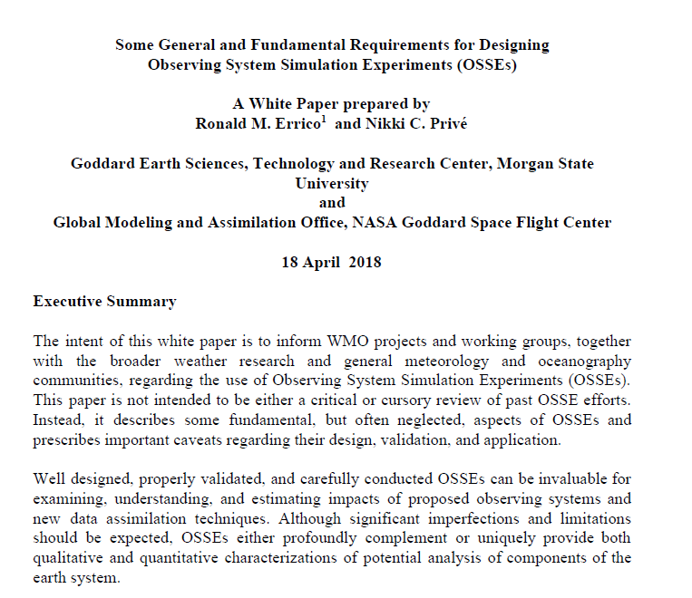
DAOS-WWRP-WMO White Paper

