Slide 1
NASA’s GMAO Atmospheric Motion Vectors Simulator
Description and Application to the MISTiC Winds Concept
David Carvalho ^{(a,b)}, Will McCarty ^{(a)}, Ron Errico ^{(a,c)}, Nikki Privé ^{(a,c)}
^{(a)} Global Modeling and Assimilation Office (GMAO), NASA Goddard Space Flight Center, Greenbelt, MD, USA.
^{(b)} Goddard Earth Sciences Technology and Research (GESTAR), Universities Space Research Association (USRA), Columbia, MD, USA.
^{(c)} Goddard Earth Sciences Technology and Research Center (GESTAR), Morgan State University, Baltimore, MD, USA
Workshop on Sensitivity Analysis and Data Assimilation in Meteorology and Oceanography
1-6 July 2018
Aveiro, Portugal

Slide 2
Why simulate AMVs?
In the recent past, significant efforts have been made to estimate the potential added value of new observations to the present Earth observing system by quantifying their expected impact on the current weather forecasting skills.
    OSSEs (Observation System Simulation Experiments) are an essential tool for this. A key aspect is that the envisioned observations are realistically simulated (mainly in terms of spatial and temporal distributions, and errors), for the DAS to show a similar behavior when applied to real observations.
    A code was designed to simulate cloud and water vapor features tracking AMVs using as an atmosphere the GEOS-5 Nature Run (G5NR), to be later used as simulated AMVs in OSSEs. The simulated wind observations are taken at G5NR gridpoints where clouds and water vapor gradients exist.
Similarly to what is done in the GMAO OSSE framework, all simulated observations are drawn from the G5NR:
      7 km horizontal resolution
      72 vertical levels
      Output every 30 mins

Slide 3
How to simulate AMVs?
However, feature tracking on a model grid such as the G5NR is not a reasonable option…
    Coarse spatial resolution compared to satellite imagery (7 km vs. ~2-5 km)
    Temporal resolution is also insufficient (30 mins vs. 10-15 mins)
    G5NR does not have clouds and water vapor fields, but cloud fractions and humidity fields (not exactly the same…)
Instead, trackable clouds and water vapor features are identified in the G5NR:
    Trackable cloud
    a “cloudy layer”: a set of adjacent vertical levels with a combined cloud fraction in the range of 20-80%
    below the tropopause
    not stationary
    able to be seen by the instrument (not substantially covered by higher clouds above)
    Trackable water vapor feature
    Points in the G5NR where humidity gradients are high
    below the tropopause
    not stationary
    not significantly covered by clouds above
Notes:
Points with higher cloud fractions are more likely areas where few (or none) cloud edges are discernible, making it difficult to track clouds (lack of reference points). Real cloud tracking AMVs are predominantly obtained in areas where cloud edges are discernible (smaller, but not very thin, clouds).
Highest probabilities for cloud layers with cloud fractions in the 40-60% range; increasing probabilities for cloud layers with cloud fractions in the 20-40% range; decreasing probabilities for cloud layers with cloud fractions in the 60-80% range.
Height assignment: for mid-high level cloud layers (cloud top below 700 hPa) the height is defined as the height of the cloud layer top, while for low-level cloud layers the height is defined as the cloud layer bottom.
The cloud fraction of each cloud layer is computed assuming a maximum random overlap: the cloud fractions of each level within a single cloud layer maximally overlap, while independent cloud layers within the column, if present, randomly overlap.
This probability function favors (gives higher probabilities to) trackable water vapor features with higher RH gradients and shallower (if none) clouds located above.

Slide 4
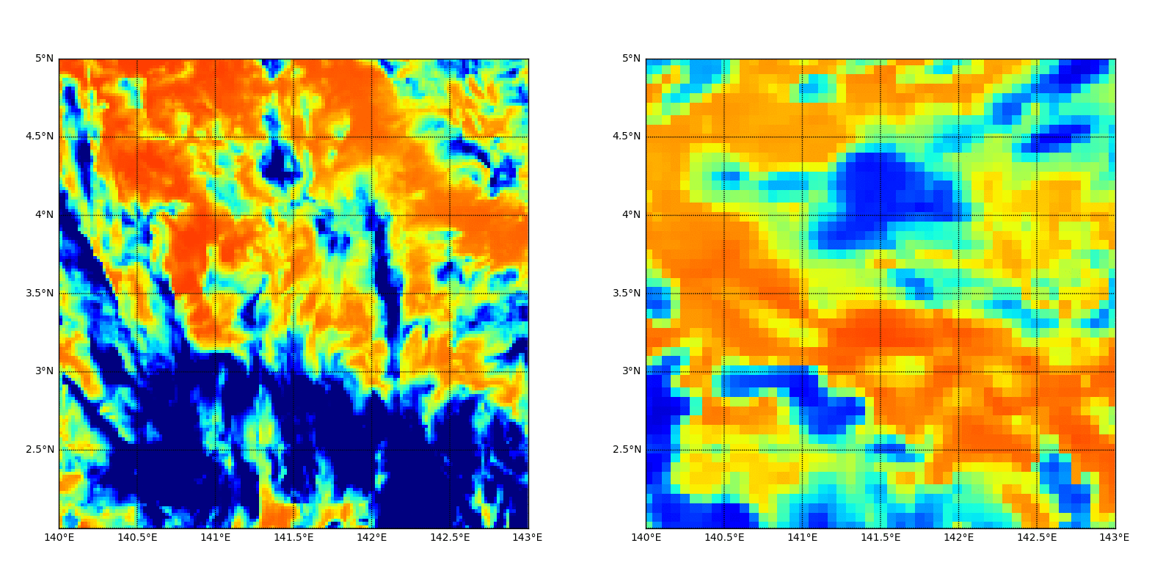
Challenges in simulating AMVs from model output
    In the real atmosphere, a cloud or water vapor feature is trackable if it maintains its shape or appearance. That doesn’t happen with cloud fraction or humidity fields in the NR.

Slide 5
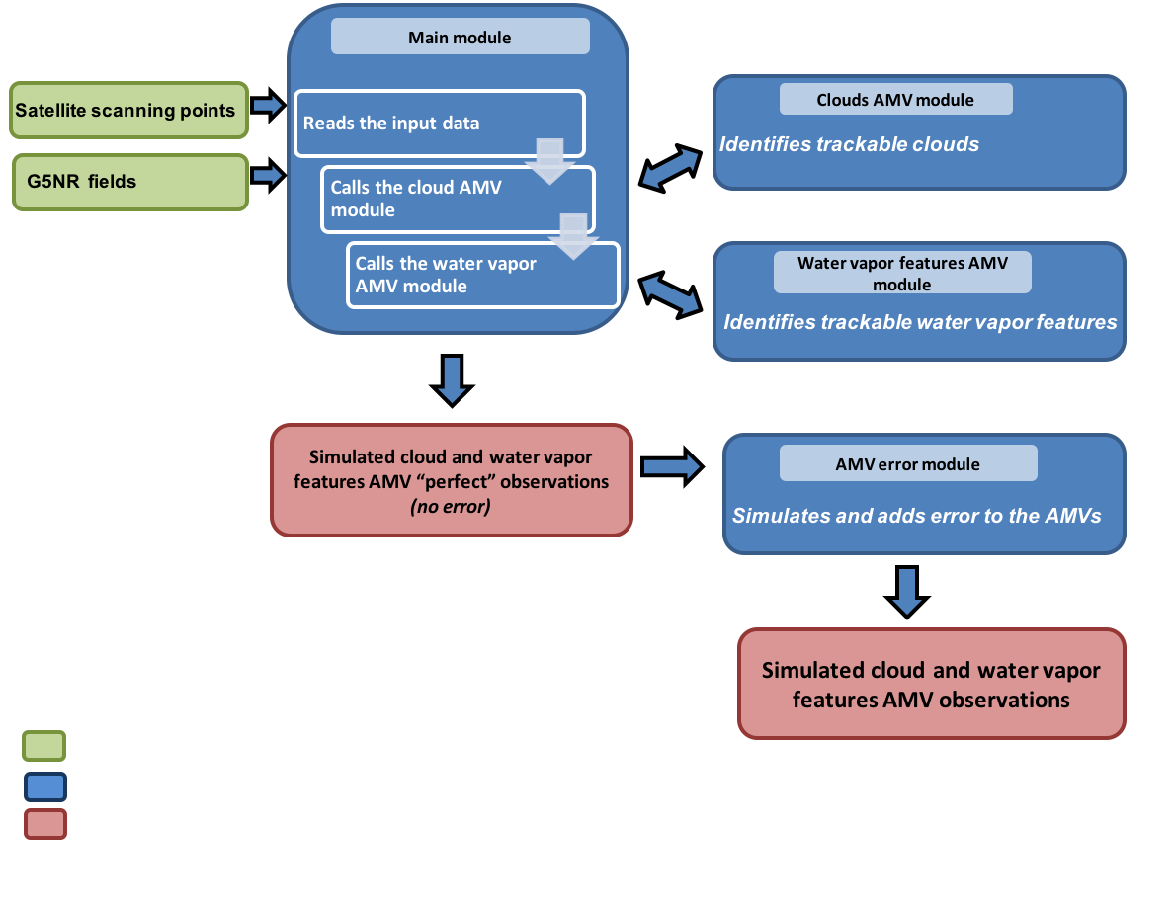
GMAO AMV simulator
A proxy instrument, or a set of assumptions, have to be considered to tune the code in order to derive the expected observation counts and spatio-temporal distributions.

Slide 6
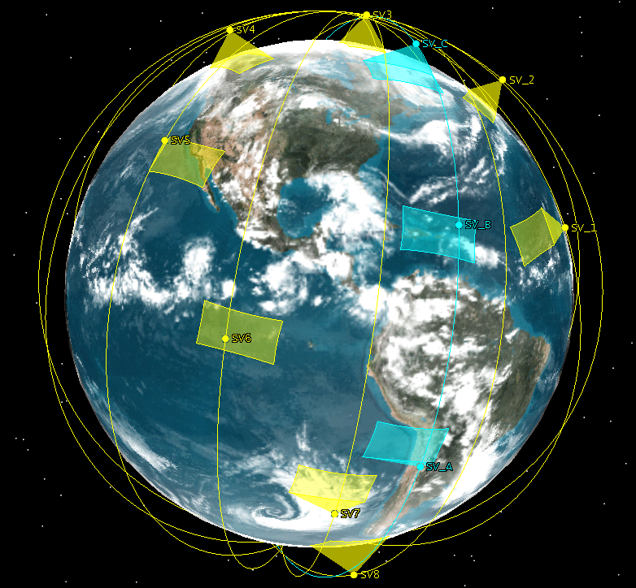
MISTiC Winds observing system concept: a case study
  NASA mission concept consisting of a constellation of low Earth orbit (LEO) MicroSats.
  Designed to provide temperature and humidity soundings of the atmosphere with high spatio-temporal resolution, providing radiances and AMV retrievals globally (including in the AMV latitudinal gap, 55-70 deg. N and S).
  The AMVs simulator was used to synthetize the AMVs expected to be derived from the MISTiC instruments, to be later used in OSSEs to assess the impact of these new observations.
The Himawari-8 Advanced Imager (AHI) was considered as a proxy instrument to tune and validate the AMVs simulator when applied to MISTiC.
The approach is to tune the code to match the real AHI AMVs counts and distributions taking as input the Himawari-8 scanning points, and then use that configuration (with some changes specific to MISTiC instruments) to simulate MISTiC AMVs considering the satellite constellation scanning points.

Slide 7
MISTiC Winds: simulated vs. real AHI cloud AMVs
Simulated Himawari-8 AHI cloud AMVs vertical distribution and number of obs match the real ones (~17,400 simulated vs. ~17,300 real average counts per synoptic time)
Horizontal distribution not so much… Differences between the real and G5NR meteorology and cloud fields (?)
Notes:
Real AHI cloud AMVs tend to be scarcer over land. For example, AHI AMVs below 400 hPa over land are usually blacklisted or given a low quality index.
This was not mimicked by the cloud AMV simulator since it is not expected that MISTiC cloud-tracking AMVs will show this behavior.

Slide 8
MISTiC Winds: simulated vs. real AHI WV AMVs
Simulated Himawari-8 AHI water vapor AMVs vertical distribution and number of obs match the real ones (~11,450 simulated vs. ~11,500 real average counts per synoptic time)
Again, horizontal distribution not so much… Differences between the real and G5NR meteorology and relative humidity fields (?)

Slide 9
MISTiC Winds: simulated vs. real AHI AMVs - Errors
For the DAS to show a similar behavior when applied to simulated observations, the differences between the observations and the background fields (background departures) have to be realistic >> similar to the real obs.
Simulated AHI obs. error (following Errico et al., 2016) was added to the simulated AHI AMVs (random and correlated error).
    As a first guess, the simulated AHI errors were used as proxy for the MISTiC AMVs errors and added to the MISTiC “perfect” obs.
Despite the differences, the simulated AHI AMVs show a high degree of realism in terms of obs counts, spatial distributions and errors
Notes:
Traditional AMVs are performed in radiance space (large uncertainty in height assignment) while MISTiC approach is to retrieve WV AMVs on constant pressure surfaces (height assignment error now translated into retrieval error).
As a first guess, we kept the correlated vertical scales the same and assume that the Himawari-8 AHI water vapor AMVs error are a decent approximation to the MISTiC water vapor AMVs.

Slide 10
MISTiC Winds: simulated MISTiC AMVs
Considering only one orbital plane (3 satellites), MISTiC Winds is able to collect approximately 13,000 cloud AMV observations and 5,000 water vapor AMVs every 6 hours.
The simulated WV AMVs vertical distribution reflect one of the expected added-value of MISTiC Winds, being able to derive AMVs below 500-400 hPa, an unique feature among the water vapor AMVs derived from the current Earth observing system.

Slide 11
MISTiC Winds: simulated MISTiC AMVs
If 4 orbital planes are considered, a full global coverage could be obtained every 6 hours, collecting ~ 74,000 AMV observations.
Another unique advantage of MISTiC is that it can cover the current AMV latitudinal gap.

Slide 12
Conclusions
An AMVs simulator was developed to simulate AMVs from future satellite constellation concepts, which can be later used in OSSEs to estimate the potential added value of new observations to the Earth observing system.
The designed code identifies trackable clouds and water vapor features in the G5NR considering its cloud fraction and humidity fields.
As a case study and application example, NASA’s GMAO AMV simulator was used to simulate AMVs expected to be collected by a NASA mission concept – MISTiC Winds, a constellation of satellites equipped with infrared spectral midwave spectrometers.
A tuning and validation considering a proxy instrument to MISTiC Winds (Himawari-8 AHI) showed that the AMVs simulator synthesizes AMVs with enough quality and realism to produce a response from the DAS equivalent to the one produced with real observations (the main goal of an OSSE).
When applied to MISTiC Winds, it can be expected that a full global coverage will be obtained every 6 hours with approx. 74,000 wind observations, if considering a constellation composed of 12 satellites (4 orbital planes).
The GMAO AMV simulator is a tunable and flexible code that can be easily adapted and applied to AMVs simulation expected to be derived from different instruments and satellite orbit configurations.

