Slide 1
Morgan State University Conflict of Interest in R&D Training Module
2025

Slide 2

Learning Objectives
By the end of this module, you should be able to:
Define Conflict of Interest
Understand COI Exemptions in R&D
Be familiar with Morgan’s Conflict of Interest in R&D Policy
Understand the University’s procedures and processes for exemptions and conflict management

Slide 3
Introduction
Maryland law encourages public senior higher education institutions to promote economic development in the State and to increase their financial resources through arrangements with the private sector, including collaborative research and development, commercial application of institution-owned intellectual property, and provision of technical assistance.
To facilitate these purposes, the Maryland Public Ethics Law allows for the exemption of Morgan State University personnel from some of the law's conflict of interest provisions.

Slide 4
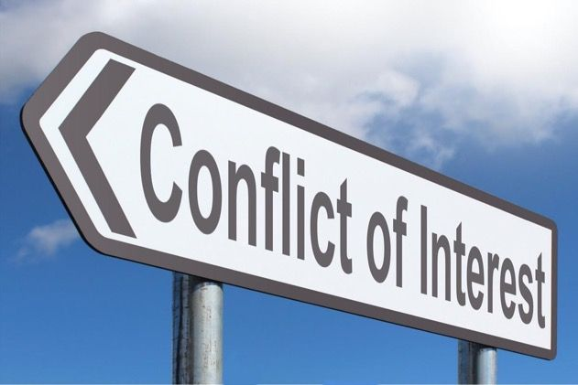
Conflict of Interest
Conflict of Interest
A potential conflict of interest exists when there is a possibility for an individuals outside financial interests to directly and/or significantly affect the individual’s professional actions or decisions.
Where can a conflict of interest occur?
Gifts
Employment
Technology licensing
Activities of family members
Purchasing and other business relationships
Research (Conflict of Interest in R&D)

Slide 5

Morgan’s Conflict of Interest in R&D Policy Goals
Protect Research Participants
Protect the Integrity of the Research
Protect the Institution, Faculty, Employees and Students
Funding Status
Litigation
Reputation/Public Image
Best Policy Practices

Slide 6
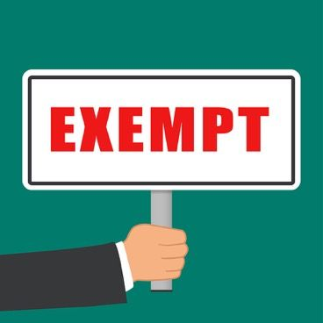
Conflict of Interest R&D Exemptions
The University Board of Regents has approved the Policy for Conflicts of Interest in Research and Development. The Policy and Procedures for obtaining exemptions, are approved by the State Ethics Commission (SEC).
A Conflict of Interest (COI) Committee reviews COI in R&D Disclosures and COI Management Plans.
An approved COI Disclosure Form and COI Management Plan are required for an exemption to be considered by the University’s President for approval.

Slide 7

Morgan’s Conflict of Interest Policies
A present or former official or employee of a unit of the University may have a relationship (as defined herein) with an entity engaged in research or development, or an entity having a direct interest in the outcome of research or development, which relationship would otherwise be prohibited by the conflict of interest provisions of the Ethics Law, if such relationship is disclosed and approved by the President in accordance with the University's faculty conflict of interest procedures developed pursuant to this policy.

Slide 8
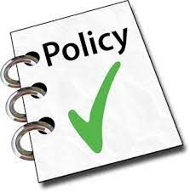
Morgan’s Conflict of Interest Policies, cont’d.
The President, a Vice President or one holding a similar such position may have such a relationship only if the Board of Regents makes the following findings:
That participation by, and the financial interest or employment of, the official is necessary to the success of the research or development activity.
That any conflict of interest can be managed consistent with the purposes of relevant provisions of the Public Ethics Law.

Slide 9
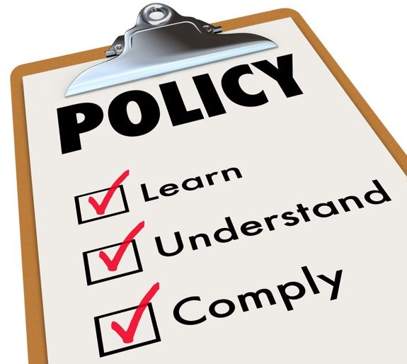
Morgan’s Conflict of Interest Policies, cont’d.
The approval of a relationship under the COI in R&D Policy does not relieve the official or employee from the obligation to comply with other University policies, including the University Policy on Professional Commitment of Faculty.

Slide 10
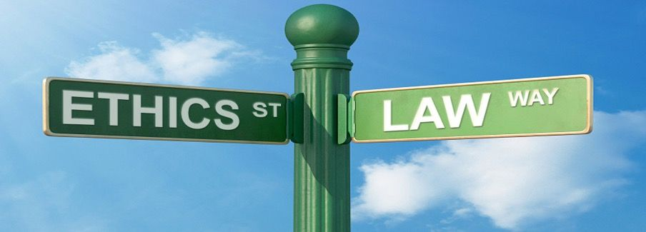
Morgan’s Conflict of Interest in R&D Procedures
The University shall develop procedures based on the policy and purposes of the Maryland Public Ethics Law. The procedures shall be approved by the Office of the Attorney General and approved as to conformity with the Maryland Public-Private Partnership Act by the State Ethics Commission. The approved procedures shall be filed with the Office of the President and the Board of Regents.

Slide 11
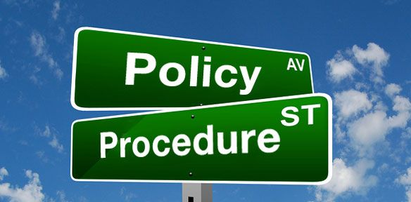
Morgan’s Conflict of Interest in R&D Procedures, cont’d.
Procedures shall:
Require timely disclosure of any relationship. The disclosure shall be filed with the State Ethics Commission and maintained as a public record at the University.
Require review of all disclosed relationships by a designated official who shall determine what further information must be disclosed and what restrictions shall be imposed in order to manage, reduce, or eliminate any actual or potential conflict of interest. The designated official shall also determine whether the disclosed relationship represents a harmful interest. If so, approval shall not be granted.

Slide 12

Morgan’s Conflict of Interest in R&D Procedures, cont’d.
Procedures shall:
Include guidelines to ensure that relationships do not improperly give an advantage to entities with which the relationships exist, lead to misuse of University students or employees for the benefit of such entities, or otherwise interfere with the duties and responsibilities of the official or employee maintaining the relationship.
Require that each relationship be approved or disapproved by the President, with such determination to be the final decision.
Require that any relationship maintained by the President or a Vice President, and by one holding any other position designated by the Board of Regents be approved by the Board of Regents.

Slide 13

State: Financial Interests & Conflict of Interest in Research & Development
An official or employee may not "be employed by" or "have a financial interest in” an entity that does business with the official's/employee's agency or that is regulated by the official's/employee's agency.
There is no threshold for employment. “Be Employed by” includes, but is not limited to, consulting, contractual service agreements, part-time work, work on weekends.
A COI Exemption in R&D must be approved by the employee’s university.

Slide 14

COI Committee Recommendation for Exemption
The COI Committee may not recommend approval for an exemption of any relationship that would:
Give improper advantage to an entity with whom the employee has a relationship;
Lead to misuse of institution students or employees for the benefit of such entities (e.g., supervisor’s undue influence);
Otherwise interfere with the duties and responsibilities of the official, faculty member, or other employee maintaining a relationship;
Be so influential as to impair impartiality in conducting research, interpreting research results, or determining research or other professional and employment priorities.

Slide 15

Supervisory Positions: Improper Influence
In a university sponsored research setting, a potential conflict exists when:
There is a possibility that an individual’s outside financial interests, or employment, could directly and significantly affect the design, conduct, or reporting of university research.
There is improper influence, or even the appearance of improper influence, on other university employees and students, for the benefit of the supervisor.

Slide 16

Case Study A Question & Answer
Dr. Ray Leone, received a COI in R&D Exemption to form a start-up company and license the patent rights that he and his graduate student, Mr. Lee, invented.
A year later a new company (RL, Inc.), secured an R&D Grant to further develop & commercialize the invention.
Mr. Lee, Dr. Leone’s paid graduate assistant is funded by a NSF grant. He has now been asked by Dr. Leone (his advisor) to work as a weekend contractor for RL, Inc.
Ms. Johns, an administrative assistant working for Dr. Leone, has been asked to work a few hours on the weekends - and make some extra money – helping the company with a variety of tasks.
A New COI Disclosure Form submission is needed because:
Dr. Leone is Ms. Johns supervisor.
Dr. Leone’s company would be paying Mr. Lee, while he is paid by the university, and Dr. Leone is his advisor.
The requests may lead to misuse of University students and employees for the benefit of the company.
All of the Above
Answer: D. Dr. Leone’s requests are to the benefit of the company. New information is not covered under the existing exemption.

Slide 17

State: Financial Interests & Conflict of Interest in Research & Development
Maryland Law defines “Financial Interest” as:
Ownership of more than 3% of a business entity by board member or employee or spouse of board member or employee
Ownership of securities that represent more than 3% of a business entity by board member or employee or spouse of board member or employee
Ownership of an interest (e.g., shares) with a market value of more than $1,000.

Slide 18

Federal: Financial Interests & Conflict of Interest in Research & Development
Under federal law, a “financial interest” is an interest of more than $5,000 per year in outside income.
A financial interest consists of one or more of the following interests of the Investigator (and those of the Investigator’s spouse and dependent children) that reasonably appear to be related to the Investigator’s institutional responsibilities:
Salary;
Any payment for services (e.g., consulting fees, honoraria, paid authorship); and
Equity interest holdings, including any stock, stock option, or other ownership interest.

Slide 19

Federal: Financial Interests & Conflict of Interest in Research & Development
Significant financial interest does not include financial interests (salary, royalties, or other remuneration) paid by the Institution to the Investigator. This also does not include equity considerations held by the institution to be shared with the investigator under IP Policy provisions.

Slide 20
Case Study B Question & Answer
While working at the University, Dr. Angela Smith developed a new nanotechnology innovation, and will be submitting a Intellectual Property Disclosure to the University’s Office of Technology Transfer. She is preparing a proposal, as PI, to the NSF to continue R&D of a specific commercial application.
Mr. Wayne Smith, Dr. Smith’s spouse, is the V.P. of Product Development at NanoZ Inc. - a private nanotechnology company. He currently owns 10% of NanoZ, and is an inventor on three NanoZ patents.
Dr. Smith lacks certain assistance/facilities to perform aspects of the proposed project and has included an engineer at NanoZ under a subaward in the proposal.
Dr. Smith needs to submit a COI Disclosure Form & Management Plan because:
She has not yet submitted an IP Disclosure to the University
NanoZ, Inc. may learn details about her invention
Her husband owns 10% stock in NanoZ
All of the Above
Answer: C. Dr. Smith’s spouse has greater than a 3% ownership interest in NanoZ, a proposed sub-awardee under Dr. Smith’s NSF grant application.

Slide 21
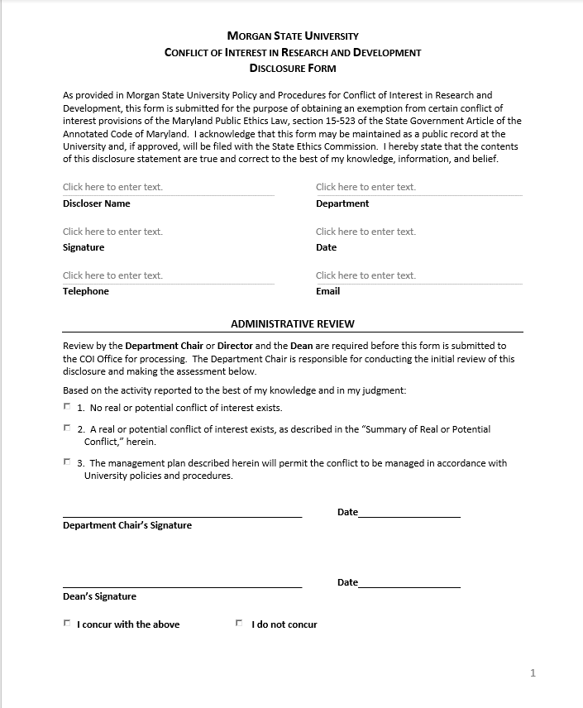
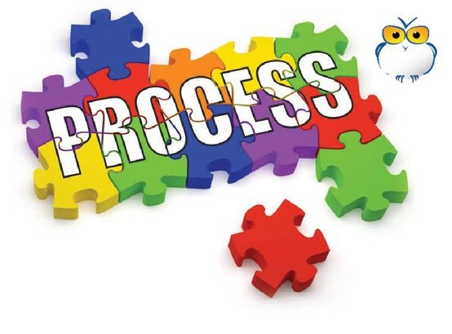
Conflict of Interest Disclosure Form
To get an COI exemption request started, a disclosure form must be filled out and submitted to your department/unit chair.
The Conflict of Interest in Research and Development Disclosure Form can be found online at https://bit.ly/3k4DFS3

Slide 22

Additional Resources
Go to the Morgan COI Website for more specific information and resources:
https://bit.ly/2YTzYqn
COI Policy and Procedures
COI Disclosure Form
Process Description and Flow Chart
Guidance Materials for Faculty and Staff
Information, Education and Training Materials
COI Committee Member List
Update on COI Committee Work
Minutes of COI Committee Meetings and Meeting Schedule

Slide 23
10 Question Quiz Section

Slide 24

Quiz Question 1
True or False
A potential conflict of interest exists when outside financial interests directly affect an individual’s professional actions or decisions.
Answer:
True

Slide 25
Quiz Question 2
True or False
The approval of a relationship under the Conflict-of-Interest Policy relieves an employee from the obligation to comply with the University Policy on Professional Commitment of Faculty.
Answer:
False.
The employee is not relieved of any obligations under University Policies

Slide 26
Quiz Question 3
Choose the correct answer from the options below.
Conflict of Interest Disclosures are filed with the:
University President
State Ethics Commission (SEC)
Office of Technology Transfer
Provosts Office
Answer:
b.
The University files all COI Disclosures with the SEC and maintains a public file.

Slide 27
Quiz Question 4
True or False
Under State of Maryland ethics law, a state employee may not “be employed by” or “have a financial interest in” an entity that does business with their state agency.
Answer:
True

Slide 28
Quiz Question 5
Choose the correct answer from the options below.
Maryland Law defines “Financial Interest” as: Ownership of more than __% of a business entity by board member or employee, or spouse of board member or employee.
1
3
10
51
Answer:
b.
The threshold is 3%.

Slide 29
Quiz Question 6
True or False
To initiate a request for a COI in R&D Exemption, an employee should file a COI Disclosure form with the State Ethics Commission.
Answer:
False.
The COI Disclosure Form is submitted to the Department Chair/Unit Leader.

Slide 30
Quiz Question 7
Choose the correct answer from the options below.
If an employee has a question about Conflict of Interest in Research & Development, they may discuss it with:
Department Chair
Conflict of Interest Committee (COIC) Member
Office of Technology Transfer (OTT)
All of the above
Answer:
d.
An employee may discuss COI with their department chair, COIC member, or the OTT.

Slide 31
Quiz Question 8
True or False
The Conflict-of-Interest in R&D Disclosure Form and Management Plan is submitted to the Department Chair/Unit Head.
Answer:
True.
After review and signature, the chair submits it to their Dean or Vice President.

Slide 32
Quiz Question 9
Choose the correct answer from the options below.
Who approves a COI Exemption in R&D by an employee?
Conflict of Interest Committee
Department Chair/Dean
University President
Maryland State Ethics Commission
Answer:
c.
The President of the University approves COI Exemptions in R&D.

Slide 33
Quiz Question 10
Choose the correct answer from the options below.
Where can a Conflict of Interest in R&D occur?
Activities under a Consulting Agreement
Activities of family members
A University Research Project
All of the above
Answer:
d.
All of these activities may constitute a COI in R&D.

Slide 34
Morgan State University Conflict of Interest in R&D Training Module
Thank you for taking the Self- Administered COI in R&D Training Module

