Slide 1

COLLEGE 101
MORGAN STATE UNIVERSITY’S
SCHOOL OF COMPUTER , MATHEMATICAL, AND NATURAL SCIENCES
FIRST YEAR PEER MENTORING PROGRAM

Slide 2
Get Out Your Phones!!
Pull Up Instagram
Follow us @MSUSCMNSPeerBEARS
If you EVER have ANY questions DM us.

Slide 3
WHO IS GOING TO COLLEGE??????????

Slide 4
WHY DO YOU FEEL THAT YOU CAN NOT GO COLLEGE ??????????????

Slide 5
COMMON PROBLEMS
I DON’T HAVE MONEY TO PAY FOR COLLEGE
I DON’T HAVE THE GRADES
NOBODY BELIEVES IN ME
WHAT CAN COLLEGE DO FOR ME? I’M A RAPPER AND MY YOUTUBE/SOUNDCLOUD VIEWS WILL GET ME PAID
SOMEONE SAID I CAN’T MAKE IT TO COLLEGE

Slide 6
SOLUTIONS!!!

Slide 7
SOLUTIONS
Option 1 (Ms. Raquel)
-Get good grades in HS
-Earn SCHOLARSHIPS
-Have schools PAY YOU to go to college and have your bills covered
Option 2 (Mr. Kevin)
-Pass classes in HS
-Take out loans (initially)
-Pay for your first year of college
-Get good grades
-Earn Scholarships, have your bills covered

Slide 8
If you don’t think you can make it , BELIEVE IN ME!

Slide 9
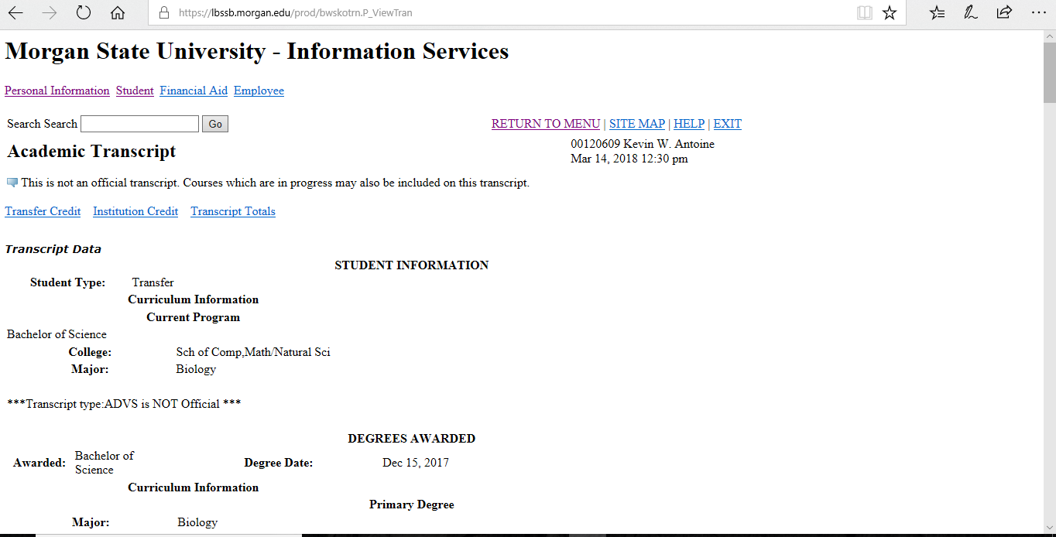

Slide 10
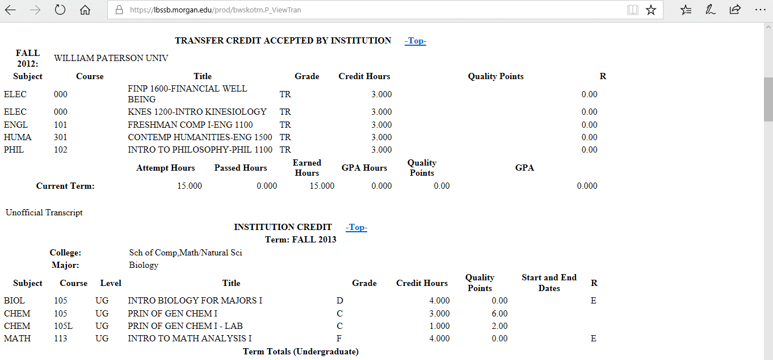

Slide 11
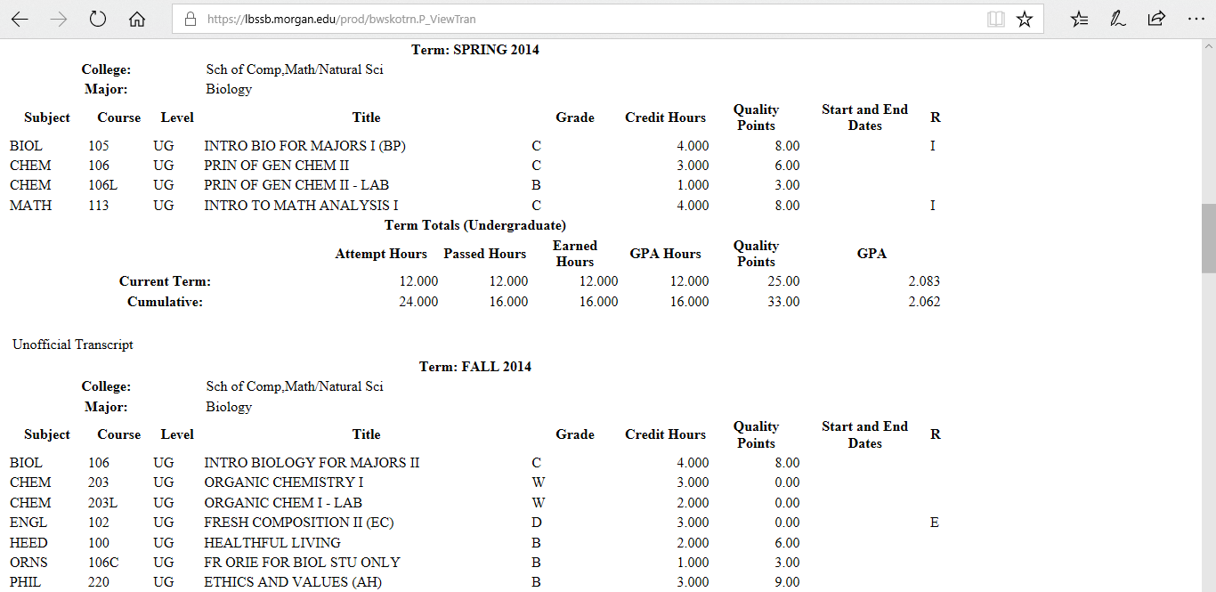

Slide 12
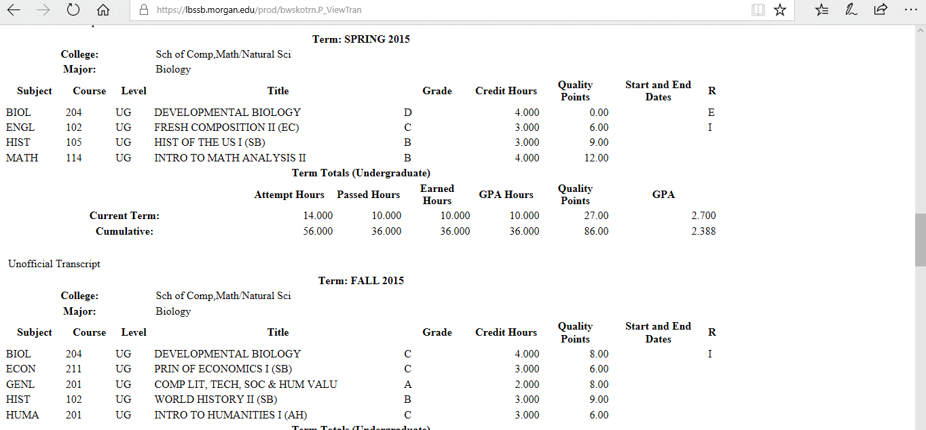

Slide 13
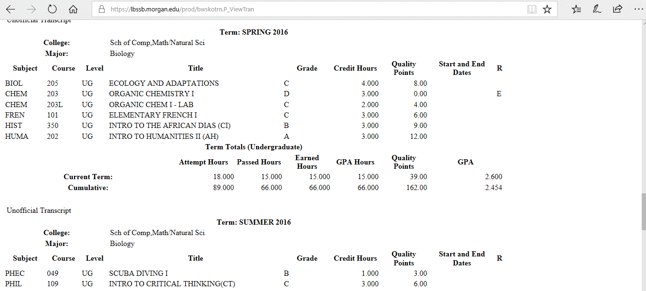

Slide 14
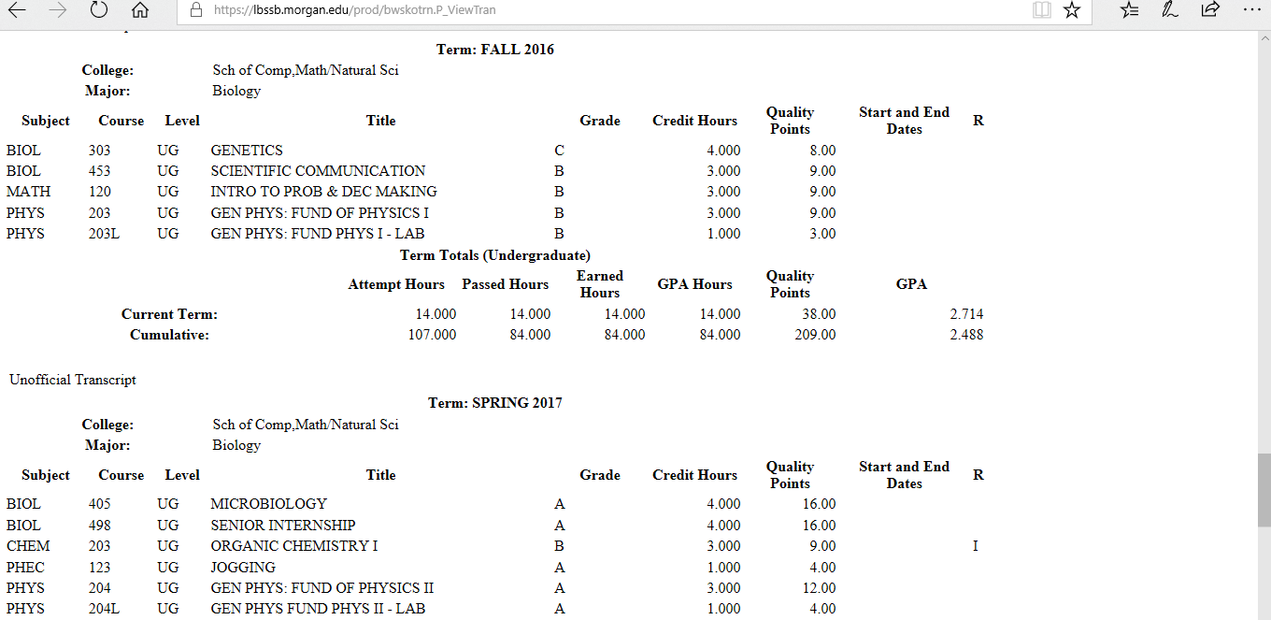

Slide 15
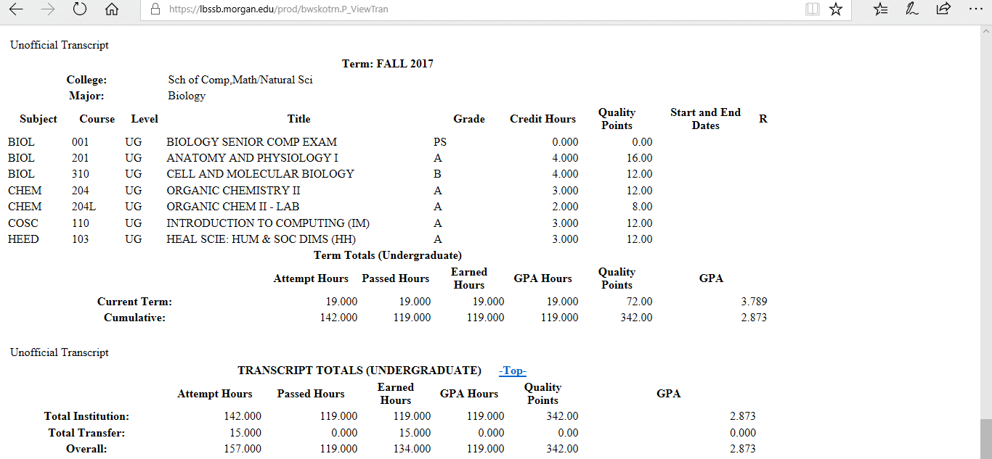

Slide 16
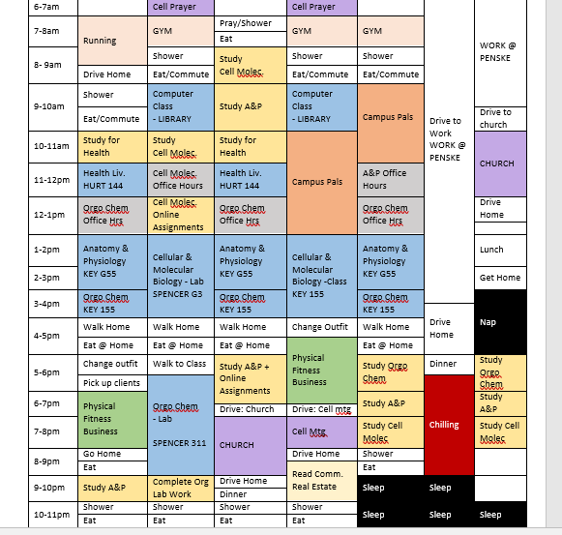

Slide 17
If We DID it than YOU CAN TOO!!!!!

Slide 18
We Walk it Like we Talk it. So Should YOU

Slide 19
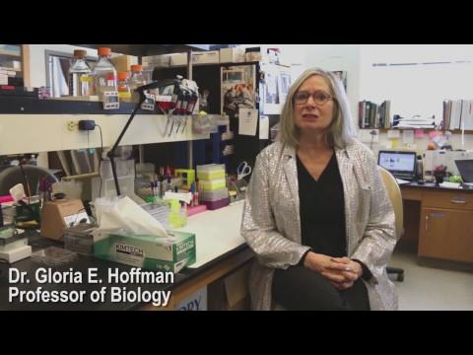

Slide 20
ATTENDING MORGAN STATE UNIVERSITY
IN THE SCHOOL OF COMPUTER, MATHEMATICAL, AND NATURAL SCIENCES.

Slide 21
Paying Your Bills
On Campus | Tuition | University Fees | Health Insurance | Room and Board | 14 Meals/Week | Total
 | $2632 | $1251.50 | $365 | $3218 | $1675 | $9141.50
W/Out Insurance |  |  |  |  |  | $8776.50
Off Campus | Tuition | University Fees | Health Insurance
 | $2632 | $1251.50 | $365 |  |  | $4248.50
W/Out Insurance |  |  |  |  |  | $3883.50

Slide 22
SCHOLARSHIPS!!!!
For those who qualify for “Option 1”, here are some scholarships that you can apply for as a first time freshman at MSU
SCMNS Scholarships
(Actuarial Science Majors)
Actuarial Science Program Scholarship
(Biology Majors)
Biology Foundation Scholarship
Dr. Elton P. Maddox Jr. Endowed Scholarship
Marsha Vaughn Endowed Future Scientist Fund
Dr. James and Waltine C. WIllis Endowed Scholarship
(Chemistry Majors)
Harold & Geraldine Delaney Endowed Scholarship
A.A. Willis Endowed Scholarship
(Physics Majors)
Dr. Frederick Oliver Fund
Julius Taylor Scholarship
(Math Majors)
Clement and Lola M. David Endowed Scholarship
Clara I. Adams Honors College
Martin D. Jenkins Scholarship
GPA 3.3
SAT 1270 or ACT 26
Award up to FULL TUITION, ROOM & BOARD and $1000 for Books
Harriet Tubman Honors Associate Award
GPA 3.0
SAT 1080 or ACT 21
Award up to $7500/year
University Scholarships
Alpha Delta Endowed Scholarship
Shirley Cooke Restricted Scholarship

Slide 23
FINANCIAL AID!!
For those who qualify for “Option 2”, here is the breakdown of initial loans you may have to take out if your parents can’t afford your fees out of pocket
FED Direct Unsub Loans; $1,000 Per Semester
FED Direct Subsidized Loan $2,000 Per Semester
Federal Pell Grant: $1500 Per Semester First Year
FED Direct Addt Unsub Loan $ 2,000 Per Semester
If you took the SAT YOU ARE ELIGIBLE TO APPLY TO MORGAN STATE FOR FREE
Possible $5,000 a Semester school is only 3,812 Per Semester without room and board
TIME TO GO TO COLLEGE!!!

Slide 24
NOW THAT I KNOW THE COST OF MSU, HOW DO I CHOOSE MY MAJOR IN STEM?

Slide 25
Do a Career & Self Assessment
Decide on a Career Path
Examine earning potential
Know what subjects you like; and are good at

Slide 26
STEM Majors at MSU and Possible Career Opportunities Reports from PayScale.com
BIOLOGY: Research Assistant (~50K), Physical Therapist (~$70K),Research Associate (~$75K), Family Physician (~$90K) or Physicians Assistant (~$100K)
MATH: Software Developer (~$70K),Sr. Software Engineer (~85K), Director of Analytics (~$100K), or Engineering Supervisor (~$140K)
CHEMISTRY: Chemistry Lab. Tech. (~$45K) Research Chemist (~$55K), Research Scientist (~$70K),or Sr. Research Scientist (~$95K)
PHYSICS: Software Developer (~$70K), Research Scientist (~$80K), Data Scientist (~$95), or Sr. Systems Engineer (~$110K)
COMPUTER SCIENCE: Software Developer (~$65K) , Software Engineer (~$70K), Software Programmer (~$100K), or Sr. Software Engineer (~$105K)
ENGINEERING PHYSICS: Project Engineer (~$70K), Software Engineer (~$75), Nuclear Engineer (~$80K)Sr. System Engineer(~$100K),
ACTUARIAL SCIENCE: Actuary (~$65K), Analyst (~$70K), Inside Sales Manager (~$80K), Chief Operating Officer (~$100K), Chief Financial Officer (~$140K)
MEDICAL TECHNOLOGY: Lab. Supervisor (~$60K), Me.d Tech. Scientist (~$70K), Lab. Manager (~$75K), or Lab. Director (~$95K)

Slide 27
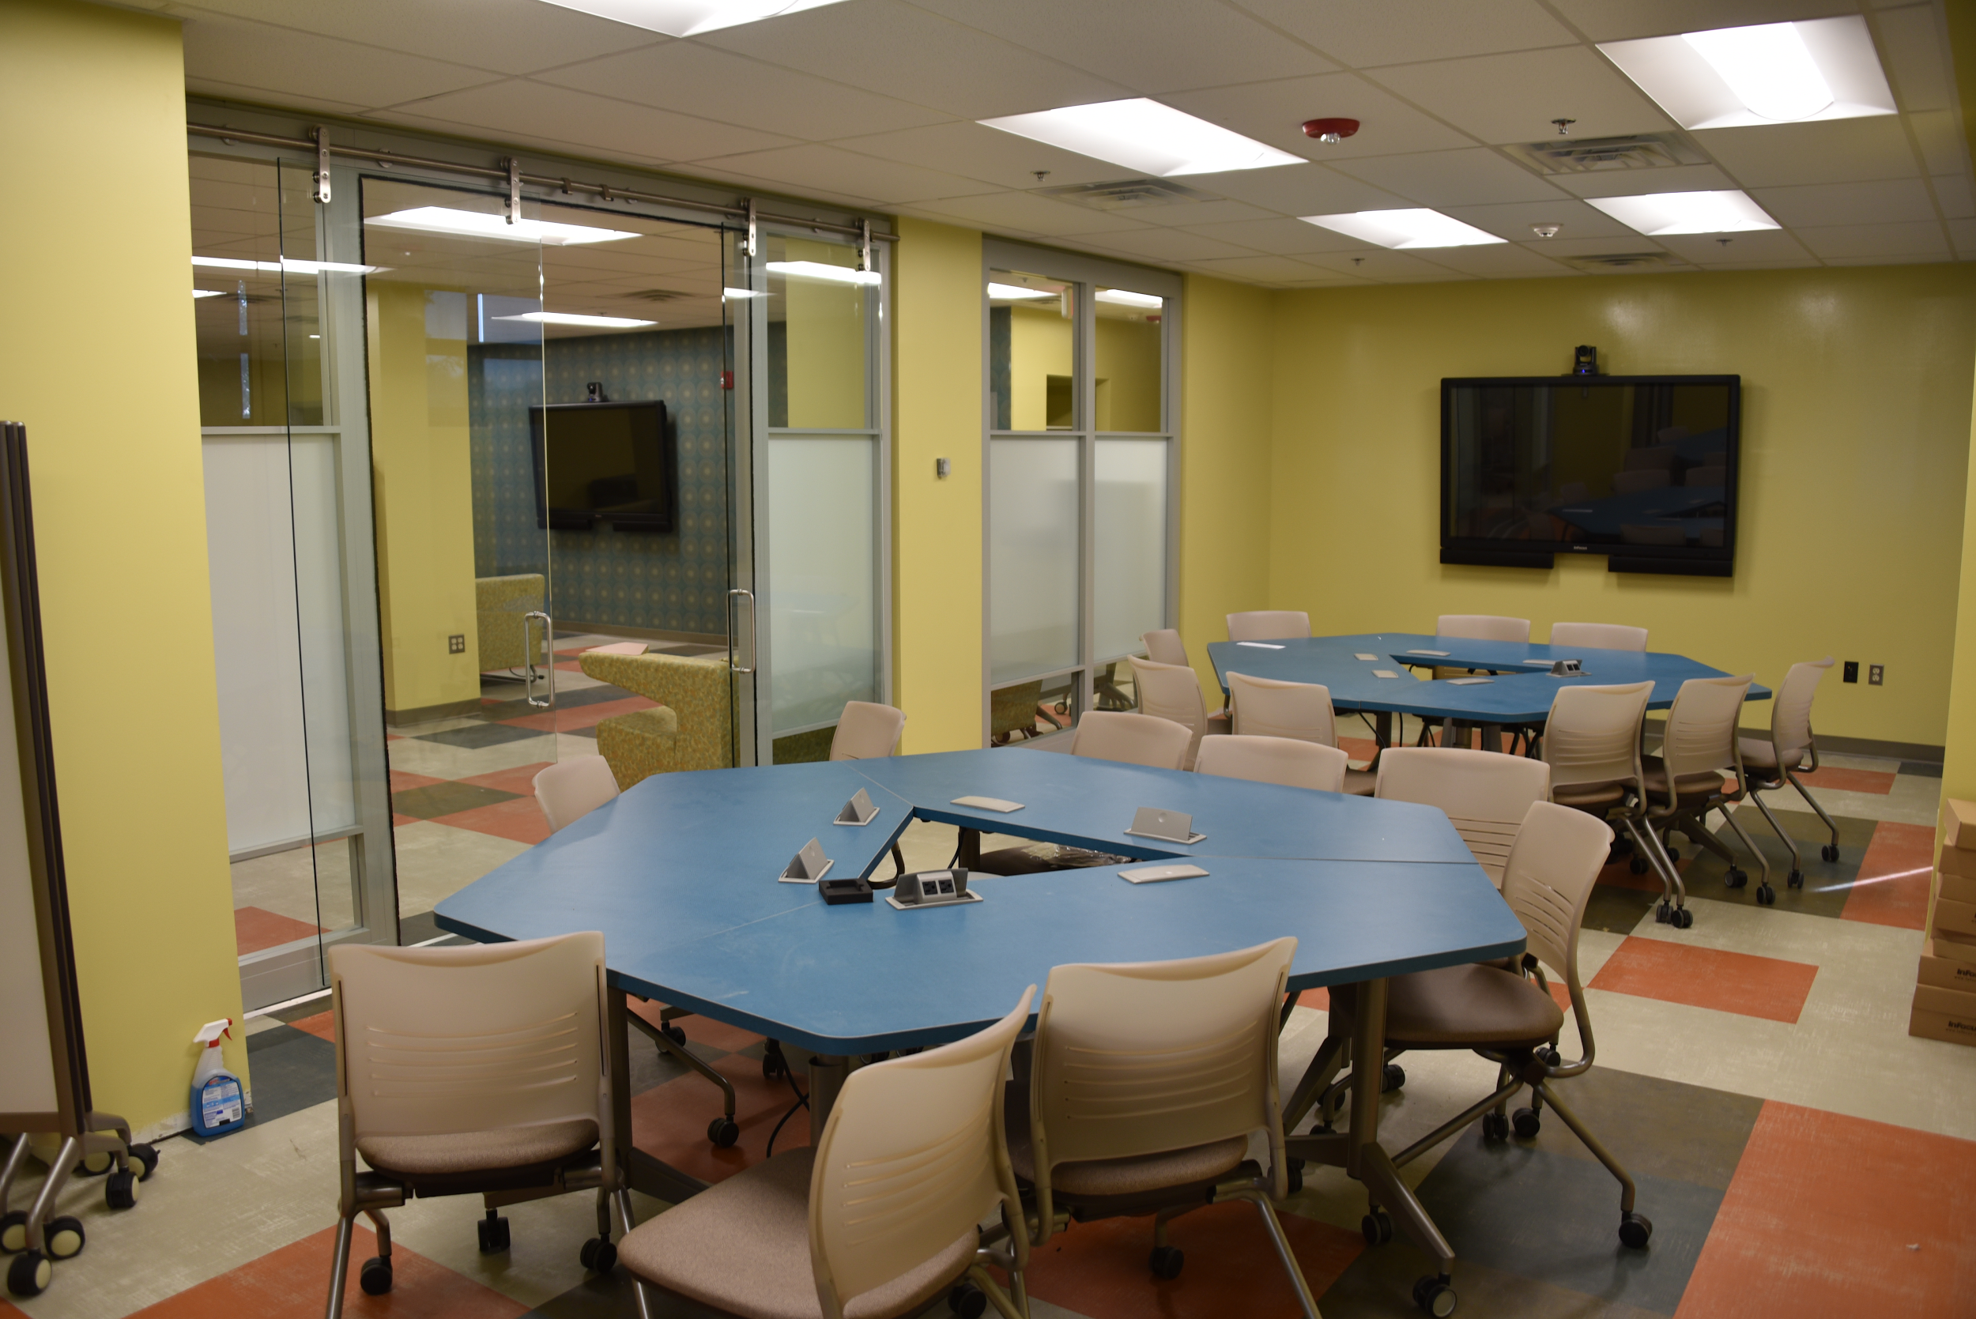
The Student Research Center
The Student Research Center is an interdisciplinary research organization ran by students. The SRC,
Expands students' research skills by offering them the opportunity to conduct demonstrations, lab activities, or community research through the development of their own SRC-funded research projects.
Provides a facility where students can interact with each other and engage in health research.
Hosts seminars and workshops for students to learn more about the health-research industry.
Offer opportunities for students to attend symposiums and retreats funded by the Student Research Center.
Collaborates with other registered student organizations and offer them networking and health-research opportunities.
Offers students the opportunity to serve the community.

Slide 28
Bring us your dreams and allow us to help manifest your dreams into REALITY

Slide 29

First Year Mentoring Program
We are the Peer B.E.A.R.S
Bringing Enrichment And Rearing Success

Slide 30
MORGAN STATE FIRST YEAR PEER MENTORING PROGRAM
This program is to help first year STEM majors complete and graduate from Morgan State
STEM- BIOLOGY, MATH, CHEMISTRY, PHYSICS, COMPUTER SCIENCE, ENGINEERING PHYSICS, ACTUARIAL SCIENCE, MEDICAL TECHNOLOGY MAJORS
You will be matched with a successful junior or senior who will help your complete matriculation, If you ever felt know one is hear to help or hear you problems the solution is hear.
This program is to provide with scholarship opportunities, internships, and research experience you don’t have to look for these things we are here to provide them.
We only take you as a serious as you take yourself point blank period.

Slide 31
Benefits of Being a Mentee
First year mentees will have a plethora of internship/scholarship opportunities if you keep grades up
First year mentees will be inducted into the fellowship at the first year ceremony
First year mentees learn the oath, and creed to being a SCMNS Scholar
First year mentees will be introduced into the tier system as you earn apparel that represents the program
First year mentees are highlighted for their accomplishments
First year mentees who meet proper grade requirements will have research opportunities beginning freshman year.

Slide 32
Maximizing Your Undergraduate Experience
Be INVOLVED
EXPLORE different disciplines
Be PROACTIVE about your education
LEARN yourself
MAKE FRIENDS
Have FUN
https://www.youtube.com/watch?v=0HXlsyXyrHg
https://www.youtube.com/watch?v=jxc4e92roHc&list=RDjxc4e92roHc

Slide 33
Thank YOU!
You can contact us at 443.885.2092 or 443.885.4515
Raquel Shortt
Lead Mentor
raquel.shortt@morgan.edu
Kevin Antoine
Coordinator
kevin.antoine@morgan.edu
Claton Lewis
Director
claton.lewis@morgan.edu

